Slide 1
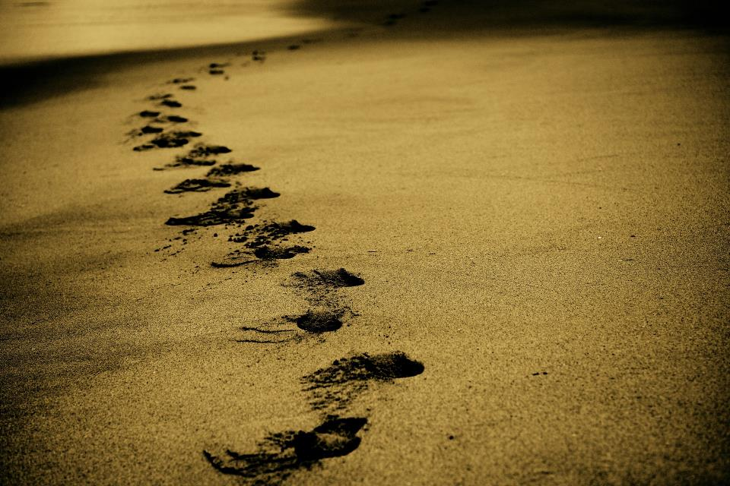
Picture copyright-free from pixabay
Leader: We are on this journey together…
Children: We are friends along the way…
ALL: May God go with us.
Notes:
Slide 1 or 2 [choose whichever image you prefer, or use them in rotation]:
Use the greeting for this term
Leader: We are on this journey together…
Children: We are friends along the way…
ALL: May God go with us.
BSL interpretation:
Sign for ‘way’ (nearest to the idea of ‘journey’): British Sign Language BSL Video Dictionary - way
Sign for ‘friends’: British Sign Language: friends
Sign for ‘God: British Sign Language BSL Video Dictionary - God
Sign for ‘go with us’ – we have invented this! After you’ve signed ‘God’, bring your finger down alongside your other finger and make them ‘journey together’ in front of you.
Engaging:
As we heard last week, in the final term of this school year, we are beginning a new theme:

Slide 2
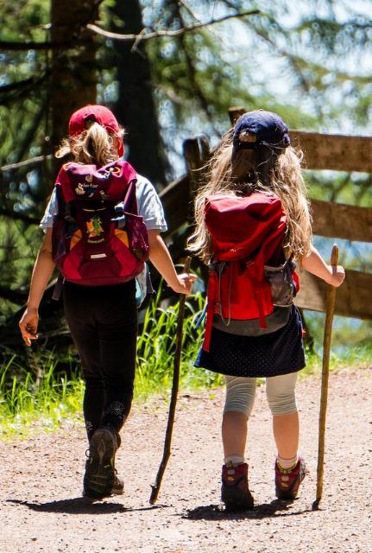
Picture copyright-free from pixabay
Leader: We are on this journey together…
Children: We are friends along the way…
ALL: May God go with us.
Notes:
Slide 1 or 2 [choose whichever image you prefer, or use them in rotation]:
Use the greeting for this term
Leader: We are on this journey together…
Children: We are friends along the way…
ALL: May God go with us.
BSL interpretation:
Sign for ‘way’ (nearest to the idea of ‘journey’): British Sign Language BSL Video Dictionary - way
Sign for ‘friends’: British Sign Language: friends
Sign for ‘God: British Sign Language BSL Video Dictionary - God
Sign for ‘go with us’ – we have invented this! After you’ve signed ‘God’, bring your finger down alongside your other finger and make them ‘journey together’ in front of you.
Engaging:
As we heard last week, in the final term of this school year, we are beginning a new theme:

Slide 3
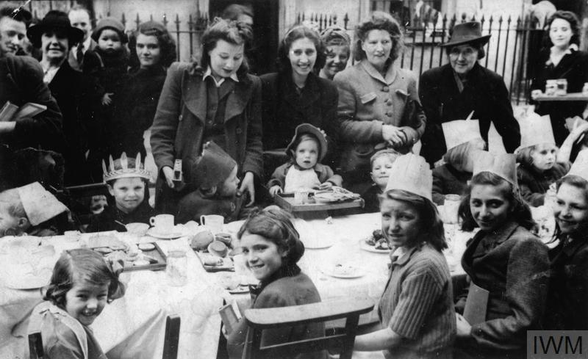
What’s going on here?
Notes:
Slide 3: What’s going on here? Talk together about what you can see happening in the picture.
It shows women and children having a tea party in their street – marking the day that victory in Europe was announced as the first big step in ending WWII.
Why do you think this was worth celebrating?

Slide 4
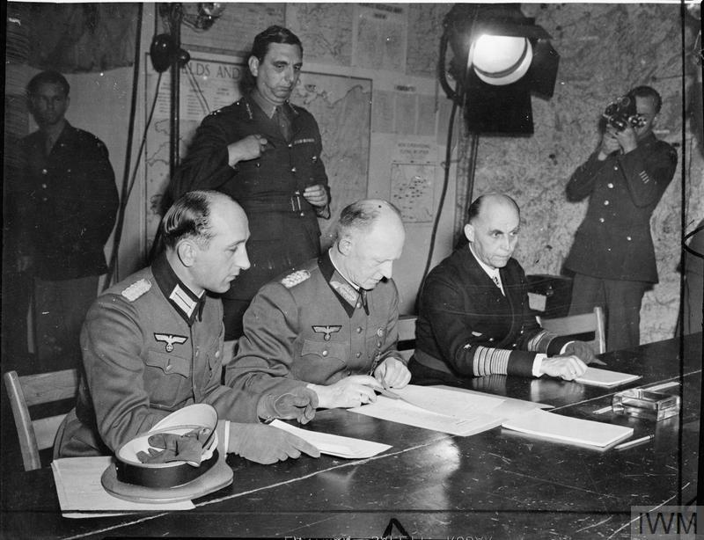
Notes:
Slide 4: On May 8th 1945, World War II ended after 6 long years, with the signing of a peace agreement.

Slide 5
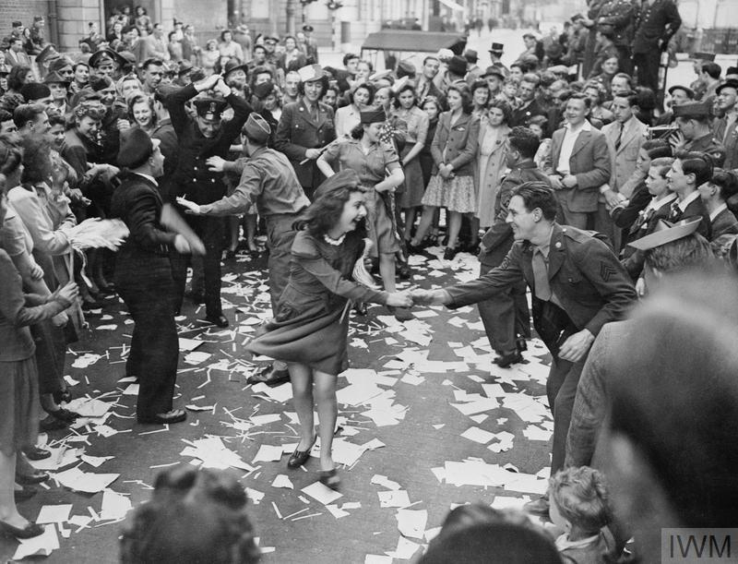
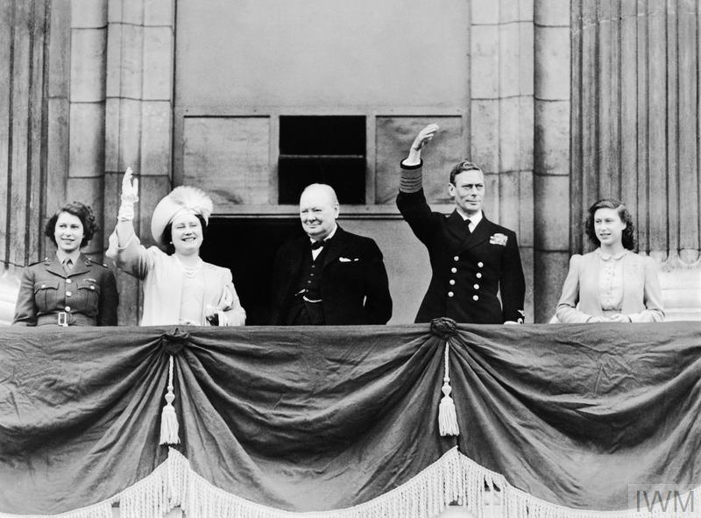
Notes:
Slide 5: Victory in Europe Day was celebrated all across the UK – and even the Royal Family got involved. Our late Queen, then Princess Elizabeth (on the left), recalled it as being one of the most memorable days of her life, when she was allowed to leave the Palace with her sister and celebrate with the rest of London!

Slide 6

Few of us who fought in that war are still with us today. But those of us who are ask only one thing.
That you remember.
Remember those who gave the ultimate sacrifice….
Remember how it took all of us coming together across classes, religions, nations and races to prevail.
Remember that peace and democracy don’t just happen, they need to be maintained…. To remember what happened isn’t just about honouring the fallen – to remember is also our best hope of avoiding it ever happening again.
Notes:
Slide 6: 10 soldiers who survived WWII have written a letter to the nation, and we are going to use some of their words to help us to think today.
Few of us who fought in that war are still with us today. But those of us who are ask only one thing.
That you remember.
Remember those who gave the ultimate sacrifice….
Remember how it took all of us coming together across classes, religions, nations and races to prevail.
Remember that peace and democracy don’t just happen, they need to be maintained…. To remember what happened isn’t just about honouring the fallen – to remember is also our best hope of avoiding it ever happening again.
[Explore together what this means, for the ages of children in your community.]

Slide 7

Notes:
Slide 7: And so today/this week, we are choosing to remember. Lots of places across the country will have had a great big tea party on Bank Holiday Monday! [Share some of the ways in which this will happen in your school / community context]

Slide 8
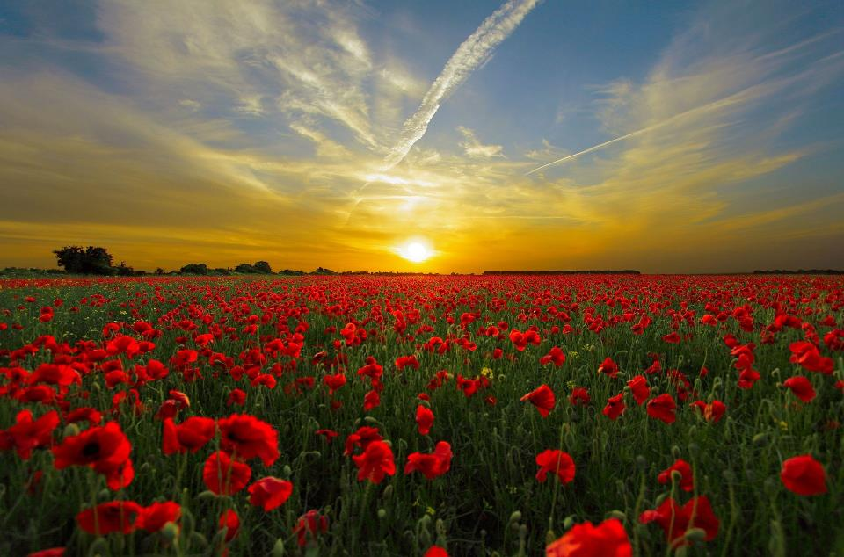

….I wonder what we might do today to uphold (keep) peace in our school community?....
Remember….
Notes:
Slide 8: Every year, we wear poppies and remember, but on this 80th anniversary of VE Day, it’s as important as ever that we take time to remember again. [pause between sentences]
….We remember what it cost those who fought in WWII….
….We remember what their families had to go through, being separated from them….
….We remember how people worked together to bring peace…..
….We remember that peace should never be taken for granted…..
….I wonder what we might do today to uphold (keep) peace in our school community?....
[If using paper chain image & slide 9:
But we also remember that there are still places in our world where peace is hard to find….]

Slide 9
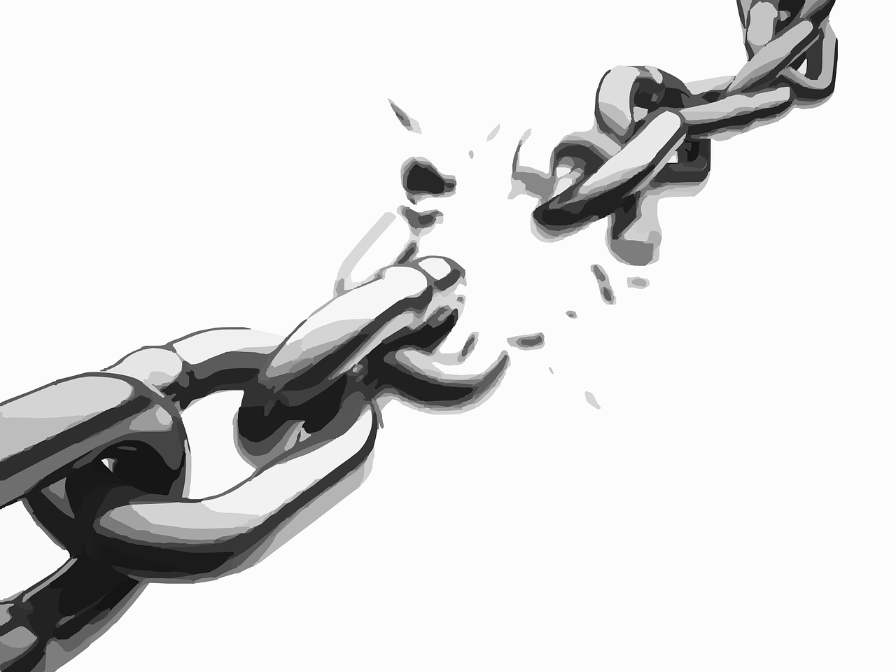
Notes:
Slide 9: Many hundreds of years ago, when Jesus walked the earth, he stood up in the Temple in Jerusalem and read these words – ancient words that the prophet Isaiah had written long before he was born: he talked about breaking chains that held people prisoner, and so we have written the words onto a chain of our own. [Read the words on your paper chain]
God has sent me to announce freedom …to break the chains of everyone who suffers.
You will know from the news that there are places in our world where people need peace to come, places where people are not free, and so on this day when we are thankful for peace, it is good to be able to remember these places [and to pray for them.]
The words spoken by Jesus are a reminder that peace is important to God too – and that one day, peace will reign, even in the places we have thought about. Jesus spoke these words not as a hope, but as a certainty. These words are echoed in the prayers of people all across the world.
Optional action: And so, we are going to enact our hopes now – we are going to break this chain of paper, as we hope and pray for peace to come….[break the chain: you might want to say again the words that Jesus spoke: Jesus said: God has sent me to announce freedom …to break the chains of everyone who suffers.

Slide 10
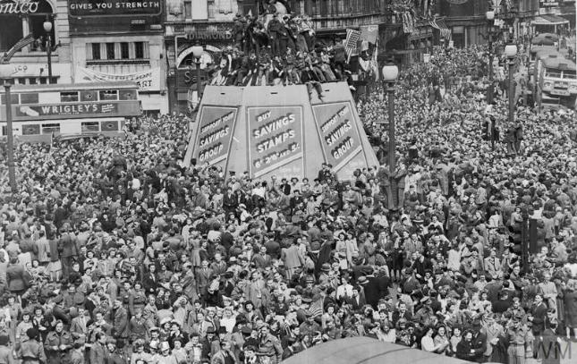
God of peace
We are thankful on this day to be able to stand with the nations and remember how peace came at the end of World War II. May we continue to remember all who made this happen and to bring before you the places in our world that need peace.
Together, we will remember them.
Notes:
Slide 10: So on this special day of celebration, I am going to invite you to pray if you’d like to:
God of peace
We are thankful on this day to be able to stand with the nations and remember how peace came at the end of World War II. May we continue to remember all who made this happen and to bring before you the places in our world that need peace.
Together, we will remember them.

Slide 11
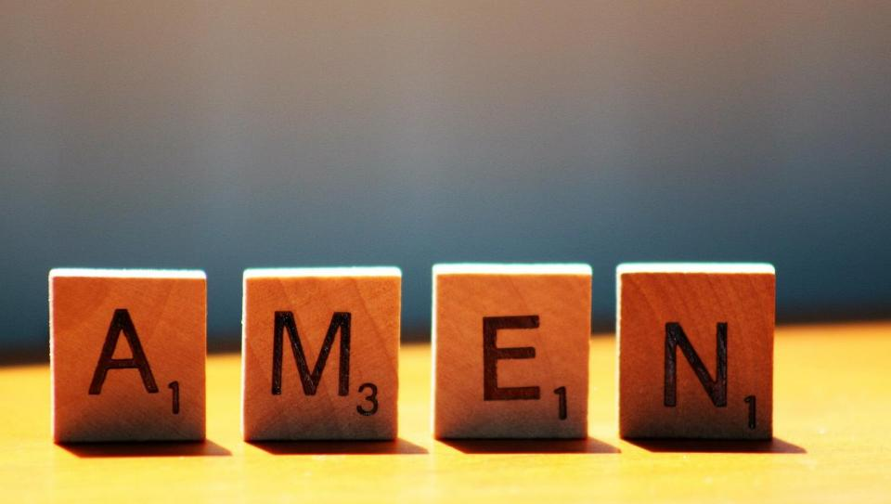

Slide 12
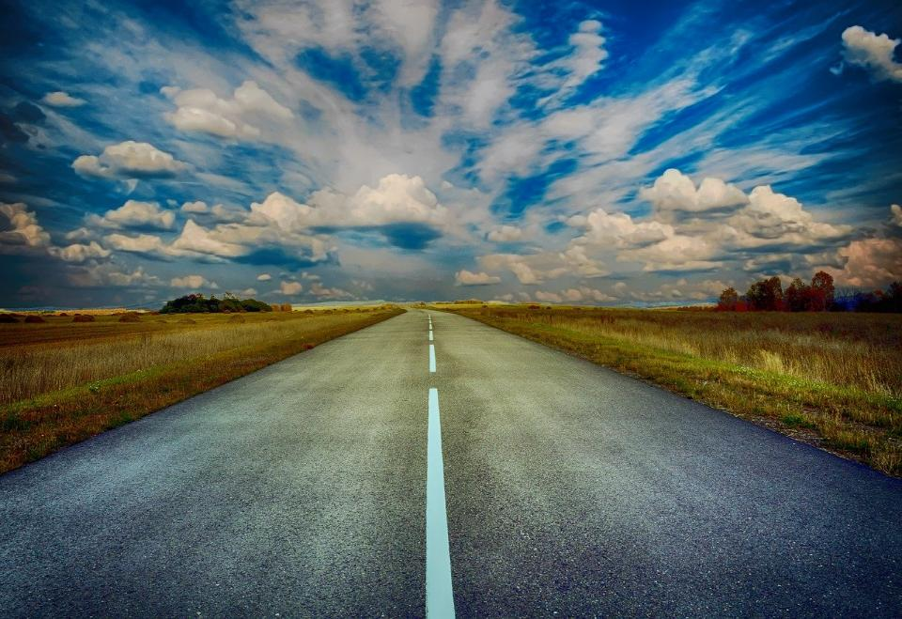
Picture copyright-free from pixabay
Leader: We have journeyed together today. As we leave this place and time and go into the day ahead…
ALL: …May God go with us.
Notes:
Slide 12: Use this term’s leaving words
Leader: We have journeyed together today. As we leave this place and time and go into the day ahead….
ALL: ….May God go with us.
Sign for ‘God: British Sign Language BSL Video Dictionary - God
Sign for ‘go with us’ – we have invented this! After you’ve signed ‘God’, bring your finger down alongside your other finger and make them ‘journey together’ in front of you.

