Slide 1
On the journey of life….
....we are glad to be together as a school community.
Notes:
Slide 1: Use these gathering words for this term, or your usual greeting if you prefer. Why not invent some actions to make them extra memorable?!

Slide 2
As we gather today….
....may we learn from each other and hear from God.
Notes:
Slide 2: Use these gathering words for this term, or your usual greeting if you prefer. Why not invent some actions to make them extra memorable?!

Slide 3
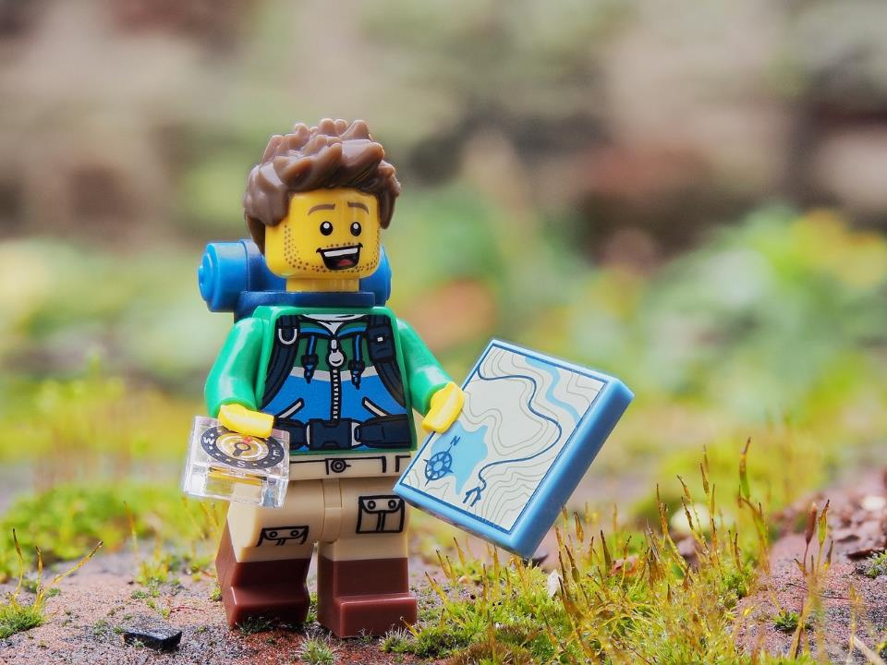
Are we nearly there yet?!!!
Notes:
Slide 3: Are we nearly there yet?!! I wonder if you’ve ever said these words? Where were you – and how long was your journey?! [share stories together]

Slide 4
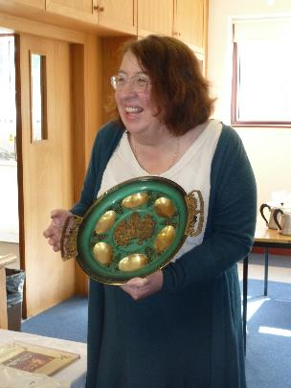
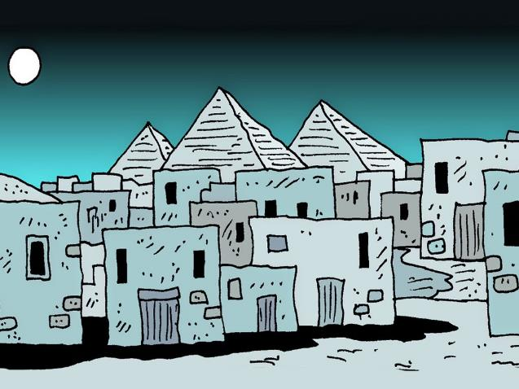
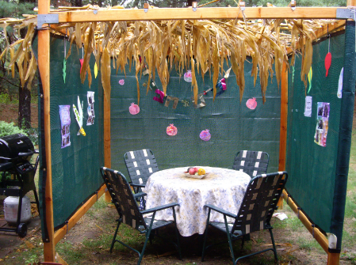
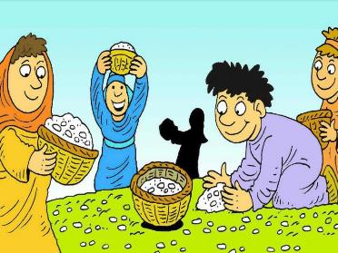
‘Remember that….’
Notes:
Slide 4: Last week, we took a little time out of the story of Moses and God’s people to remember: just like they did, we ‘Remembered that….’ Today, we are going to re-tell some of their story as we join the Israelites, God’s people, back on their journey.
We’re going to use a very familiar story frame to help us – a model that you may know from this book [show Bear Hunt book] So, there are parts for you to join in with, just like the bear hunt story.

Slide 5
We’re going on a journey…
Notes:
Slide 5: Our story is called, ‘We’re going on a journey’....and it’s full of many of the extraordinary things that happened to God’s people. Some we’ve already heard about, and others are new, as they carry on their journey to the land that God has promised them, their new home. [use script on p.3-4]

Slide 6
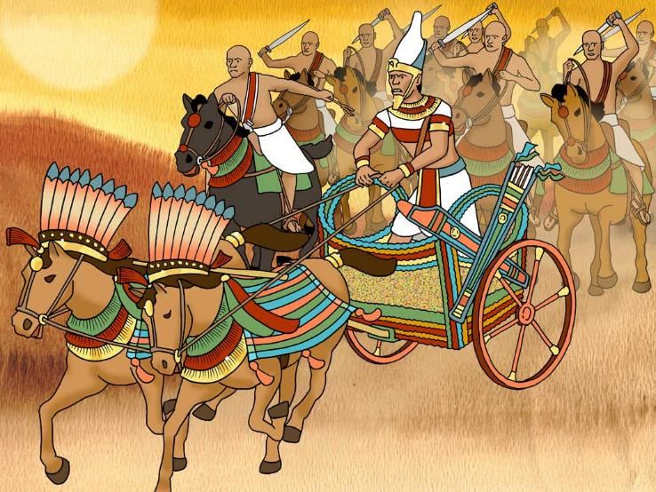
We’re going on a journey.
It’s going to be a long one.
We’re a bit tired….
‘ARE WE NEARLY THERE YET?!!’
Uh-oh!!
Notes:
Slide 6: Uh-oh!!
Soldiers, hairy, scary soldiers!

Slide 7
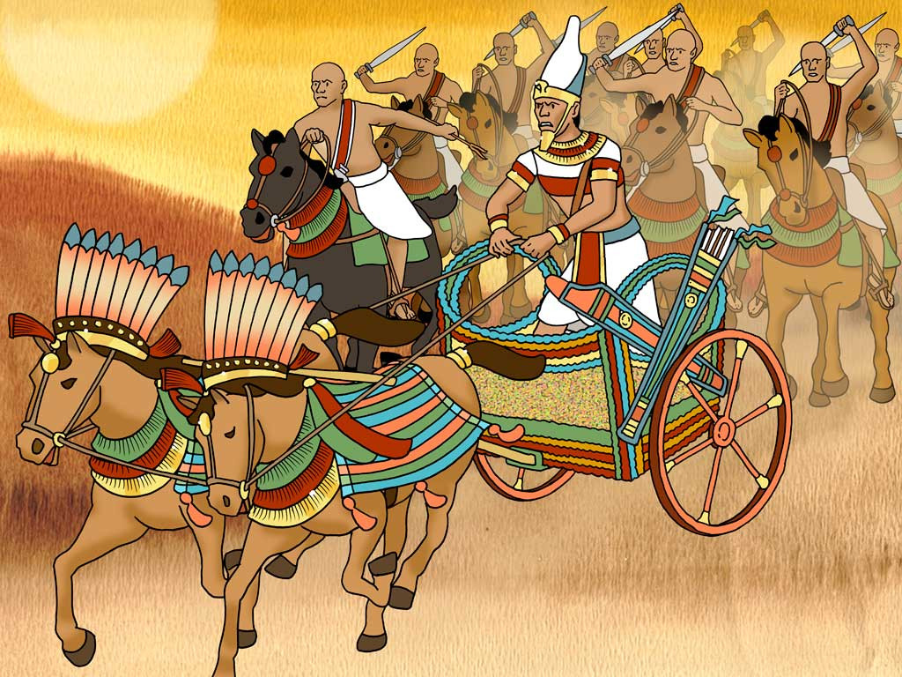
We can’t hide from them.
We can’t go around them.
We’ll have to run away then….

Slide 8
run, run,
run, run,
run, run!

Slide 9
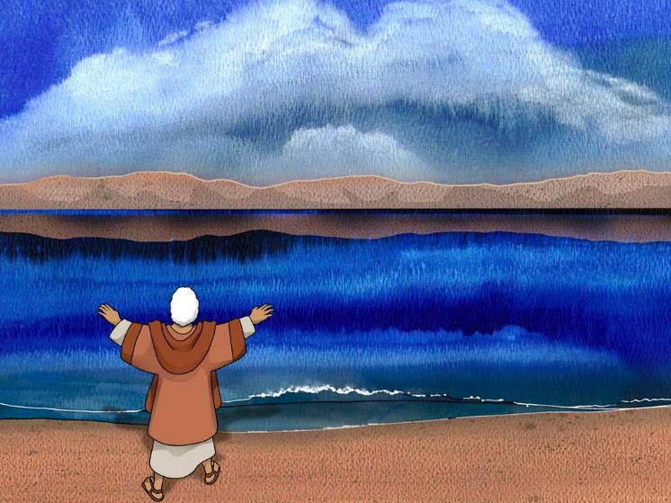
We’re going on a journey.
It’s going to be a long one.
We’re a bit tired….
‘ARE WE NEARLY THERE YET?!!’
Uh-oh!!
Notes:
Slide 9: Uh-oh!!
The sea! The wide, Red Sea.

Slide 10
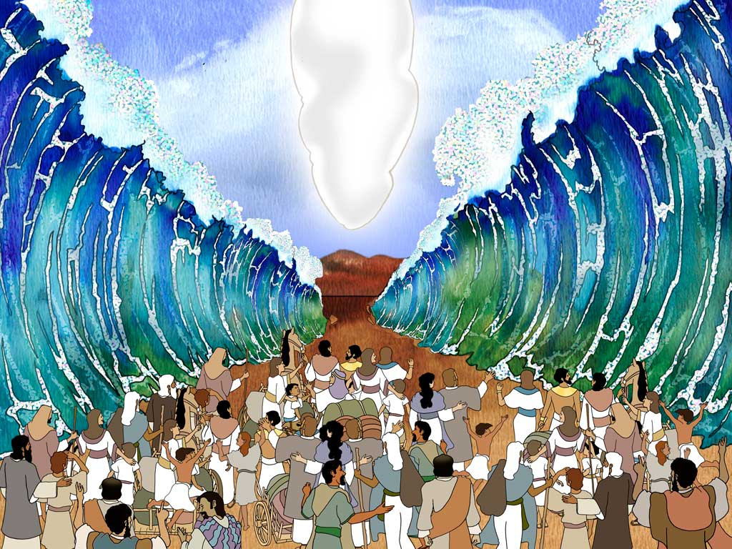
We can’t go around it.
We can’t go across it.
But we can go through it!!….

Slide 11
Oh wow!!
Oh wow!!
OH WOW!!!

Slide 12
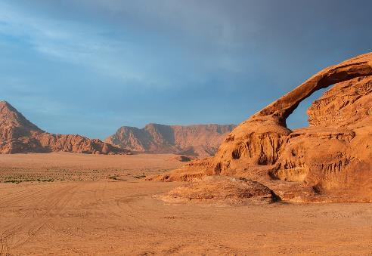
We’re going on a journey.
It’s going to be a long one.
We’re a bit tired….
‘ARE WE NEARLY THERE YET?!!’
Uh-oh!!
Notes:
Slide 12: Uh-oh!
A desert, a wide open desert

Slide 13
We can’t go over it.
We can’t go under it.
We’ll have to go across it!

Slide 14
crunch, crunch,
crunch, crunch,
crunch, crunch!

Slide 15
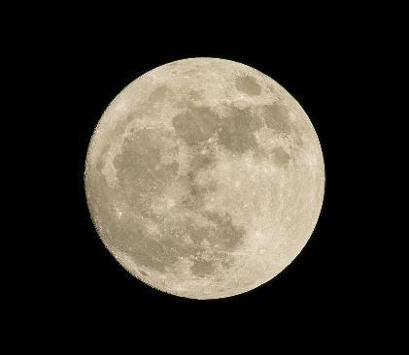
We’re going on a journey.
It’s going to be a long one.
We’re a bit tired….
‘ARE WE NEARLY THERE YET?!!’
Uh-oh!!
Notes:
Slide 15: Uh-oh!!
It’s night time – we want to go to bed now!

Slide 16
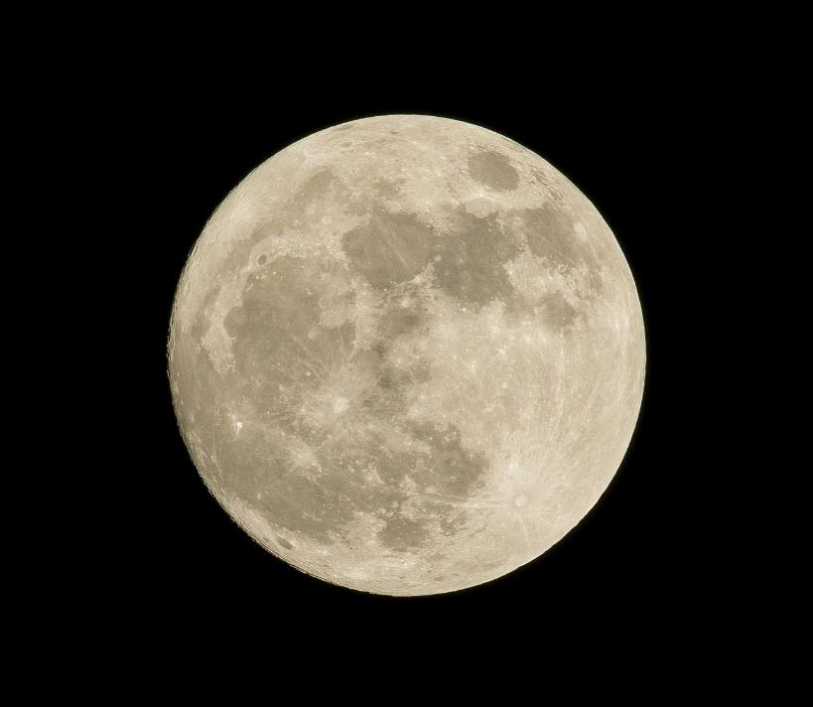
We can’t go to sleep yet,
We need to put the tents up….
Night, night everyone!!!

Slide 17
snore, snore,
snore, snore,
snore, snore!

Slide 18
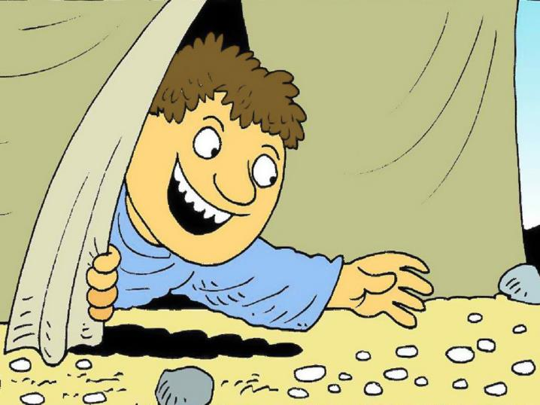
We’re going on a journey.
It’s going to be a long one.
We’re a bit tired….
‘ARE WE NEARLY THERE YET?!!’
Oooo look!!
Notes:
Slide 18:
Oooo look!! Manna! White, crispy manna….

Slide 19
We don’t know what to call it,
We don’t know how it got here,
But God has provided!

Slide 20
munch, munch,
munch, munch,
munch, munch!

Slide 21
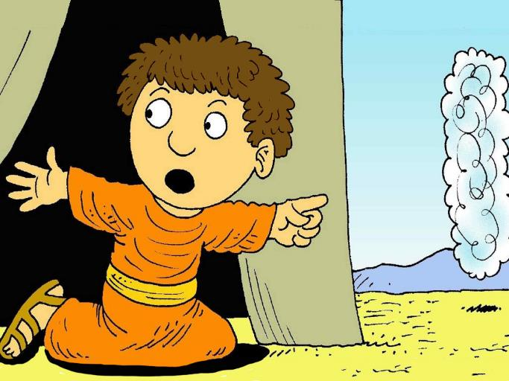
We’re going on a journey.
It’s going to be a long one.
We’re a bit tired….
‘ARE WE NEARLY THERE YET?!!’
Oooo look!!
Notes:
Slide 21:
Oooo look!!
The cloud…. The cloud is on the move!!

Slide 22
It’s God’s presence with us: we can’t lose sight of it,
and God says ‘Move!’

Slide 23
Pack UP!
Pack UP!
Pack UP!!!!

Slide 24
We’re going on a journey.
It’s going to be a long one.
We’re a bit tired….
‘ARE WE NEARLY THERE YET?!!’
Uh-oh!!
Notes:
Slide 24: Uh-oh!
A desert, a wide open desert

Slide 25
We can’t go over it.
We can’t go under it.
We’ll have to go across it!

Slide 26
crunch, crunch,
crunch, crunch,
crunch, crunch!

Slide 27
We’re going on a journey.
It’s going to be a long one.
We’re a bit tired….
‘ARE WE NEARLY THERE YET?!!’
Uh-oh!!
Notes:
Slide 27: Uh-oh!!
It’s night time – we want to go to bed now!

Slide 28
We can’t go to sleep yet,
We need to put the tents up….
Night, night everyone!!!

Slide 29
snore, snore,
snore, snore,
snore, snore!

Slide 30
We’re going on a journey.
It’s going to be a long one.
We’re a bit tired….
‘ARE WE NEARLY THERE YET?!!’
Oooo look!!
Notes:
Slide 30:
Oooo look!! Manna! White, crispy manna….

Slide 31
We don’t know what to call it,
We don’t know how it got here,
But God has provided!

Slide 32
munch, munch,
munch, munch,
munch, munch!

Slide 33
We’re going on a journey.
It’s going to be a long one.
We’re a bit tired….
‘ARE WE NEARLY THERE YET?!!’
Oooo look!!
Notes:
Slide 33:
Oooo look!!
The cloud…. The cloud is on the move!!

Slide 34
It’s God’s presence with us: we can’t lose sight of it,
and God says ‘Move!’

Slide 35
Pack UP!
Pack UP!
Pack UP!!!!

Slide 36
We’re going on a journey.
It’s going to be a long one.
We’re a bit tired….
‘ARE WE NEARLY THERE YET?!!’
Uh-oh!!
Notes:
Slide 36: Uh-oh!
A desert, a wide open desert

Slide 37
We can’t go over it.
We can’t go under it.
We’ll have to go across it!

Slide 38
crunch, crunch,
crunch, crunch,
crunch, crunch!

Slide 39
We’re going on a journey.
It’s going to be a long one.
We’re a bit tired….
‘ARE WE NEARLY THERE YET?!!’
Uh-oh!!
Notes:
Slide 39: Uh-oh!!
It’s night time – we want to go to bed now!

Slide 40
We can’t go to sleep yet,
We need to put the tents up….
Night, night everyone!!!

Slide 41
snore, snore,
snore, snore,
snore, snore!

Slide 42
We’re going on a journey.
It’s going to be a long one.
We’re a bit tired….
‘ARE WE NEARLY THERE YET?!!’
Oooo look!!
Notes:
Slide 42:
Oooo look!! Manna! White, crispy manna….

Slide 43
We don’t know what to call it,
We don’t know how it got here,
But God has provided!

Slide 44
munch, munch,
munch, munch,
munch, munch!

Slide 45
We’re going on a journey.
It’s going to be a long one.
We’re a bit tired….
‘ARE WE NEARLY THERE YET?!!’
Oooo look!!
Notes:
Slide 45:
Oooo look!!
The cloud…. The cloud is on the move!!

Slide 46
It’s God’s presence with us: we can’t lose sight of it,
and God says ‘Move!’

Slide 47
Pack UP!
Pack UP!
Pack UP!!!!

Slide 48
We’re going on a journey.
It’s going to be a long one.
We’re a bit tired….
‘ARE WE NEARLY THERE YET?!!’
…..
Notes:
Slide 48:
……unfortunately, no!
The journey went on – and on…. And on!
For 40 years, God’s people wandered in the desert – and for today, this is where we leave them [add your own cliffhanger sound effect here]

Slide 49
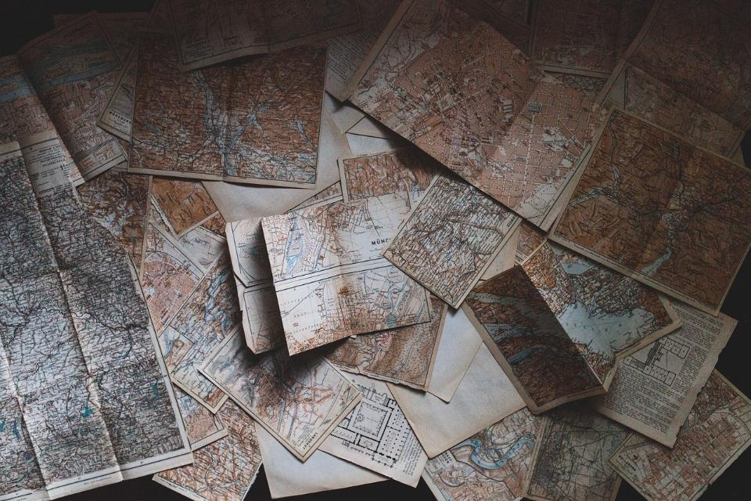
….I wonder why the journey of God’s people was such a long one?....
….I wonder what they learned about God as they travelled?....
….I wonder what we have learned during our time together this term?....
Notes:
Slide 40: Wondering questions…
….I wonder why the journey of God’s people was such a long one?....
….I wonder what they learned about God as they travelled?....
….I wonder what we have learned during our time together this term?....
[you might also want to spend some time reflecting on / talking about whether you’ve ever felt stuck in a ‘loop’, like God’s people did in the desert]

Slide 50
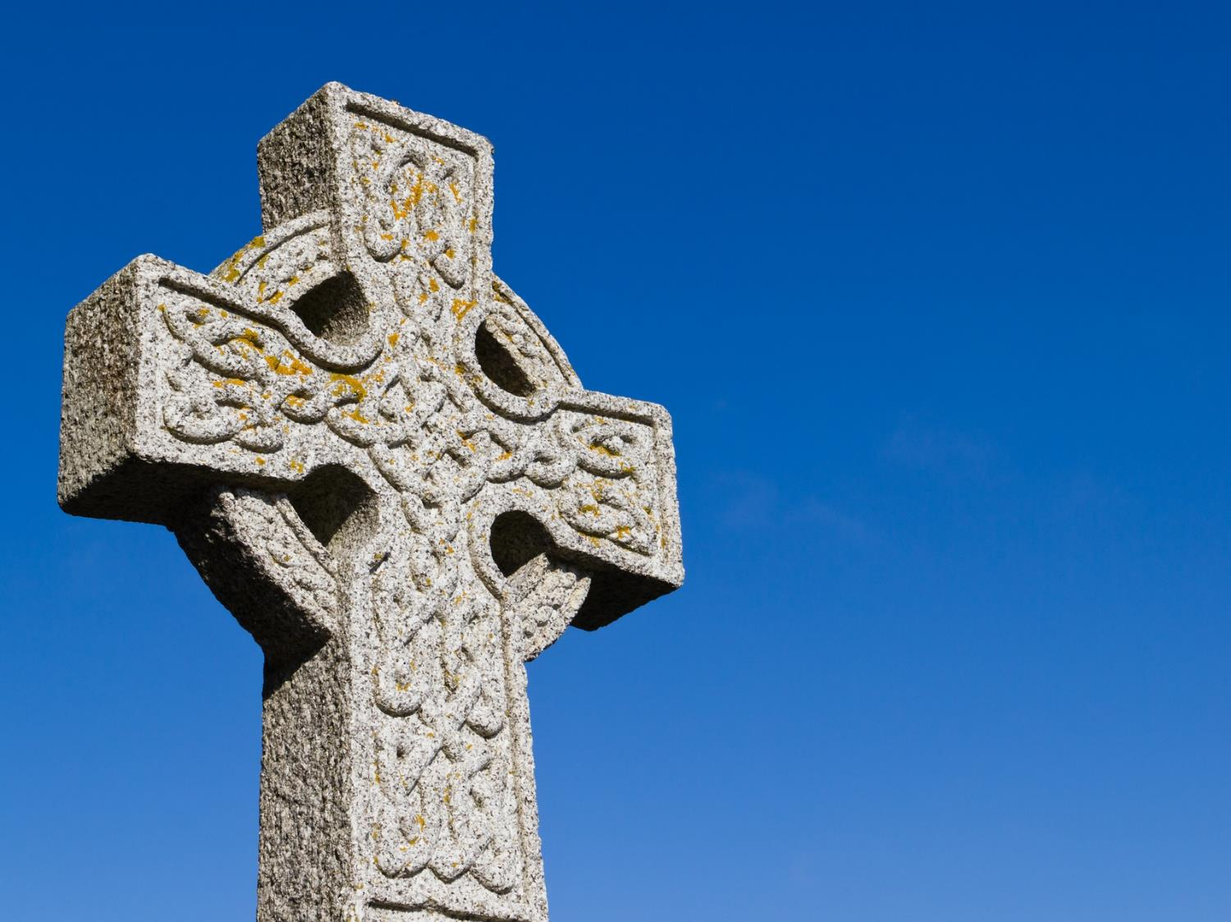
A Celtic Blessing
Notes:
Slide 49: I’m going to turn my thoughts into a prayer now. If you’d like to pray too, then find a way to make it your own….
Today’s prayer is a blessing that is very old, probably from Ireland (which is one part of the British Isles) This blessing talks about wishing someone well as they go on their journey….that their journey will be an easy one. This may be an actual journey, but it could also mean the journey of people’s day-to-day lives. As you listen, you might not understand every word, because the language is like a poem, so I’m going to use some pictures to help us. [Try to leave a pause between each slide, and resist the urge to explain the words: let them sink in and let the words and pictures ‘speak’ to children at whatever level they will absorb them, even if it’s only to enjoy how they sound. Read it more than once if you think it will help.]

Slide 51
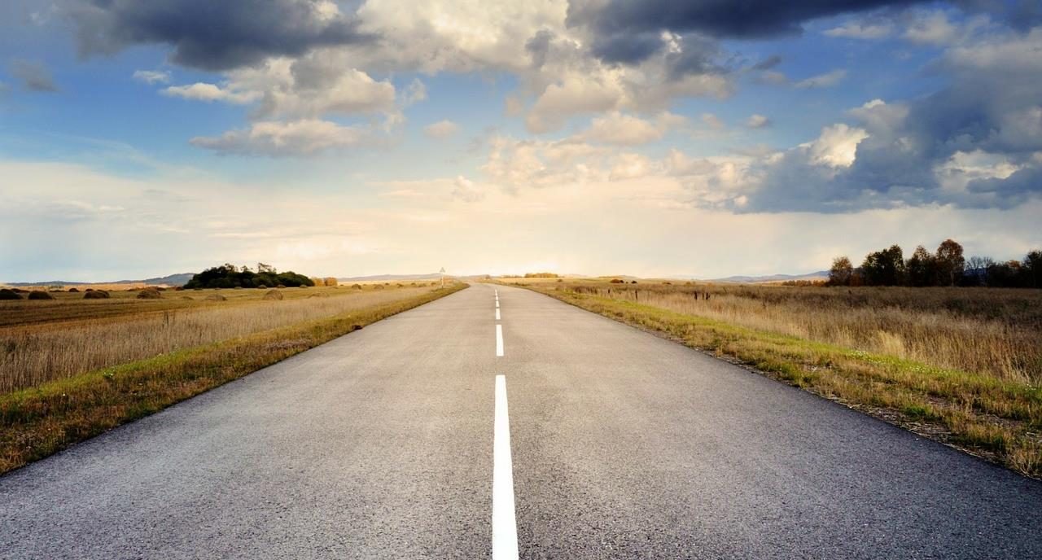
May the road rise up to meet you.

Slide 52
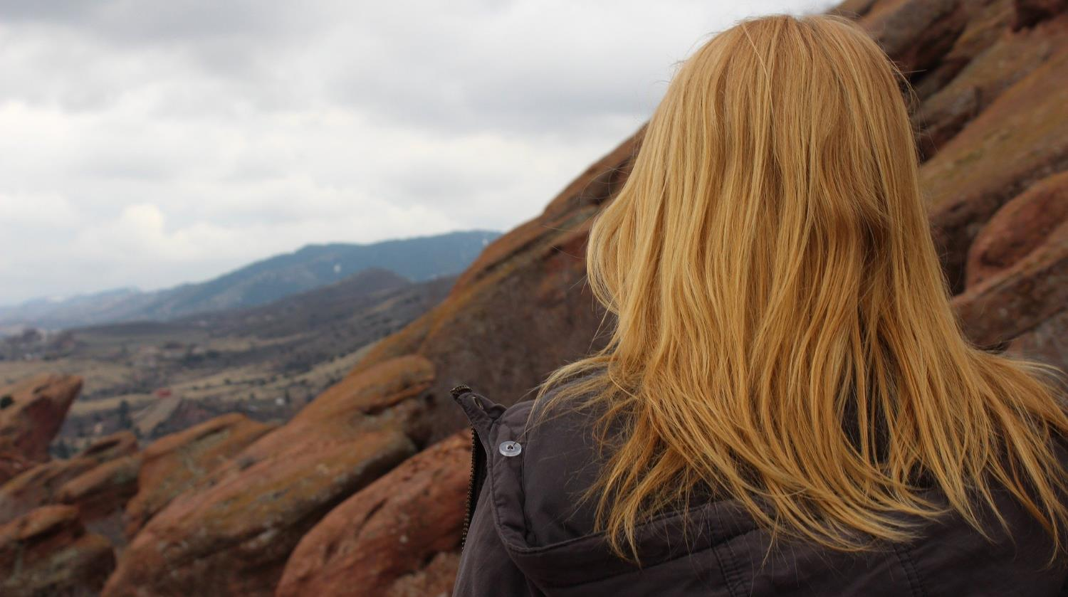
May the wind be always at your back.

Slide 53
May the sun shine warm on your face,

Slide 54
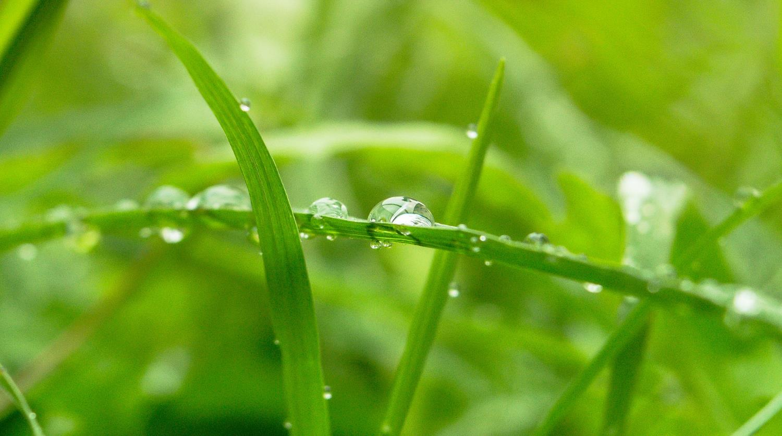
…the rains fall soft on your fields…

Slide 55
…and until we meet again,

Slide 56
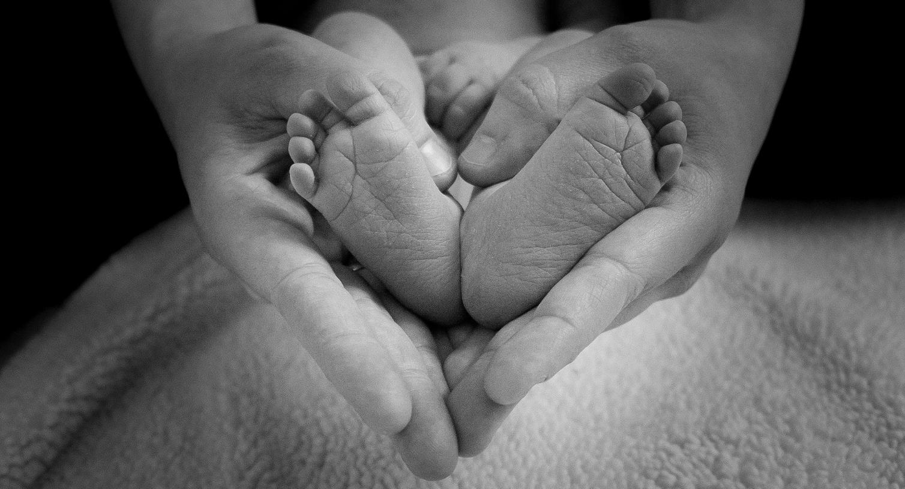
…may God hold you in the palm of his hand.

Slide 58
Leader: As we leave this place & time and go into the day ahead…
All: May today’s words help us to become a stronger community.
Notes:
Slide 16: Remind children of today’s key message – to ‘Remember that…..’

Slide 59
Notes:
Reflective activity: ‘Are we nearly there yet?!!’
Create a map that reflects the journey of your life so far.
Who has helped you on your journey?
You might want to write their names on your map along your ‘journey’.
Say thank you!

