Slide 1







All pictures copyright-free from pixabay
Notes:
Slide 1: Rising hearts stilling exercise
Use the stilling slide if desired: the suggested words should be spoken slowly, leaving pauses inbetween to create a sense of stillness.
As you sit quietly, watch the hearts rising….[PAUSE]
Now practise slower breathing…..in…..and out…..in……and out…..keep this going as you continue to look at the hearts….[PAUSE]
You maybe notice that you are feeling calmer and more relaxed….[PAUSE]
As you breathe, think back to how we have built up our school community in love during this last week….. [PAUSE]
We come into this special / sacred space and time to be still….to think deeply…..to be together as a school community…..
In our time together today, we will begin with another mystery, listen to a song, share a story and then use it to help us to think.
But first, let’s welcome one another as we begin….

Slide 2
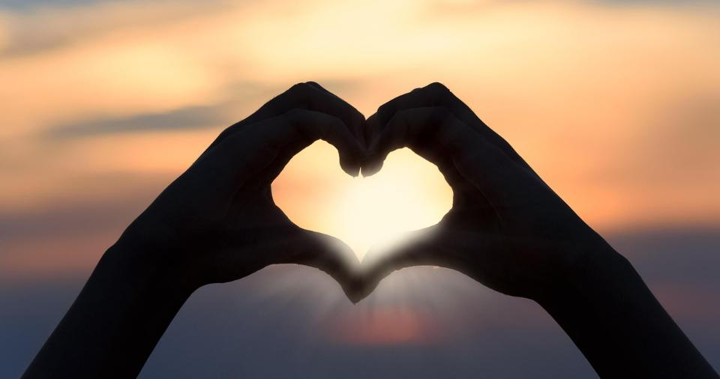
Leader: As we gather together today…
ALL: …we bring our thoughts and our hearts into this sacred space.
Notes:
Slide 2: Gathering
Leader: As we gather together today….
ALL: ….we bring our thoughts and our hearts into this sacred space.
Here are BSL actions for some of the words:
Leader’s words:
Gather: https://www.signbsl.com/sign/gather (1st video)
Today: https://www.signbsl.com/sign/today (1st video)
Pupils’ response:
Thoughts: https://www.signbsl.com/sign/thoughts (1st video)
Hearts: https://www.signbsl.com/sign/heart (1st video)

Slide 3

Notes:
Slide 3: A mystery: the greatest gift
[Show the gift box – which hopefully, most pupils will have noticed by now! Look at the label, then wonder together about what might be inside it. You could put children into talking pairs to discuss their ideas together, then collect some thoughts before you open the box and discover the large heart.]
I wonder why you think this might be the greatest gift?…..Do you agree with this idea? Maybe you can think of some examples from your own experience?
We’re going to do something that we’ve not done this term yet – listen to a song! It’s a golden oldie called ‘Love is something if you give it away’ – we’re going to listen to a small part of it and then talk about the words….(and maybe we’ll sing it together at the end!)

Slide 4
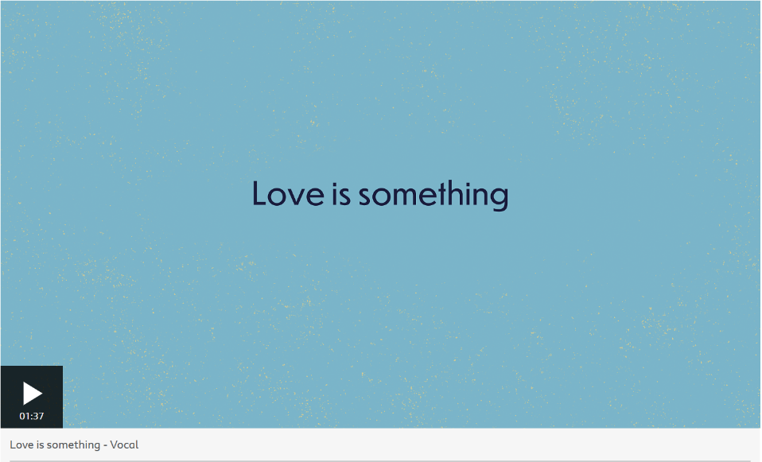
‘Love is something if you give away,
You end up having more.’
Notes:
Slide 4: Listen to chorus & v1 The song is linked to the image on the screen and should open if you click on it. Alternatively, you could load it from the link in the script for this week.
The words we’ve just listened to say this:
Love is something if you give away,
You end up having more.
It seems to be an impossibility: to give something away and end up having more! I wonder if you can explain how this impossible maths works?! [ask a few children: answers will hopefully be along the lines that giving love away to other people means that more love is shared around – and you get love in return, or similar!]

Slide 5
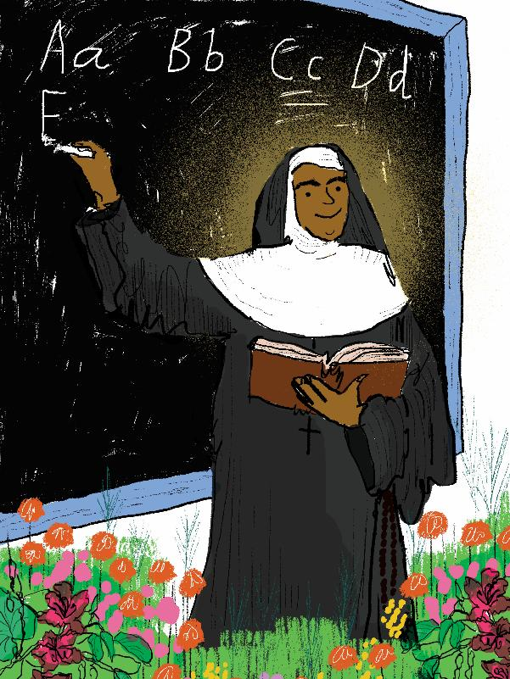
St. Alphonsa
(1910-1946 CE)
Love is the greatest gift we can give to others. Let us show love and compassion to all, just as God has shown us.
Shine like stars!
These images © Jen Khatun & SPCK and must not be used outside of this context
Notes:
Slide 5: We’re going to share another Hero of Hope’s story now, a woman who spoke these words about love: ‘Love is the greatest gift we can give to others. Let us show love and compassion to all, just as God has shown us.’ This woman is St. Alphonsa, who was born here……

Slide 6

Notes:
Slide 6: World map
…in the very south of India, in a state named Kerala. She is the first Indian woman to have been made a saint.

Slide 7
St. Alphonsa
(1910-1946 CE)
Shine like stars!
These images © Jen Khatun & SPCK and must not be used outside of this context
Notes:
Slide 7: As a young girl, St. Alphonsa was called Annakutty and lived in a small village with her family. She was often ill, and had several long stays in hospital, but this never stopped her from reaching out to others. She saw her frequent illnesses as an opportunity to understand how it feels to be ill and in pain, so that she could be more compassionate with others when they were suffering, because she knew how it felt.

Slide 8
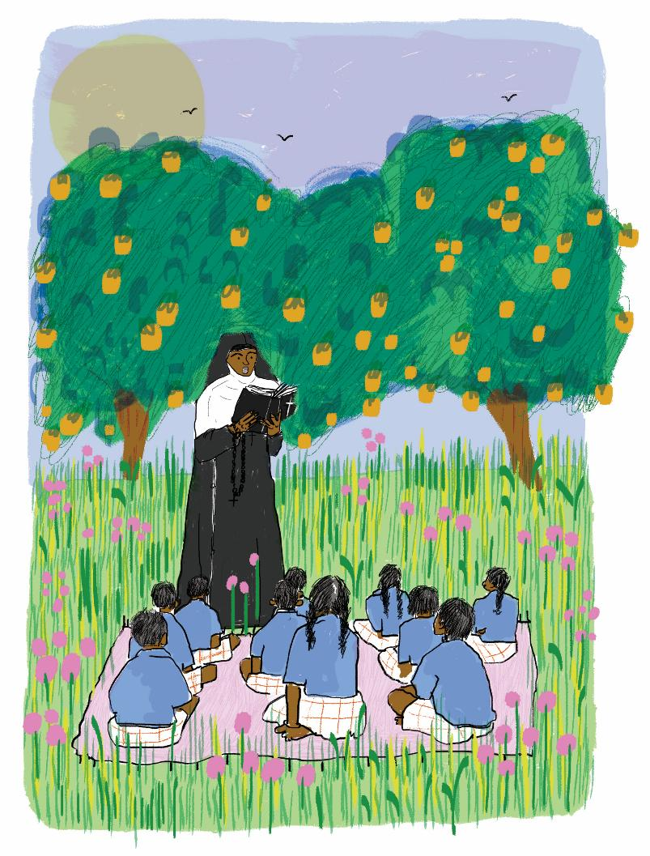
These images © Jen Khatun & SPCK and must not be used outside of this context
Notes:
Slide 8: She also loved being with children and told them stories that demonstrated the importance of being loving and caring, and showing empathy with others. She lived her short life with great perseverance, always thinking how she could make others’ lives better, going out of her way when they needed help, even though she was often in pain herself.
I wonder if she might remind you of the Good Samaritan who we heard about last week? [you might want to ask for some feedback]
We’re nearly at the end of our time together today, so for the last part of our collective worship, we’re going to pause with our thoughts…..

Slide 9
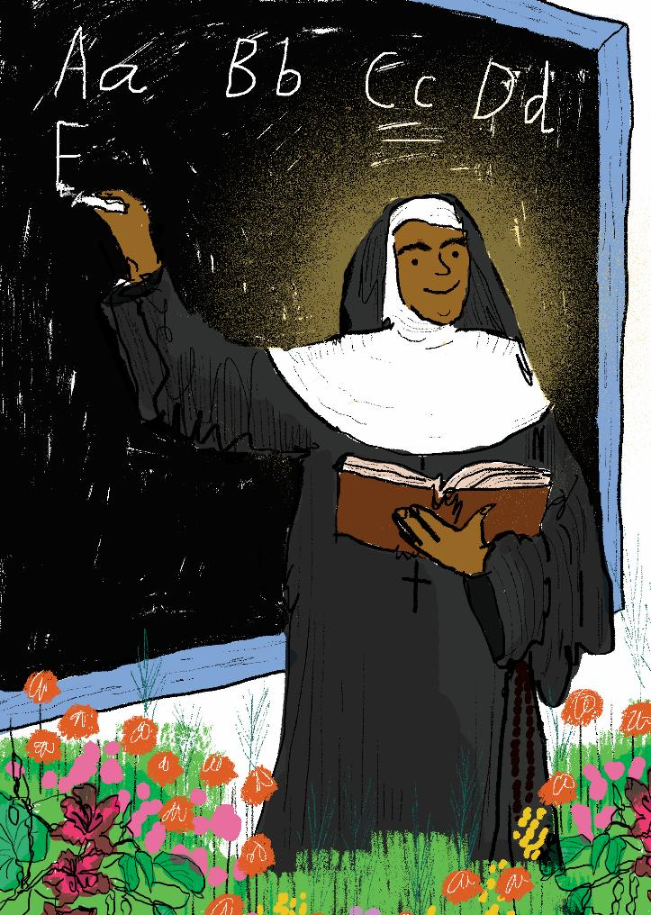
….I wonder how God might have shown his love for us?.....
….I wonder how you think St. Alphona’s life ‘shone like a star’?.... ….I wonder how you think she gave love away?....
….I wonder how we might ‘give love away’ this week?....
Love is the greatest gift we can give to others. Let us show love and compassion to all, just as God has shown us.
Notes:
Slide 9: Responding and words for worship
We’ve heard these words that St. Alphonsa spoke about love: Love is the greatest gift we can give to others. Let us show love and compassion to all, just as God has shown us.
As we draw our time together to a close, let’s take a few moments to reflect on the story of her life, and what we might learn from it….
….I wonder how God might have shown his love for us?.....
….I wonder how you think St. Alphonsa’s life ‘shone like a star’?....
….I wonder how you think she gave love away?....
….I wonder how we might ‘give love away’ this week?....

Slide 10
Notes:
Slide 10: The greatest gift
Let’s go back to our mystery ‘greatest gift’ that we started our time together with….
We just asked the question: ….I wonder how we might ‘give love away’ this week?....
I have here a few red hearts to gather some ideas from you now…. [ask children for their ideas and write some onto the hearts. This will model what you want them to do in their classrooms. As you write their ideas, create a ‘chain of love’ at the front of the hall.]
This week, we are going to be adding to this chain of love through the ideas that we gather in our classrooms, but hopefully also through the small acts of love that we see in action around our school…..

Slide 11

God who is love
Thank you for the example of St. Alphonsa who gave her love so freely to others.
Help us to give love away as we live and work here as part of our school community.
May our school be a place filled with love!
Notes:
Slide 11: Prayer
As we turn to prayer now, just spend a few moments looking at, and thinking about, the hearts that we have gathered here in our hall. [You may need to read them out if pupils are far away] Think about how we might turn these ideas into actions. You may want to bring this or your own idea into a prayer now: you may wish to make this prayer your own, or prefer to think quietly to yourself.
God who is love
Thank you for the example of St. Alphonsa who gave her love so freely to others.
Help us to give love away as we live and work here as part of our school community.
May our school be a place filled with love!

Slide 12
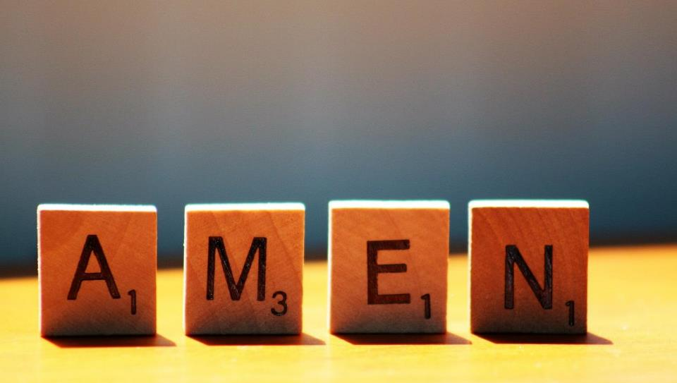

Slide 13



Leader: As we leave this place & time and go into the day ahead…
All: May we shine like stars!
Notes:
Sending: Slide 13
Leader: As we leave this place & time and go into the day ahead…
All: May we shine like stars!

Slide 14

Notes:
Slide 14: Reflective areas
Cut heart shapes out of coloured paper for your reflective areas. Children will make these into a ‘chain of love’ around your classroom.
‘Love is the greatest gift we can give.’
Think: How did St. Alphonsa give love away during her life? How might you ‘give love away’ this week?
Do: Take a heart shape and write your idea inside it. Make a class ‘chain of love’ around your classroom. Try to find an opportunity to act on your idea this this week.
Talk: At the end of the week, look at all the ideas you have gathered and find out what a difference they have made.
We also encourage you to explore the full story of St. Alphonsa from the book during the week.

