Slide 1
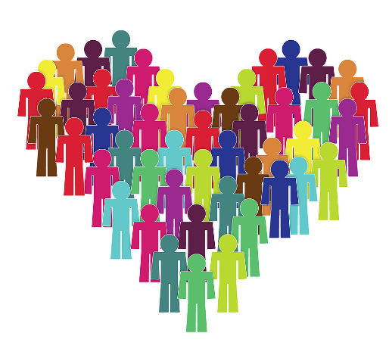
Pictures copyright-free from pixabay
Leader: We are a creative community. As we gather together today…
ALL: May our thinking, talking and wondering help us to grow.
Notes:
Slide 1: Gathering
Use the new greeting, with BSL actions if desired.
Leader: We are a creative community. As we gather together today….
ALL: May our thinking, talking and wondering help us to grow.
Here are BSL actions for some of the words:
Leader’s words:
Creative: https://www.signdictionary.co.uk/view/creative?q=creative#title
Community: (we use the word ‘gathering’ as it’s a simpler sign!) https://www.signbsl.com/sign/gathering
Gather together: https://www.signbsl.com/sign/gather (1st video)
Pupils’ response:
Think: https://www.brightbsl.co.uk/signs/think
Talk: https://www.signbsl.com/sign/talk (1st video)
Wonder: https://www.signbsl.com/sign/wonder (1st video)
Grow: https://www.signbsl.com/sign/grow (2nd video)

Slide 2
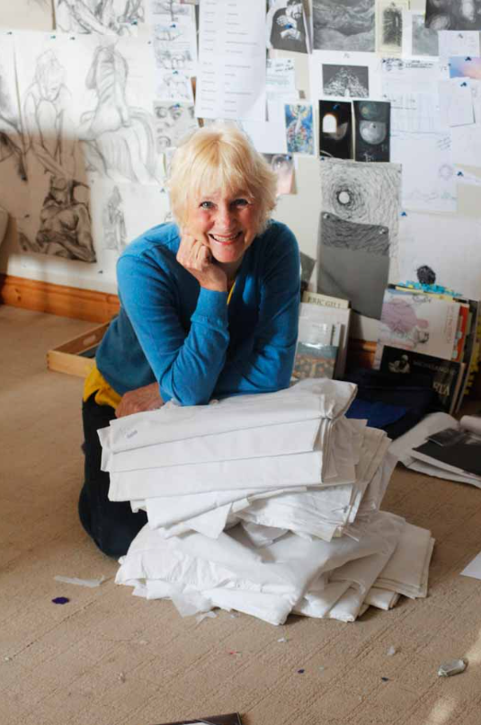
Threads Through the Cross
Notes:
Slide 2: Threads Through the Cross

Slide 3
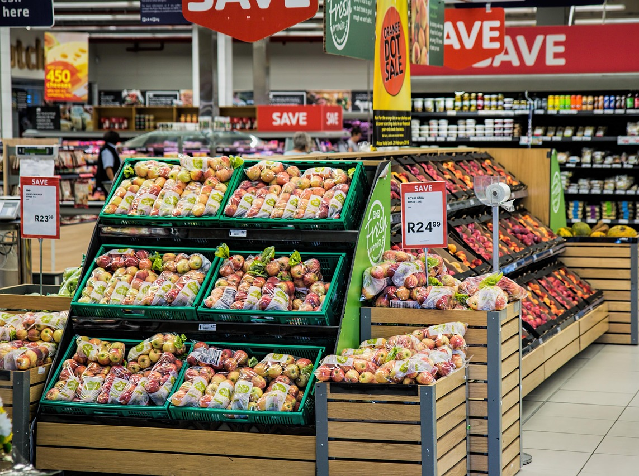
The shopping memory game
Notes:
Slide 3: The shopping memory game…..
Play your own version of this popular game, which starts ‘I went to the supermarket and I bought……’ Each child remembers the previous items and adds their own to the ever-increasing list.
You all played really well – but it makes me realise that it’s a good idea to make a list of what we might need when we go shopping, rather than having to remember all we need to buy!!!

Slide 4

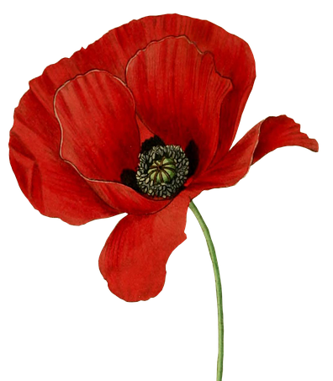
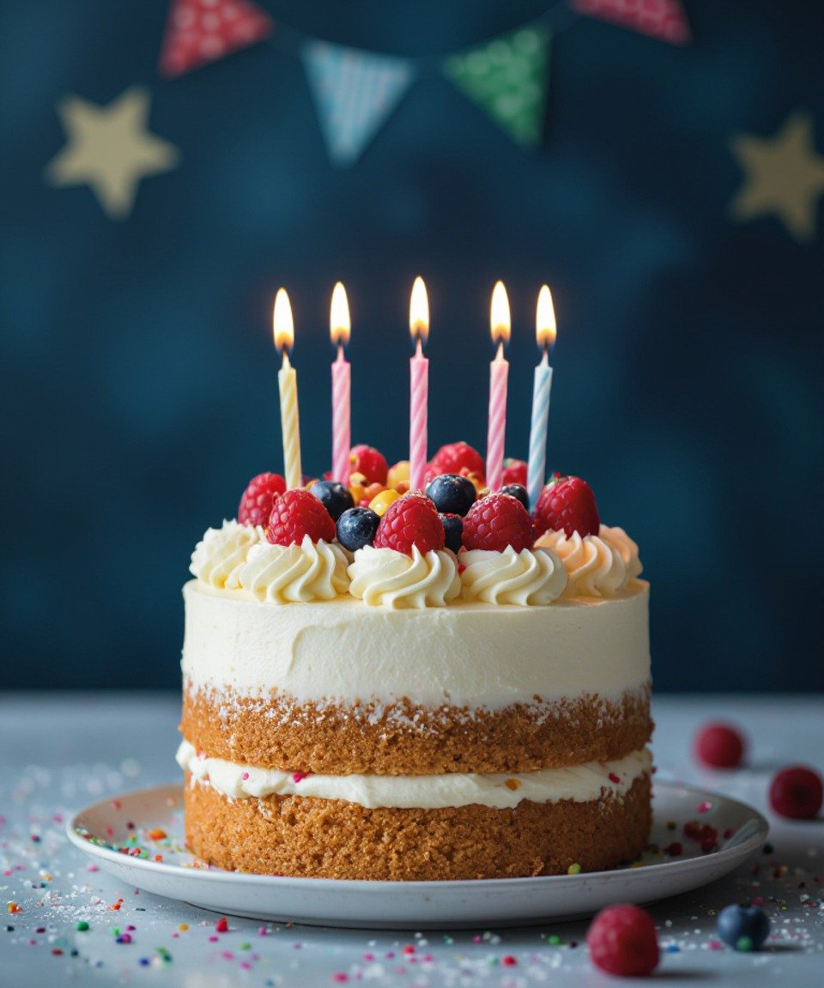
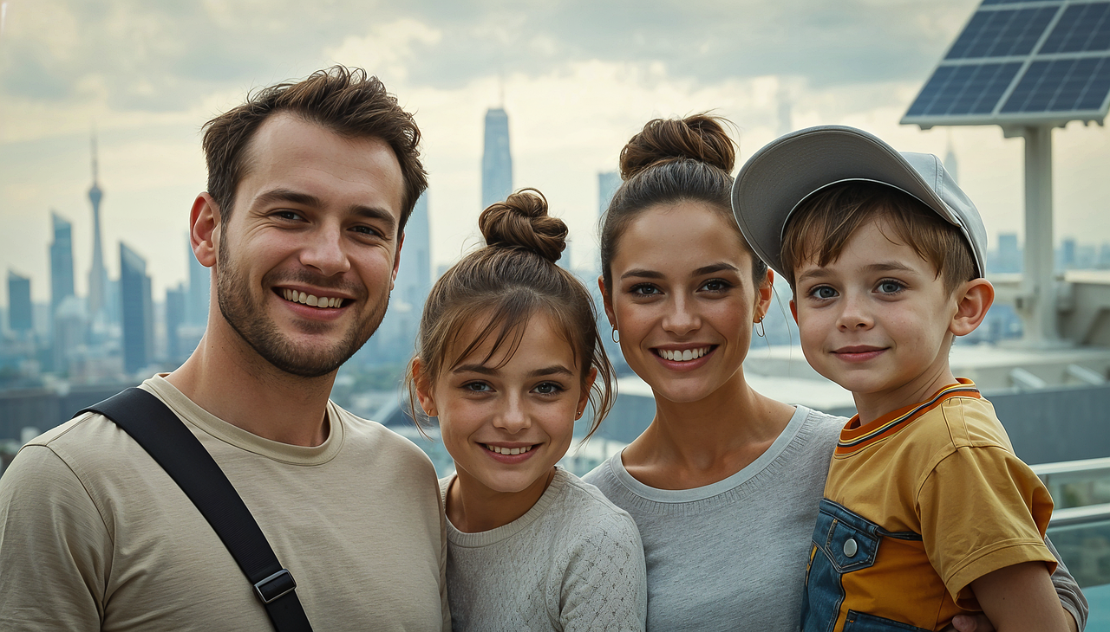
How do these help us to remember?
I wonder what helps you to remember?
Milk
Eggs
Grapes
Salad
Tissues
Notes:
Slide 4: All these things help us to remember, but how?
We’ve already decided that a shopping list helps us to remember what to buy at the shops, so we don’t leave anything out (like happened in our game!) But what about these other things? [ask pupils to explain each]
Birthday cake with candles (to remember how old someone is)
Family photo (to remember a special holiday – or people we don’t see very often)
Poppy (to remember those who have died in wars.)
All these things all help us to remember in some way. I wonder what pictures you might have chosen for this theme?!
I wonder what special things help you to remember? [allow some responses]
Today’s panel shows an event that is also all about remembering. Some of you might remember this story…..

Slide 5
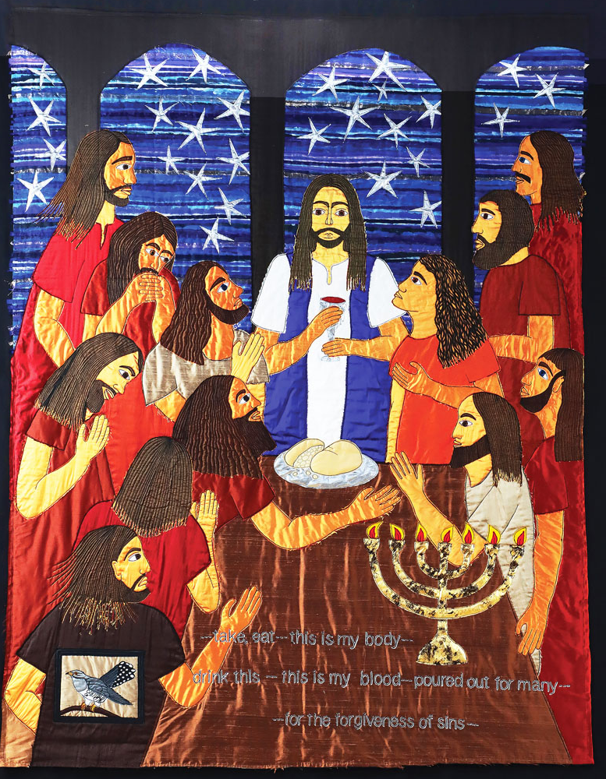
Remember me
Take, eat…this is my body.
Drink this – this is my blood, poured out for many for the forgiveness of sins.
Notes:
Slide 5: Jacqui called it Remember me
Spend a while just gazing at the panel. Relax, and focus on calm breathing.
Let your eyes take in (look at) every detail……. [leave silence for a short while]
Now I’m going to use some questions to help us…for now, we’re not going to tell each other the answers. [select from the questions below, or use all, depending on the time / pupils you have]
….Which story do you think this is?
….Who are the people in this panel?
….What are they doing?
….How are the people feeling?
….What important event do you think is being remembered here? [for older pupils, it might be useful to point out that Jesus and the disciples were gathered to celebrate Passover – some may already have made this link in prior RE learning – or from the menorah pictured here.]
Tell the story of this meal: [based on verses from the Bible, and Jacqui’s own text from the panel]
The friends were all gathered in Jerusalem to celebrate the Passover. As they sat down to eat, Jesus took some bread. He thanked God for it, broke it, and gave it to the disciples. Then Jesus said, “Take, eat…this is my body that I am giving for you. Do this to remember me.” In the same way, after supper, Jesus took the cup and said, “Drink this – this is my blood, poured out for many for the forgiveness of sins. This cup shows the new agreement that God makes with his people.”
If pupils ask about the bird, it’s a cuckoo, traditionally considered to be a traitor in the nest as it places its own eggs into a bird’s nest, which hatch and push out of the nest the chicks who belong there.

Slide 6
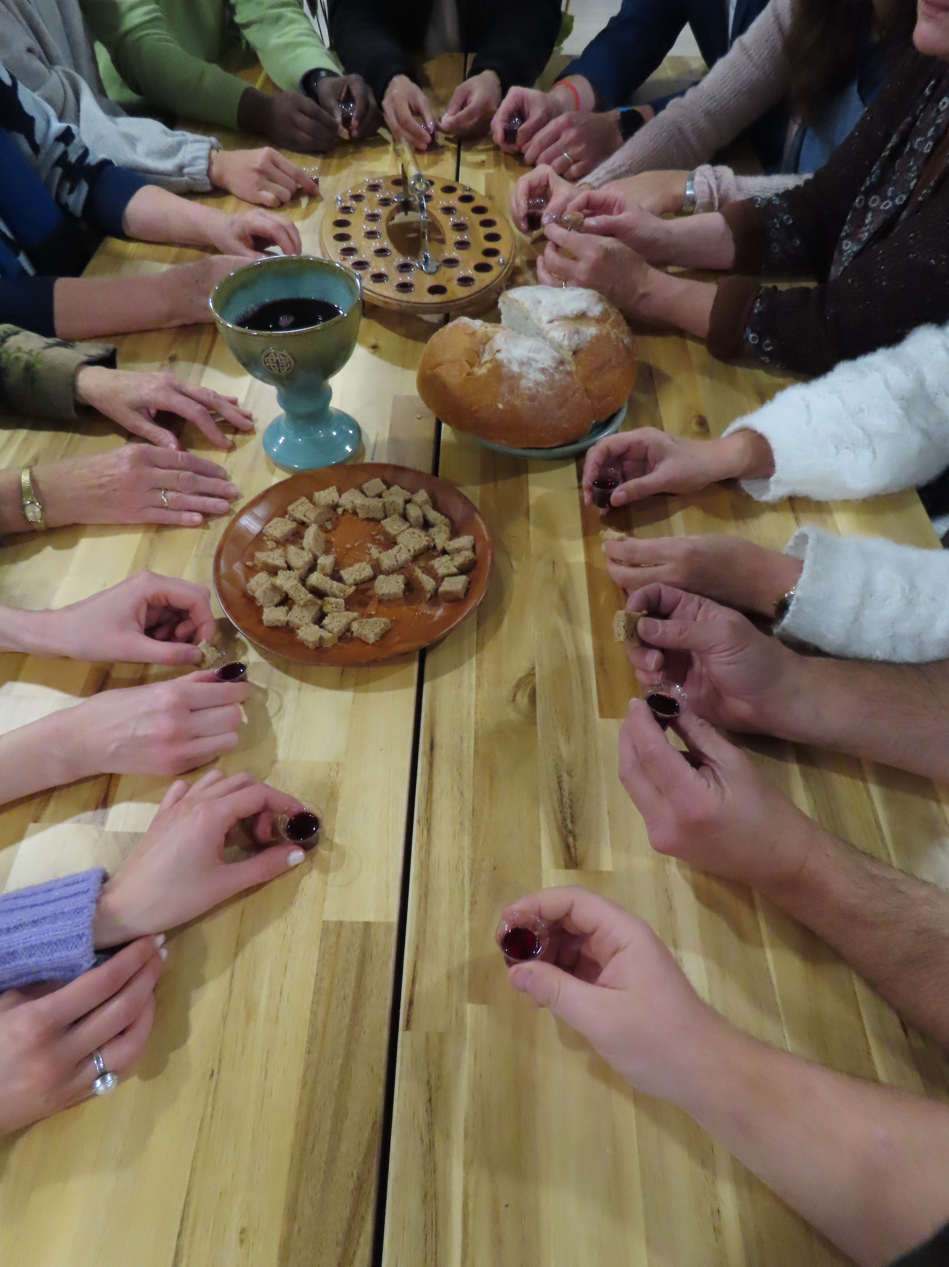
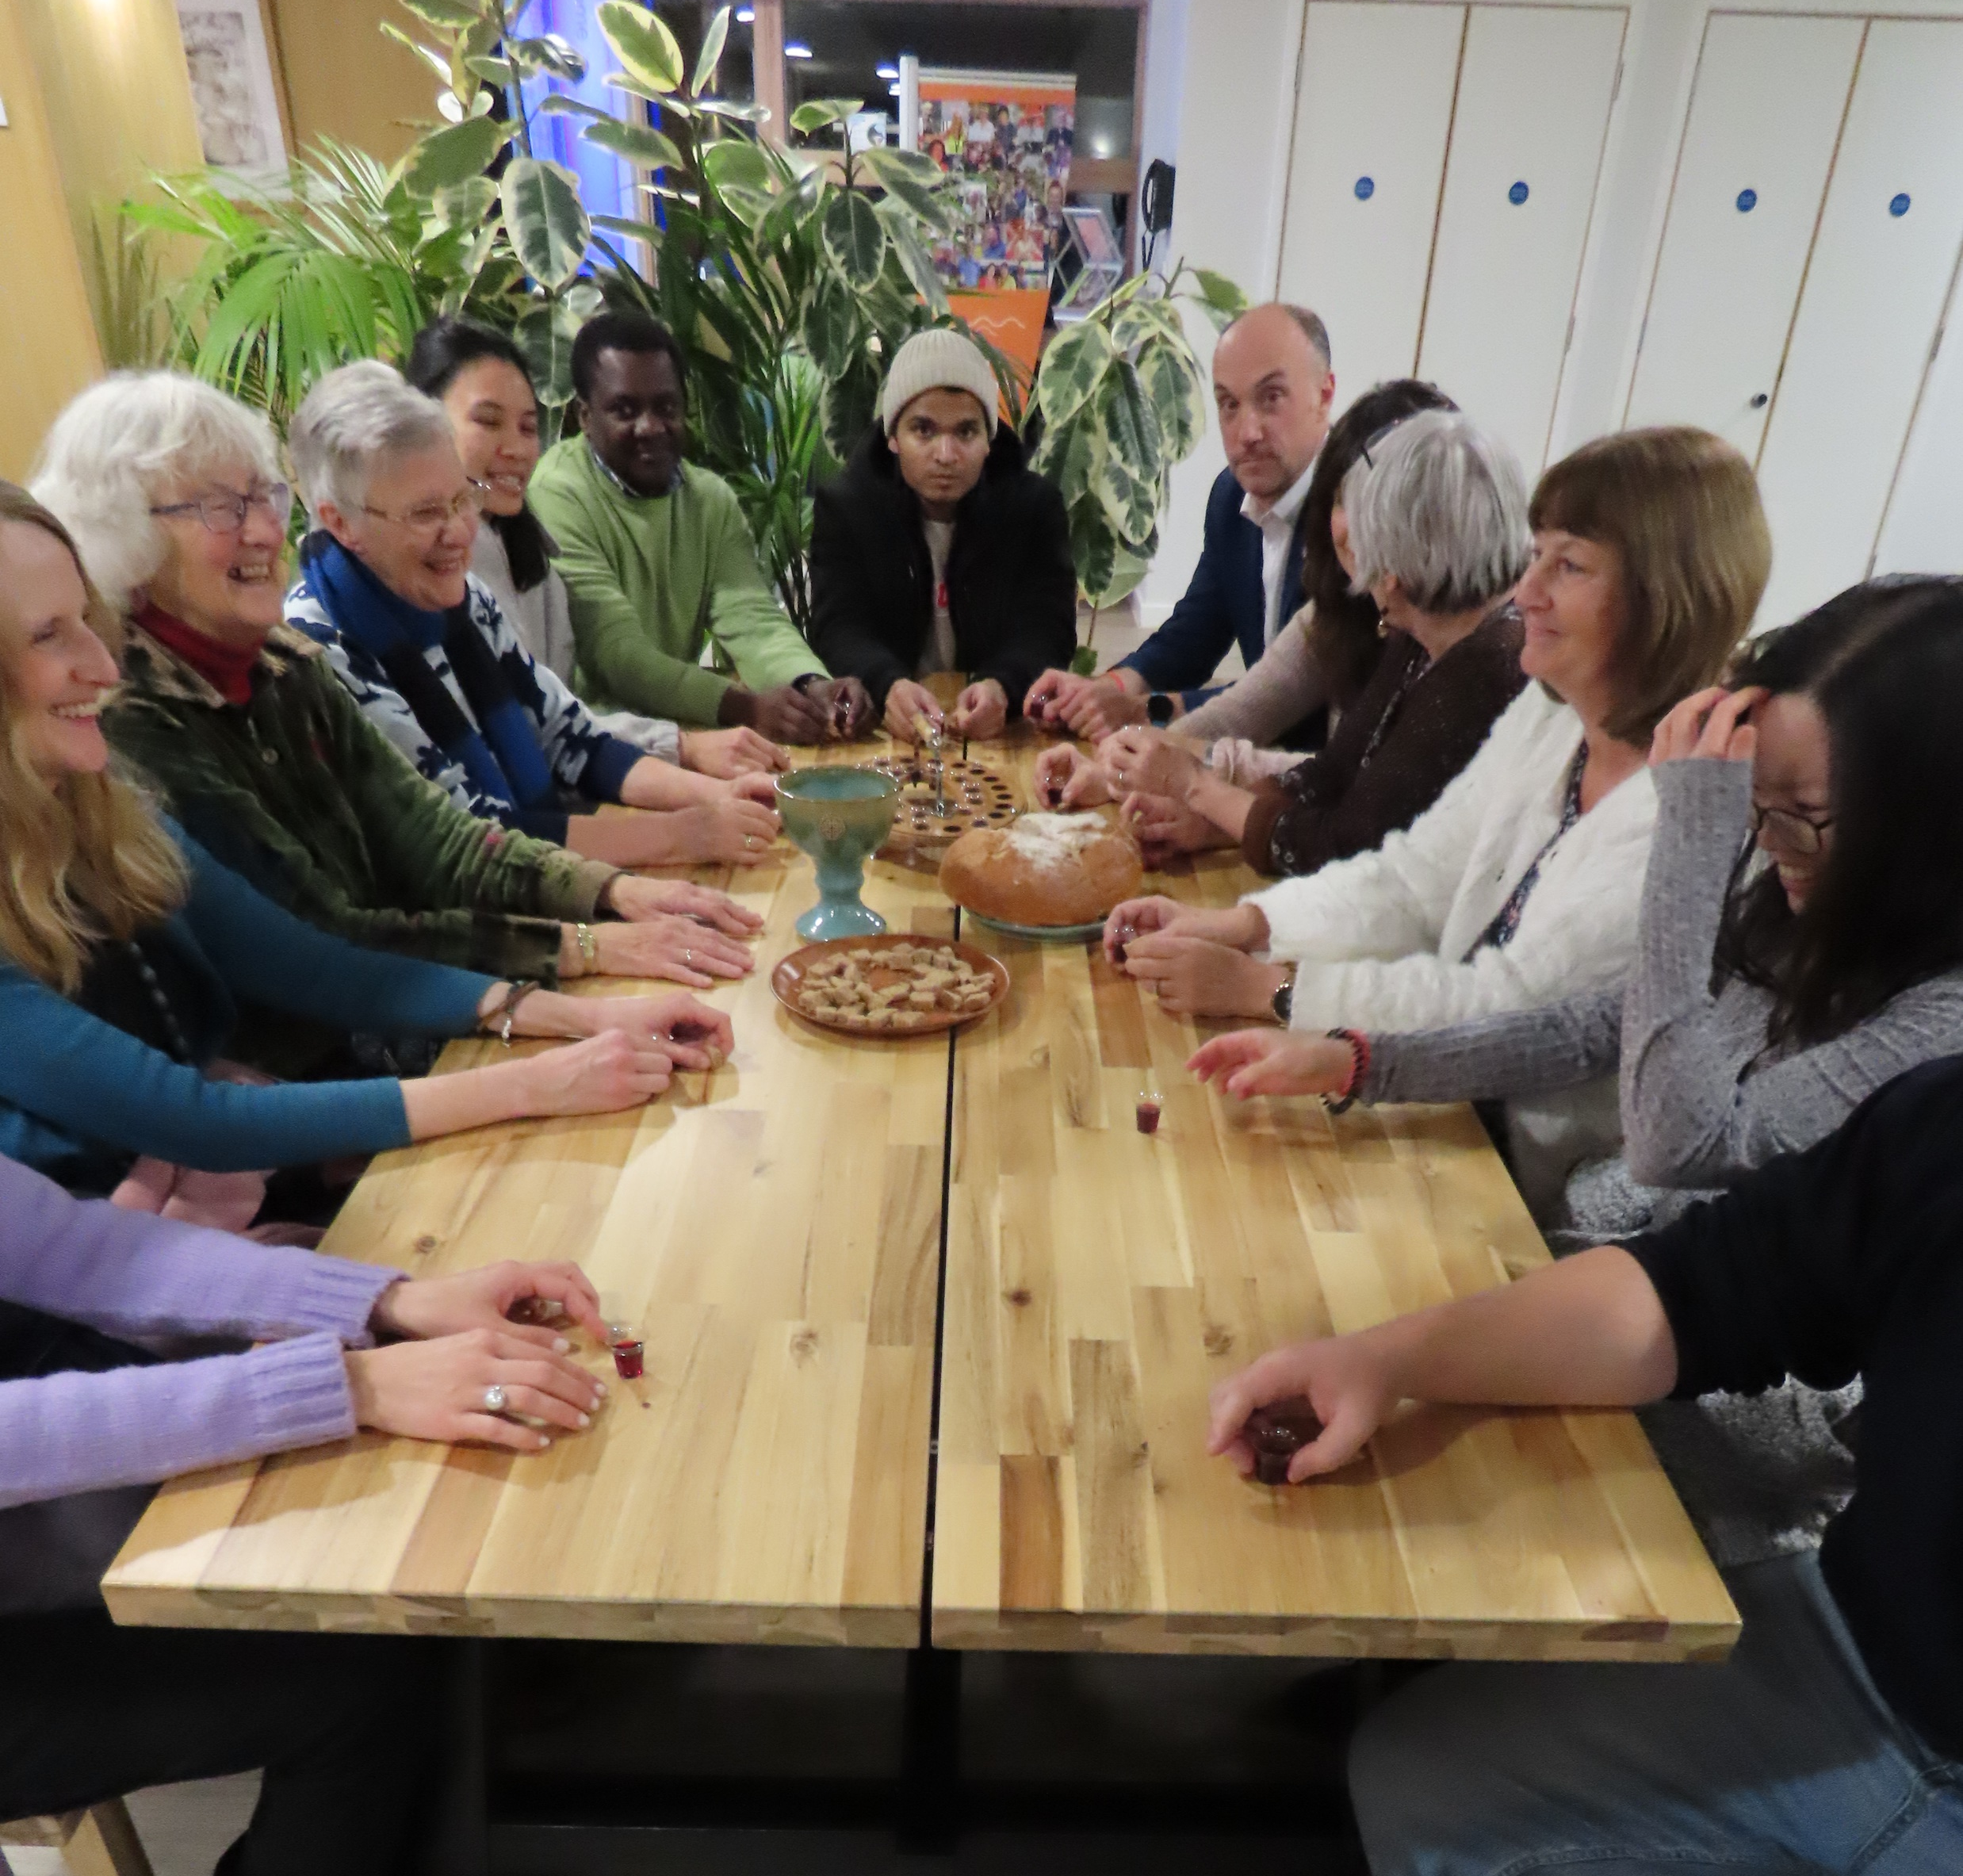
Do this to remember me
….I wonder why it’s so important to Christians that they do this?....
Notes:
Slide 6: Communion table
The important symbols that Jesus used, bread and wine, were to help people remember his death on the cross. For over 2000 years, Christians all over the world, many of them every week, have used bread and wine to remember this important event – and in obedience to Jesus’ words ‘Do this to remember me’.
….I wonder why it’s so important to Christians that they do this?.... [encourage pupils to share their thinking]
For most Christians, in all different types of churches across the world, Communion or the Eucharist or the Lord’s Supper (as it’s known), is one of the most important ways in which they remember the sacrifice that Jesus would make in giving up his life on the cross. We will be thinking some more about this next week, but for now, we are going to think some more about remembering.

Slide 7
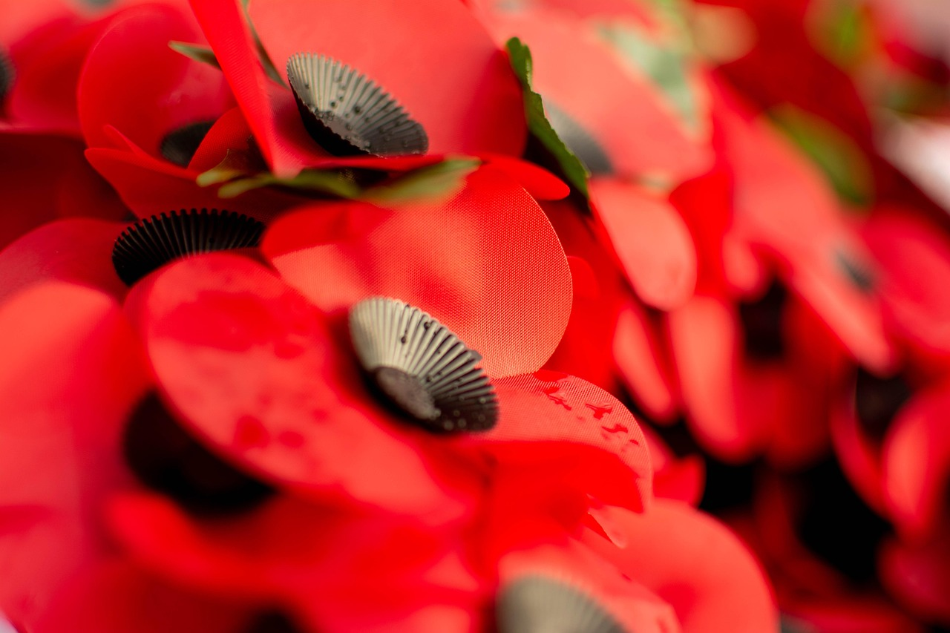
‘At the going down of the sun, and in the morning, we will remember them…’
‘We will remember them.’
Notes:
Slide 7: Remember…..
At this time of year, we often pause to remember, as a nation and across the world..
We remember the many acts of courage, selflessness and service of those who fought in past wars, and think about those who are still doing so. We remember by wearing a poppy which helps us to show that we are grateful. But it’s also a time when we remember that war brings great sadness, especially for those who have lost people or places that they love. In WWI and WWII, the peace that we enjoy in our country was won at a very great cost, but as some of you might know, there are other places around the world where they do not yet have peace. And so, we can also show we care by remembering these places this year. Each Remembrance Day we hear these words, originally from a poem called ‘For the Fallen’ (by Lawrence Binyon): ‘At the going down of the sun, and in the morning, we will remember them’, to which people respond with the words ‘We will remember them.’ These are very solemn (serious) words because they contain a promise to remember. But they also contain a challenge for each day: to show in our everyday actions that we are grateful, that we are not taking our lives for granted – and that we too want to make a difference in a world that still needs peace.

Slide 8
….I wonder what things you think it’s important that we remember?.....
….I wonder why it’s so important that we remember the sacrifice of others?....
....or how remembering helps us to be thankful?....
Notes:
Slide 8: Responding and words for worship
We’ve been thinking today about remembering…… how Jesus spoke of his death and asked his followers to remember him in bread and in wine……and about how important it is that we remember the ways in which others have also given their lives for the peace that we still enjoy….
….I wonder what things you think it’s important that we remember?.....
….I wonder why it’s so important that we remember the sacrifice of others?....
....or how remembering helps us to be thankful?....
If you’re having a time of Remembrance, you might like to do this here: you could re-use the words from Lawrence Binyon’s poem used on the previous slide as a way of marking the end of your time.

Slide 9
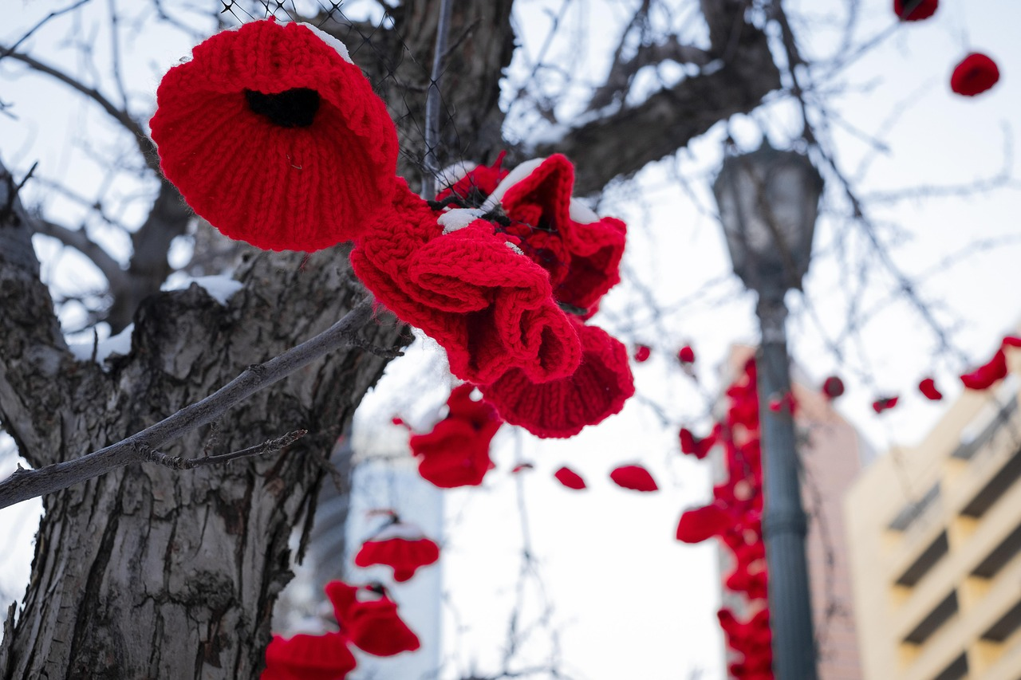
‘We will remember….’
Notes:
Slide 9: Opportunity for reflection / prayer
I’m going to pray now. If this is something that you feel comfortable doing, then there will be some words for us to share together. If you don’t want to pray, then use the quiet to be still with your own thoughts. We’re going to use some words that we often hear on Remembrance Day, ‘We will remember….’
Join in the words to make this prayer yours if you would like to….

Slide 10
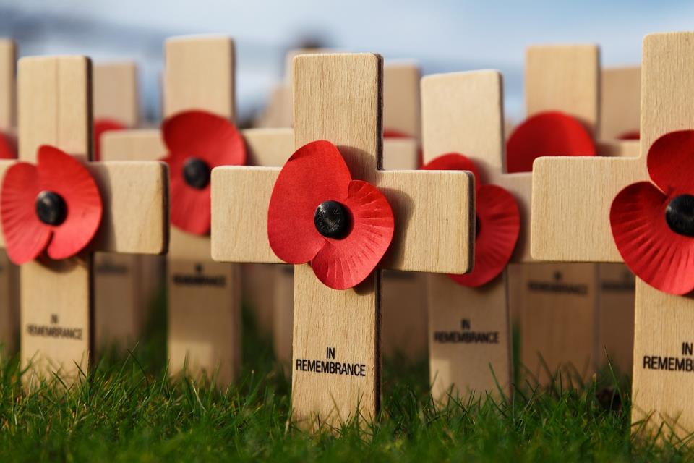
‘We will remember….’
Notes:
Slide 10: God of all comfort
Thank you for those who gave their lives for our freedom
‘We will remember….’

Slide 11
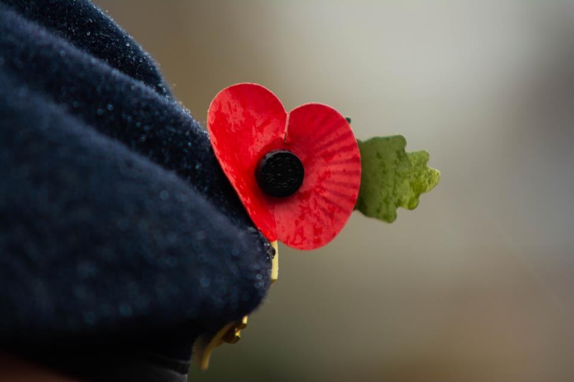
‘We will remember….’
Notes:
Slide 11: As we wear our poppies this year
‘We will remember….’

Slide 12
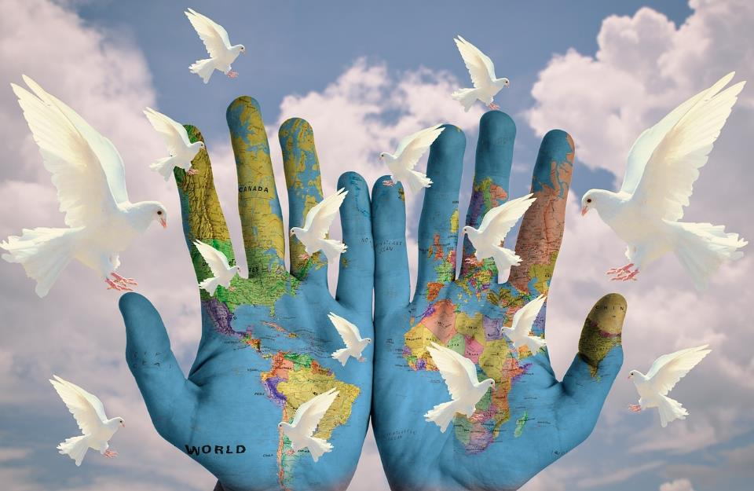
‘We will remember….’
Notes:
Slide 12: As we think of places where peace is hard to find
‘We will remember….’

Slide 13
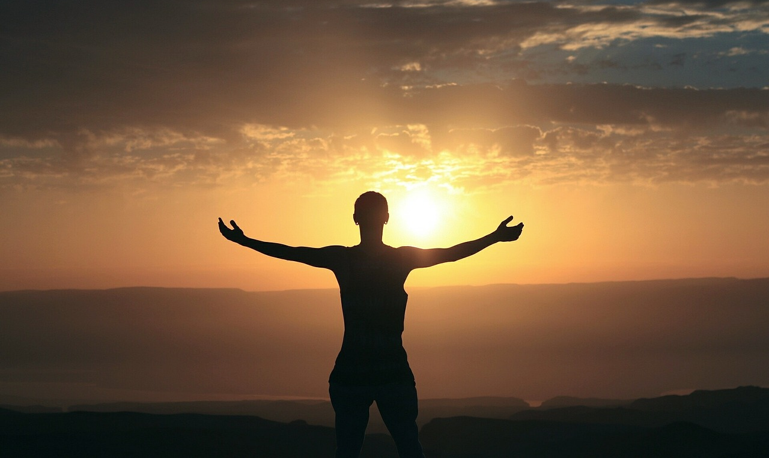
‘We will remember….’
Notes:
Slide 13: As we are thankful for the peace that we enjoy….
‘We will remember….

Slide 14
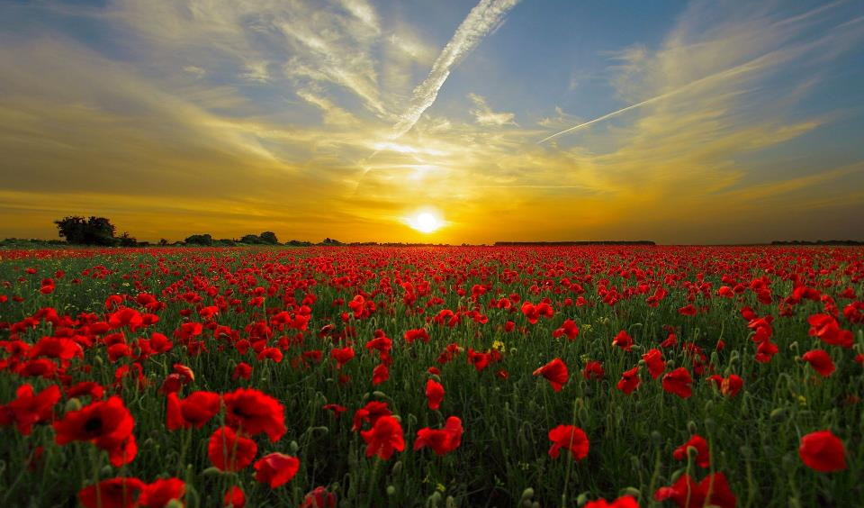
‘We will remember….’
Notes:
Slide 14: At the going down of the sun, and in the morning, we will remember them
‘We will remember….’

Slide 15
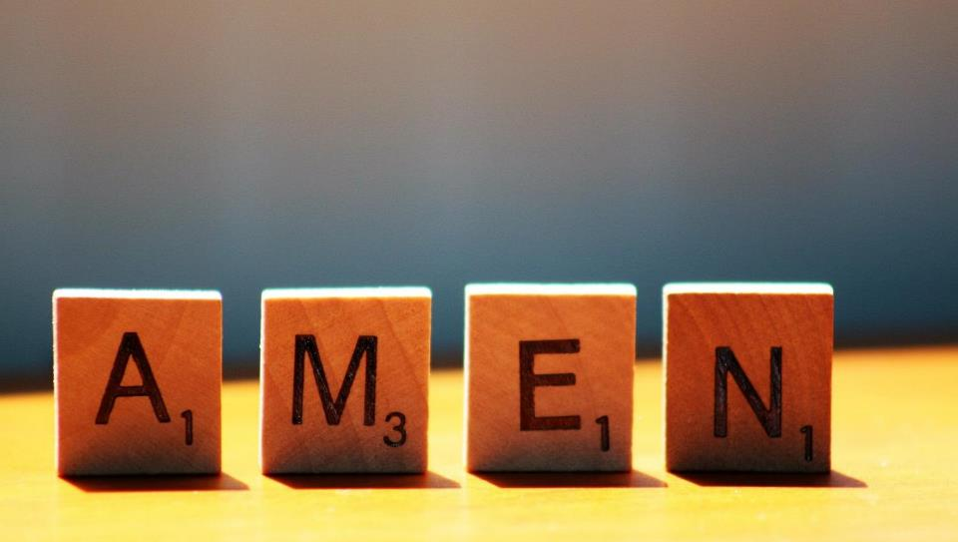

Slide 16
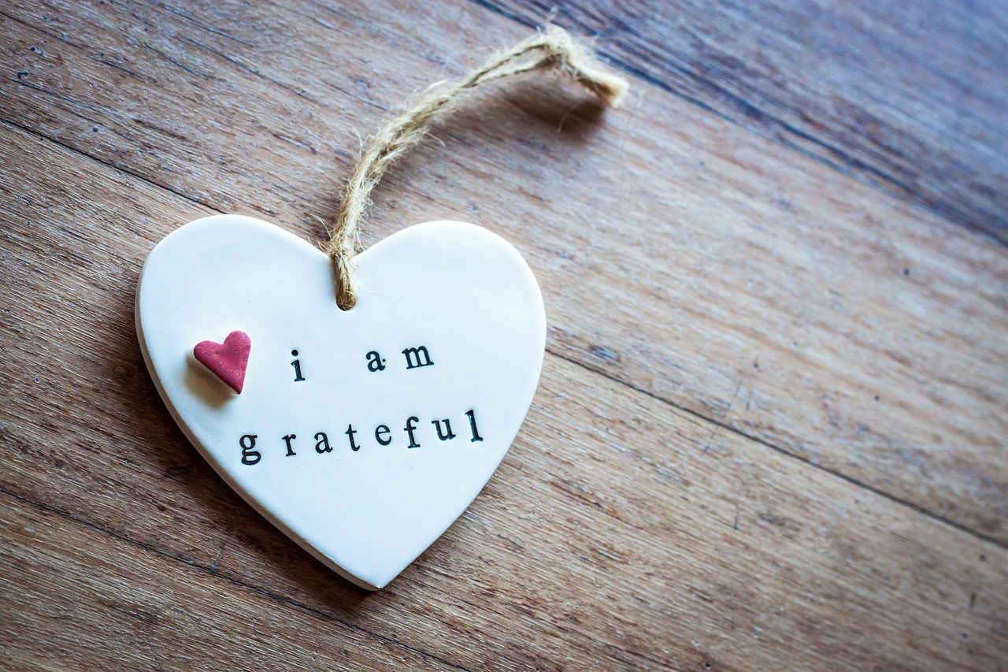


Leader: As we leave this place & time and go into the day ahead…
All: Together, we create a thankful community!
Notes:
Sending: Slide 16 (NB note different word from last week!)
Leader: As we leave this place & time and go into the day ahead…
All: Together, we create a thankful community!
BSL Together: https://www.signbsl.com/sign/together (1st video); Thankful: https://www.signbsl.com/sign/thanks
You already have signs for ‘community’

Slide 17

Notes:
Slide 16: Reflective areas
Do: Wear a poppy or hold one in your hand as you reflect.
Remember: What does the poppy mean for us as we remember?
Talk: How might we live more peacefully in our school community, as a way of remembering?

Slide 18
Notes:
Slide 18: Showing the Last Supper from different cultural perspectives
We have had to place the art on two different slides this week due to size differences.
Looking at these two creative interpretations of this part of the story may be something that links with your RE curriculum, reflecting the fact that Christianity is a global religion, encouraging pupils to appreciate the diversity that exists across cultures, traditions and geographical areas. It’s important for pupils’ wider understanding that they are given opportunities to think about how Christians show Jesus as being ‘like them’, and that this important story for Christians is imagined in different ways across the world. It also creates an inclusive classroom environment, giving all pupils opportunity to see themselves in the art that they view.
You may wish to consider these questions:
What is the same? What is different?
Which culture / tradition does the 2nd piece come from?
Why do we think this?
What questions might we want to / need to ask?

Slide 19
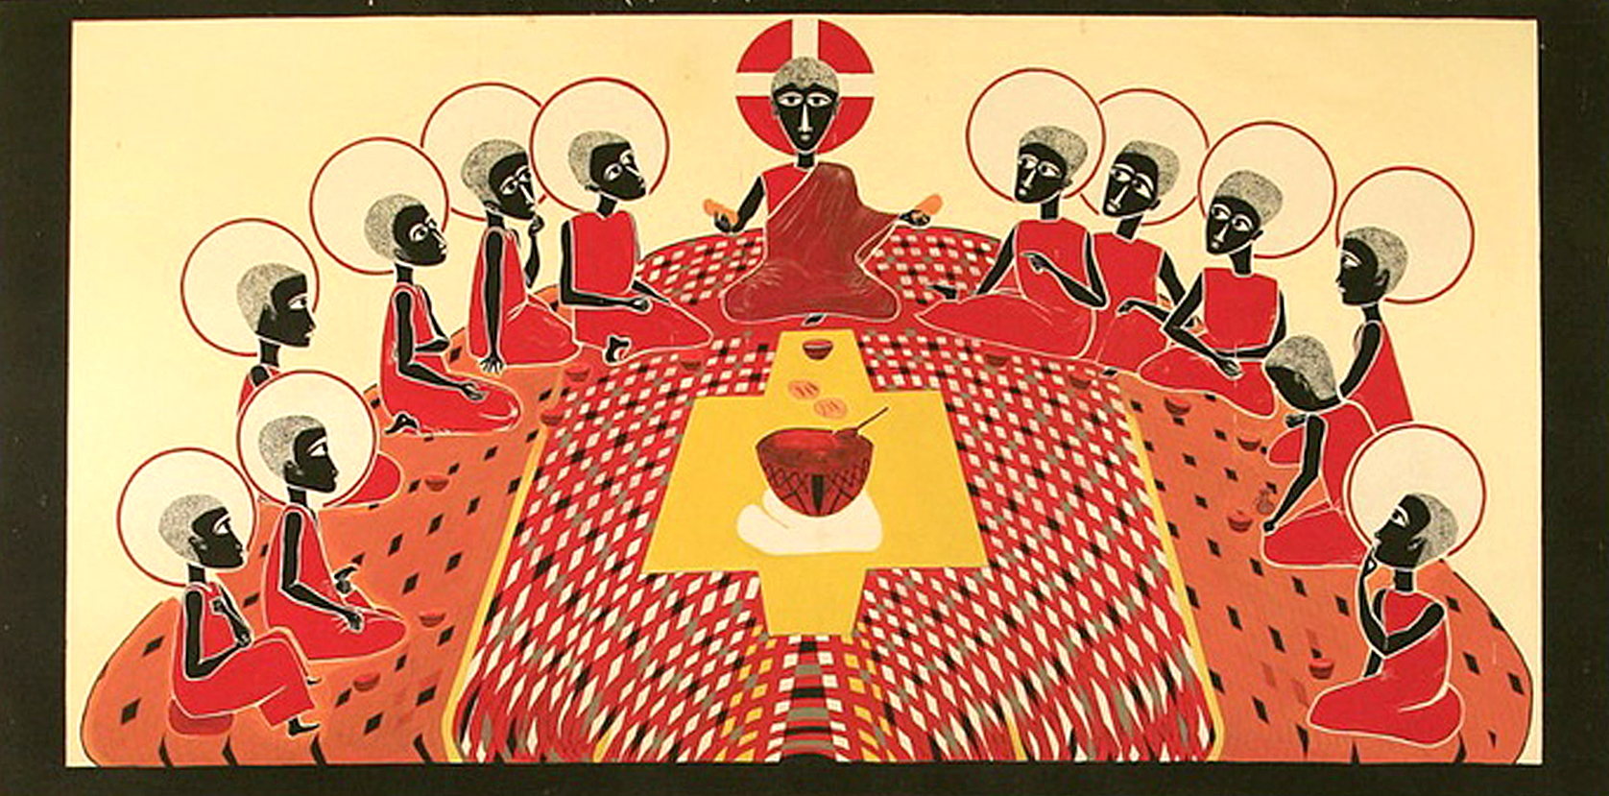
Last Supper by Father George Saget, Senegal (Africa) from Art in the Christian Tradition
Notes:
Slide 19: Showing the Last Supper from different cultural perspectives
We have had to place the art on two different slides this week due to size differences.
Link to original artwork: https://diglib.library.vanderbilt.edu/act-imagelink.pl?RC=58346, which includes some key information.
Looking at these two creative interpretations of this part of the story may be something that links with your RE curriculum, reflecting the fact that Christianity is a global religion, encouraging pupils to appreciate the diversity that exists across cultures, traditions and geographical areas. It’s important for pupils’ wider understanding that they are given opportunities to think about how Christians show Jesus as being ‘like them’, and that this important story for Christians is imagined in different ways across the world. It also creates an inclusive classroom environment, giving all pupils opportunity to see themselves in the art that they view.
You may wish to consider these questions:
What is the same? What is different?
Which culture / tradition does the 2nd piece come from?
Why do we think this?
What questions might we want to / need to ask?

