Slide 1
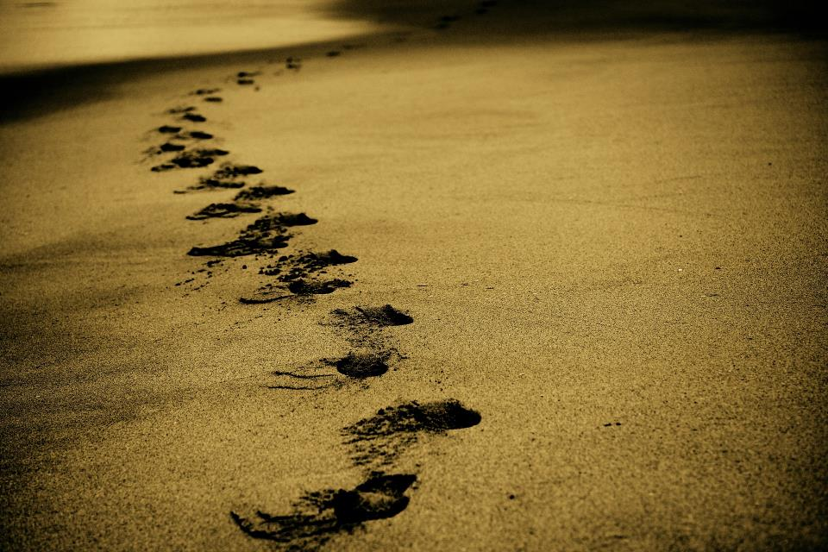
Picture copyright-free from pixabay
Leader: We are on this journey together…
Children: We are friends along the way…
ALL: May God go with us.
Notes:
Slide 1 or 2 [choose whichever image you prefer, or use them in rotation]:
Use the greeting for this term
Leader: We are on this journey together…
Children: We are friends along the way…
ALL: May God go with us.
BSL interpretation:
Sign for ‘way’ (nearest to the idea of ‘journey’): British Sign Language BSL Video Dictionary - way
Sign for ‘friends’: British Sign Language: friends
Sign for ‘God: British Sign Language BSL Video Dictionary - God
Sign for ‘go with us’ – we have invented this! After you’ve signed ‘God’, bring your finger down alongside your other finger and make them ‘journey together’ in front of you.
Engaging:
As we heard last week, in the final term of this school year, we are beginning a new theme:

Slide 2
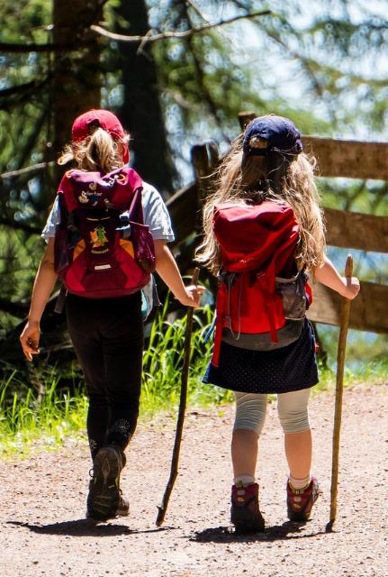
Picture copyright-free from pixabay
Leader: We are on this journey together…
Children: We are friends along the way…
ALL: May God go with us.
Notes:
Slide 1 or 2 [choose whichever image you prefer, or use them in rotation]:
Use the greeting for this term
Leader: We are on this journey together…
Children: We are friends along the way…
ALL: May God go with us.
BSL interpretation:
Sign for ‘way’ (nearest to the idea of ‘journey’): British Sign Language BSL Video Dictionary - way
Sign for ‘friends’: British Sign Language: friends
Sign for ‘God: British Sign Language BSL Video Dictionary - God
Sign for ‘go with us’ – we have invented this! After you’ve signed ‘God’, bring your finger down alongside your other finger and make them ‘journey together’ in front of you.
Engaging:
As we heard last week, in the final term of this school year, we are beginning a new theme:

Slide 3

Picture copyright-free from pixabay
What’s in the rucksack today?
Notes:
Slide 3: What’s in the rucksack today? Open your rucksack and get the purse with money out.

Slide 4
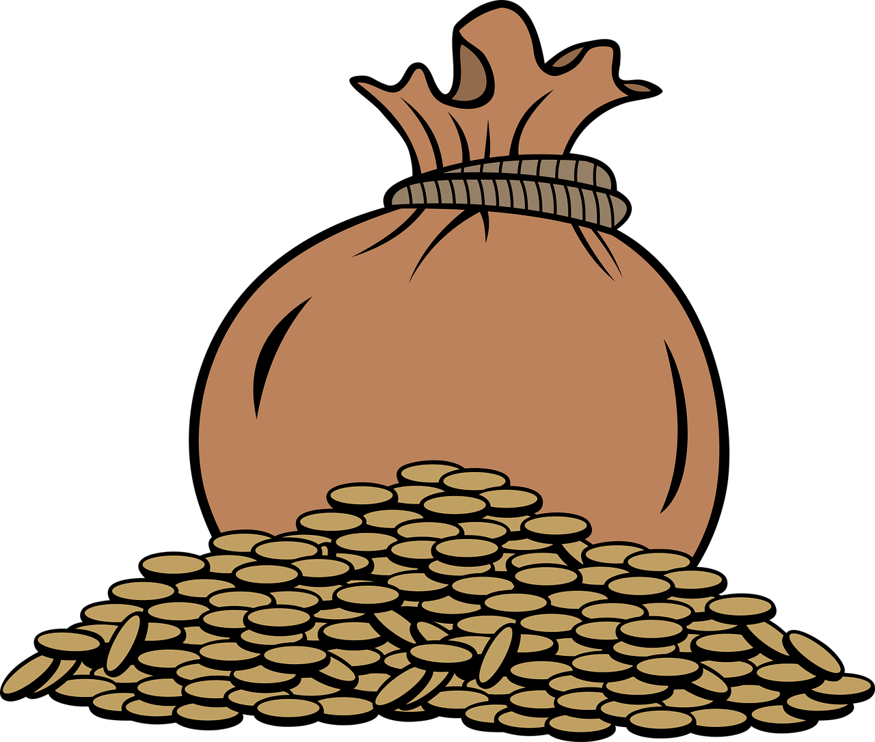
Money, money, money….
Notes:
Slide 4: Money, money, money…. Talk together – how might money be useful on a journey, or in life? [draw on travel experiences of children here, including any who have been abroad. At this stage, try to avoid any comment on ‘good’ uses of money – you will draw this out later.]

Slide 5
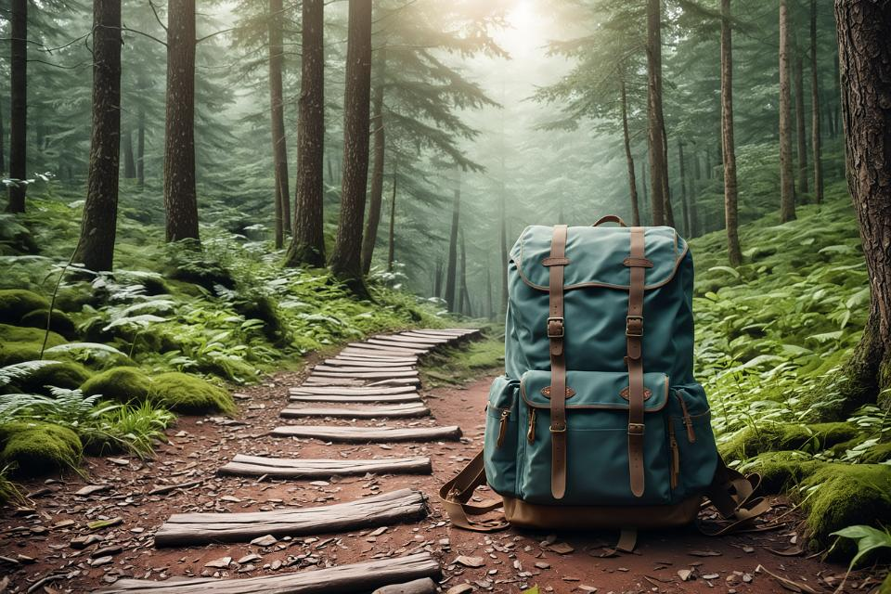
Picture copyright-free from pixabay
To boldly go….
Notes:
Slide 5: To boldly go….. We have travelled across the world with many different people throughout history this term so far, and today, we are going to share a story from Sikhism, (or more correctly, the Sikhi religion), about its founder, Guru Nanak Ji. The word ‘Ji’ is spoken after his name as a way of showing respect.

Slide 6
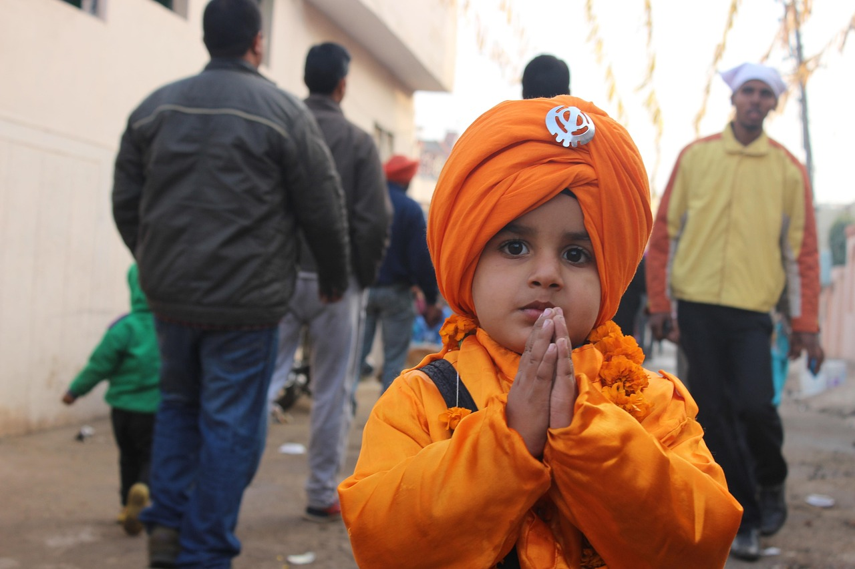
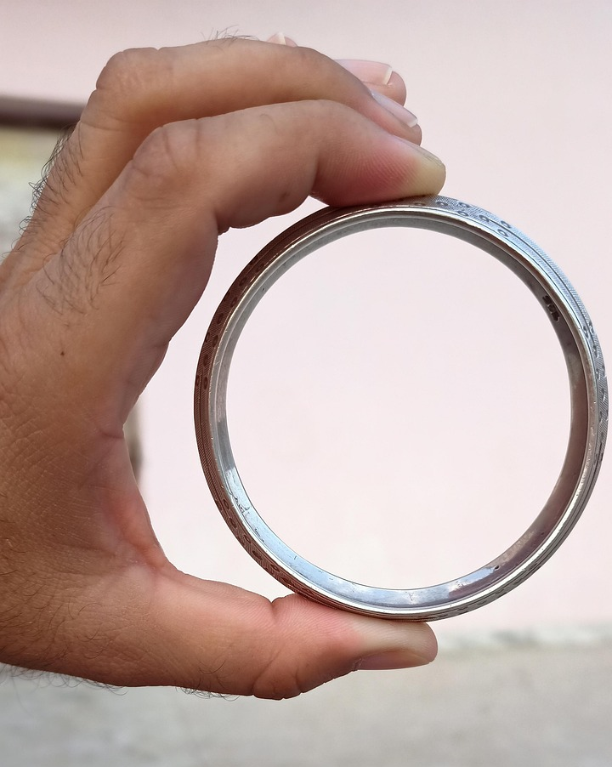
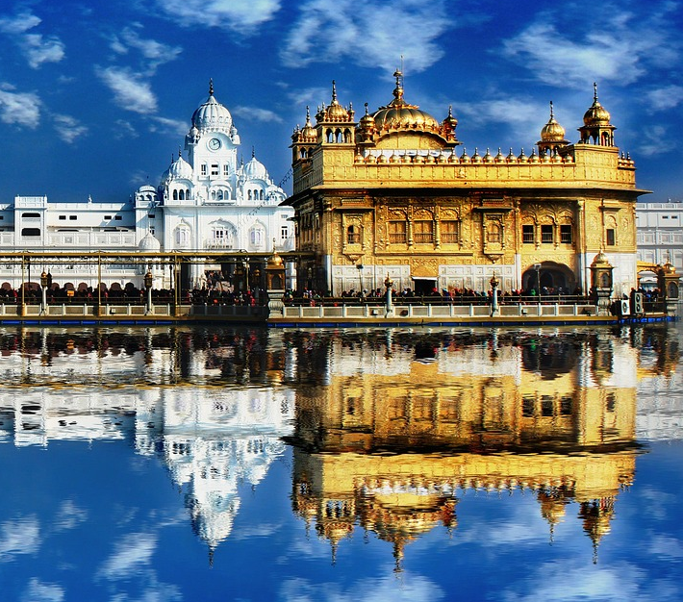
Notes:
Slide 6: Sikhi is a worldwide religion that has its roots in the Punjab region of India and Pakistan. People who are Sikhs follow the teachings of the ten gurus, which includes the final Eternal guru, Guru Granth Sahib Ji. The Tenth Guru is not a person, but the Sikhi holy book containing teachings of previous, human, Gurus. It is treated with the highest respect as it contains the words spoken by the Gurus.

Slide 7
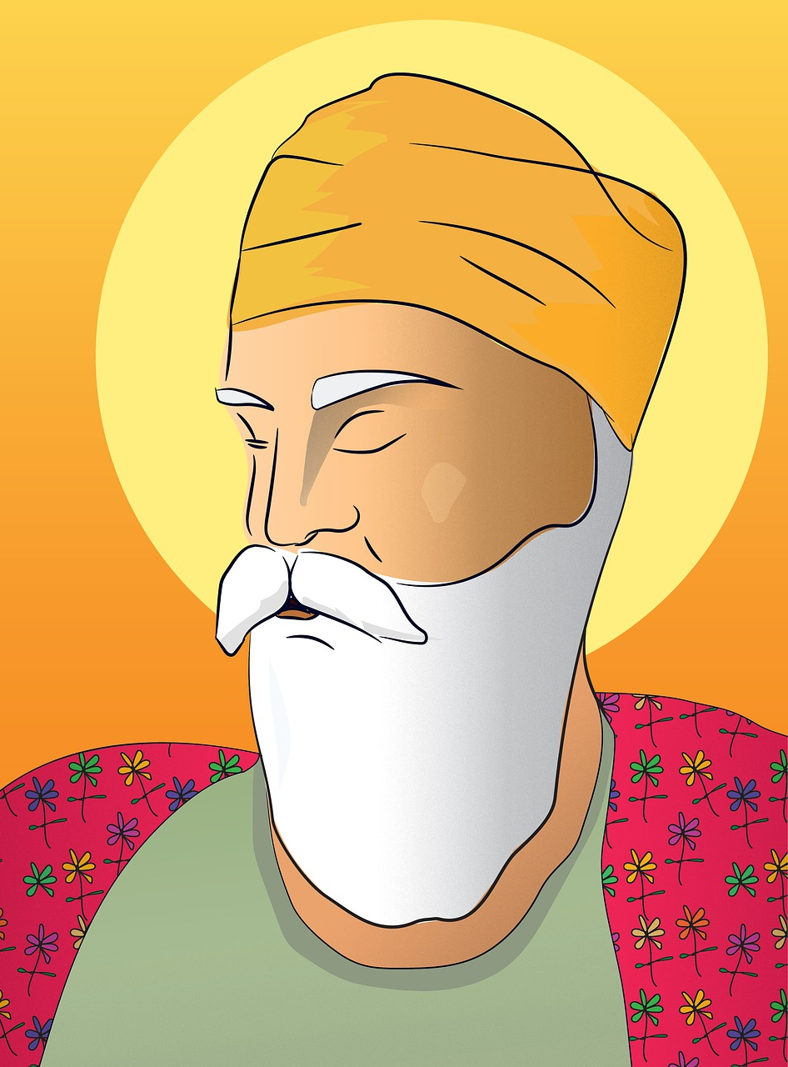
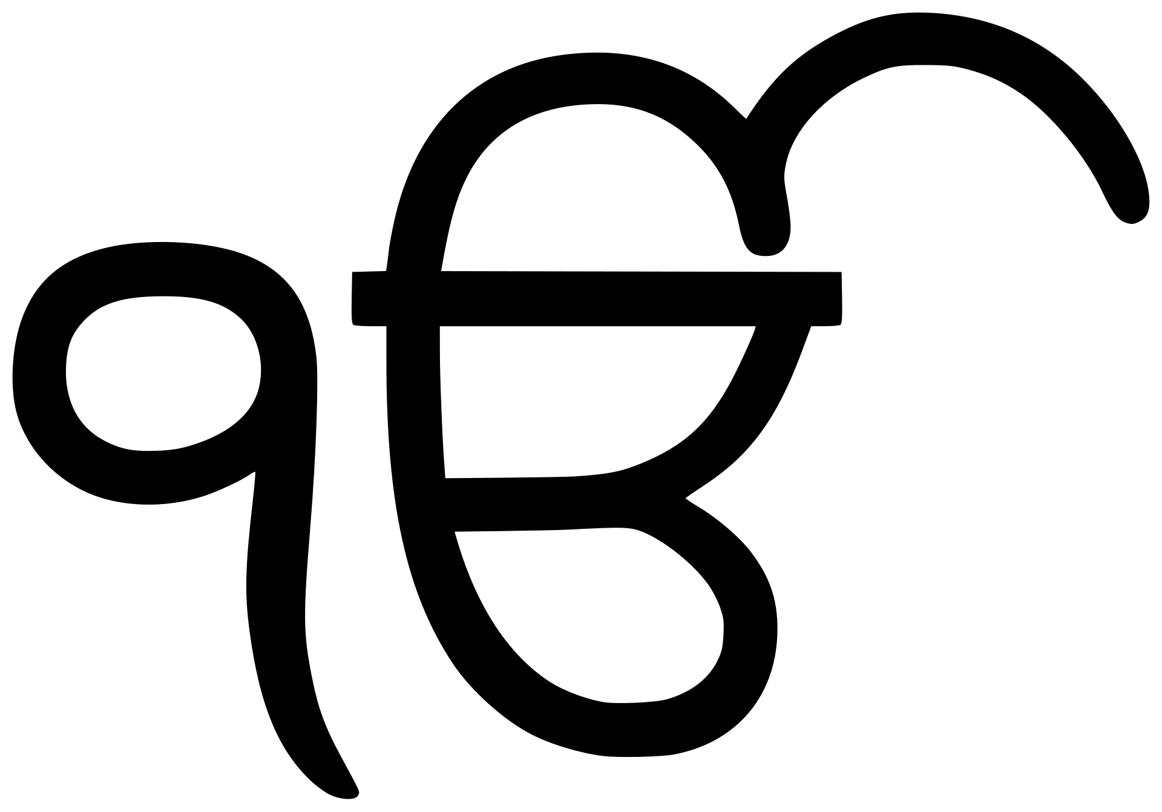
Picture copyright-free from pixabay
Guru Nanak Ji
(1469-1539CE)
Notes:
Slide 7: The word guru means ‘teacher’, and Guru Nanak Ji, the 1st Guru, is especially important because of the things he taught about Waheguru (Wondrous Teacher), the One God and how to serve others. He is believed to be one of the most well-travelled people in history, as he took the message of Ik Onkar across Asia, travelling around India, Pakistan, Nepal, Tibet and Arabia – more than 28000km!! The stories about his life and travels help Sikhs today know how to live well, so let’s hear one now! As you listen, be thinking about the important messages that this story might hold for Sikhi people – and maybe for us too!

Slide 8

Duni Chand and the Needle
Notes:
Slide 8: Our story is called Duni Chand and the Needle. [use script on p.4 – it’s not a long story! There are also some optional join-in actions.]

Slide 9
Duni Chand and the Needle
Notes:
Slide 9: So, what do we think the message of this story is? [allow children to share their ideas]

Slide 10
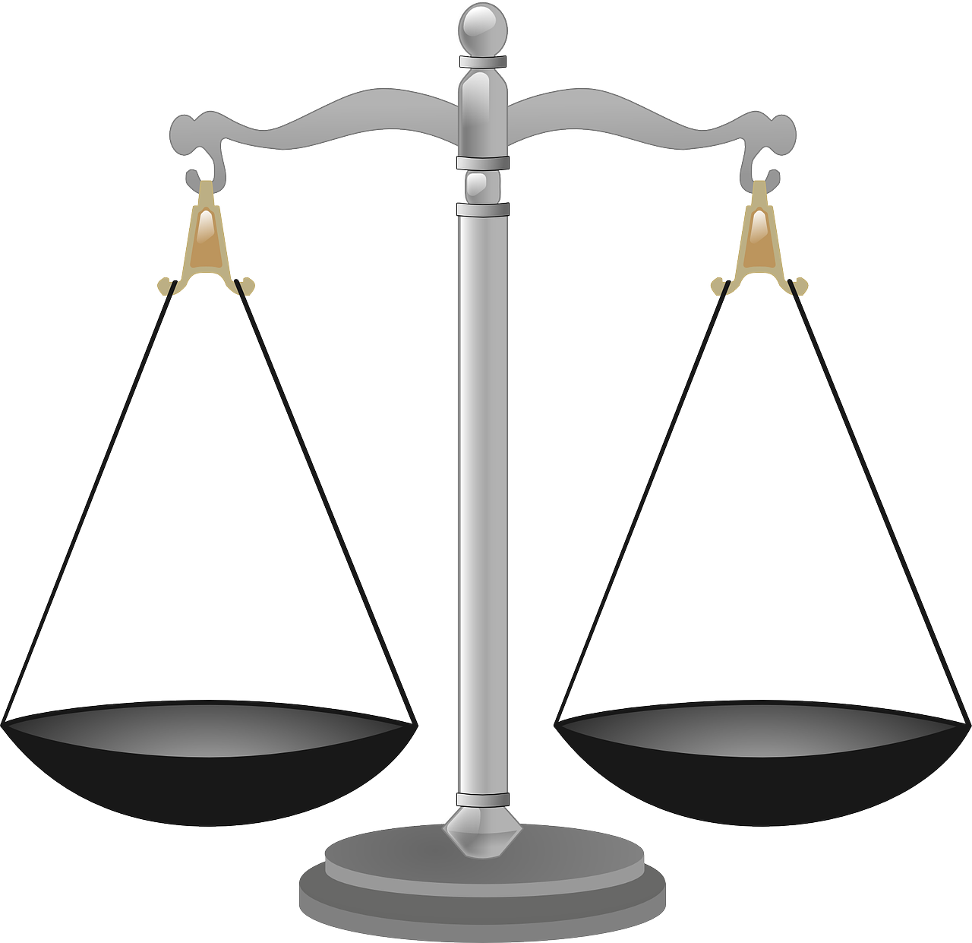


Notes:
Slide 10: The challenge that Duni Chand faced in his life is a question that people are still asking today!: which is more important? – wealth or good deeds? It sounds as if the answer is obvious, but as we saw in Duni Chand’s life, it’s maybe not as easy after all….. Guru Nanak Ji taught that wealth wasn’t in itself bad, but that it could not go with someone after they die. As Duni Chand found out, using his money to serve others in this life meant that his good deeds would seen by God and go with him into his next life. This important idea is treasured by Sikhi people across the world as they consider how to live a good life. Some of us will have our own ideas about this as well!! [you might want to talk together as a class during the rest of the week]

Slide 11
‘Store your treasure in heaven. The treasure in heaven cannot be destroyed…..or stolen. Your heart will be where your treasure is.’
I wonder what you treasure?
I wonder what ‘treasure in heaven’ might be?
…or what Jesus meant about someone’s heart being where their treasure is?
I wonder what connects this idea with our story?
Notes:
Slide 11: 1400 years before the birth of Guru Nanak Ji, another wise teacher (Jesus!) spoke these words: ‘Store your treasure in heaven. The treasure in heaven cannot be destroyed …..or stolen. Your heart will be where your treasure is.’
….I wonder what you treasure?...
…I wonder what ‘treasure in heaven’ might be?...
…or what Jesus meant about someone’s heart being where their treasure is?...
…I wonder what connects this idea with our story?...
[pause and think/talk about these ideas together]

Slide 12
Dear God
For all that we treasure, we give you thanks.
Help us to treasure the things that will truly last.
Notes:
Slide 12: Prayer
Dear God
For all that we treasure, we give you thanks.
Help us to treasure the things that will truly last.

Slide 13
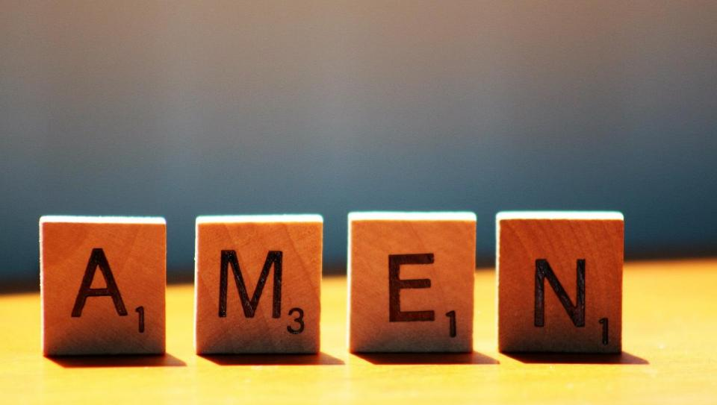

Slide 14
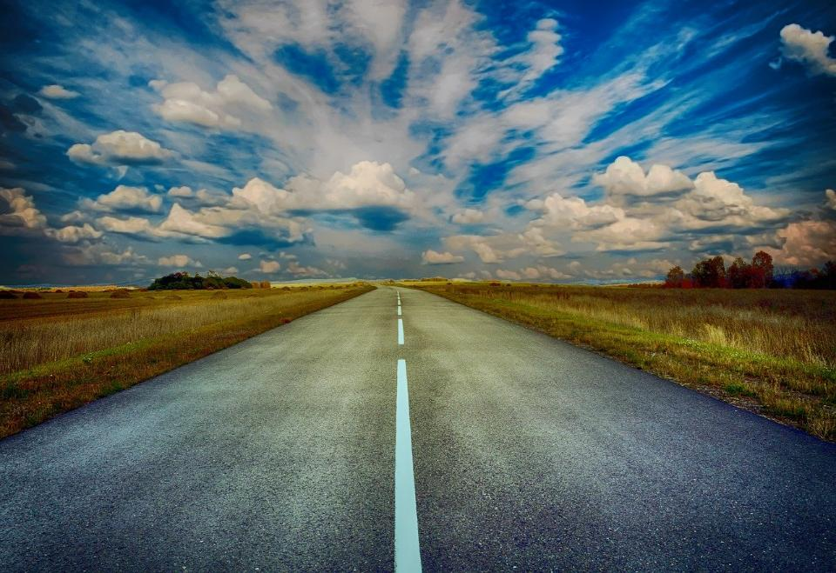
Picture copyright-free from pixabay
Leader: We have journeyed together today. As we leave this place and time and go into the day ahead…
ALL: …May God go with us.
Notes:
Slide 17: Use this term’s leaving words
Leader: We have journeyed together today. As we leave this place and time and go into the day ahead….
ALL: ….May God go with us.
Sign for ‘God: British Sign Language BSL Video Dictionary - God
Sign for ‘go with us’ – we have invented this! After you’ve signed ‘God’, bring your finger down alongside your other finger and make them ‘journey together’ in front of you.

Slide 15
Notes:
Ideas for classroom reflection: treasure!
Pick up some ‘treasure’ and hold it in your hand while you think.
What do you truly treasure?
Think about the message in the story or the words of Jesus.
Put your treasure back in the bag when you have finished thinking.
Talk about your ideas with others in your class: do you agree that some treasure will last longer?

