Slide 1
Leader: We are here together
Children: With ears ready to hear and hands ready to serve.
ALL: May we be wise in all our actions today.
Notes:
Slide 1: Use our new gathering words. Why not invent your own actions to accompany them?
Leader: We are here together
Children: With ears ready to hear and hands ready to serve.
All: May we be wise in all our actions today.

Slide 2
Notes:
Slide 2: Let’s start today by reminding each other of this week’s Wise Words from King Solomon’s book of Proverbs, in the Bible:

Slide 3
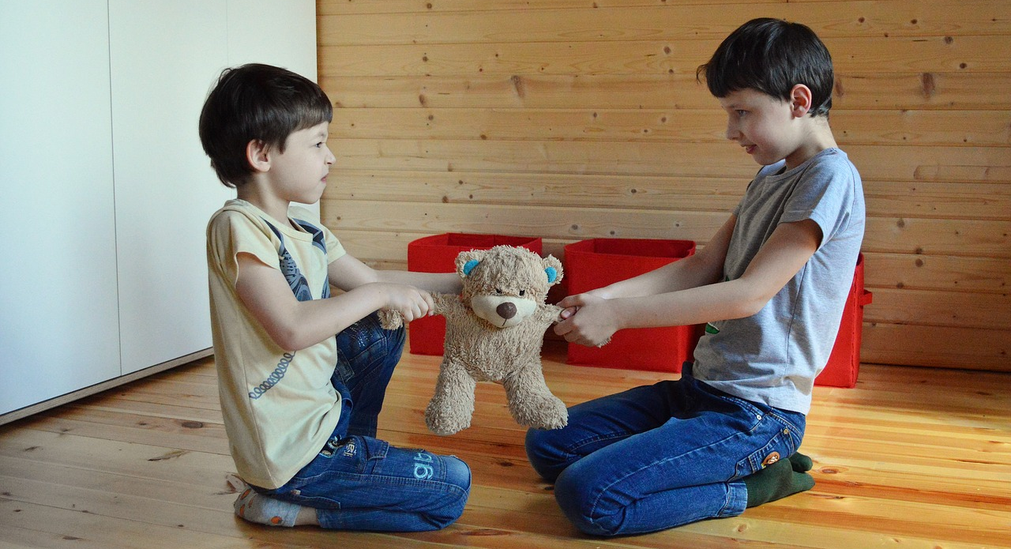
‘The start of an argument is like a leak in a dam – so stop it before it bursts!.’ (Proverbs 17:14)
Notes:
Slide 3: ‘The start of an argument is like a leak in a dam – so stop it before it bursts!’

Slide 4
argument
Notes:
Slide 4: Earlier this week, we looked at the word ‘argument’ and noticed the tiny word ‘ME’ in the middle....
Arguments often happen because WE want something OUR way. We also heard the advice that Jesus gave to his friends about being peacemakers. We shared stories from the classroom of ways to try to stop arguments from getting out of control and we’re going to share another story together now to help us to think some more. It’s a story by our favourite Greek author….

Slide 5
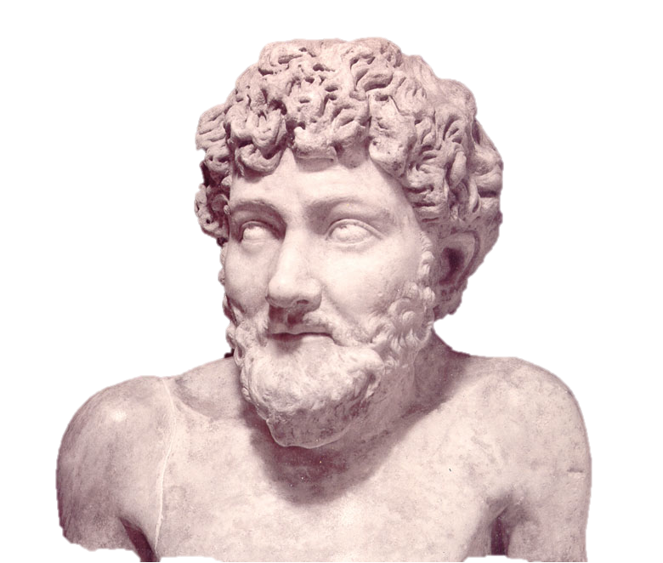
Aesop 620-560 BC
Notes:
Slide 5: ….Aesop…. about Four Oxen (which are large animals with horns, a bit like cows).

Slide 6
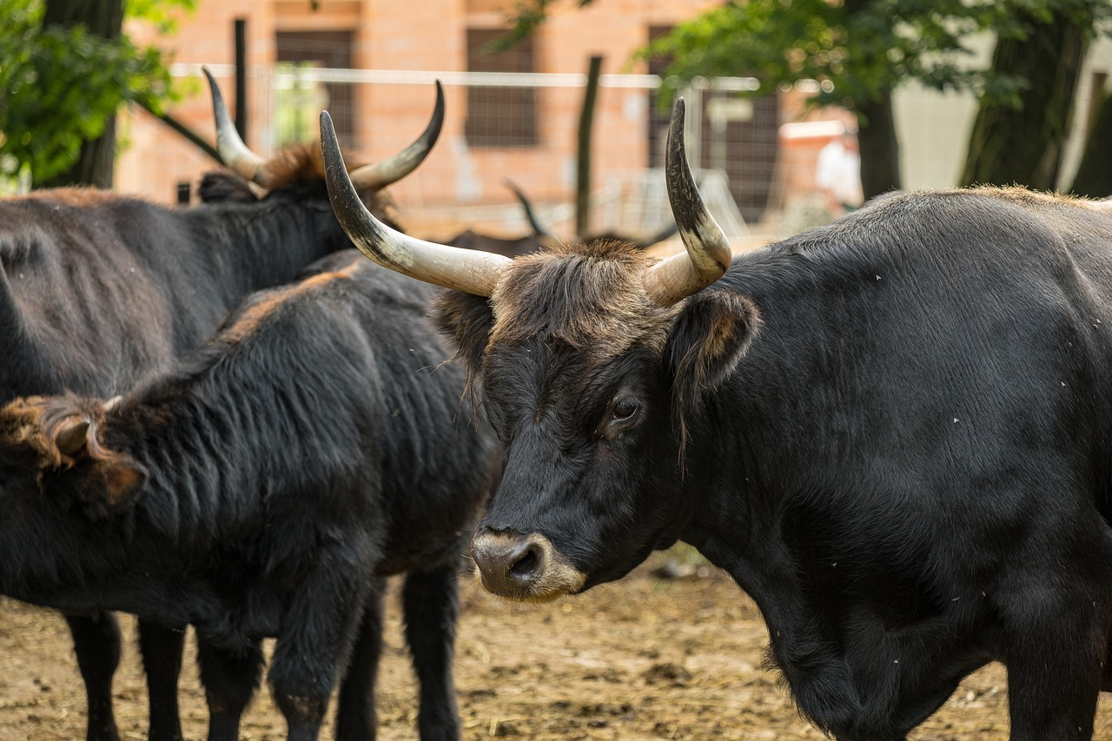
Notes:
Slide 6: In a dusty field lived four oxen – Daisy, Donald, Dennis and Doris. They were all firm friends. They didn’t lead very exciting lives and spent most of their days chewing under the shade of the large olive tree that grew at one end of the field.
The only time they moved apart from each other was early in the morning, before the sun got too hot, and then, they would find their favourite part of the field. As the day got hotter and hotter, they would keep each other company under the shade of the big olive tree, dozing, or chewing or just idly chatting. And that was how they lived out their days, until the day of the argument that nearly ended their friendship….
Early one morning, as the four oxen were going about their business in their favourite parts of the field, Doris suddenly pricked up her ears and raised her head as she heard a sound, one that she couldn’t recall having heard before. It was the sound of soft feet, padding her way….then…. …a rustling sound in the bushes beside the field. Doris instinctively knew that something was not right and, nostrils flaring, she called to her friends….. and from the other three corners of the field, Daisy, Dennis and Donald all rushed towards Doris, who was running away from the strange sound that she had heard.

Slide 7
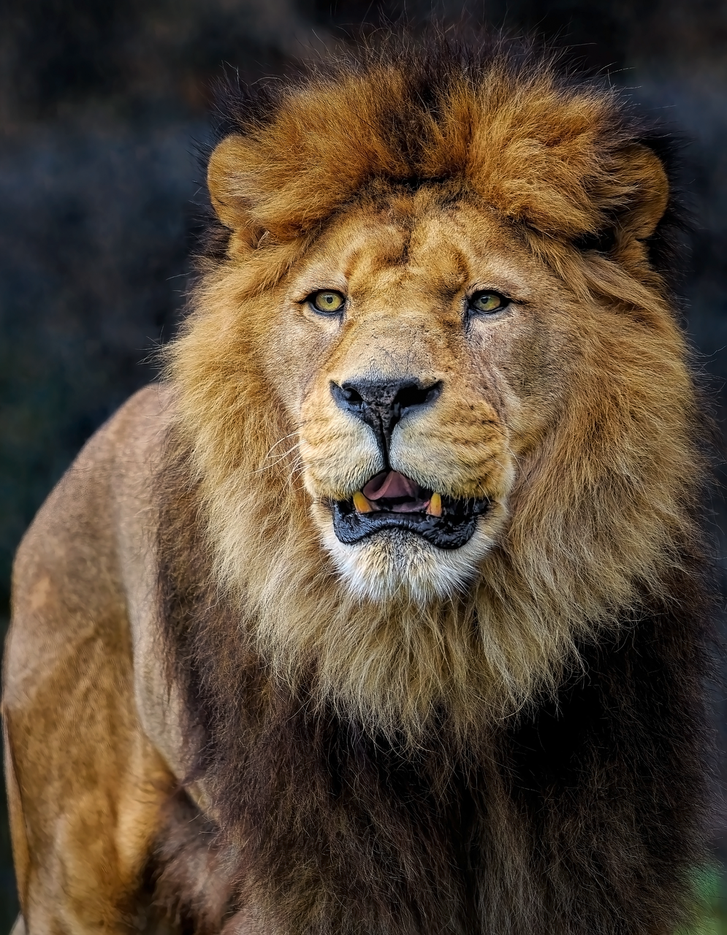
Notes:
Slide 7: It was a lion!
He had spotted Doris chewing peacefully in her corner and had thought she would make a delicious breakfast. But the lion had not been quite fast enough. The four oxen had turned their tails towards each other with their horns facing outwards, so that every place that the lion tried to attack them, he was met with their sharp, pointed horns. Eventually the lion realised he wasn’t going to get a meal this way, gave up and padded away, leaving the four oxen panting and exhausted.
Day after day, the same thing happened. As each of the four oxen were going about their early morning activities, one of them would hear the soft, padding footsteps of the lion approaching. But each day, the lion was met by oxen horns whichever way he aimed his attack. Until about a week later, that is, when the oxen were exhausted and thoroughly fed up with this new daily routine….

Slide 8
Notes:
Slide 8: Standing tail to tail, tired and irritable, they began to argue with each other….. “Your tail’s tickling me!” complained Doris.
“And you keep bumping into me!” moaned Dennis.
“Stand still, Dennis!” insisted Daisy.
“Leave him alone!” exclaimed Donald “He’s not doing anything wrong..”
Before long, a full-scale argument was taking place….with the oxen all complaining at each other and exclaiming that they were right and the others were wrong. Soon after that, they each sulked off in a huff to their own little corner of the field, completely forgetting why they had been huddled together in the first place. Instead of protecting each other from the hungry lion, they now glared at each other angrily from their own part of the field. They had never experienced this before – and so they had NO IDEA how to put things right between them.

Slide 9
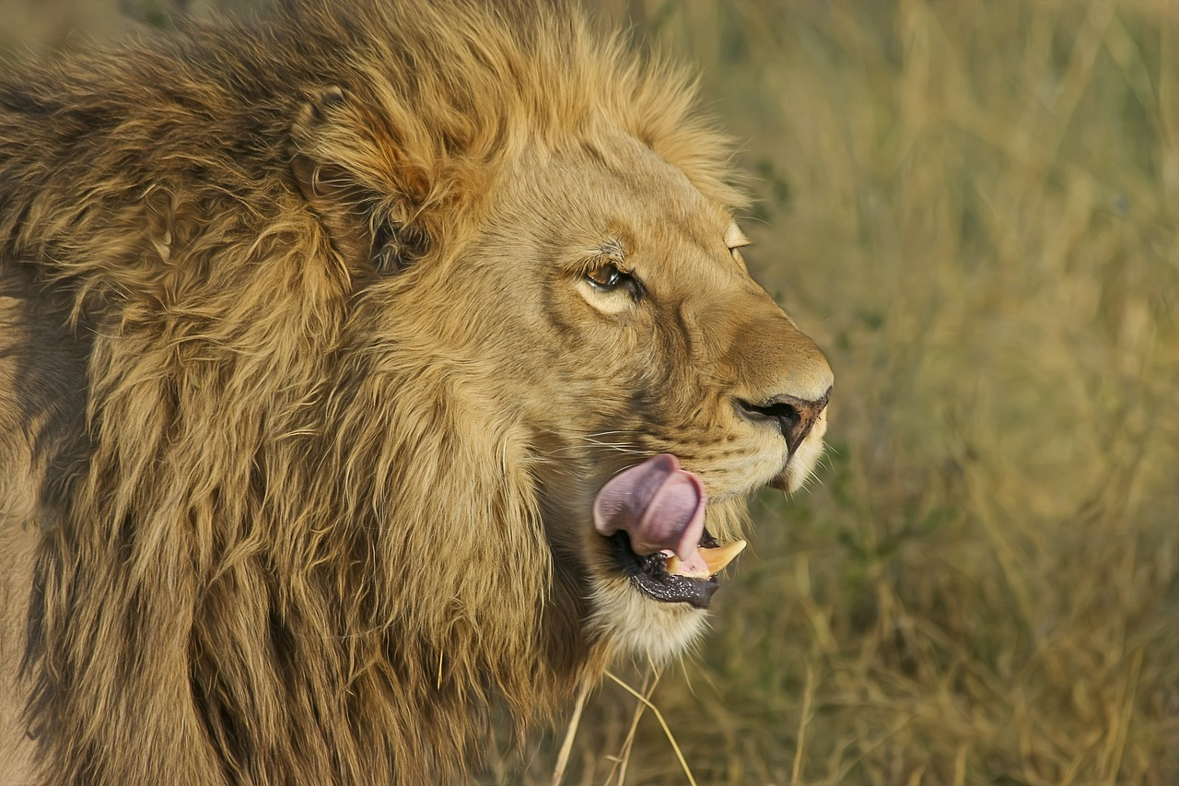
Notes:
Slide 9: And that was just what the lion was waiting for…. the argument had driven the oxen apart – and kept them in their own little corners. Now the lion could easily target a single oxen, where he hadn’t been able to get near them when they were all standing together.

Slide 10
‘The start of an argument is like a leak in a dam – so stop it before it bursts!.’ (Proverbs 17:14)
Notes:
Slide 10: The argument divided the happy little community that the oxen had made together under the trees – with disastrous consequences. The same is true for us…..arguments can leave people feeling isolated and alone, just like Daisy, Donald, Dennis and Doris. We all know how it feels when people aren’t getting along together – and so Wise King Solomon’s words seem to be such good advice to us as a school community: ‘The start of an argument is like a leak in a dam – so stop it before it bursts!’
Our wise words today remind us to try to stop arguments before they get out of control.
Arguments divide communities and stop people from getting along. That doesn’t mean we can’t disagree with each other, because that would be totally unrealistic – of course arguments will happen from time to time. But we also need to help each other to put things right when they do go wrong. As we come towards the end of our time today, I wonder what advice you might have given Daisy, Donald, Dennis and Doris, to help them to do this: to sort out their differences before the lion got the better of them? [ask pupils to share]

Slide 11
forgiveness
Notes:
Slide 11: Responding and words for worship
So let’s look at another word hidden in another word! ‘ForGIVEness’.
This important word ‘forgiveness’ is the key to helping us to stop arguments – and we hope is at the heart of our school community, helping us to put things right when they go wrong. [children may have used this word already in their advice to the Four Oxen – or at least conveyed the importance of saying ‘sorry’]
When we forgive each other, we GIVE each other the chance to start again, to rebuild what might have been broken by the argument, to bring peace.
[NB If you’ve been using the zips in your reflective areas, it might help to visualise this concept using the zip]

Slide 12
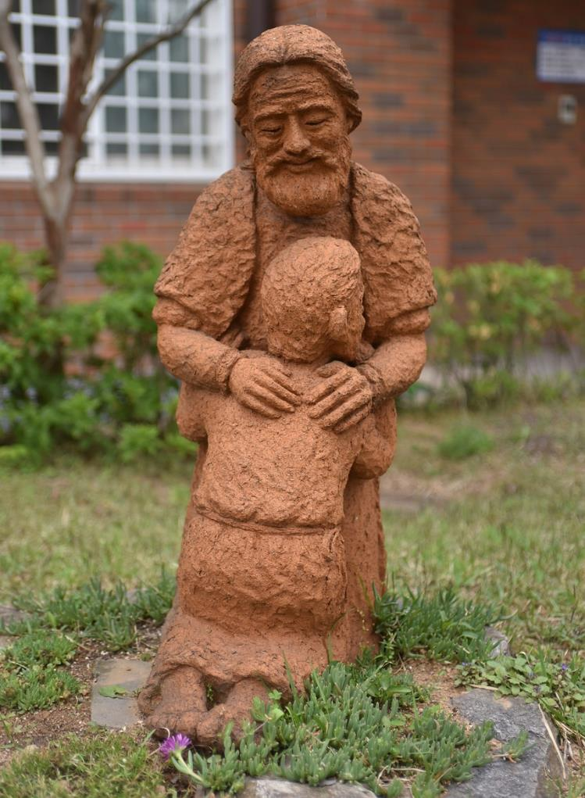
….I wonder how forgiveness might help to stop arguments from getting out of control?....
….I wonder what forgiveness looks like in our school community?....
Notes:
Slide 12: In the quietness of your own heart now, think about a time when you needed – or gave – forgiveness. Think about how it felt before….and after the forgiveness happened…..[leave a good pause here for reflection]
….I wonder how forgiveness might help to stop arguments from getting out of control?....
….I wonder what forgiveness looks like in our school community?....
The Bible tells people who are Christians that forgiveness is God’s idea – that they can forgive because he is forgiving. So what better way to end our time together today than to pray and ask for God’s help? If you want to do this – to pray – then find a way to make the prayer your own and if you’d like to, to join in the Amen at the end.

Slide 13
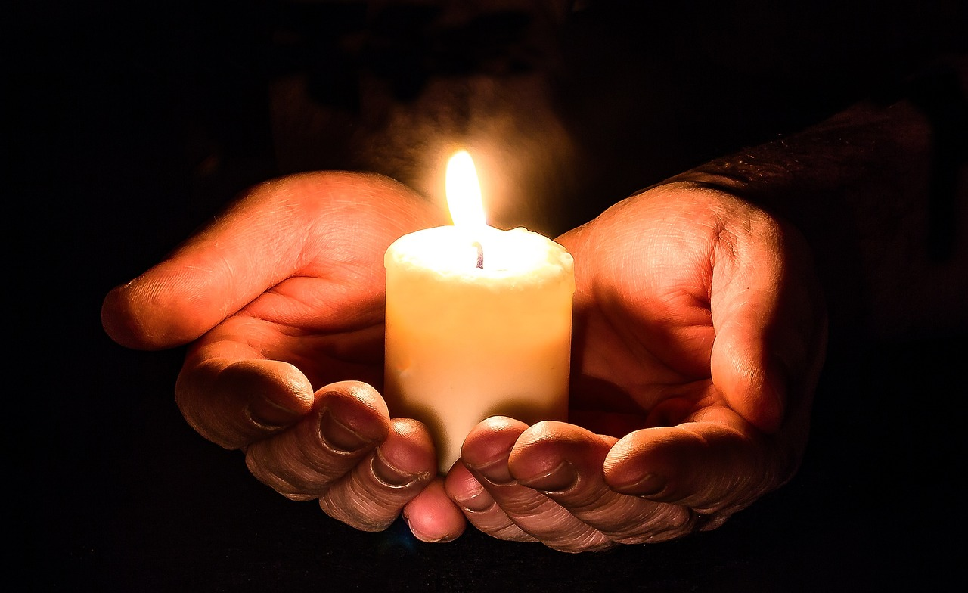
God who is forgiving, we come to you today knowing that we often find this hard. In our school community and in our families, we want to give each other the chance to start again when things have gone wrong.
Please help us, we pray.
Notes:
Slide 13: Prayer
God who is forgiving, we come to you today knowing that we often find this hard. In our school community and in our families, we want to give each other the chance to start again when things have gone wrong. Please help us, we pray.

Slide 15
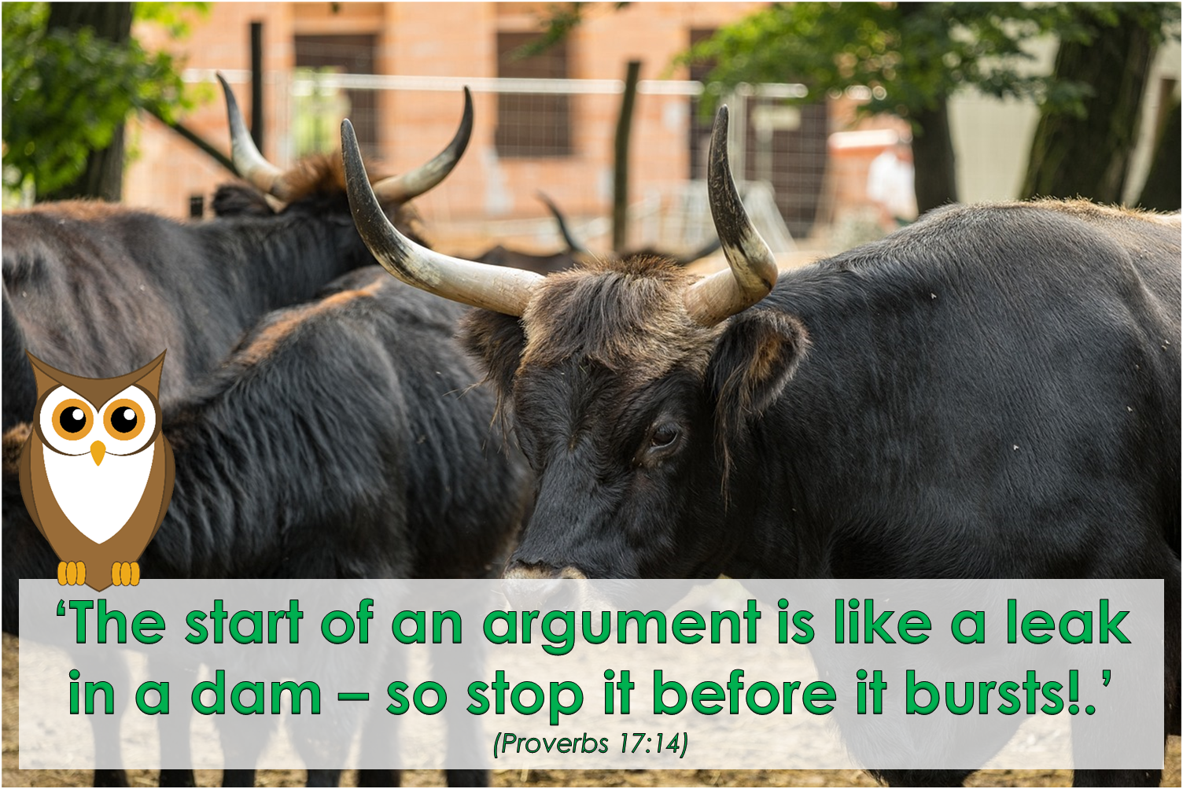
Leader: As we leave this place & time and go into the day ahead…
All: May today’s words help us to make wise choices.

Slide 16
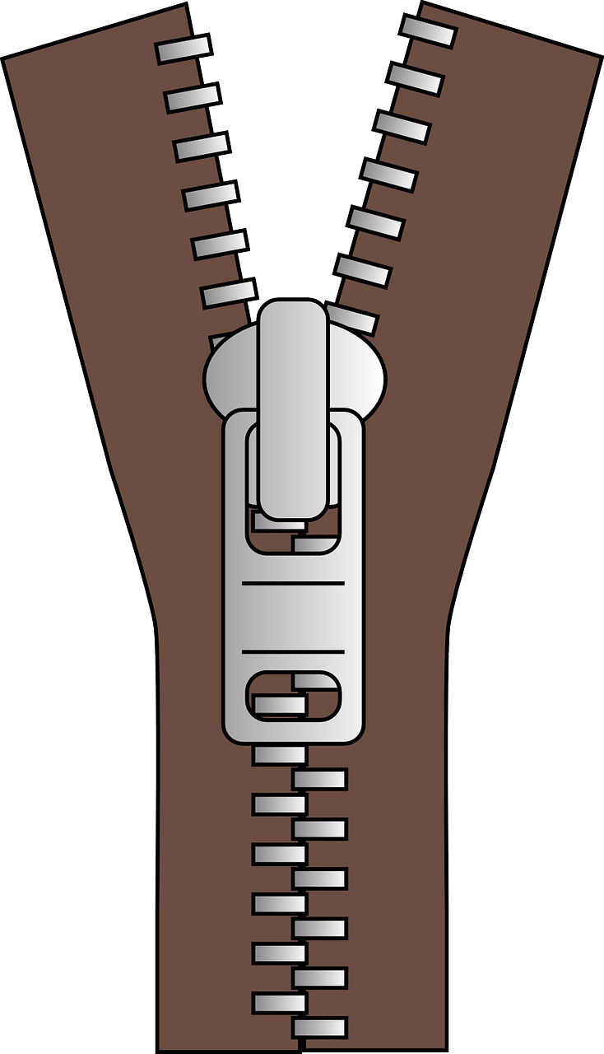
Notes:
Reflective prayer activity:
There are many parts of our world that are not very peaceful at the moment.
Use a zip to help you to pray for places where peace is needed.
Or use the zip to help you pray for people who you know who have argued.

