Slide 1
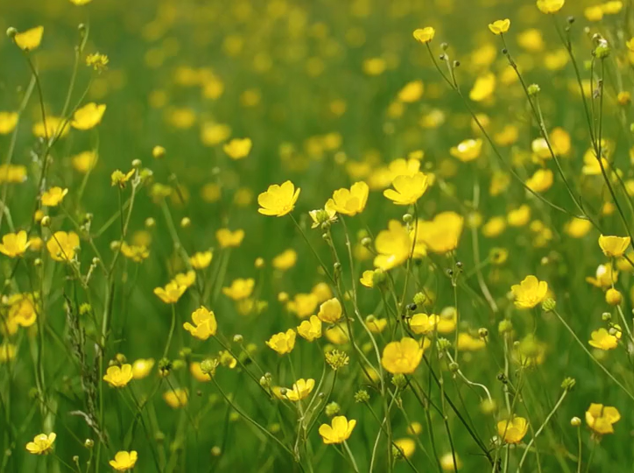



All pictures copyright-free from pixabay
Notes:
Slide 1: Spring flowers stilling exercise
Use the stilling slide if desired: the suggested words should be spoken slowly, leaving pauses inbetween to create a sense of stillness.
As you sit quietly, watch the spring flowers blowing gently in the breeze….[PAUSE]
Now practise slower breathing…..in…..and out…..in……and out…..keep this going as you continue to look at the flowers….[PAUSE]
You maybe notice that you are feeling calmer and more relaxed….[PAUSE]
As you breathe, think back to all the lives we’ve heard about this term and how they have shone like stars….. [PAUSE]
We come into this special / sacred space and time to be still….to think deeply…..to be together as a school community…..
In our time together today, we will have a quiz, share a story and then use it to help us to think.
But first, let’s welcome one another as we begin….

Slide 2
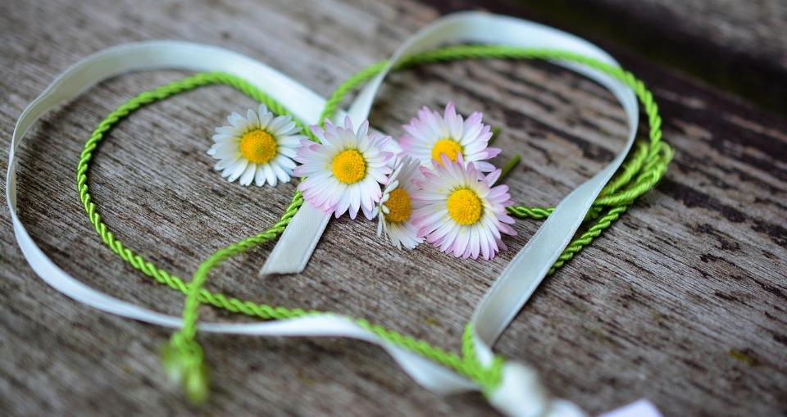
Leader: As we gather together today…
ALL: …we bring our thoughts and our hearts into this sacred space.
Notes:
Slide 2: Gathering
Leader: As we gather together today….
ALL: ….we bring our thoughts and our hearts into this sacred space.
Here are BSL actions for some of the words:
Leader’s words:
Gather: https://www.signbsl.com/sign/gather (1st video)
Today: https://www.signbsl.com/sign/today (1st video)
Pupils’ response:
Thoughts: https://www.signbsl.com/sign/thoughts (1st video)
Hearts: https://www.signbsl.com/sign/heart (1st video)

Slide 3

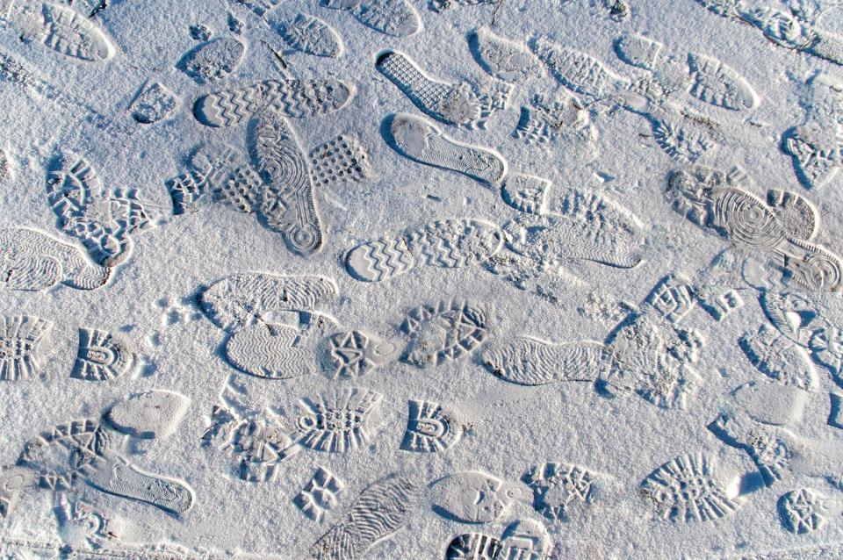
Whose footsteps?
Notes:
Slide 3: Quiz – Whose Footsteps
On the next few slides are some footprints that have been left behind…..but can we work out whose they are?

Slide 4
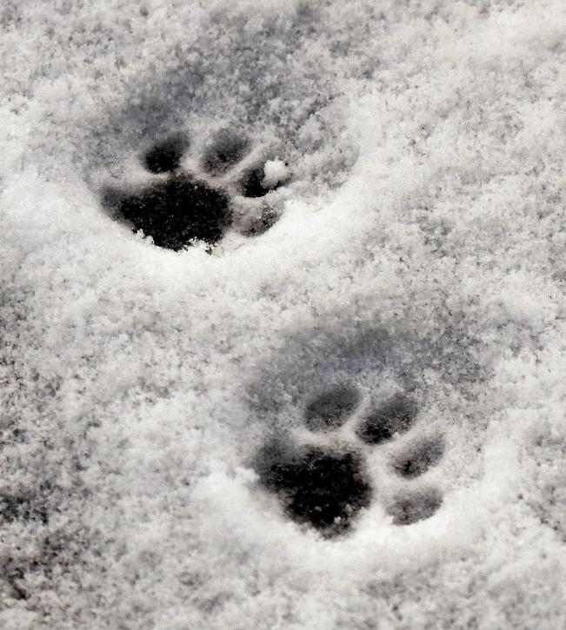

Notes:
Slide 4: Whose footsteps?

Slide 5
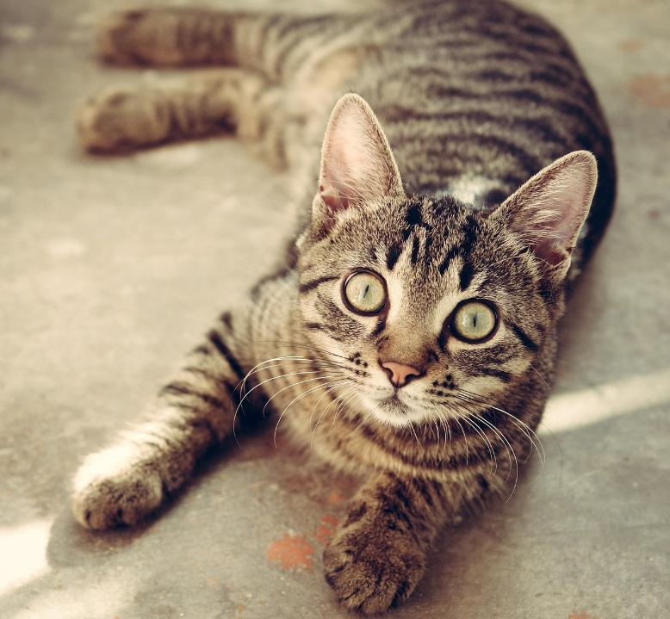
Notes:
Slide 5: Cat

Slide 6
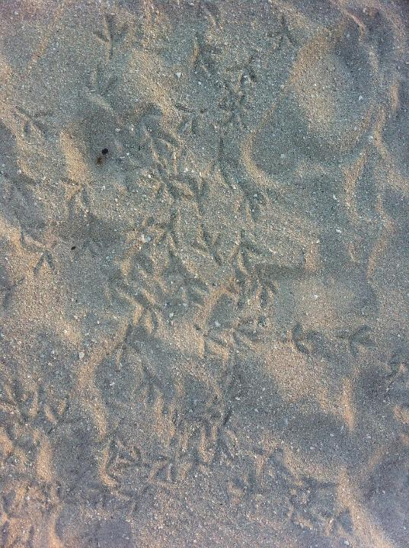

Notes:
Slide 6: Whose footsteps?

Slide 7
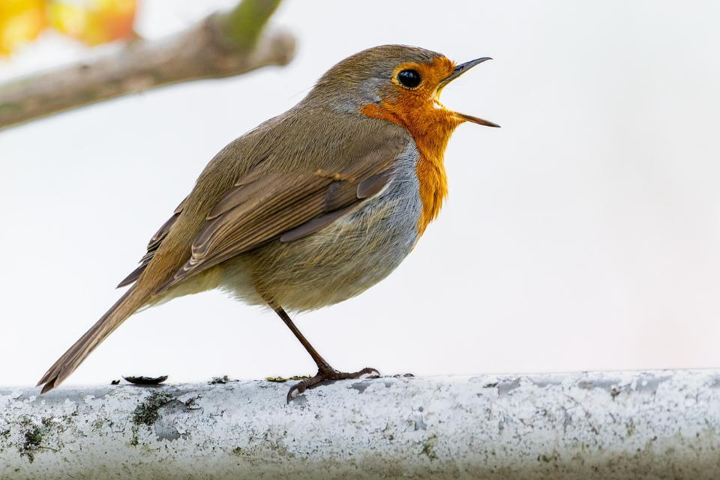
Notes:
Slide 7: Bird (this is a robin, but many birds-without webbed feet-have prints similar to this)

Slide 8
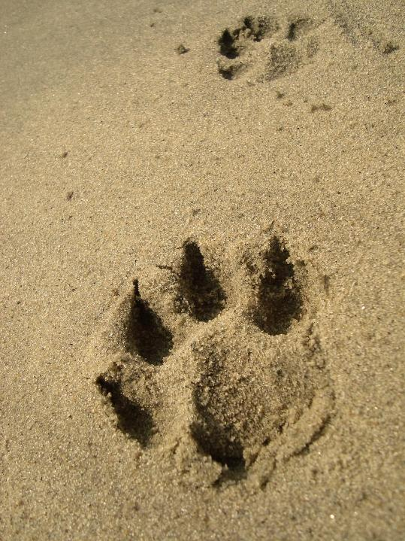

Notes:
Slide 8: Whose footsteps?

Slide 9
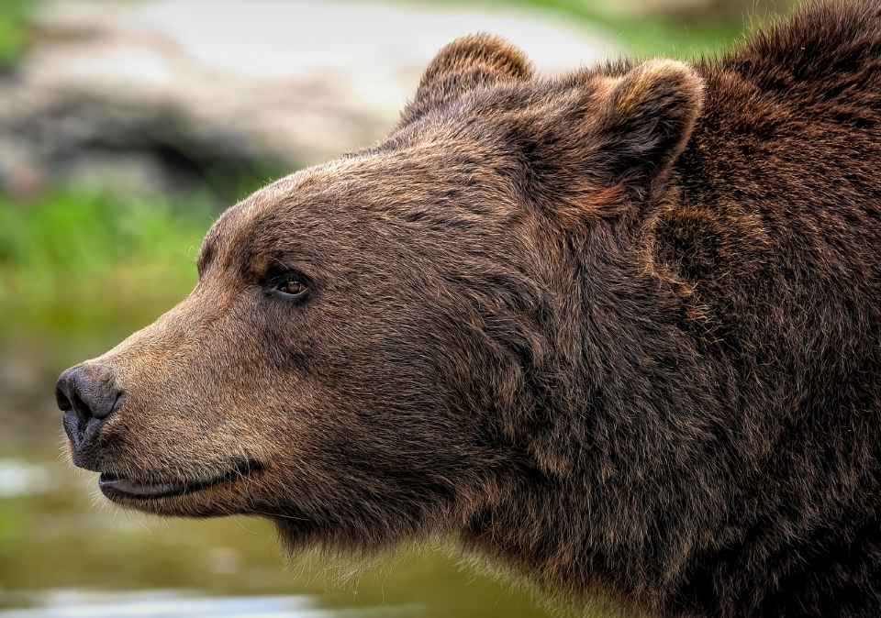
Notes:
Slide 9: Bear

Slide 10
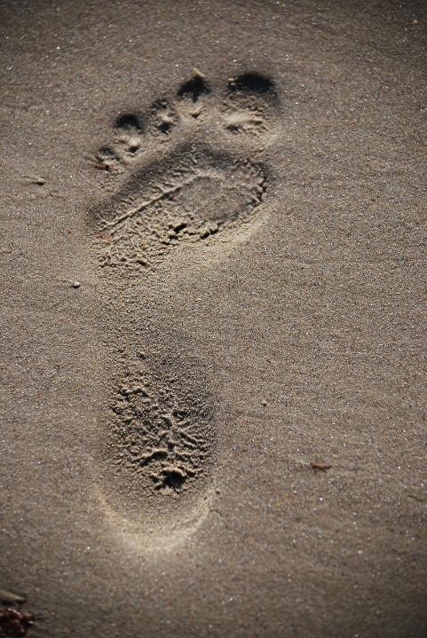

Notes:
Slide 10: Whose footsteps?

Slide 11
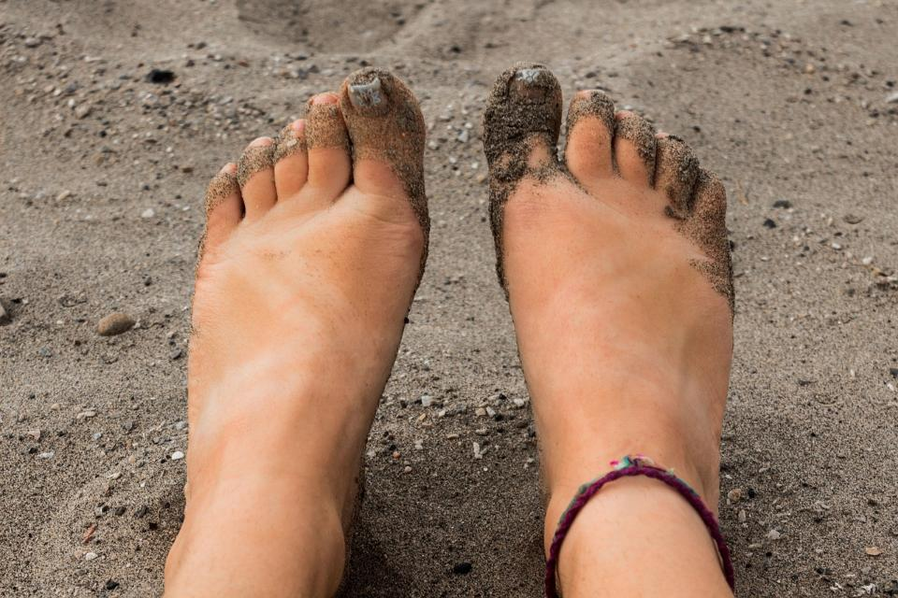
Notes:
Slide 11: Human being

Slide 12
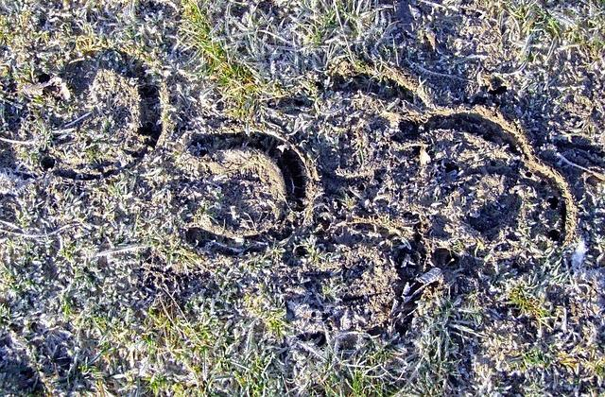

Notes:
Slide 12: Whose footsteps?

Slide 13
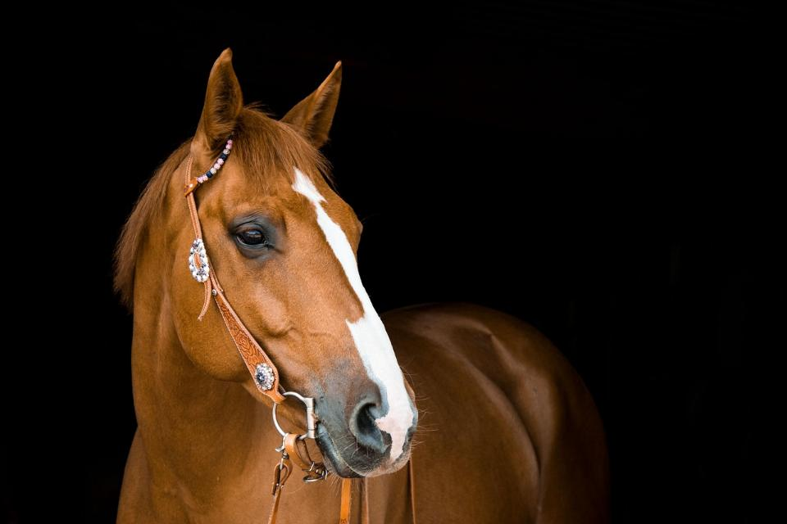
Notes:
Slide 13: Horse

Slide 14
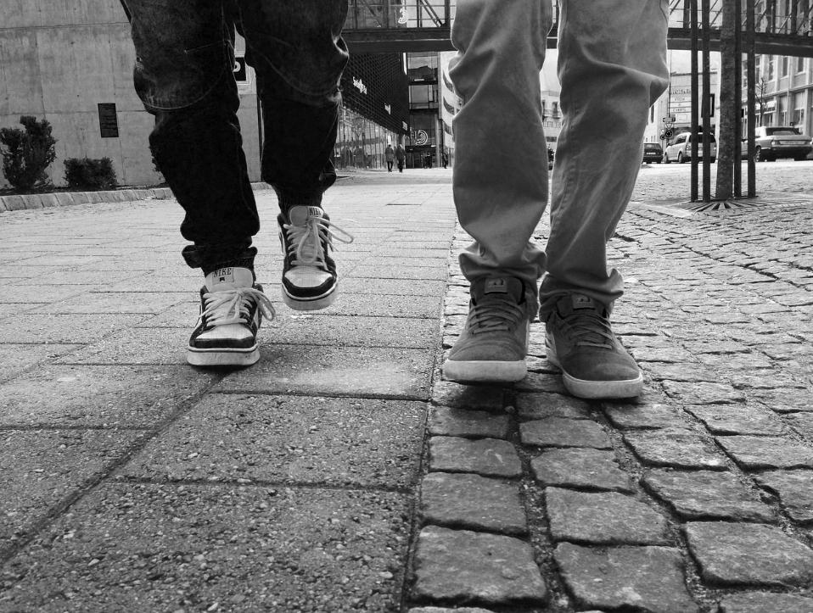
‘following in someone’s footsteps’
Notes:
Slide 14: ‘Following in someone’s footsteps’
When people talk about ‘following in someone’s footsteps’, it’s a way of saying that they want to live their life by following someone’s good example. We’re going to be thinking about this in our time together today. [you might want to ask some adults in the room to share some examples from their experience here.]

Slide 15
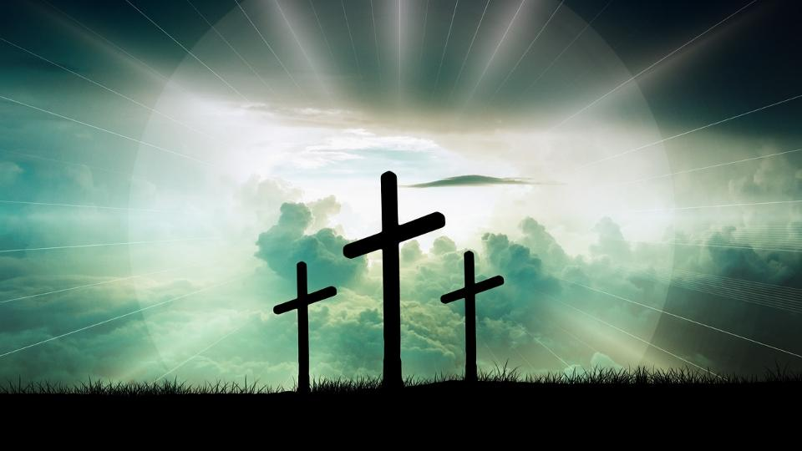
‘If any of you want to be my followers, you must forget about yourself. You must take up your cross and follow me.’
Notes:
Slide 15: People who are Christians will try to follow the example of Jesus, to ‘follow in his footsteps’. The cross is a special symbol for them because it is a reminder of the life that Jesus lived. The Easter narrative is a very special part of the Bible, and the cross an important symbol, because it reminds them of how Jesus lived, and served and gave up his life.
Jesus once said this:
‘If any of you want to be my followers, you must forget about yourself. You must take up your cross and follow me.’ (Mark 8:34)
What Jesus meant when he said this was that for people who are Christians, who follow in his footsteps, life may not always be easy. Following in his footsteps means forgetting about the things that they want, putting the needs of other people first and doing what he would do, even if it means facing difficulties, or even suffering, in their lives. We have seen this in the lives of our Heroes of Hope…..

Slide 16
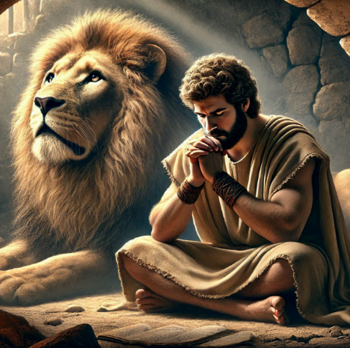
Shine like stars!
This image is © Jen Khatun & SPCK and must not be used outside of this context
Notes:
Slide 16: This term, we’ve been hearing stories from the lives of people across the world and across history, thinking about the things that made them ‘shine like stars’ – standing out in the world that they lived in, and in what we might want to learn from their lives. But each one of them was following in the footsteps of Jesus……let’s remind ourselves how…..!

Slide 17
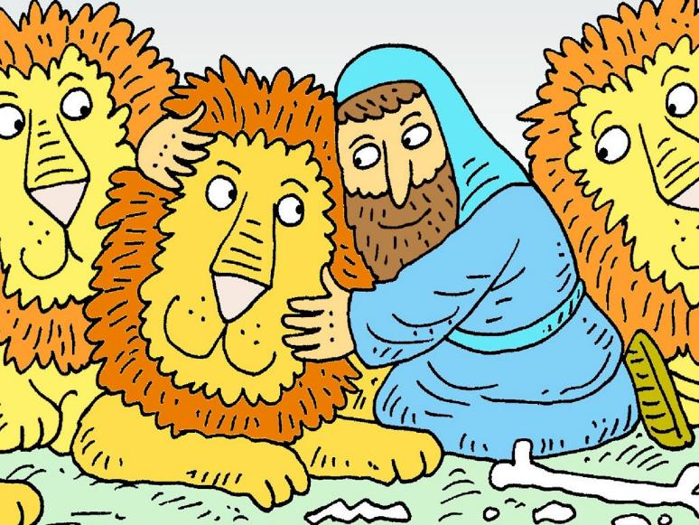
…just like Jesus.
Notes:
Slide 17: In the first half of term, we heard how Daniel and his friends lived with courage, standing up for things that were good and right….
….just like Jesus. [you will use these words across the next few slides, so you might want to invite children to join in!]

Slide 18
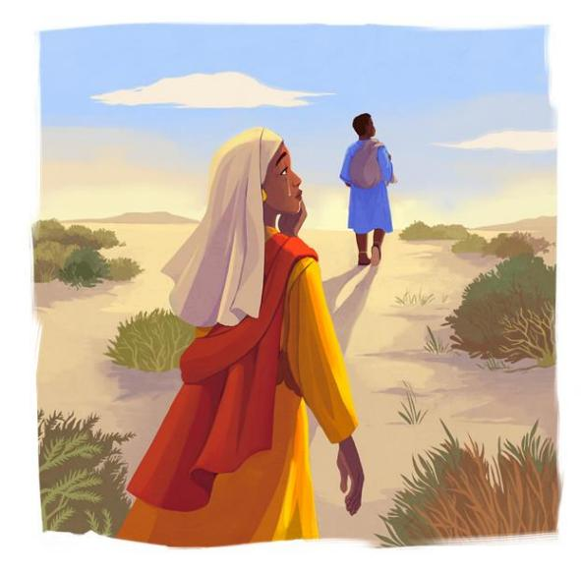
St. Monica (331-387CE)
…just like Jesus.
This image is © Daniela Gamba & SPCK and must not be used outside of this context
Notes:
Slide 18: In the life of St. Monica, we heard how her faithful love and prayers for her son Augustine changed his life. She showed him what ‘love is….’ …just like Jesus. [you will use these words across the next few slides, so you might want children to join in!]

Slide 19
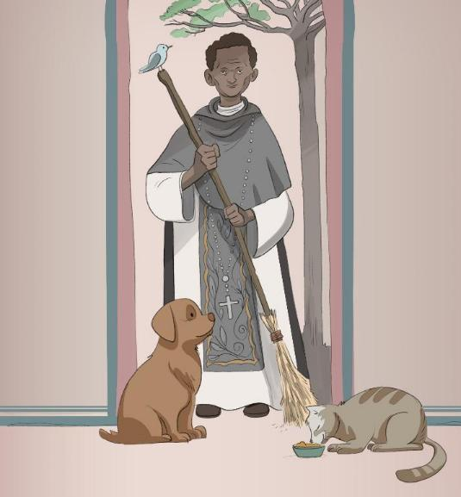
St. Martin de Porres (1579-1639CE)
…just like Jesus.
This image is © Neda Kazemifar & SPCK and must not be used outside of this context
Notes:
Slide 19: In the life of St. Martin de Porres, we heard how he treated those who were sick and injured, going out of his way to help them and heal them …just like Jesus.

Slide 20
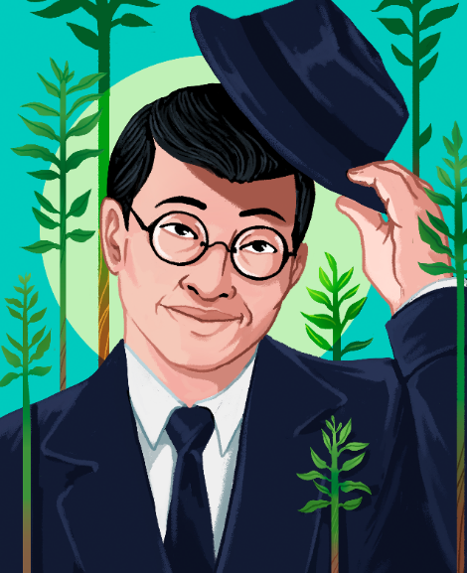
Toyohiko Kagawa
(1888-1960CE)
賀川 豊彦
…just like Jesus.
This image is © Anastasia Magloire Williams & SPCK and must not be used outside of this context
Notes:
Slide 20: We also heard about the life of Toyohiko Kagawa in Japan, who loved the parable of the Good Samaritan and lived his life according to the message about being a good neighbour, even to enemies….. …just like Jesus.

Slide 21
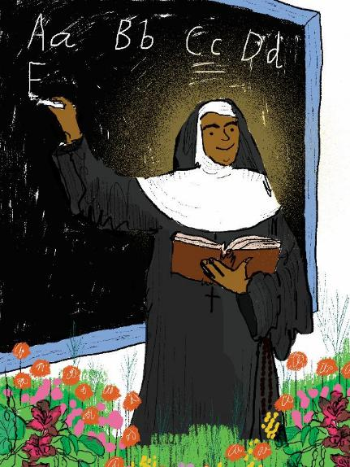
St. Alphonsa
(1910-1946 CE)
…just like Jesus.
This image is © Jen Khatun & SPCK and must not be used outside of this context
Notes:
Slide 21: And last week, we heard about St. Alphonsa who overcame great pain and suffering to help those around her and gave love as the greatest gift….. …just like Jesus.

Slide 22
‘If any of you want to be my followers, you must forget about yourself. You must take up your cross and follow me.’
Notes:
Slide 22: Responding and words for worship
Jesus said: ‘If any of you want to be my followers, you must forget about yourself. You must take up your cross and follow me.’ (Mark 8:34)
Think quietly about these words for a few moments. You might want to think about what they mean for Christians…..or you might want to think about what they mean to you…..

Slide 23
….I wonder what we might have learned from our Heroes of Hope over the past few weeks?.....
….I wonder what it might mean for us to ‘follow in their footsteps, or in the footsteps of Jesus?.....
….I wonder whose footsteps you might follow as you live your life?....
This image is © Jen Khatun & SPCK and must not be used outside of this context
Notes:
Slide 23: Responding and words for worship
We’ve heard how our Heroes of Hope followed in the footsteps of Jesus in the way they lived their lives….
As we draw our time together to a close, let’s take a few moments to reflect and wonder together…..
….I wonder what we might have learned from our Heroes of Hope over the past few weeks?.....
….I wonder what it might mean for us to ‘follow in their footsteps, or in the footsteps of Jesus?.....
….I wonder whose footsteps you might follow as you live your life?....

Slide 24

May we follow in his/her footsteps.
May we follow in his footsteps.
May we follow in her footsteps.
May we follow in his footsteps.
May we follow in his footsteps.
May we follow in her footsteps.
Notes:
Slide 24: Prayer
As we turn to prayer now, there are some words that you can make your own if you would like to, which will come onto the screen each time you see a footprint appear….our words are May we follow in his/her* footsteps. [*this will change, depending on the context]
Daniel lived his life with courage….
May we follow in his footsteps.
St, Monica lived her life with love….
May we follow in her footsteps.
St, Martin lived his life with compassion….
May we follow in his footsteps.
Toyohiko Kagawa lived his life being a good neighbour….
May we follow in his footsteps.
St. Alphonsa lived her life with perseverance….
May we follow in her footsteps.

Slide 25


Slide 26
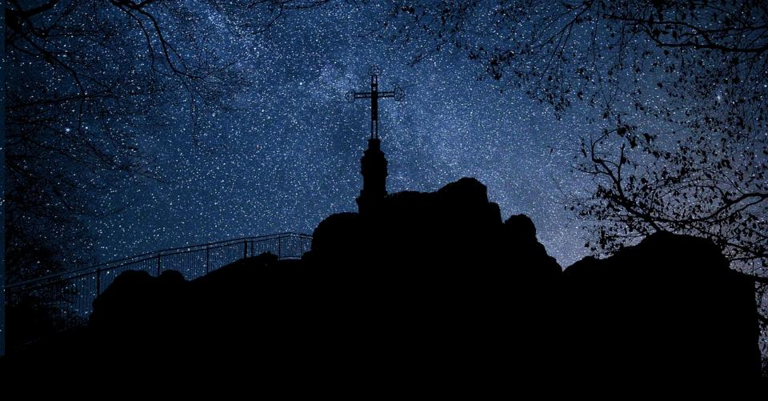


Leader: As we leave this place & time and go into the day ahead…
All: May we shine like stars!
Notes:
Sending: Slide 13
Leader: As we leave this place & time and go into the day ahead…
All: May we shine like stars!

Slide 27

Notes:
Slide 27: Reflective areas
Cut footstep shapes out of paper.
Think: Think about the people whose stories we have shared this term. Which stories have inspired you most?
Talk: Whose ‘footsteps’ might you want to follow in?
Do: Draw or write your ideas onto a footprint shape. These could be displayed in your classroom, or made into a book.

