Slide 1
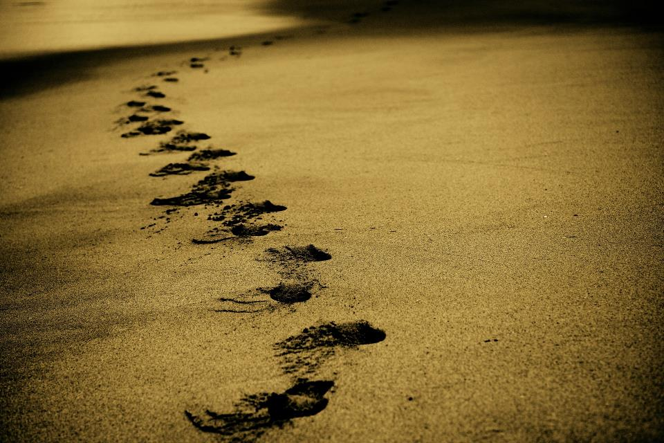
Picture copyright-free from pixabay
Leader: We are on this journey together…
Children: We are friends along the way…
ALL: May God go with us.
Notes:
Slide 1 or 2 [choose whichever image you prefer, or use them in rotation]:
Use the greeting for this term
Leader: We are on this journey together…
Children: We are friends along the way…
ALL: May God go with us.
BSL interpretation:
Sign for ‘way’ (nearest to the idea of ‘journey’): British Sign Language BSL Video Dictionary - way
Sign for ‘friends’: British Sign Language: friends
Sign for ‘God: British Sign Language BSL Video Dictionary - God
Sign for ‘go with us’ – we have invented this! After you’ve signed ‘God’, bring your finger down alongside your other finger and make them ‘journey together’ in front of you.
Engaging:
As we heard last week, in the final term of this school year, we are beginning a new theme:

Slide 2
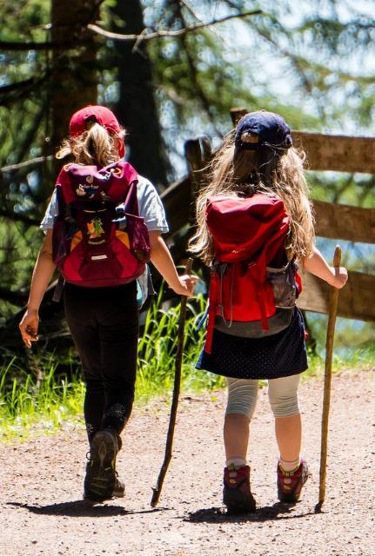
Picture copyright-free from pixabay
Leader: We are on this journey together…
Children: We are friends along the way…
ALL: May God go with us.
Notes:
Slide 1 or 2 [choose whichever image you prefer, or use them in rotation]:
Use the greeting for this term
Leader: We are on this journey together…
Children: We are friends along the way…
ALL: May God go with us.
BSL interpretation:
Sign for ‘way’ (nearest to the idea of ‘journey’): British Sign Language BSL Video Dictionary - way
Sign for ‘friends’: British Sign Language: friends
Sign for ‘God: British Sign Language BSL Video Dictionary - God
Sign for ‘go with us’ – we have invented this! After you’ve signed ‘God’, bring your finger down alongside your other finger and make them ‘journey together’ in front of you.
Engaging:
As we heard last week, in the final term of this school year, we are beginning a new theme:

Slide 3
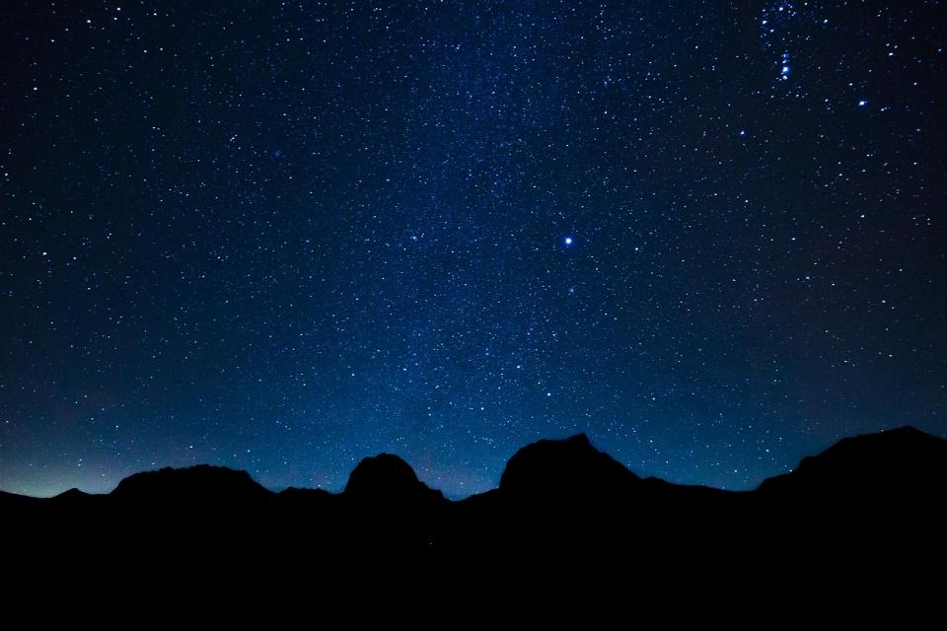
The wise people will shine like the brightness of the sky. Those who teach others to live right will shine like stars forever and ever.
(Daniel 12:3)
Notes:
Slide 3: We’re starting today with some words from the Bible. These were written down about the time of one of the great prophets of the Old Testament, the prophet Daniel, who was miraculously kept safe from the lions in the den. [You can read about this in Daniel chapter 6] What do you think we mean by ‘wise people’ – and how might they ‘shine like stars’? How might wisdom be like a light in the darkness? [Briefly talk together]

Slide 4
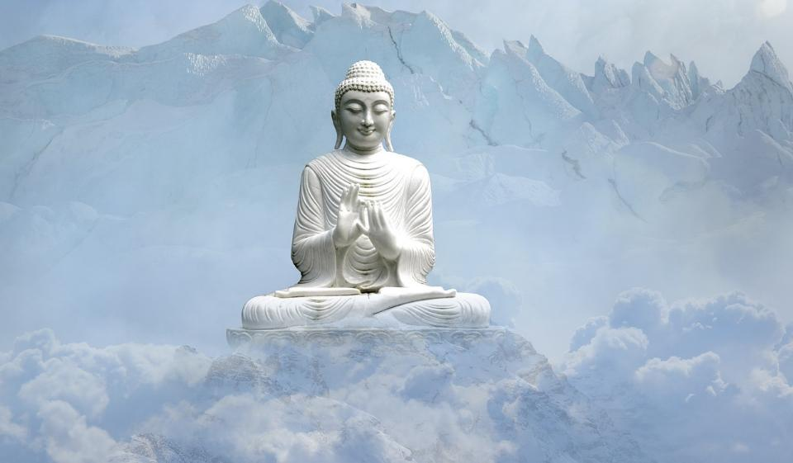
Dharma Day: 10th July 2025
Notes:
Slide 4: Dharma Day: Today / this week / 10th July is a special celebration for many people who are Buddhists – a celebration called Dharma Day. Buddhism is a religion that started far across the world in countries like China and Tibet, but there are Buddhists in countries all over the world. Dharma Day remembers the time when the Buddha – the first wise teacher of Buddhism – taught his first followers. Interestingly, he lived at around the same time as the Prophet Daniel!

Slide 5
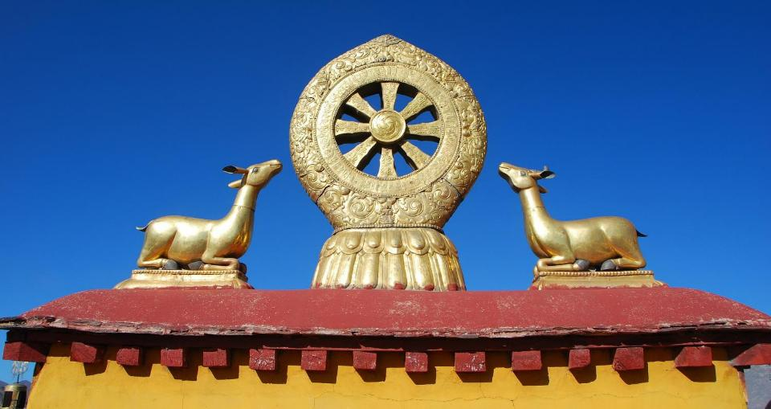
Dharma Day: 10th July 2025
Notes:
Slide 5: One of the symbols of Buddhism is this – a wheel that represents the teachings that Buddhists live by. Dharma Day is also called the ‘festival of the first turning of the wheel’ – because it remembers the day that this teaching started – when the wheel started turning, if you like. Buddhists all over the world will think today/this week about the wise teachings of the Buddha and how it helps them on the journey of their own life. Before we hear some of the Buddha’s wisdom today, let’s find out…..

Slide 6

Picture copyright-free from pixabay
What’s in the rucksack today?
Notes:
Slide 6: What’s in the rucksack today? Open your rucksack and get out the torch. Talk together about how a torch might be useful on a journey.
Just like a torch can bring light into a dark place, Buddha, taught that wisdom can do the same on the journey of life. He once said….

Slide 7
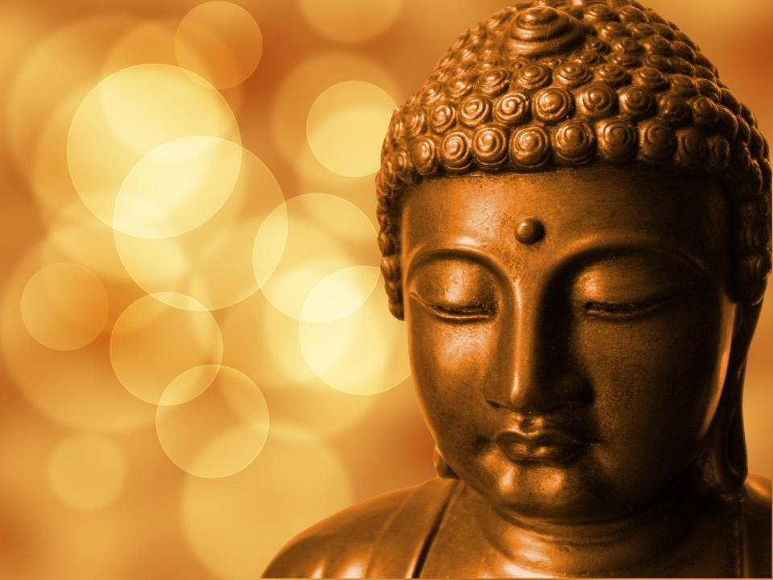
‘No light is brighter than wisdom. Wisdom is the light in the world.’
Notes:
Slide 7: ‘No light is brighter than wisdom. Wisdom is the light in the world.’
One of the ways that many Buddhists gain wisdom is through hearing stories from the life of the Buddha, and we are going to share one together now. As you listen, think about the important message that Buddhists might find in this story, which might help them to live wisely.

Slide 8
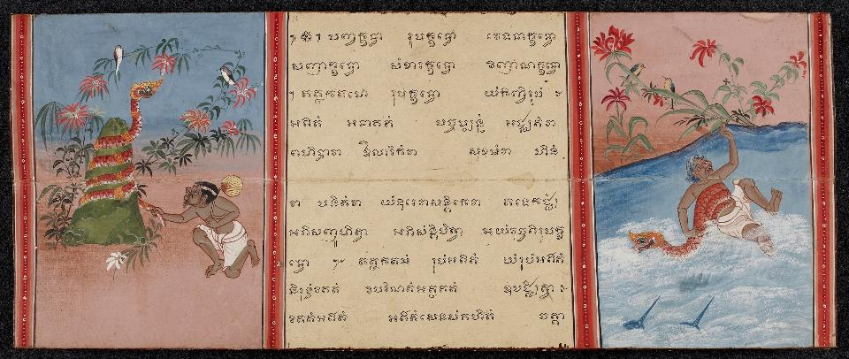
The Jataka Tales
Notes:
Slide 8: Our story comes from a very famous book of stories about the many lives of the Buddha, called The Jataka Tales.

Slide 9
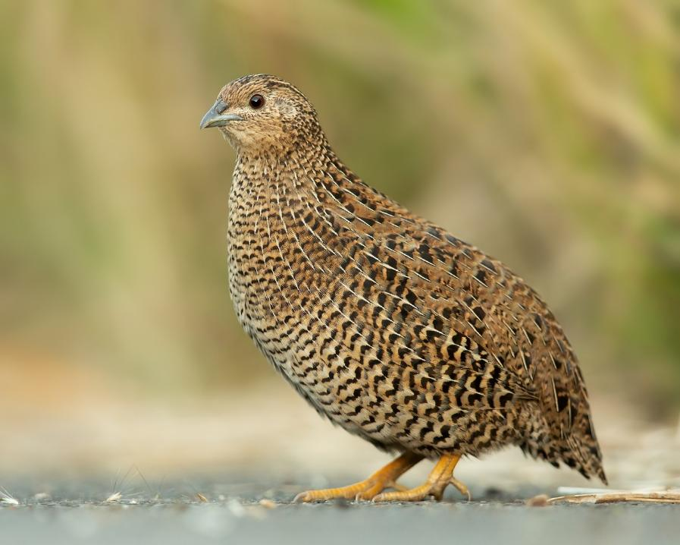
King of the Quails
Notes:
Slide 9: It’s called King of the Quails
A quail is a small bird that looks like this! As you listen, see if you can hear the wisdom in this story.

Slide 10
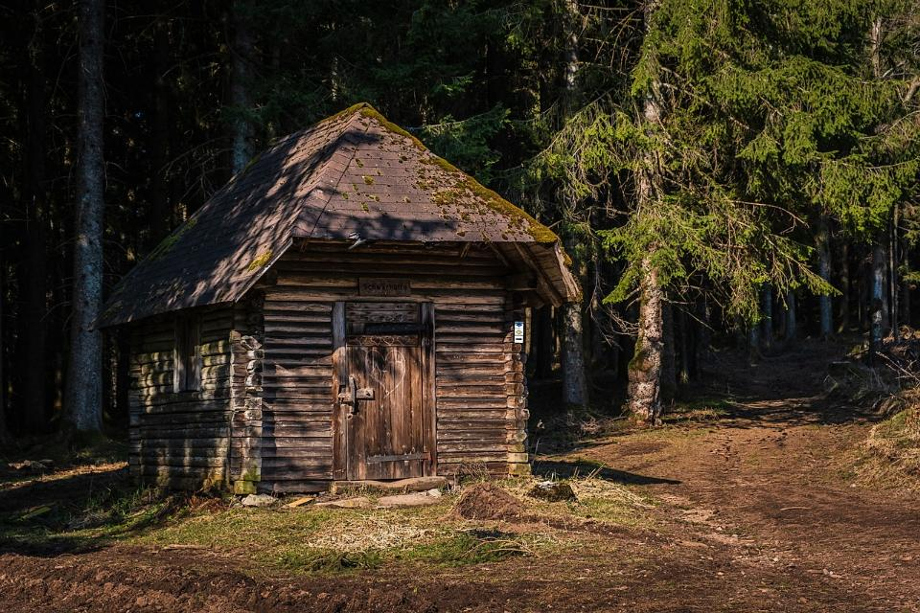
Notes:
Slide 10: A fowler lived in a little hut in the woods. He earned a living catching the flocks of quail that landed in the clearing to feed.

Slide 11

Notes:
Slide 11: The quails were easily frightened and so when the fowler’s net loomed large over them, they simply froze and off they went to be sold.

Slide 12
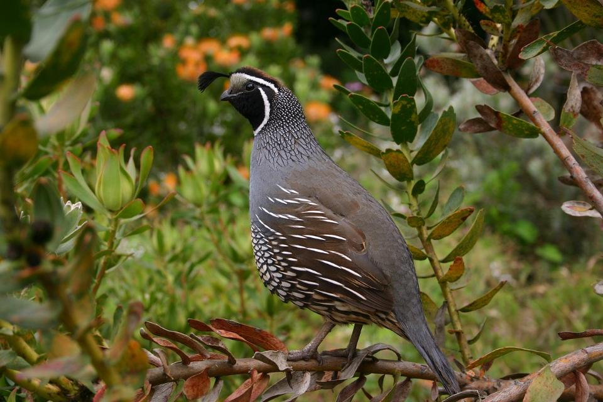
Notes:
Slide 12: The King of the Quails was the wisest of them all and as he watched, with despair, from the trees as another net full of birds was carried off by the fowler, he came up with a clever plan. Under cover of the trees, he called a meeting of all the quails. ‘The next time the fowler throws his net over you, this is what you must do. Every single one of you must flap as hard as you can. Together you will be able to lift up the net and fly away.’

Slide 13
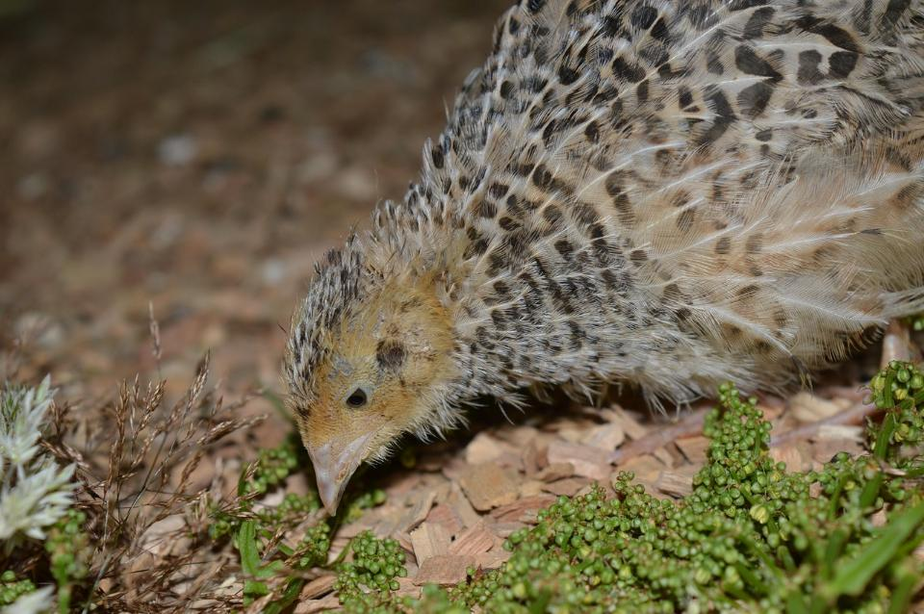
Notes:
Slide 13: Early that next morning, the quails were again gathered in the clearing in the woods, pecking at the berries that had fallen from the trees that morning.

Slide 14
Notes:
Slide 14: Down came the fowler’s net, but as one, the birds flew up and away with his net, just as their wise king had instructed them to. This happened day after day, much to the fowler’s frustration, until one unfortunate incident occurred…..

Slide 15
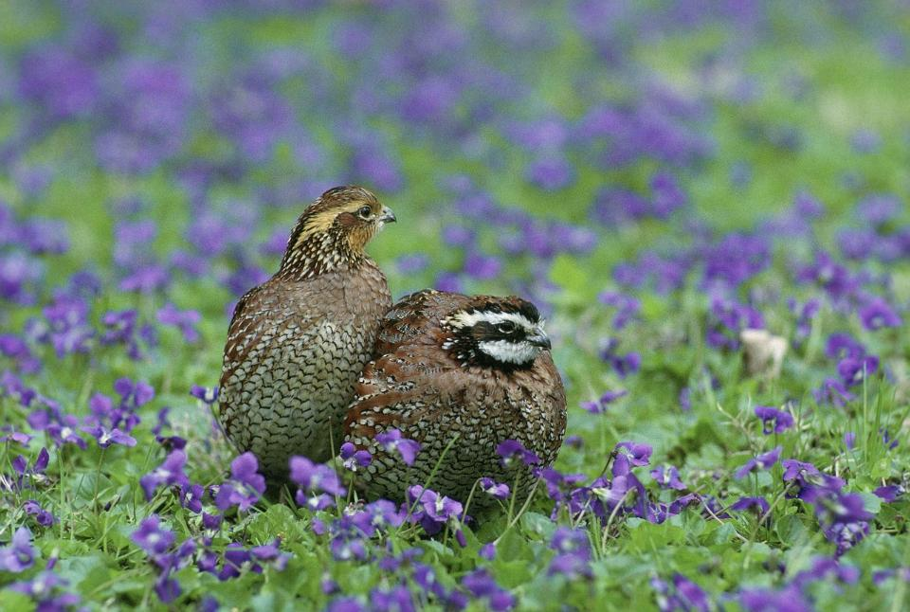
Notes:
Slide 15: In the early morning sunshine, as the quails were again enjoying the peace and quiet of the forest, one small quail bumped into another – and an argument began.

Slide 16
Notes:
Slide 16: ‘Take care!’ warned the King of the Quails, as he watched the argument escalate. ‘You’re putting yourselves in danger by being distracted with your silly argument!’
Before long, the quails were all arguing with each other about anything and everything and took no notice of the wise King’s warning. At that very moment, the fowler spied his chance!

Slide 17
Notes:
Slide 17: Down came the fowler’s net, but the birds were too cross with each other to co-operate. And so off they went to market, where the fowler sold them for a good price!

Slide 18
What’s the wisdom in this story?
Notes:
Slide 18: What’s the wisdom in this story?
[Talk together about your ideas.]
On Dharma Day, Buddhists will remember and be grateful for the wisdom of Lord Buddha, but also for others who have been wise teachers. For a few moments now, we are going to pause and think about our own school community, and those who have helped us to learn.

Slide 19
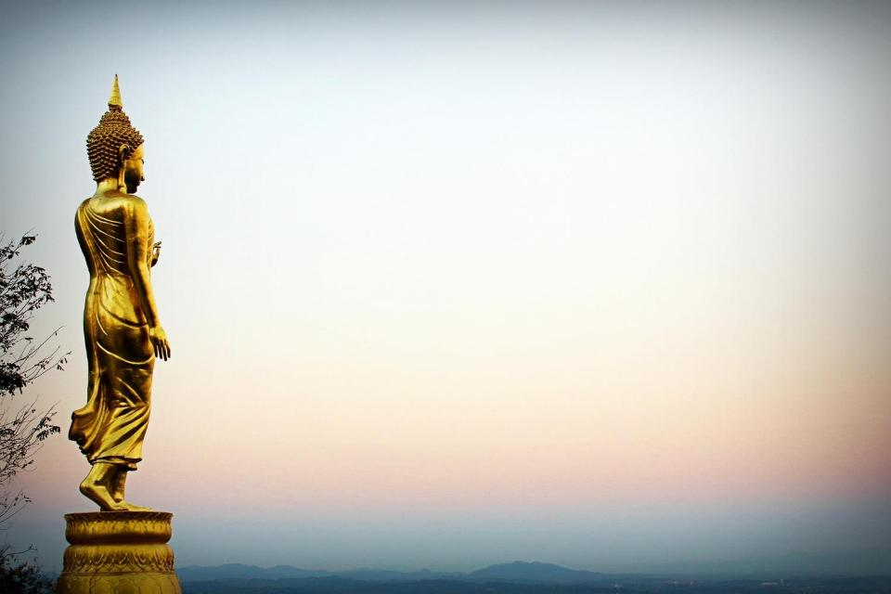
….I wonder who has shared their wisdom with you this year?...
….I wonder how we might show our teachers, especially, that we are grateful for their wisdom?....
Notes:
Slide 19: Responding (words for worship):
….so in the stillness of this moment, let’s spend some time wondering together…..
…. I wonder who has shared their wisdom with you this year?...
At the end of another school year, on/near Dharma Day, it’s good to be thankful for all those in our school community who have shared their wisdom with us…..
This might be other children, your teachers and other adults who work in your classroom, or other adults who help in school, or families that help at home.
…Pause and think for yourself now…
….I wonder how we might show our teachers, especially, that we are grateful for their wisdom?....
…Pause and think for yourself now…

Slide 20
The wise people will shine like the brightness of the sky. Those who teach others to live right will shine like stars forever and ever.
(Daniel 12:3)
….I wonder how we might be wise people, who teach others to live right?...
Notes:
Slide 20: We started our time together today with these words from the Bible. As we end our time, let’s pause one more time and think…..
…. I wonder how we might be wise people, who teach others to live right?....
…Pause and think for yourself now…

Slide 21
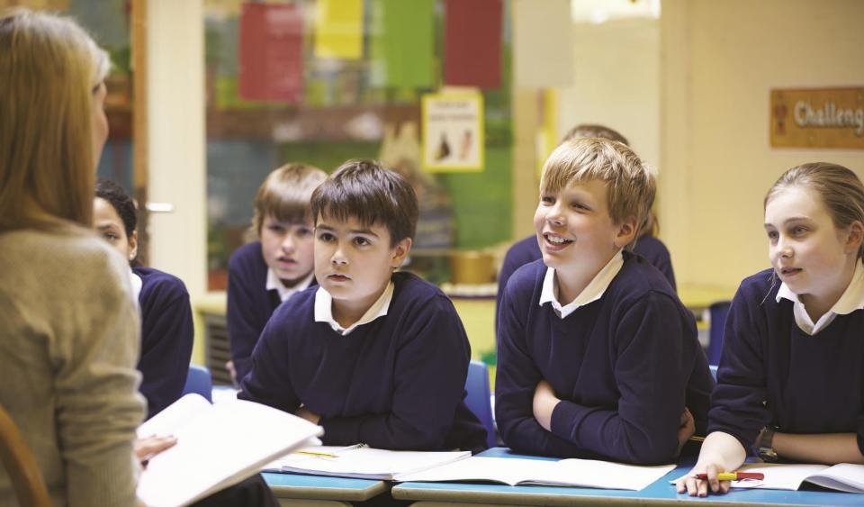
‘…we thank you God’
Notes:
Slide 21: I’m going to pray now, and ask God to bless our teachers (which of course includes all the adults who work in our classrooms!) as we draw near to the end of a busy term – and school year. They all deserve a break! Join me if you’d like to at the end of each line of the first part, by saying ‘WE THANK YOU, GOD.’
Prayer:
For all that our teachers have done for us – WE THANK YOU, GOD.
For the new things they have taught us – WE THANK YOU, GOD.
For the problems they have helped us to solve – WE THANK YOU, GOD.
For the times of fun and laughter – WE THANK YOU, GOD.
For helping us to shine – WE THANK YOU, GOD.
We are near the end of a busy year, and ready for a break – WE THANK YOU, GOD.
Give our teachers a happy end to the term, with the reward of good holidays filled with rest and relaxation, and time to be with their families.
Bless them, we pray.

Slide 22
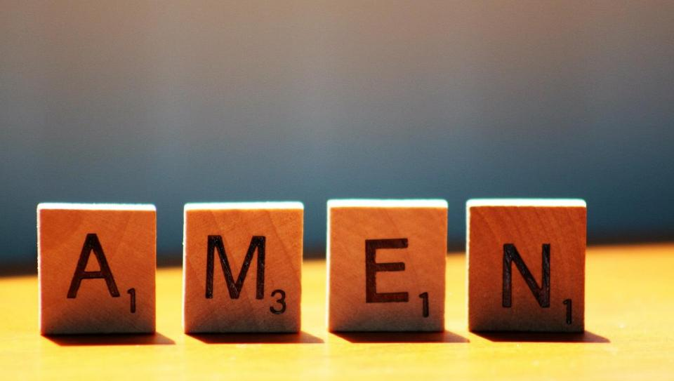

Slide 23
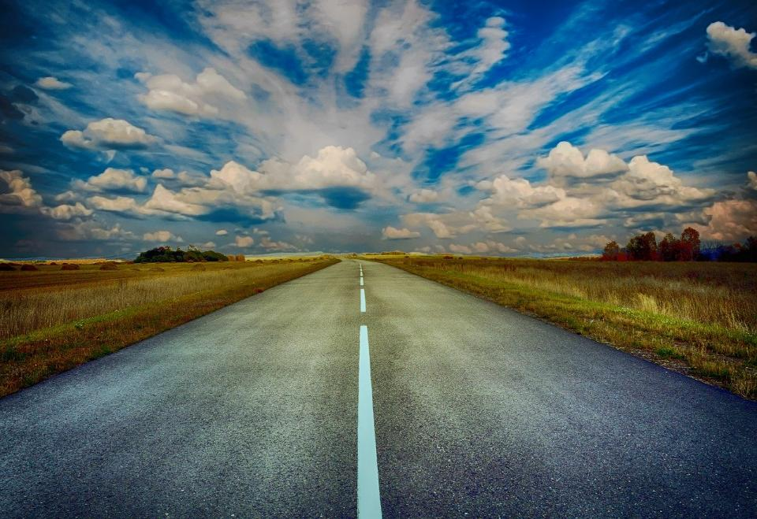
Picture copyright-free from pixabay
Leader: We have journeyed together today. As we leave this place and time and go into the day ahead…
ALL: …May God go with us.
Notes:
Slide 17: Use this term’s leaving words
Leader: We have journeyed together today. As we leave this place and time and go into the day ahead….
ALL: ….May God go with us.
Sign for ‘God: British Sign Language BSL Video Dictionary - God
Sign for ‘go with us’ – we have invented this! After you’ve signed ‘God’, bring your finger down alongside your other finger and make them ‘journey together’ in front of you.

Slide 24
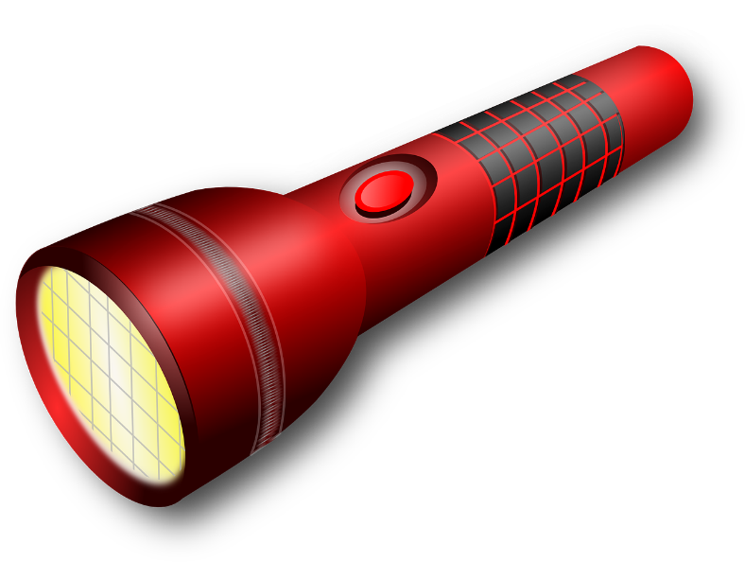
Notes:
Ideas for classroom reflection: torch cards
Think about someone who has shared their wisdom with you this year.
How has their wisdom helped you?
Write them a short thank you note in the beam on the torch card.
Don’t forget to give it to them to show that you are grateful!

Slide 25
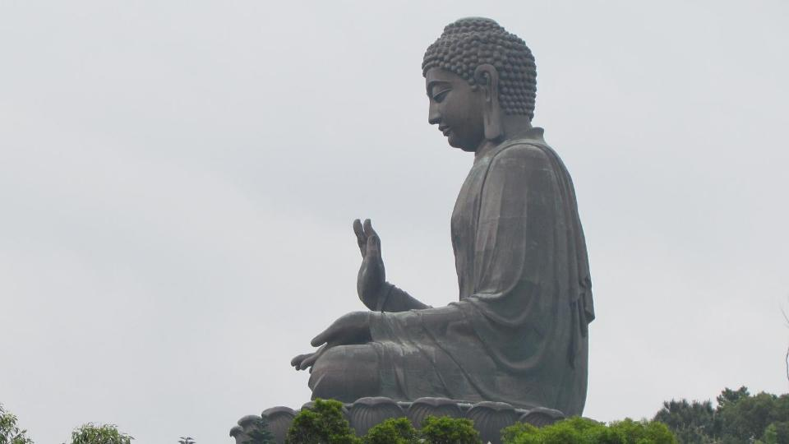
‘Happiness will never come to those who don’t appreciate what they already have.’
Notes:
Slides 25-29: Select as many as you wish to use

Slide 26
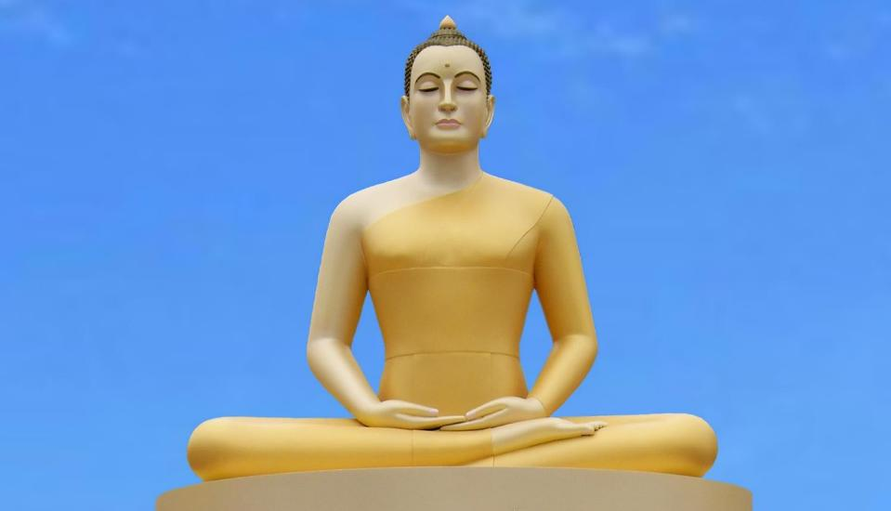
‘Every morning we are born again. What we do today is what matters most.’

Slide 27
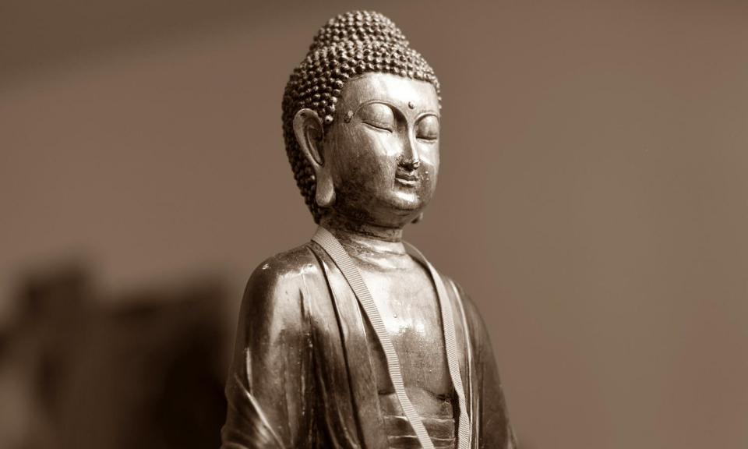
‘Generosity brings happiness.’

Slide 28
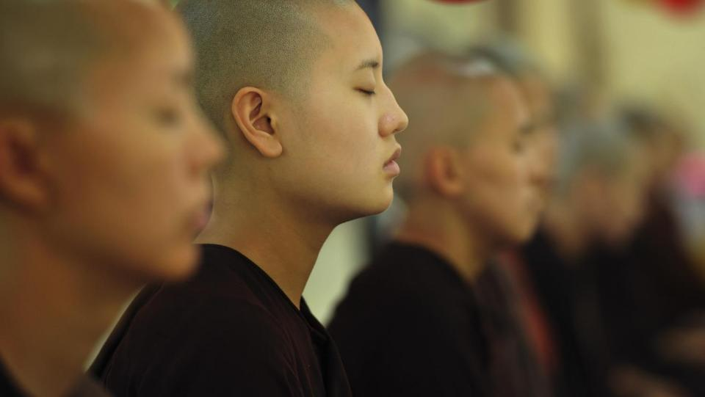
‘Train your mind to see good in everything.’

Slide 29
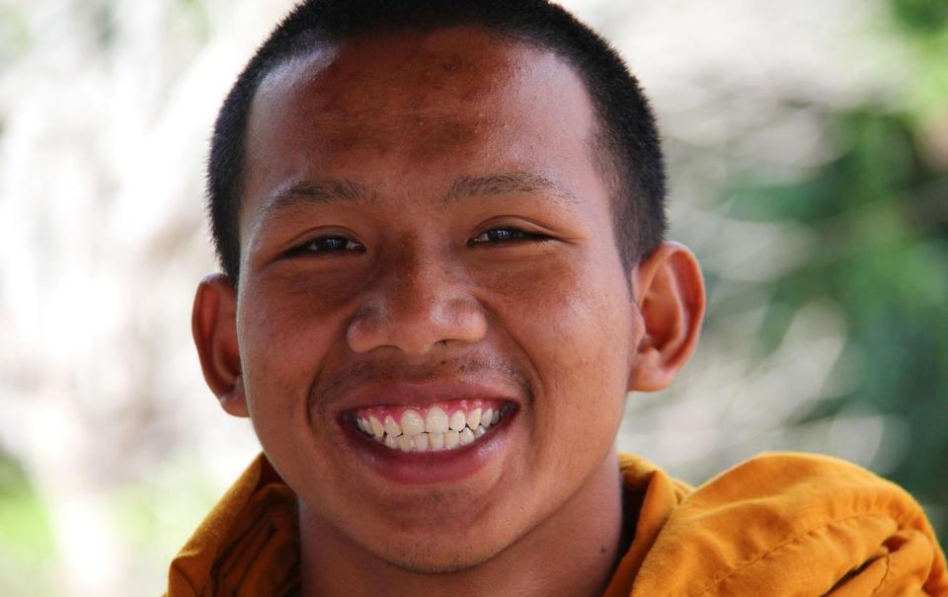
‘A smile is the way to solve many problems.’

