Slide 1
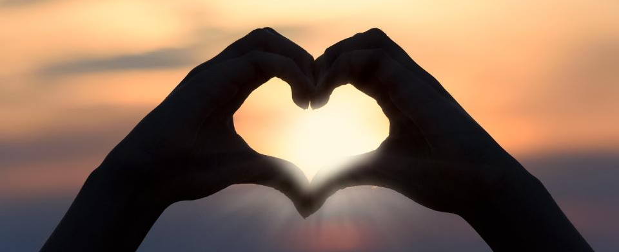
Leader: As we gather together
ALL: …we bring our hearts.
Notes:
Slide 1: Use the gathering words for this term, or your usual greeting if you prefer. The greeting comes with BSL signing; you can view the demos using links under the slide.
Leader: As we gather together,
ALL: …we bring our hearts
Signs for greeting: click on links
Hearts: British Sign Language BSL Video Dictionary - heart

Slide 2
Leader: As we gather together
ALL: …we share our thoughts.
Notes:
Slide 2: Use the gathering words for this term, or your usual greeting if you prefer. The greeting comes with BSL signing; you can view the demos using links under the slide.
Leader: As we gather together,
ALL: …we share our thoughts.
Signs for greeting: click on links
Thoughts: British Sign Language BSL Video Dictionary - thought

Slide 3
Leader: As community together
ALL: …we serve one another.
Notes:
Slide 3: Use the gathering words for this term, or your usual greeting if you prefer. The greeting comes with BSL signing; you can view the demos using links under the slide.
Leader: As community together,
ALL: …we serve one another.

Slide 4
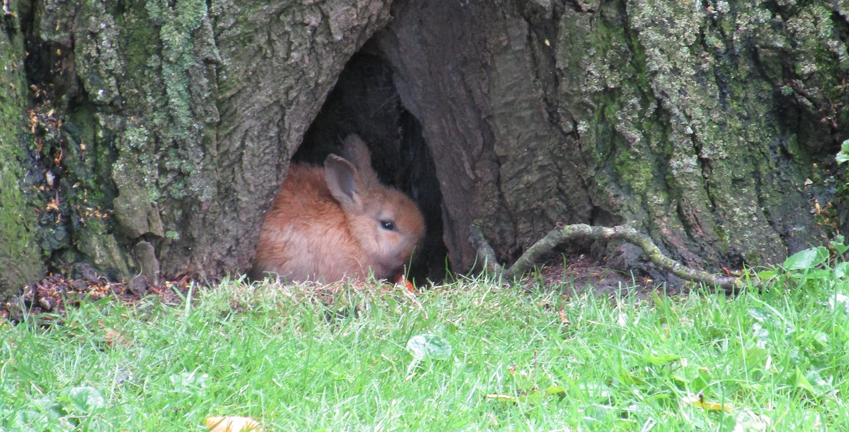
Hide and seek
Notes:
Slide 4: Hide and seek
Share some of the wonderful natural hiding places that you may have spotted last week, and if you can, share any photos you took across your school – it will help children connect last week with this week’s materials.

Slide 5
Songs from
the heart
Notes:
Slide 5: Songs from the heart
Today’s words come from across many of David’s psalms about the beauty of creation/the natural world [use whichever term you feel more comfortable with] They are brilliant examples of great descriptive writing (which we might learn from!), but also show how David found God through his experience of nature. I wonder if any of you can identify with this? Let’s have a look at what he said. [use some/all of slides 6-10 to explore with your children, asking them to say what they think David is meaning.]

Slide 6
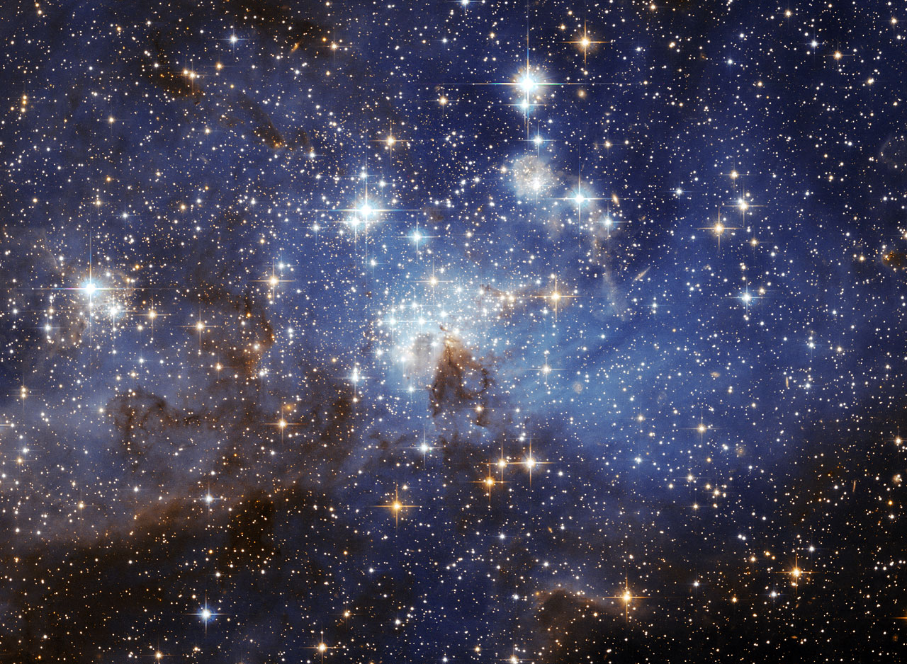
God stretches out the heavens like a tent.
(Psalm 104:2)
Notes:
Slide 6: God stretches out the heavens like a tent. (Psalm 104:2)

Slide 7
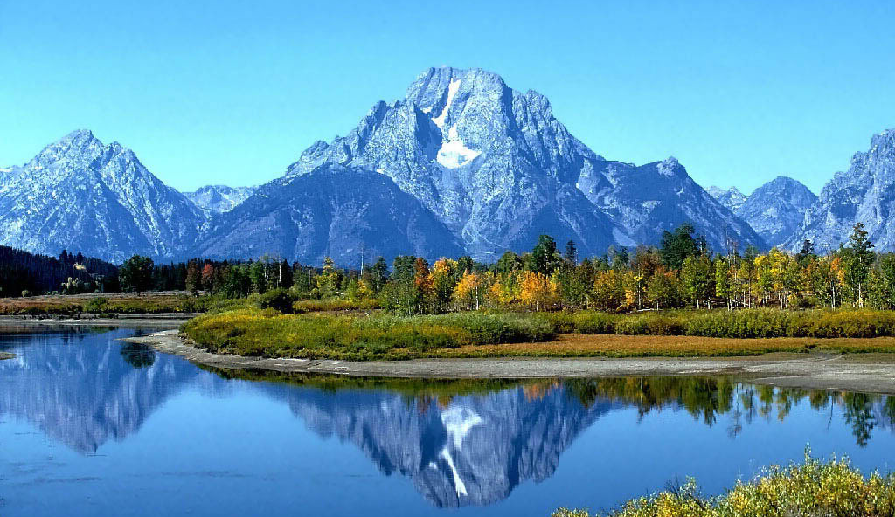
You are strong, O God, and your mighty power put the mountains in place.
(Psalm 65:6)
Notes:
Slide 7: You are strong, O God, and your mighty power put the mountains in place.
(Psalm 65:6)

Slide 8
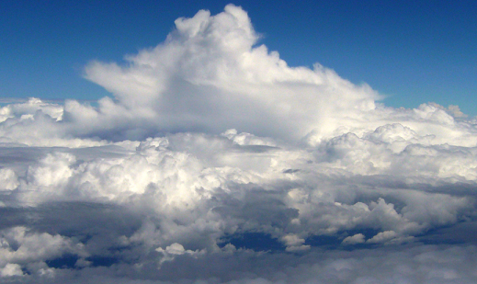
You are clothed with glory and majesty. You wear light like a robe….The clouds are your chariot with the wind as its wings.
(Psalm 104:1-3)
Notes:
Slide 8: You are clothed with glory and majesty. You wear light like a robe….The clouds are your chariot with the wind as its wings.
(Psalm 104:1-3)

Slide 9
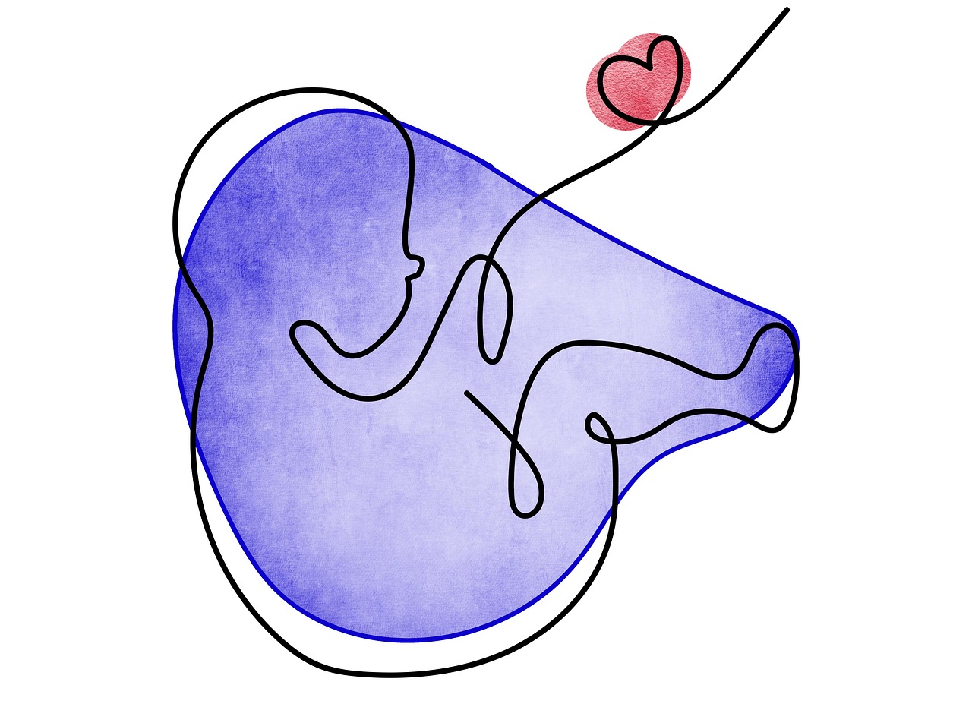
I praise you because you made me in an amazing and wonderful way. You saw my bones being formed as I took shape in my mother’s body. When I was put together there, you saw my body as it was formed. (Psalm 139:14-16)
Notes:
Slide 9: I praise you because you made me in an amazing and wonderful way. You saw my bones being formed as I took shape in my mother’s body. When I was put together there, you saw my body as it was formed. (Psalm 139:14-16)

Slide 10
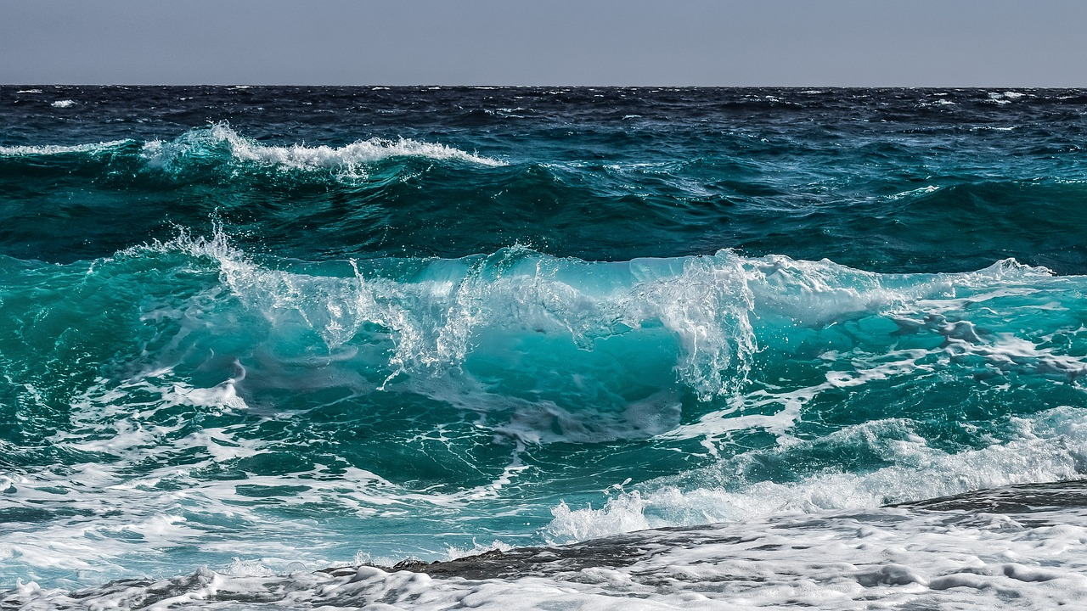
The Lord’s voice is heard over the sea. The glorious God thunders. The Lord thunders over the great ocean. (Psalm 29:3)
Notes:
Slide 10: The Lord’s voice is heard over the sea. The glorious God thunders. The Lord thunders over the great ocean. (Psalm 29:3)

Slide 11
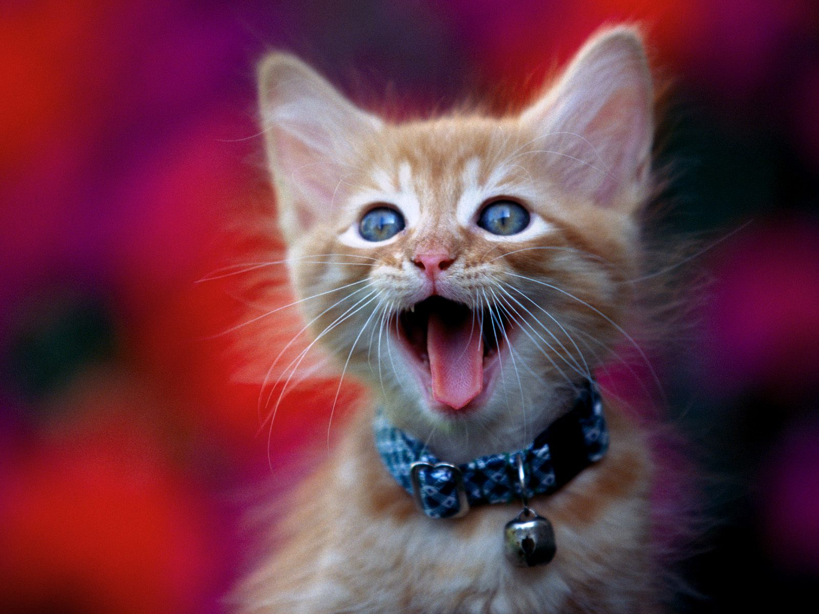
I sing for joy at the works of
your hands….
(Psalm 92:8)
Notes:
Slide 11: I sing for joy at the works of your hands…. (Psalm 92:8)
This was David’s response to what he saw around him – to give praise to God whom he believed created it all. We’ll be using a song at the end of our time together which also does this.

Slide 12
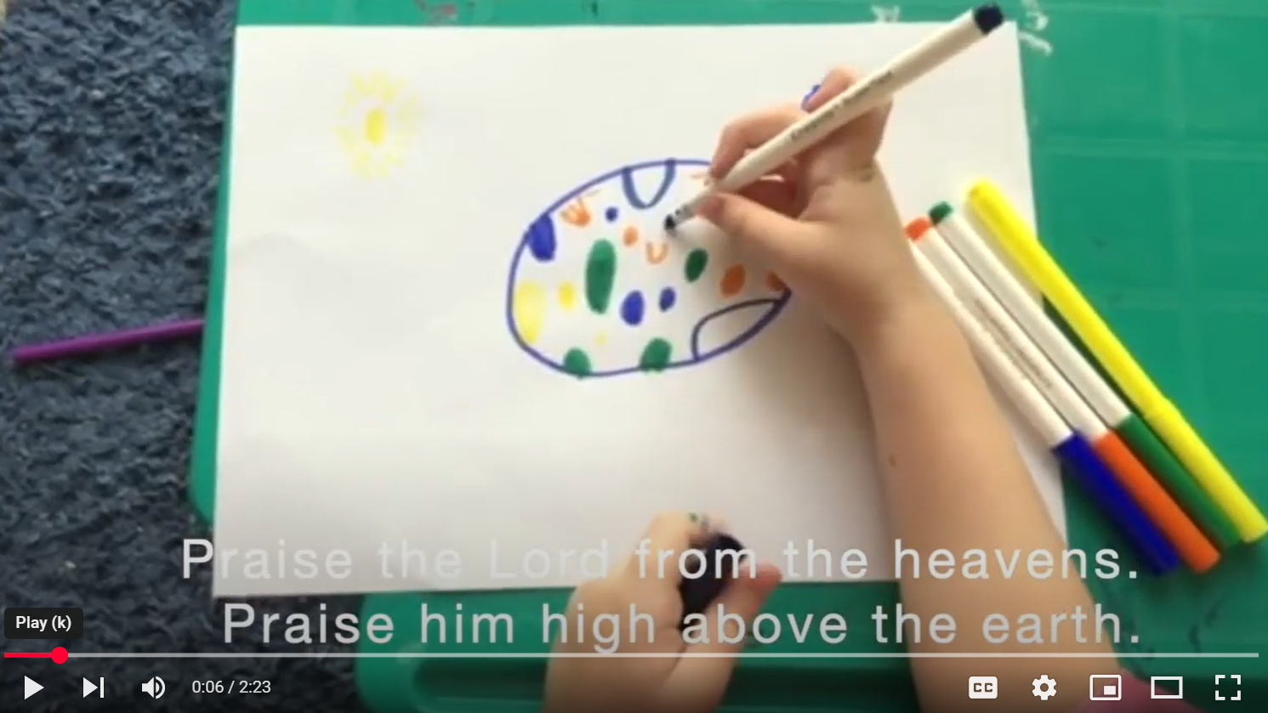
…. I wonder what made you think as you heard the words and saw the children’s ideas?....
….I wonder what might make you want to give praise to God, or say ‘Wow!’?…..
Notes:
Slide 12: As we reflect and wonder together today, we’re going to hear the words of another Psalm, and see some children from one of the churches in our Diocese as they show us their creative responses to the words. Let’s watch and wonder together (click on the image in the PPT)
[This was made during lockdown in 2020!]
…I wonder what made you think as you heard the words and saw the children’s ideas?
…I wonder what might make you want to give praise to God, or say ‘Wow!’?...

Slide 13
Shout out!
Notes:
Slide 13: We’ve heard how David often praised God when he saw something amazing, so now it’s your turn! In place of our prayer for today, we’re going to have a whole school shout out of thanks! This is not something we often encourage – shouting out, and all at once -but for today it gives us all a chance to say something. So now bring into your mind something in our world that makes you say ‘Wow!’: if you’re stuck for ideas, there are a few pictures here to get you going…

Slide 14
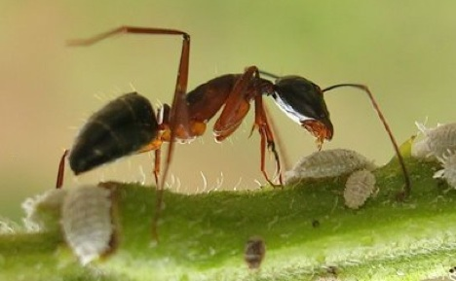
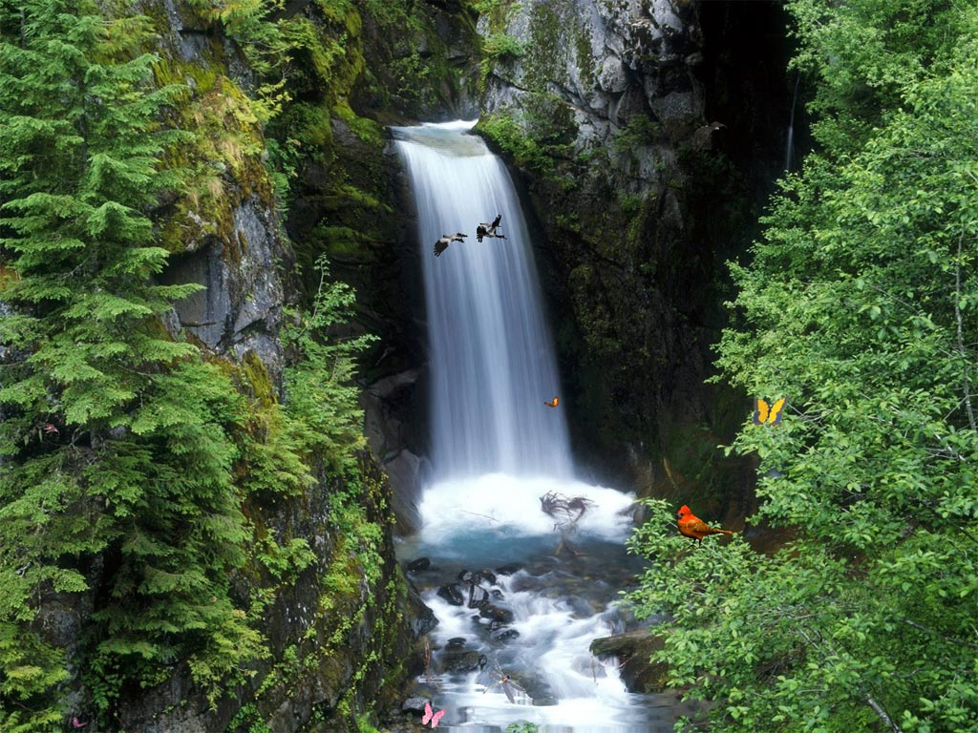
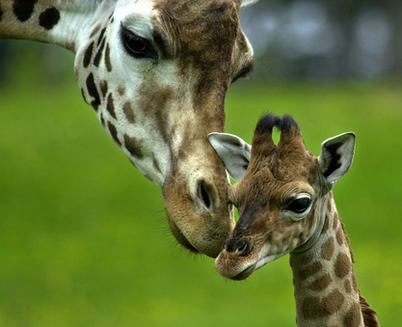
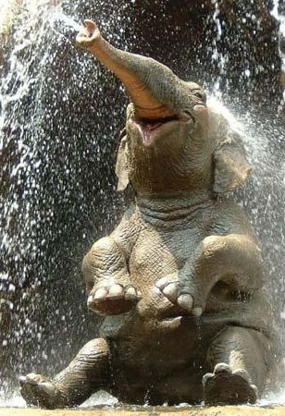
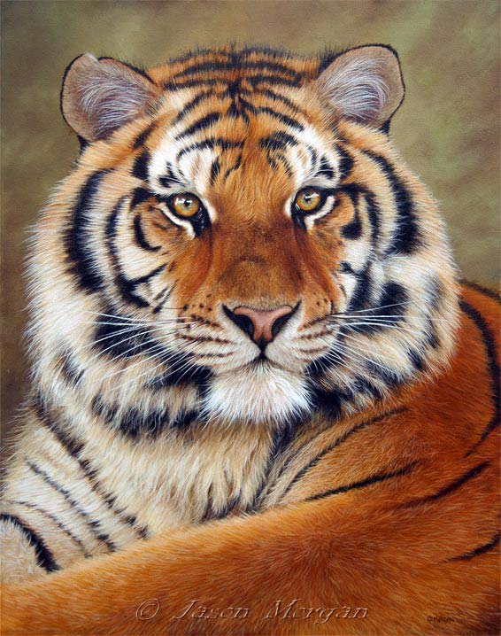
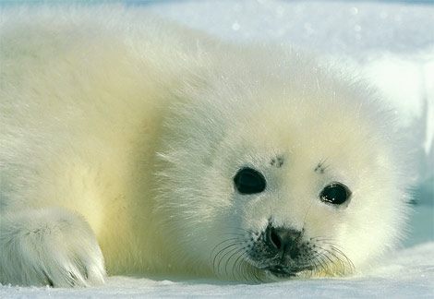
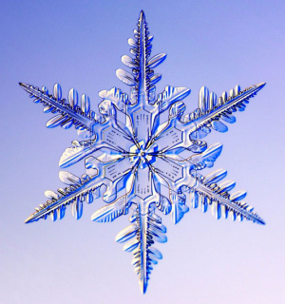
God, for all these things we are grateful!
Notes:
Slide 14: [show pictures] Are you ready? I’m going to do a countdown and then all together, we are going to shout OUR praise. 3,2,1…..
God, for all these things, we are grateful.

Slide 16
Let’s sing to God a new song!
(Psalm 33:3)
Notes:
Slide 16: This week, in our classrooms, we are going to be continuing with this theme and having the chance to write our very own songs and poems in praise of our world / creation / God. And we’re really hoping that some of them we might even be able to sing!! [using the ‘Who made the twinkling stars?’ writing frame]

Slide 17
Leader: As we leave this place & time and go into the day ahead…
All: …may we serve one another in our thoughts and words and actions.
Notes:
Sending: Slide 17
Leader: As we leave this place and time and go into the day ahead,
All: ….may we serve one another in our thoughts and words and actions.
Signs for response: click on links
Thoughts: British Sign Language BSL Video Dictionary - thought (signbsl.com)
Words (use 3rd definition): British Sign Language BSL Video Dictionary - word (signbsl.com)
Actions: British Sign Language BSL Video Dictionary - action (signbsl.com)

