Slide 1
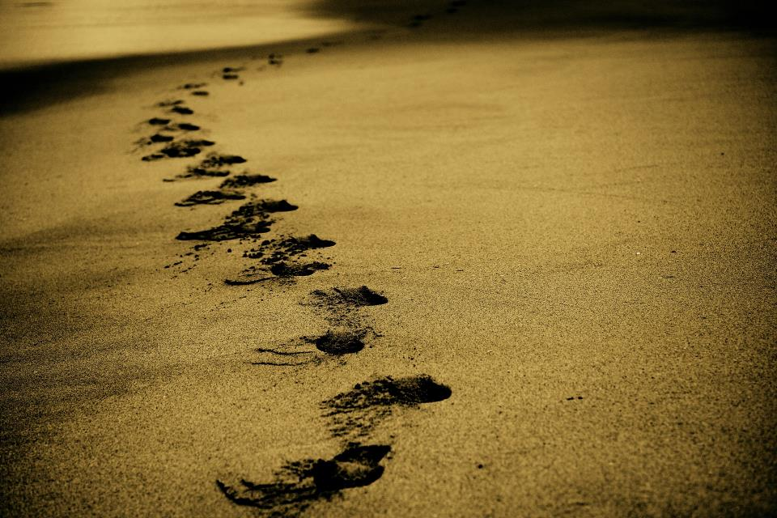
Picture copyright-free from pixabay
Leader: We are on this journey together…
Children: We are friends along the way…
ALL: May God go with us.
Notes:
Slide 1 or 2 [choose whichever image you prefer, or use them in rotation]:
Use the greeting for this term
Leader: We are on this journey together…
Children: We are friends along the way…
ALL: May God go with us.
BSL interpretation:
Sign for ‘way’ (nearest to the idea of ‘journey’): British Sign Language BSL Video Dictionary - way
Sign for ‘friends’: British Sign Language: friends
Sign for ‘God: British Sign Language BSL Video Dictionary - God
Sign for ‘go with us’ – we have invented this! After you’ve signed ‘God’, bring your finger down alongside your other finger and make them ‘journey together’ in front of you.
Engaging:
As we heard last week, in the final term of this school year, we are beginning a new theme:

Slide 2
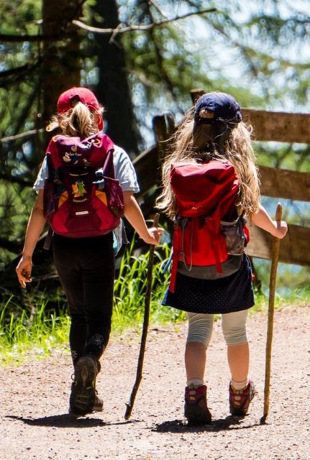
Picture copyright-free from pixabay
Leader: We are on this journey together…
Children: We are friends along the way…
ALL: May God go with us.
Notes:
Slide 1 or 2 [choose whichever image you prefer, or use them in rotation]:
Use the greeting for this term
Leader: We are on this journey together…
Children: We are friends along the way…
ALL: May God go with us.
BSL interpretation:
Sign for ‘way’ (nearest to the idea of ‘journey’): British Sign Language BSL Video Dictionary - way
Sign for ‘friends’: British Sign Language: friends
Sign for ‘God: British Sign Language BSL Video Dictionary - God
Sign for ‘go with us’ – we have invented this! After you’ve signed ‘God’, bring your finger down alongside your other finger and make them ‘journey together’ in front of you.
Engaging:
As we heard last week, in the final term of this school year, we are beginning a new theme:

Slide 3
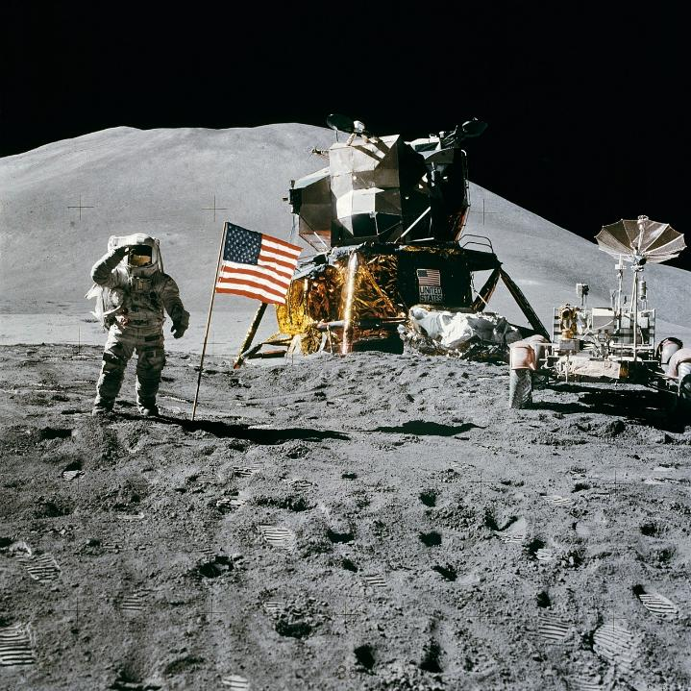
Picture copyright-free from pixabay
Moon landing: 20th July 1969
Notes:
Slide 3: We’re starting today with a picture. What’s going on here? [talk together about what children know] This year marks the 56th anniversary of this most significant historical event – the moment that someone stepped onto the moon for the very first time. It had been part of several ambitious years when the USA and Russia were both striving to be the first to do this. As you can see from the flag, the USA won the Space Race!

Slide 4
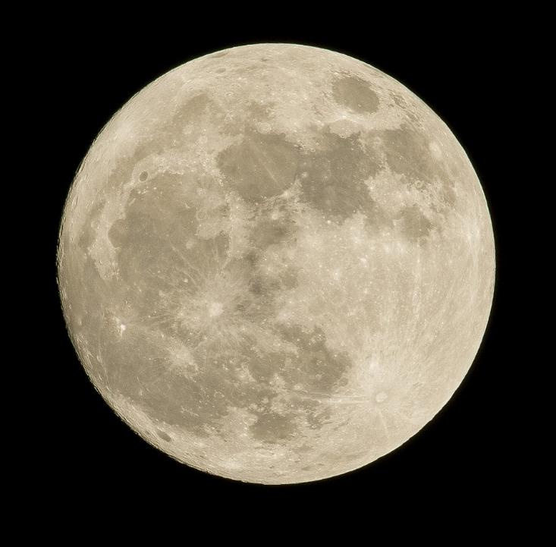
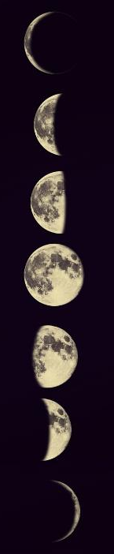
Picture copyright-free from pixabay
Notes:
Slide 4: Landing on the moon was a truly landmark achievement. Our moon orbits (travels around) our planet, the Earth, just as we orbit the Sun. It takes about 27 days for it to get all the way around, which is why we sometimes see it seeming to change shape. Our moon is a massive 384,400km (that’s 238,855 miles) from us – that’s about 25 times the distance from the UK to Australia!! So, in our time together today, we are going to be thinking about this epic journey – the longest we’ve shared this term! Before we launch (!) into today’s story, here are some things about our moon which you may not know…

Slide 5
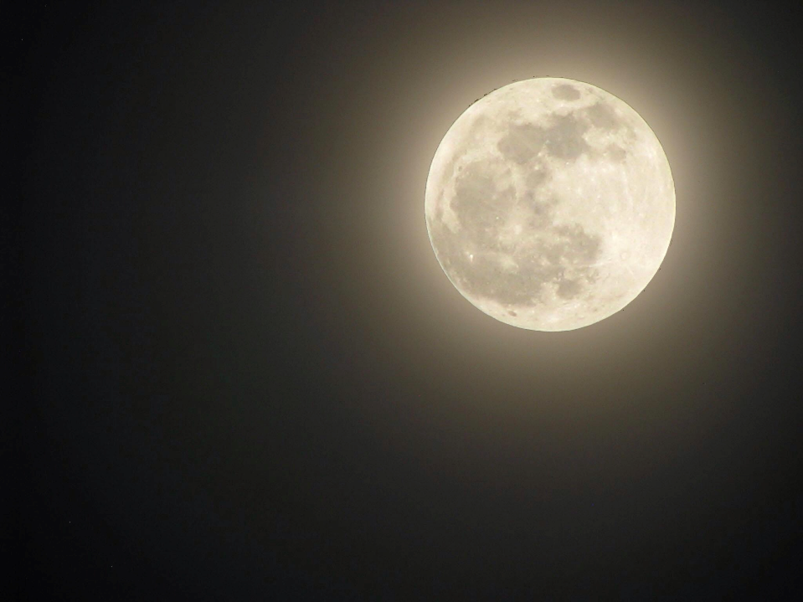
Picture copyright-free from pixabay
The moon doesn’t actually shine, but reflects the light of the sun….
Notes:
Slide 5: The moon doesn’t actually shine (i.e. it’s not a source of light), but reflects the light of the sun….

Slide 6
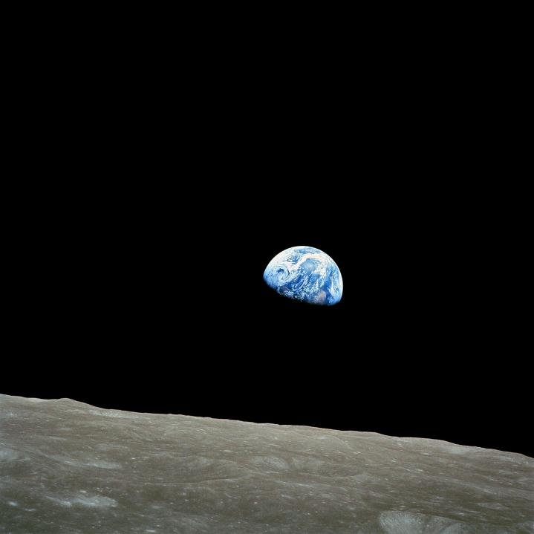
….and so does the Earth!
Picture copyright-free from pixabay
Notes:
Slide 6: ….and so does the earth!

Slide 7
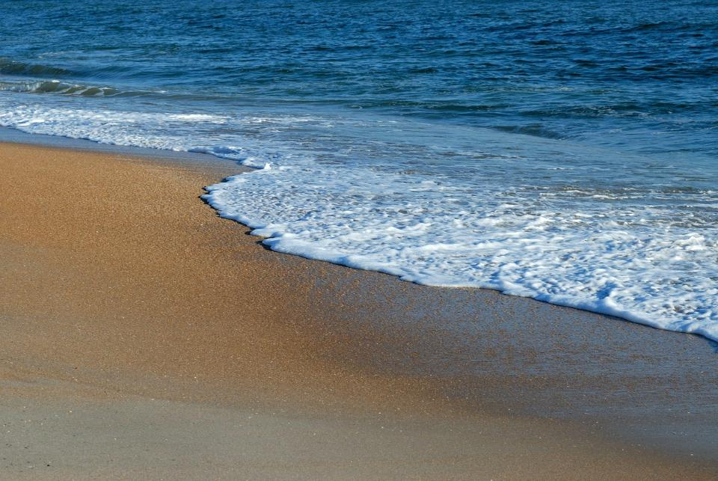
Picture copyright-free from pixabay
The moon controls the tides of our seas: two high tides and two low tides a day.
Notes:
Slide 7: The moon controls the tides of our seas: two high tides and two low tides a day.

Slide 8
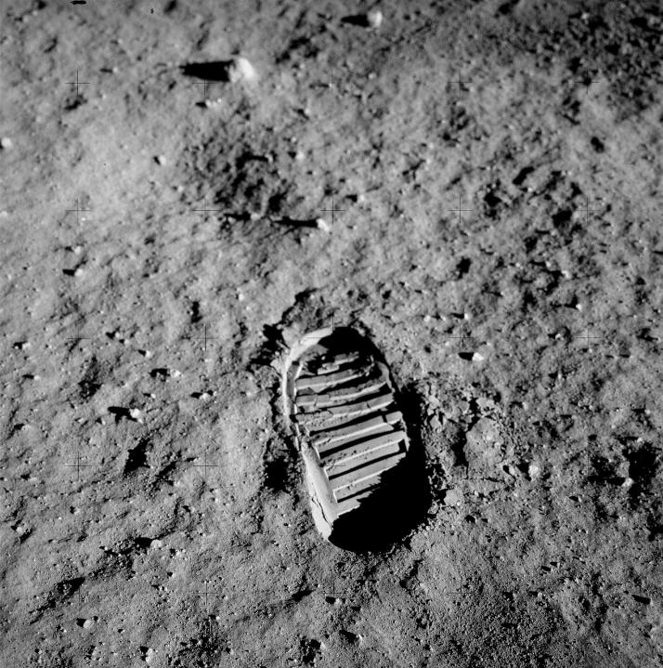
There is no wind on the moon, so the footprints made by the first astronauts in 1969 are still there!
Picture copyright-free from pixabay
Notes:
Slide 8: There is no wind on the moon, so the footprints made by the first astronauts in 1969 are still there!

Slide 9

Picture copyright-free from pixabay
There are 3 golf balls on the moon, all of them hit by astronaut Alan Shepard in 1971, on the Apollo 14 mission.
Notes:
Slide 9: There are 3 golf balls on the moon, all of them hit by astronaut Alan Shepard in 1971, on the Apollo 14 mission. This was 2 years after the first moon landing.

Slide 10
Picture copyright-free from pixabay
Moon landing: 20th July 1969
Notes:
Slide 10: Landing on the moon was a huge human achievement, and the three astronauts who were the first to step out onto the moon’s surface will be remembered in history for generations to come. Their names were Neil Armstrong, Buzz Aldrin (who’s in the photo) and Michael Collins.

Slide 11
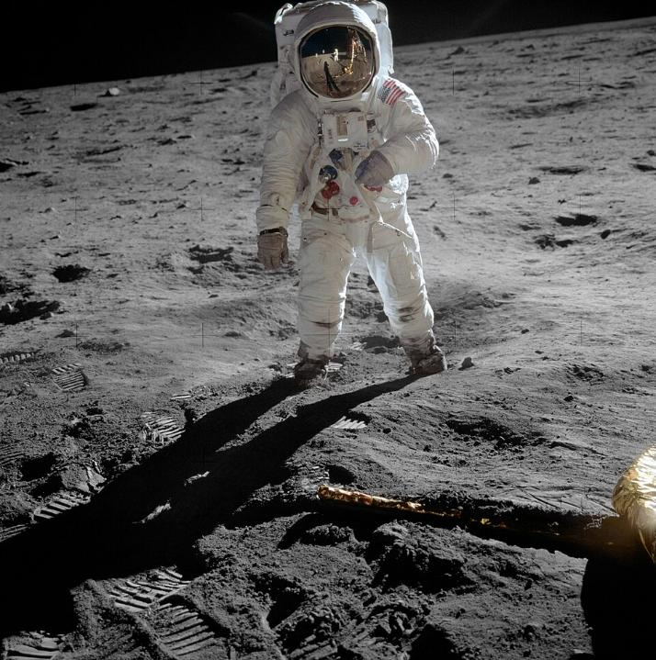

Notes:
Slide 11: But this landmark moment would probably not have happened without the team of people at NASA (that’s short for ‘National Aeronautics and Space Administration’) working hard on all the science and maths that needed to happen in order to get people into space. And so today, we are not going to hear the story of Buzz Aldrin (in this photo), or Neil Armstrong (who was taking this photo – and who you can see in the reflection on Aldrin’s visor), or even Michael Collins who remained in the orbiting command module – but about three brave women….

Slide 12
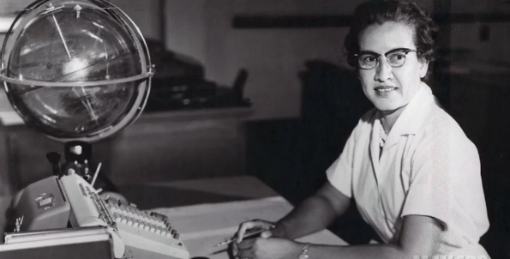
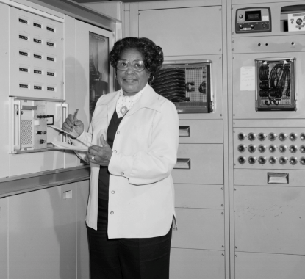
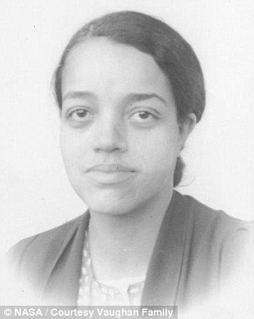

Katherine Johnson
Mary Jackson
Dorothy Vaughan
Pictures copyright-free from NASA
Notes:
Slide 12: …Katherine Johnson, Mary Jackson and Dorothy Vaughan whose stories had been hidden from public view until relatively recently. In order to hear their story, we need to roll back time a few more years, to 1962.
Before anyone even thought of landing on the moon, the aim was to put a man into orbit, circling the earth – which required an enormous rocket, lots of money and some very clever people! America was in competition with Russian astronauts to be the first country to put a man in orbit travelling around the earth – at the time, it was called the Space Race.

Slide 13
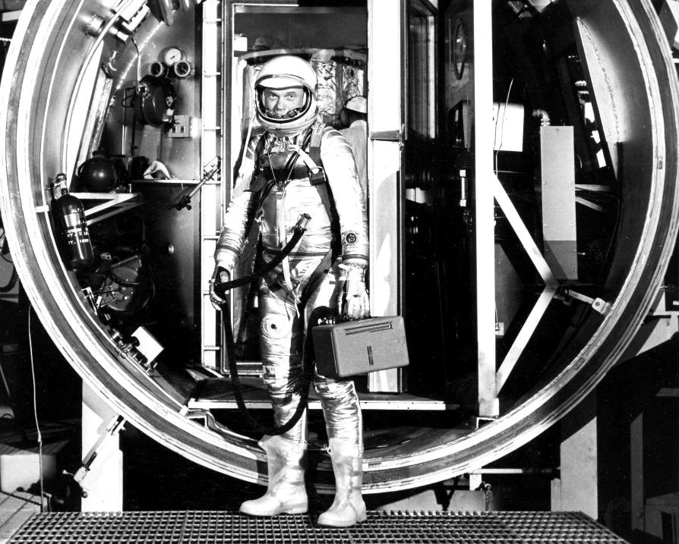
Picture copyright-free from NASA
Notes:
Slide 13: Although the Russians were the first to send a rocket into orbit around the earth in 1961, the American astronaut John Glenn circled the earth not once, but three times the following year, and the lessons they learned from that launch undoubtedly helped them to put men on the moon in 1969. Now before you say ‘How exciting!’ and imagine these three women being at the very forefront of the great Space Race, let me tell you some things about how life really was for them…..

Slide 14
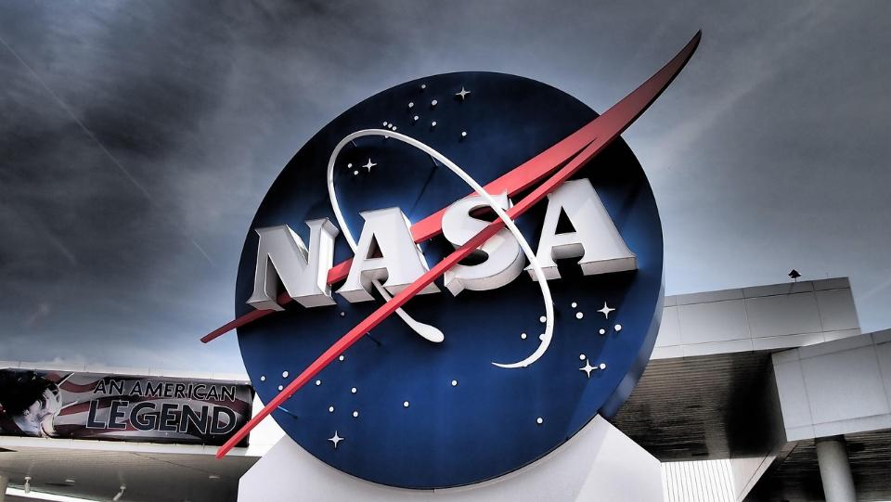
Notes:
Slide 14: At NASA in Langley, Virginia, (as in many other places in America at that time) white people had all the ‘good’ jobs. If you were a black person, it was harder for you to get the sort of education that might help you to get the qualifications for the better jobs. It was even harder if you were a black woman.
NASA called them the ‘colored computers’ and set them to work in the ‘West Area’, a mile away from NASA’s main base.

Slide 15
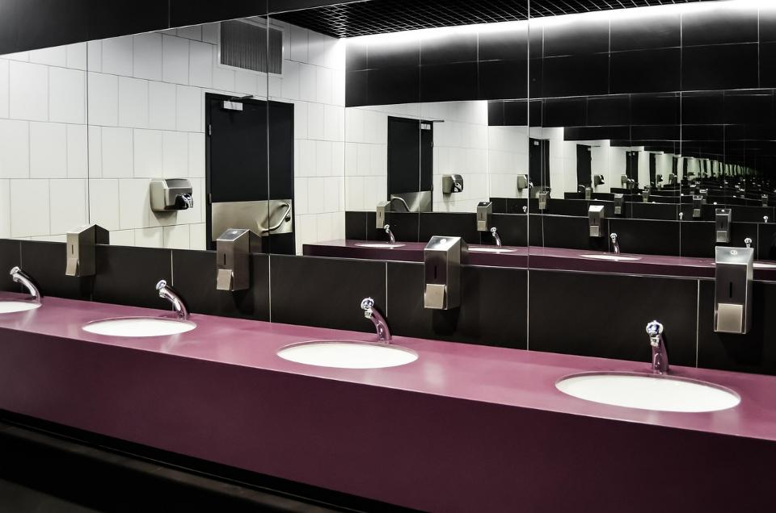
Picture copyright-free from pixabay
Notes:
Slide 15: When Katherine Johnson’s work took her into the main base at NASA, she was not allowed to use the same bathroom facilities as white people and so had to run all the way back to the West Area to use the bathrooms there: imagine a 2-mile round-trip to go to the toilet! And all too often, their supervisors took credit for the work that they, the ‘human computers’, had done: imagine that! You do a great piece of work, but your teacher takes the credit for it, and says it’s their work….

Slide 16

Katherine Johnson: Did the maths that put John Glenn into orbit (and brought him safely back down!)
Mary Jackson: Became one of the first black female engineers
Dorothy Vaughan: Taught herself and her team how to program the new IBM computers
Notes:
Slide 16: Despite all these obstacles, these three women worked their way into the history books and changed the future… Here’s how:
Katherine Johnson did the maths that both launched astronaut John Glenn into orbit, and created the brand new maths that would bring him safely down again. She also worked on the maths for the Apollo 11 mission to the Moon in 1969.
Mary Jackson had to go to court to win the right to get her engineering degree because the only place she could do it was at a university that only white people could go to. She became one of the first black female engineers and blazed a trail for others who would follow.
Dorothy Vaughan was one of the women in charge of a team of ‘colored computers’. When NASA began to use the brand new IBM computers (which took up whole rooms, you can see some in the background of the Mary Jackson photo!), she taught herself and her team FORTRAN, the computer language used to program the new computers. Now NASA couldn’t manage without them!!

Slide 17
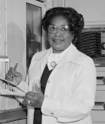
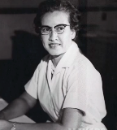
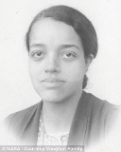
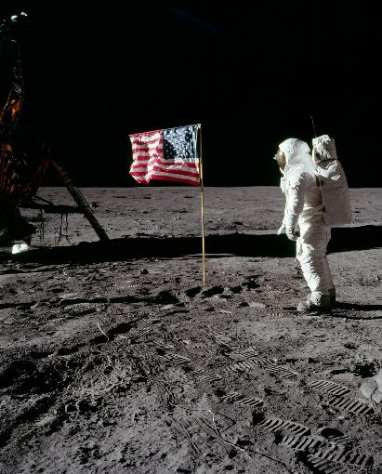
….I wonder what you think about what you’ve heard?....
….I wonder how much the world has changed since the Space Race?....
….I wonder what you might want to ask anyone in this real-life story?....
Notes:
Slide 17: Before we think about what this might mean for us as a school community, let’s just spend a few moments on [one or more] of these questions, thinking and talking together….
….I wonder what you think about what you’ve heard?....
….I wonder how much the world has changed since the Space Race?....
….I wonder what you might want to ask anyone in this real-life story?....
NB with older pupils, you might also want to talk about the differences in perspective of the NASA officials, the astronauts and the ‘colored computers’ – and who felt whose job was most important?!

Slide 18

Picture copyright-free from pixabay
What’s in the rucksack today?
Notes:
Slide 18: What’s in the rucksack today? You may have thought that we’d forgotten all about the rucksack that’s travelled with us throughout this term, but we haven’t: we’ve saved it for the very end of our time together today! Let’s look inside…. [take out the item with your school’s logo on it]Our school badge, like NASA’s logo, reminds us that we are all part of the same team and that there are things that are really important to us as a school community. Someone once said that ‘teamwork makes the dream work’. I wonder how we make this happen in our school?.... [Talk together about what these things are; you will probably also reference your school’s vision & values at this point]
At this point in the term, when we are all getting a bit tired and there’s a lot to do, including (mention end of term events such as open evening, leavers’ plays, sports day etc…..), it’s a good time to remember the importance of everyone’s contribution as a part of our school team. And so we are going to use our rucksack object as part of our reflection time together today. [place it somewhere prominent for all to see during the reflection time, or display your school logo on the screen]

Slide 19
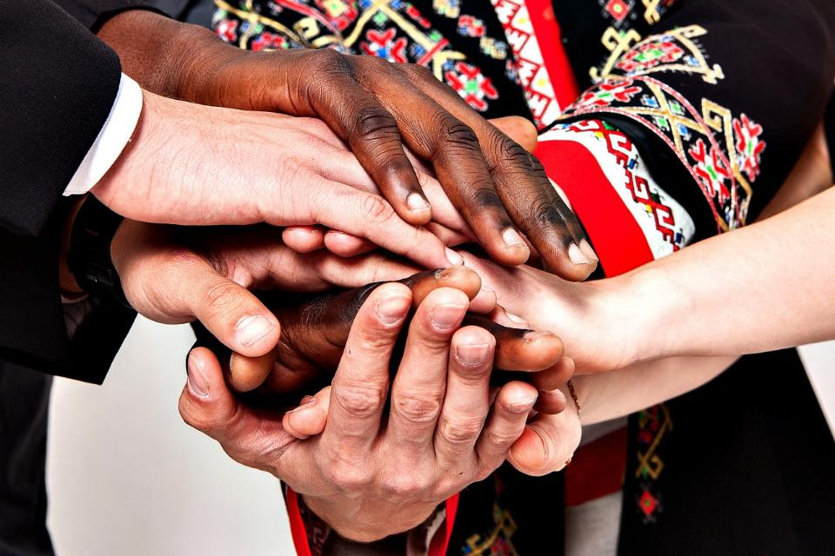
It is good and pleasant when God’s people live (and work) together in peace! (Psalm 133:1)

Slide 20



….I wonder who in our school ‘team’ might feel hidden or forgotten?....
….I wonder how we can all make sure that everyone feels valued?....and that everyone has a chance to shine?....
Notes:
Slide 20: Today, we’ve shared the story of three women who are a part of history, and whose contribution to the Space Race might easily have been forgotten….
….until quite recently, they were a hidden part of the NASA team….
….I wonder who in our own school team might feel hidden or forgotten?....
….I wonder how we can all make sure that everyone feels valued?....and that everyone has a chance to shine?....

Slide 21
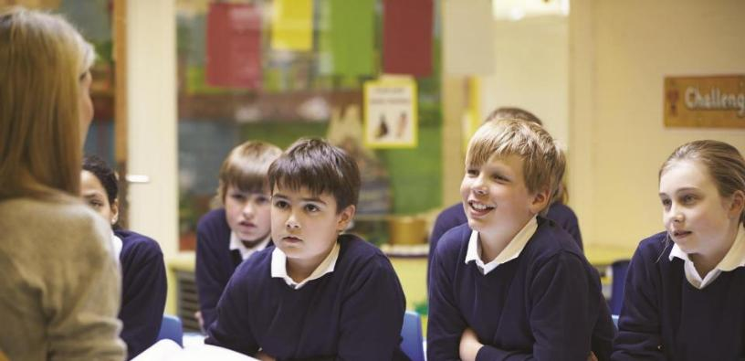
God who loves peace,
As we come towards the end of our school year, we are glad to be reminded of the importance of working together as part of a team. Thank you that each one of us has something to give and that we all matter as part of our school community. May our teamwork make our dream work, we pray.
Notes:
Slide 21: I’m going to pray now, and ask God to help us as we work together. If you’re wearing something with our school logo on it, you might want to place your hand over it as we pray a blessing on our school community.
Prayer:
God who loves peace,
As we come towards the end of our school year, we are glad to be reminded of the importance of working together as part of a team. Thank you that each one of us has something to give and that we all matter as part of our school community. May our teamwork make our dream work, we pray.

Slide 22
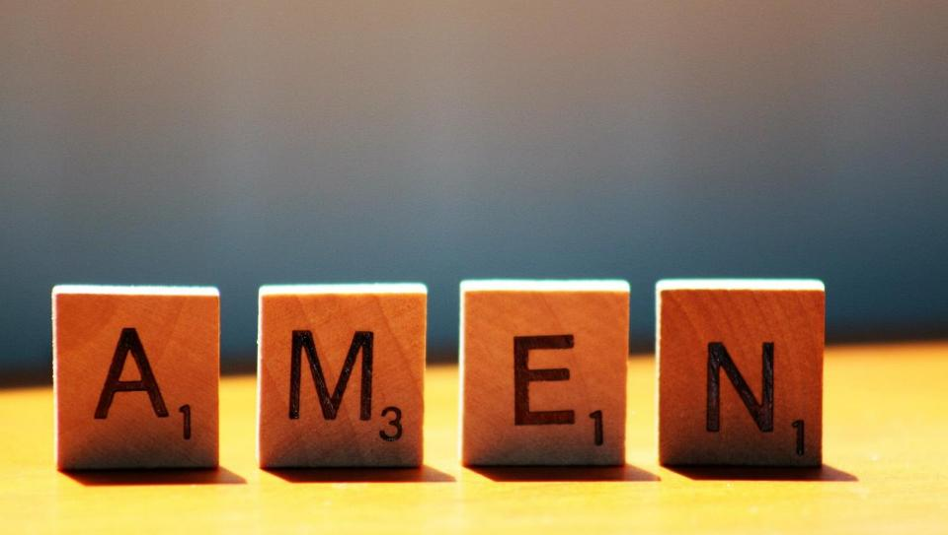

Slide 23
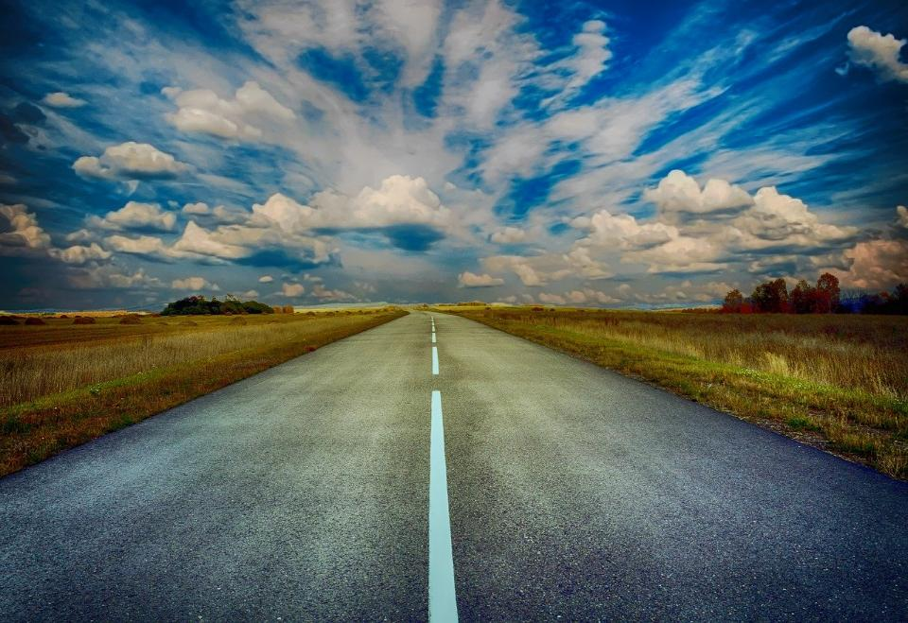
Picture copyright-free from pixabay
Leader: We have journeyed together today. As we leave this place and time and go into the day ahead…
ALL: …May God go with us.
Notes:
Slide 17: Use this term’s leaving words
Leader: We have journeyed together today. As we leave this place and time and go into the day ahead….
ALL: ….May God go with us.
Sign for ‘God: British Sign Language BSL Video Dictionary - God
Sign for ‘go with us’ – we have invented this! After you’ve signed ‘God’, bring your finger down alongside your other finger and make them ‘journey together’ in front of you.

Slide 24

Notes:
Ideas for classroom reflection: something with your school logo on
Look at your school’s badge or logo.
How does it remind you what’s important to you as a school community?
How have we worked together as a team recently?
How did we make sure that it was fair for everyone?
How can we make sure that everyone feels valued?
Now go and make it happen!!

