Slide 1
Leader: As we gather together
ALL: …we bring our hearts.
Notes:
Slide 1: Use the gathering words for this term, or your usual greeting if you prefer. The greeting comes with BSL signing; you can view the demos using links under the slide.
Leader: As we gather together,
ALL: …we bring our hearts
Signs for greeting: click on links
Hearts: British Sign Language BSL Video Dictionary - heart

Slide 2
Leader: As we gather together
ALL: …we share our thoughts.
Notes:
Slide 2: Use the gathering words for this term, or your usual greeting if you prefer. The greeting comes with BSL signing; you can view the demos using links under the slide.
Leader: As we gather together,
ALL: …we share our thoughts.
Signs for greeting: click on links
Thoughts: British Sign Language BSL Video Dictionary - thought

Slide 3
Leader: As community together
ALL: …we serve one another.
Notes:
Slide 3: Use the gathering words for this term, or your usual greeting if you prefer. The greeting comes with BSL signing; you can view the demos using links under the slide.
Leader: As community together,
ALL: …we serve one another.

Slide 4
Songs from
the heart
Notes:
Slide 4: Songs from the heart
We have reached the end of our term of themes – and we are going to finish this term in a rather unusual way, on a bit of a cliffhanger…..more of that in a moment! Throughout this term, we have shared in David’s songs from the heart and thought about how his words express so many of the different things that we all experience as human beings. Across his life, there were many ups and downs – I wonder if you can identify some of them?

Slide 5
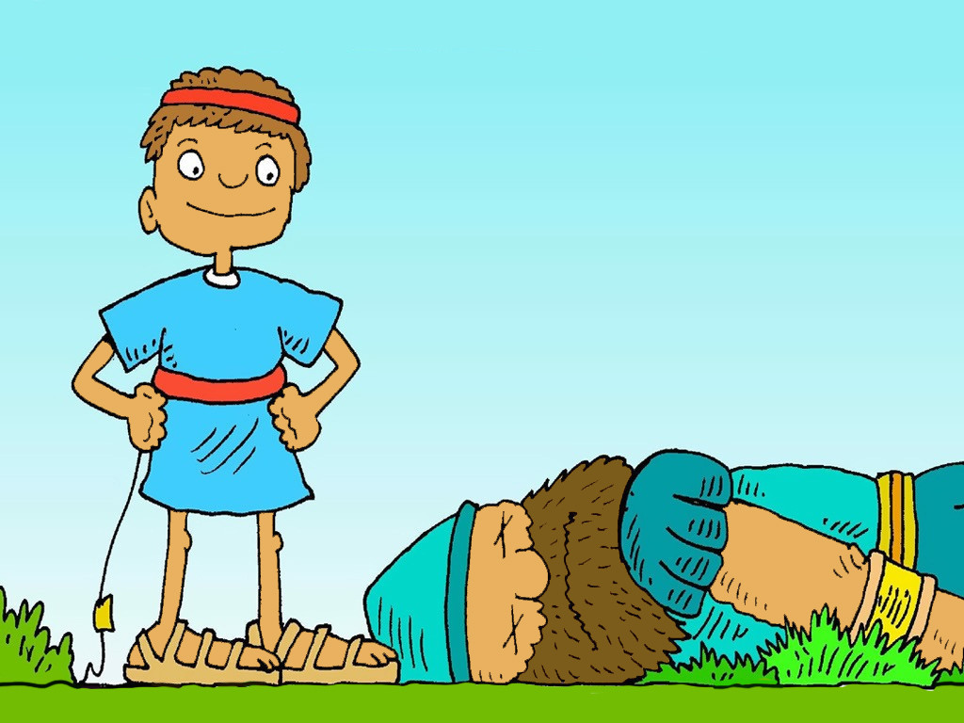
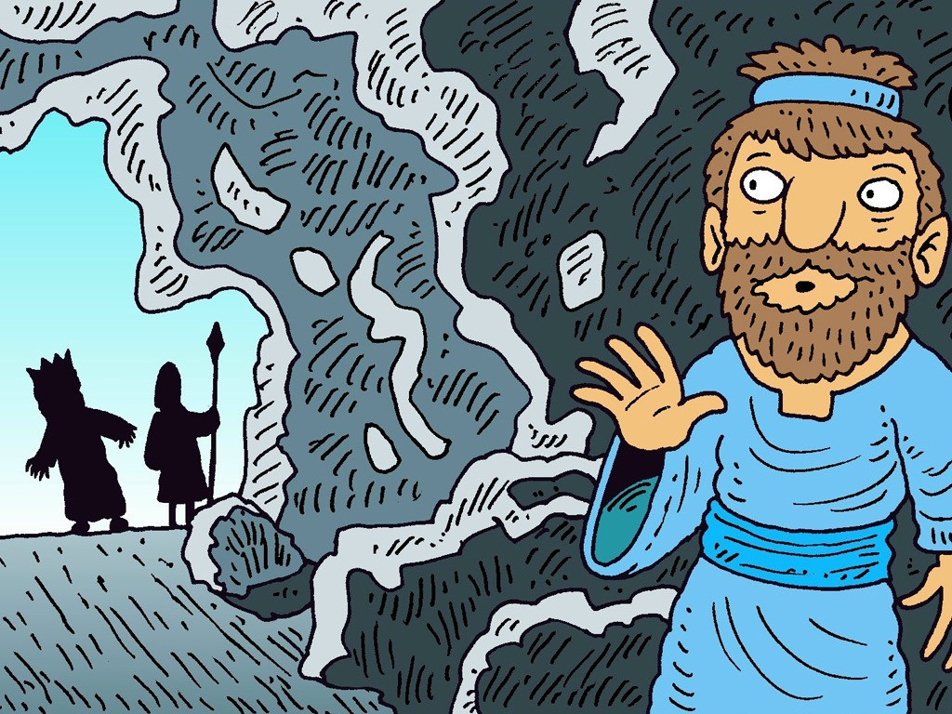
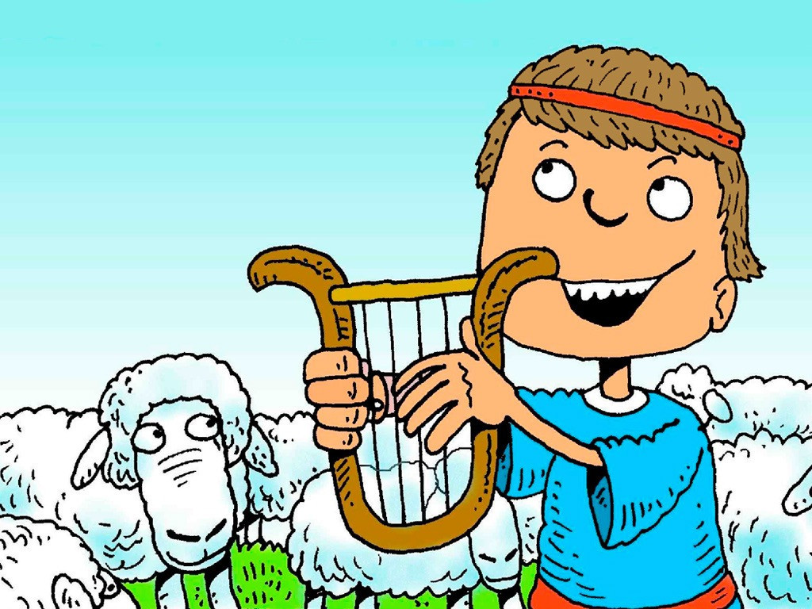
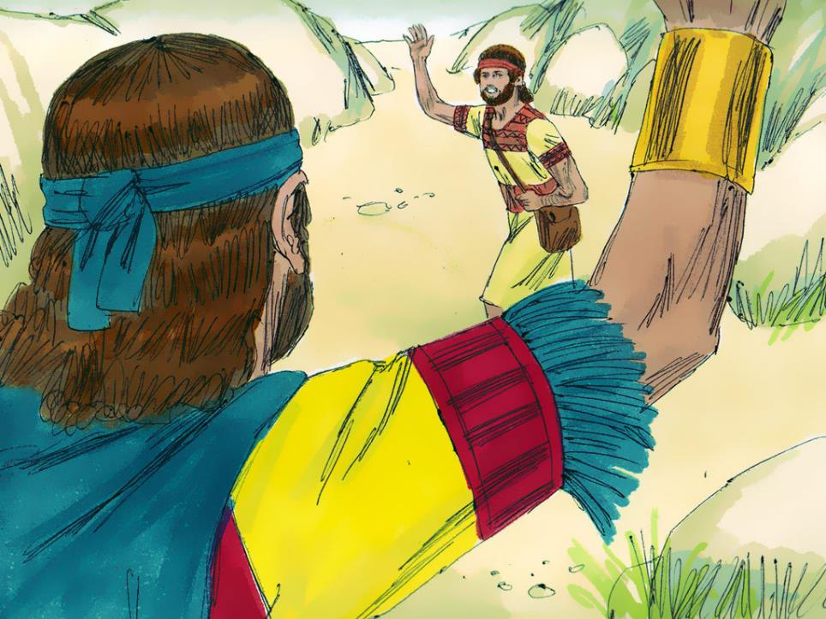
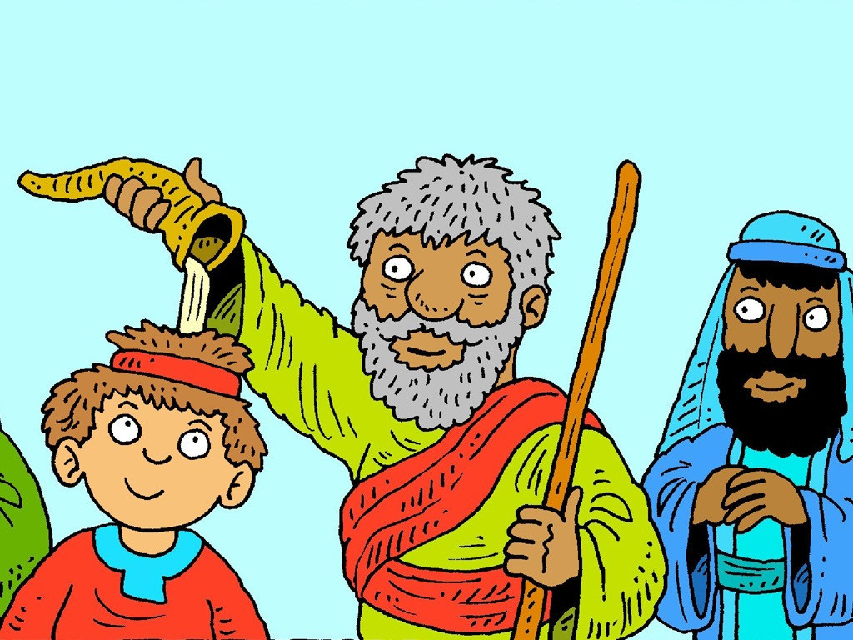
Notes:
Slide 5: scenes from David’s life
As we look at each of these, identify which are ‘up’ moments (show thumbs up) and which are ‘down’ moments (show thumbs down) [go through pictures in turn, asking children to vote with their thumbs for each]
Defeating Goliath
Being hunted by King Saul
God is my shepherd
Saying farewell to Jonathan
Being anointed as King
Many millions of people have drawn strength and hope from David’s words in the Psalms, and have found something to encourage them whether they are up or down!
We’re going to put a pause on David’s psalms now, and connect with the Easter story
We have heard David speak with such faith about God being with him, and being his hiding place in times of trouble, so it might be a bit of a surprise to hear that even David sometimes had doubts.

Slide 6
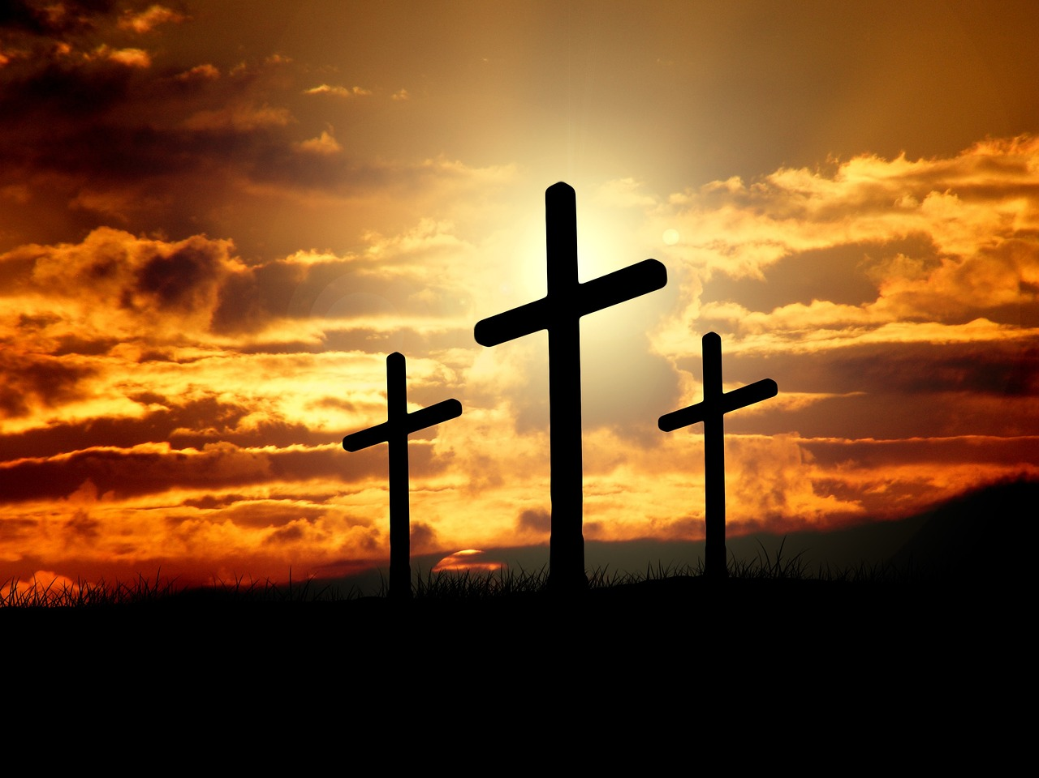
Notes:
Slide 6: At this point in the calendar, we are turning our focus towards Easter. It might surprise you to know that David’s words are scattered throughout the events that Christians all across the world remember at this time. Before we find out some more, let’s recap what we remember of the story – and we can use our thumbs again, to remind each other of whether they were a ‘thumbs up’ / good part of the story, or a ‘thumbs down’ part…..
[use slides 7-11 to help you. Some pupils might be able to see more deeply into the complexity of these events, and articulate that although the events may seem ‘thumbs up’ (e.g. eating together), what the events point to is Jesus’ death, so maybe more a ‘thumbs down’, or vice versa because of what Christians believe about Jesus’ death! Allow a bit of time for these ideas, or follow up in your RE lessons. The slides in this presentation contain images from across the world, to show how significant these events are for Christians from different cultures. You may need to explain this to younger pupils. There will be some further images where we connect with words from the Psalms]

Slide 7
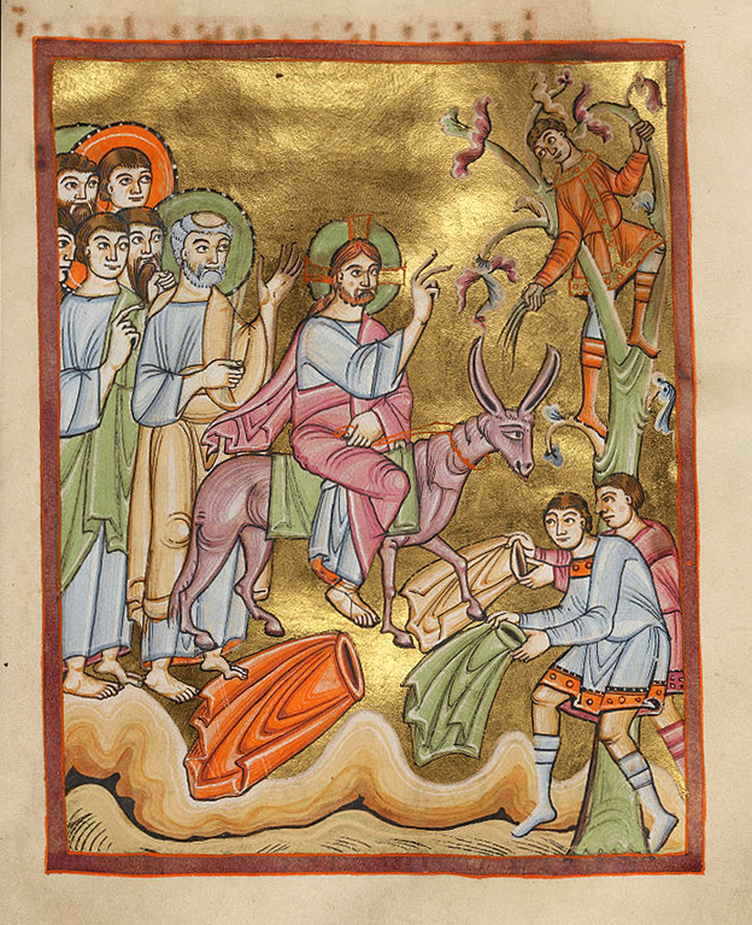
Notes:
Slide 7: Jesus rode into Jerusalem on a donkey (Palm Sunday) and people cheered for him as a King. Is this a ‘thumbs up’ moment or a ‘thumbs down’ moment?
[Image from a manuscript, 103-1040 CE]

Slide 8
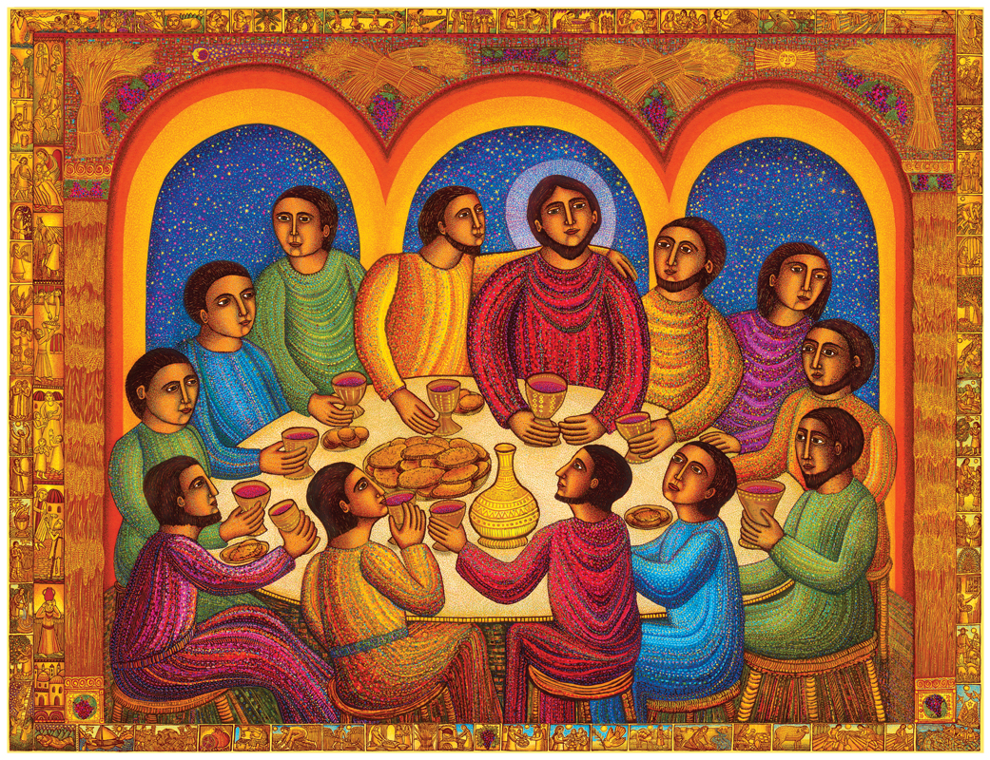
Notes:
Slide 8: Jesus and his friends had dinner together, a Last Supper. Is this a ‘thumbs up’ moment or a ‘thumbs down’ moment? [Image from American artist John Swanson, showing his Mexican heritage]

Slide 9
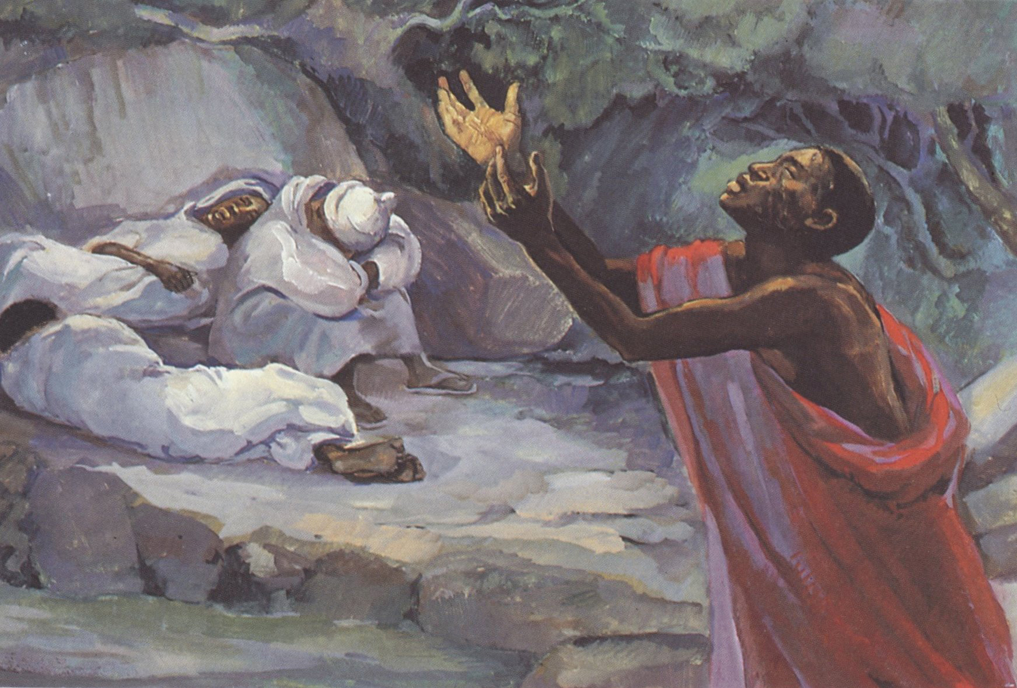
Notes:
Slide 9: The disciples go with Jesus to the Garden called Gethsemane, but they all fall asleep instead of keeping Jesus company. Is this a ‘thumbs up’ moment or a ‘thumbs down’ moment? [Image from the MAFA community in Cameroon, Central Africa]

Slide 10
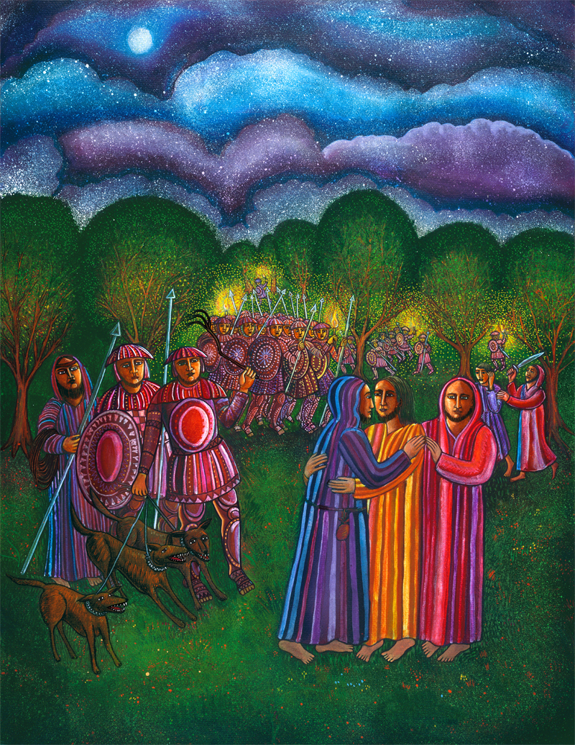
Notes:
Slide 10: Judas shows the soldiers who Jesus is, by greeting him with a kiss. Is this a ‘thumbs up’ moment or a ‘thumbs down’ moment? [Image from American artist John Swanson, showing his Mexican heritage] At this point, Jesus is arrested by the soldiers and the disciples run away, leaving him alone.

Slide 11
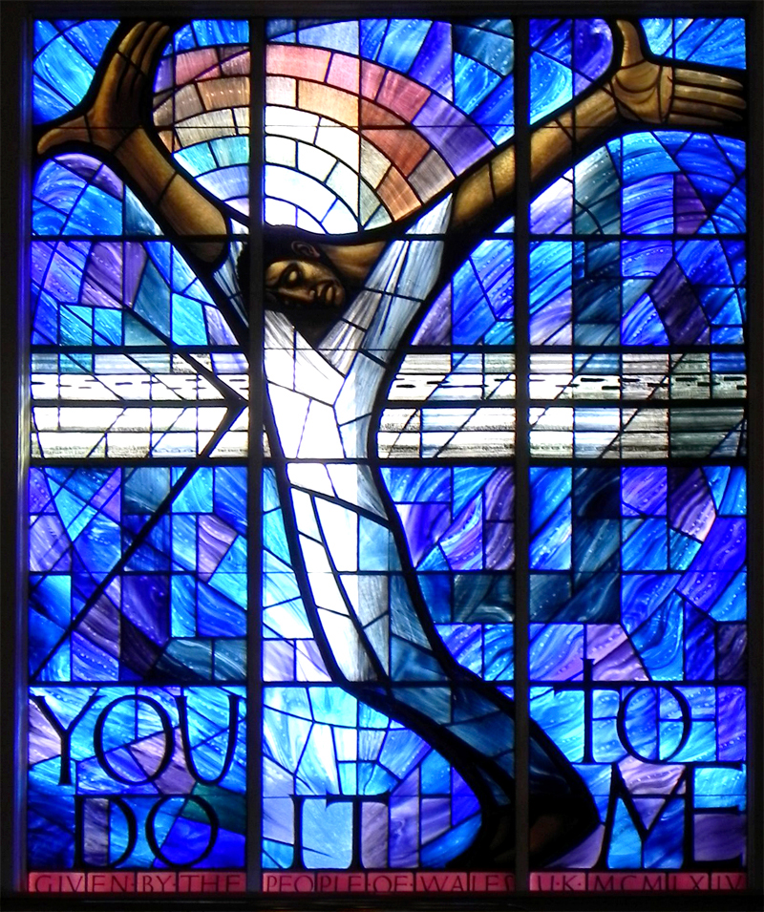
Notes:
Slide 11: Jesus dies on the cross. Is this a ‘thumbs up’ moment or a ‘thumbs down’ moment? [Image from 16th Street Baptist Church, Wales]

Slide 12
Songs from
the heart
Notes:
Slide 12: Songs from the heart
Let’s find out where the words from the Psalms pop into the Easter narrative…..
After all we’ve learned this term, it’s probably no surprise that David’s words appear at both a ‘thumbs up’ and a ‘thumbs down’ moment!

Slide 13
“My God, my God, why have you forsaken me?” Psalm 22:1
“God bless the one who comes in the name of the Lord!” Psalm 118:26
Notes:
Slide 13: When the people cheered Jesus riding into Jerusalem, they used some words from Psalm 118: “God bless the one who comes in the name of the Lord!”, which is a part of one of David’s songs of victory, when God had saved him. Everyone was very excited to see Jesus, because they believed that he was going to be the King who would save them from the Romans.
When Jesus hung on the cross, he used some of the most desperate words ever written by David: “My God, my God, why have you forsaken me?” Psalm 22:1
[forsaken is another word for abandoned, or left alone]
For Jesus, this was the deepest darkest moment of all, when he felt completely separated from God, his Father. When Jesus had no words of his own to express how he was feeling, he used the words that David had written many hundreds of years before.
It was the deepest darkest moment for the disciples, who had hoped that Jesus would save them from the Romans: their waiting and hoping had all been for nothing. For Christians, this is the deepest darkest moment in the whole Easter account, when Jesus gave up his life: and yet they call the day when this part of the story is remembered, ‘Good Friday’. It maybe whispers that all is not lost…..that better things will come, but for now we will wait until after the holiday to pick up the rest of the story!

Slide 14
…. I wonder what you are waiting for?....
….I wonder what your heart longs for?.....
….I wonder if you carry disappointments, like the disciples did?....
Notes:
Slide 14: Responding (and words for worship): you will need the sand timer for this section
As we reflect and wonder together today, let’s be still and quiet….
As you think, you might like to watch the sand as it trickles through the sand timer……
….I wonder what you are waiting for?....
.…I wonder what your heart longs for?....
….I wonder if you carry disappointments, like the disciples did?....
.…I wonder if any of the words written by David, his songs from the heart, might help you as you wait?....
….maybe it’s good to remind ourselves that all is not lost…..
….let’s hear some final words from David now as we continue to watch the sand….

Slide 15
‘Wait for the Lord; be strong and take heart and wait for the Lord.’ [Psalm 27: 14]
Notes:
Slide 15: ‘Wait for the Lord; be strong and take heart and wait for the Lord.’
These words come from the same song (Psalm 27) that David wrote about his heart’s desire, which we heard about a few weeks ago. ‘Taking heart’ is another word for having hope, recognising that difficult circumstances, and waiting, often lead to better things and building resilience in us.
These are good words to hear at this point in the story…..
Though Jesus’ disciples may have lost all hope, we know from the story that this deep dark moment is not where the story ends…..so let’s take heart and be strong for ourselves, whatever we are facing….
Prayer: As we continue to watch the sand, you might like to bring what’s in your heart as a prayer before God. Use your own words in your heart, or just continue to be still and quiet… [leave space for children to think/pray]

Slide 16
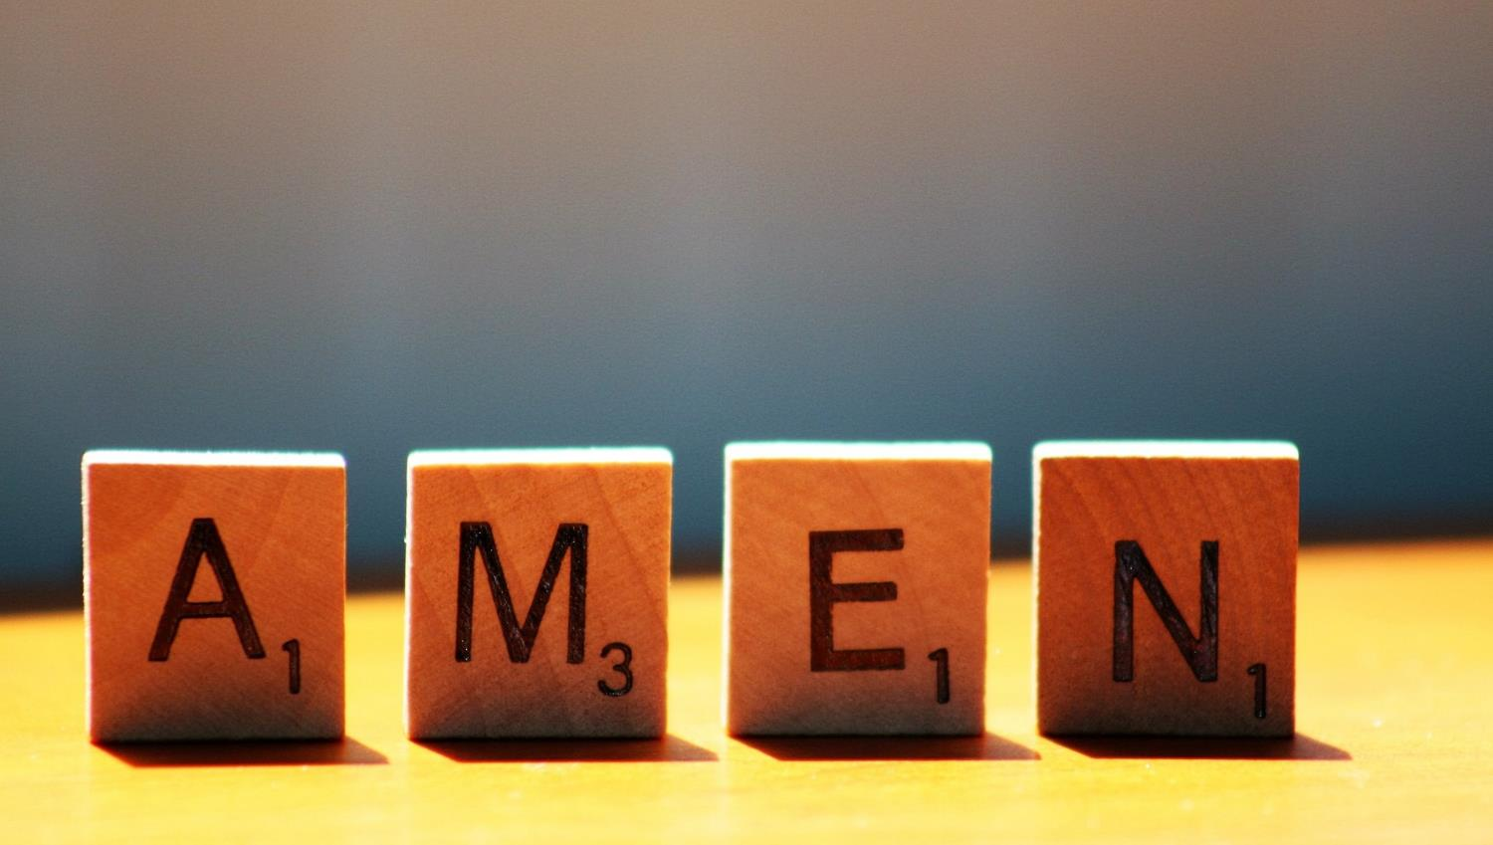

Slide 17
Leader: As we leave this place & time and go into the day ahead…
All: …may we serve one another in our thoughts and words and actions.
Notes:
Sending: Slide 17
Leader: As we leave this place and time and go into the day ahead,
All: ….may we serve one another in our thoughts and words and actions.
Signs for response: click on links
Thoughts: British Sign Language BSL Video Dictionary - thought (signbsl.com)
Words (use 3rd definition): British Sign Language BSL Video Dictionary - word (signbsl.com)
Actions: British Sign Language BSL Video Dictionary - action (signbsl.com)

Slide 18
‘Wait for the Lord; be strong and take heart and wait for the Lord.’ [Psalm 27: 14]
Notes:
Ideas for classroom reflection: Waiting…..
Are there things that you are waiting for? Maybe something that you are longing to see happen?
Turn over the sand timer and watch the sand trickle through. Some things take a long time….. You might want to use the time to help you think or pray about what you are waiting, or ponder David’s words about ‘taking heart’.

