Slide 1
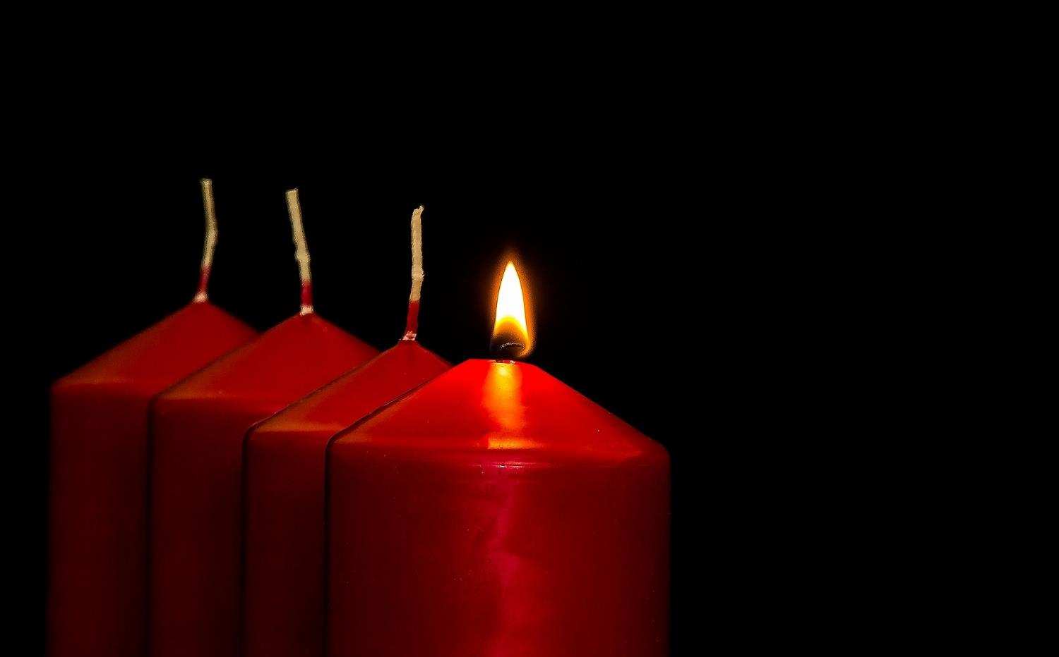
Leader: As we light our Advent candle…
All: May our time today show us something new, like light in the darkness.
Notes:
Slide 1: Use this special greeting for the Advent season, as you light your Advent candle.

Slide 2
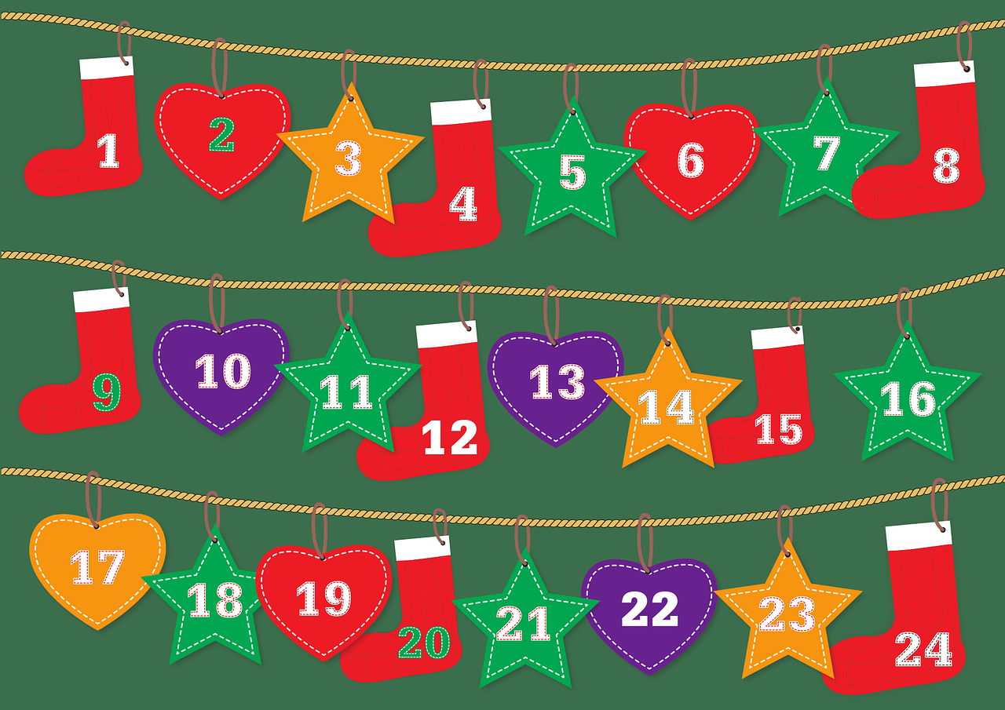
Advent calendar
Notes:
Slide 2: I am sure that you all know what this is – and how many days there are from the start to the end…..Advent calendars are a way of helping us keep track of the days leading up to Christmas Day! We are beginning the season in the Christian calendar known as Advent – a special time of waiting and preparation for Christmas Day, the day that celebrates the birth of Jesus. We will be doing this ourselves in school in lots of different ways…..
If using online Advent calendar: In a few moments, we’re going to find out about a very special Advent calendar that will join us together as a school community, and take us through Advent together.

Slide 3
Beatitudes
Beati
‘How-to-be-attitudes’
Notes:
Slide 3: We’ve been thinking all through this term about Jesus’ words in the Beatitudes, and thinking what difference they made to the people who heard them then, and what they might mean for us now. Today, we’re going to go back in history to a time just before Jesus was born…..but before we go there....

Slide 4
Notes:
Slide 4: I wonder who’s in your family? Talk together about immediate and wider family, such as cousins, and grandparents – and whether children know anything about people from further back in their family history. [Remember that there are many different models of family, and that some children may not know much – or wish to divulge much – about their family. If it helps, use your own family, with photos if you like, as an illustration: you are just wanting children to get an idea that families can be quite big – and go back through time.] People sometimes call this their ‘family tree’ because each part of their family history is like a branch, that grows and spreads out over time.

Slide 5
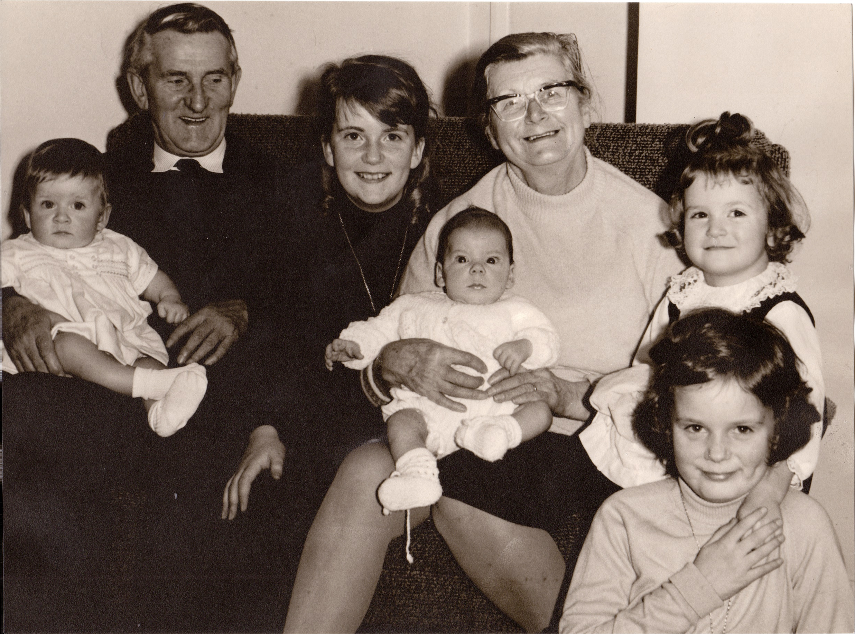
Notes:
Slide 5: Share (and talk about) your own family photos if you prefer!

Slide 6
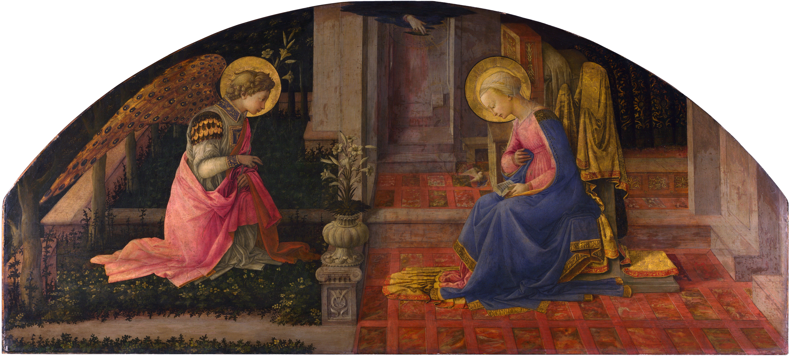
You will give birth to a son, and you will name him Jesus*.…..He will rule over the people of Jacob forever. His kingdom will never end….He will be called the Son of God.
‘The Annunciation’ – Fra Filippo Lippi (c.1449) ©National Gallery
Notes:
Slide 6: Today we’re going to go back to a time just a few months before Jesus was born, not long after the Angel Gabriel had spoken to Mary and told her about the special baby she would be carrying.
There are many works of art capturing this important moment (including this one from the National Gallery in London), but let’s hear the words that the Angel spoke to her: ‘You will give birth to a son, and you will name him Jesus* …..He will rule over the people of Jacob forever. His kingdom will never end….He will be called the Son of God.’ (Luke 1:31,33,35) *NB the name Jesus means ‘Saviour’.
The news that the Angel shared must have been both exciting and scary at the same time! Jesus was not going to be any ordinary baby: he would be God’s son, the Great Rescuer and part of a great family!

Slide 7
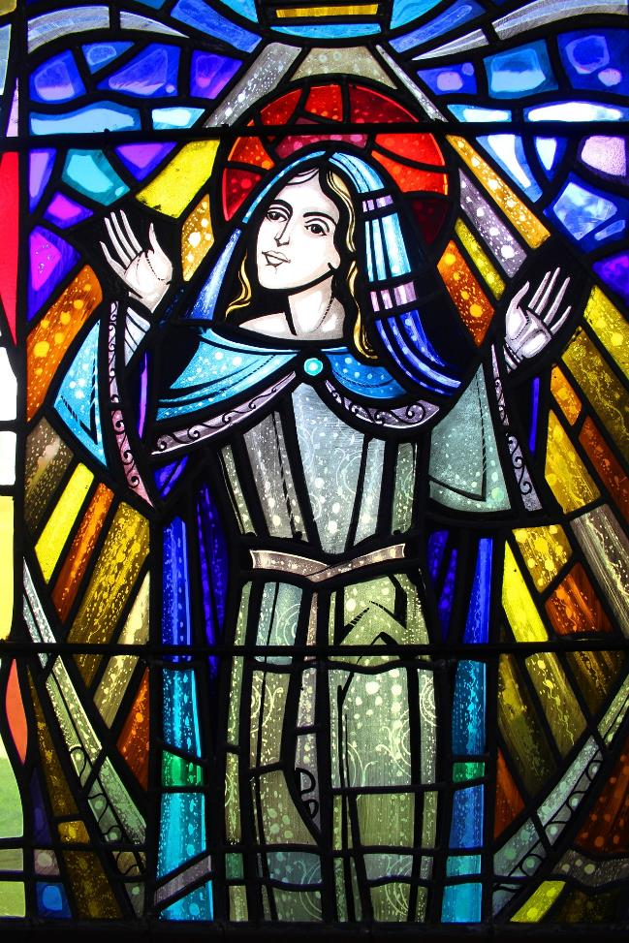
‘With all my soul I praise God; my heart is happy because God is my Saviour…..
…God has done what he promised to our ancestors, to Abraham and his family forever!’
(Luke 1: 46, 55)
Notes:
Slide 7: Mary had known about this Great Rescuer for a long time, but had no idea that she would be the Great Rescuer’s mother!! Her words of response are some of the most famous words in the Bible: ‘With all my soul I praise God; my heart is happy because God is my Saviour…..God has done what he promised to our ancestors, to Abraham and his family forever!’ (Luke 1: 46, 55)
Mary’s family was only just beginning, but this birth was part of a much bigger story….

Slide 8
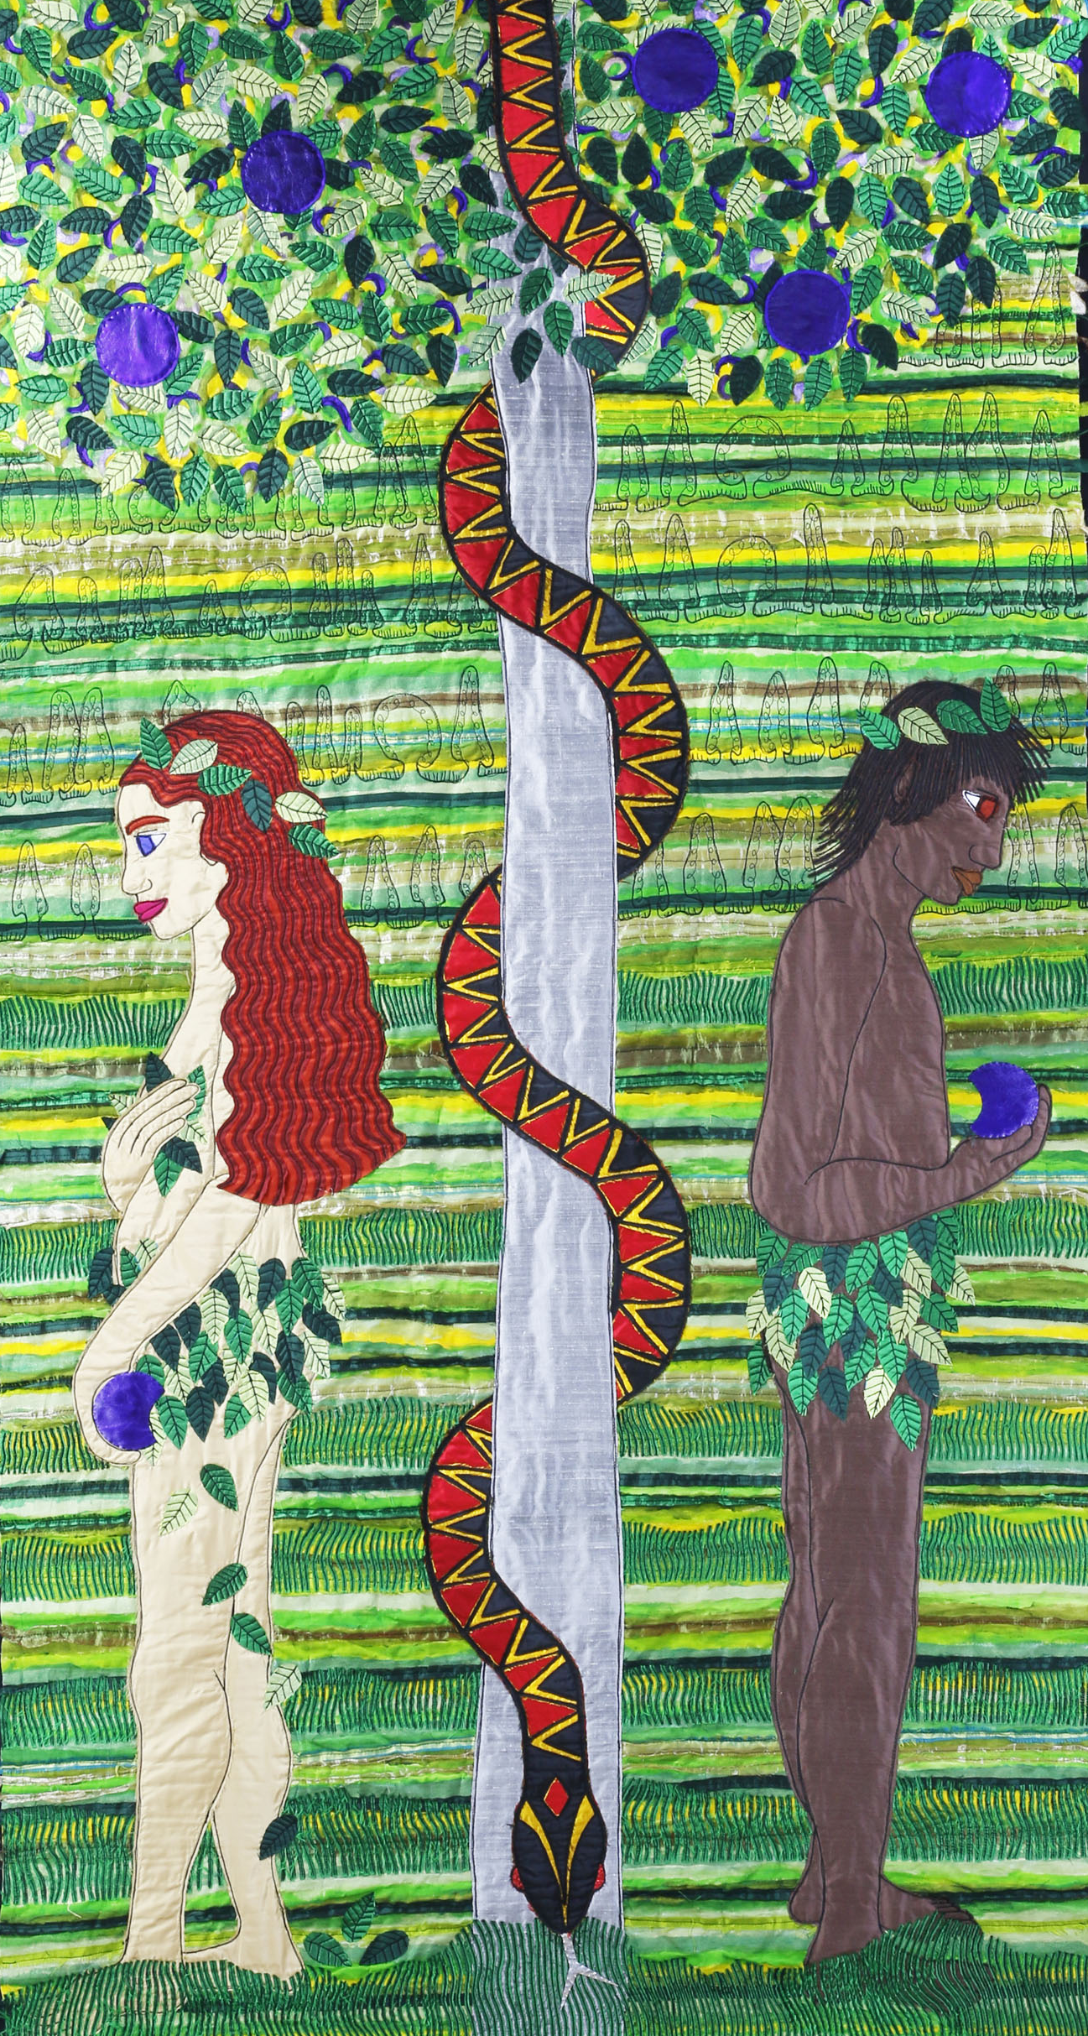
©Jacqui Parkinson
‘Threads Through Creation’
Notes:
Slide 8: ….a story that started (and went wrong!) at the very beginning of time: a story that Mary, and Christians across the world believe this baby had come to fix! The darkness that Christians believe entered the world with Adam and Eve’s disobedience was not the end of the story. Into this darkness the Light of the World would be born…..

Slide 9
“Mary treasured all these things in her heart.”
Notes:
Slide 9: It’s no wonder, then, that we hear later on in this story that Mary ‘treasured’ and wondered about all these things in her heart. So, that’s what we’re going to do now….to reflect on and wonder about the words we’ve heard….

Slide 10
….I wonder how it felt to know that the Rescuer had come as a tiny baby?....
….I wonder if this is what people expected?....
….I wonder what it is about this story that makes us wonder…?
….I wonder how Jesus might be light in the darkness?....
Advent calendar link (if using): https://calendar.myadvent.net/?id=1uiwq8a1ta0c7dn76sridohrumzys9yd
Notes:
Slide 10: Responding (and words for worship):
….you might like to look at the flame of the candle as you think….
…we’ve heard about Mary’s response to the birth of Jesus…..
…listen again to her words: “God has saved his people….
….God has done what he promised to our ancestors, to Abraham and his family forever!”
…..I wonder how it felt to know that the Rescuer had come as a tiny baby?....
….I wonder if this is what people expected?....
….I wonder what it is about this story that makes us wonder…?
….I wonder how Jesus might be light in the darkness?....
Now I’m going to use a short prayer, asking God to help us as we begin this Advent adventure together. If you would like to join me, then join in with ‘Amen’ at the end – or if you prefer, just be still with your own thoughts.
We’ll be picking up on this theme of light in the darkness as we travel together through Advent especially through our special Advent calendar. [use the link to open the door for today]

Slide 11
Dear God
As we begin this Advent season, may our hearts be open to hear this special story of the very first Christmas.
May we, like Mary, find things that will make us wonder, and give you praise.
Notes:
Slide 11: Prayer
Dear God
As we begin this Advent season, may our hearts be open to hear this special story of the very first Christmas. May we, like Mary, find things that will make us wonder, and give you praise.

Slide 13
Leader: As we leave this place & time…
All: May the light of Advent shine brightly in our school today.
Notes:
Sending: Slide 13 (You might want to use this slide throughout the Advent season to end your time together)
Leader: As we leave this place and time….
All: May the light of Advent shine brightly in our school today.

