Slide 1






All pictures copyright-free from pixabay
Notes:
Slide 1: Candle flame stilling exercise
Use the stilling slide if desired: the suggested words should be spoken slowly, leaving pauses inbetween to create a sense of stillness.
As you sit quietly, watch the candle flame flicker….[PAUSE]
Now practise slower breathing…..in…..and out…..in……and out…..keep this going as you continue to look at the flame….[PAUSE]
You maybe notice that you are feeling calmer and more relaxed….[PAUSE]
We come into this special / sacred space and time to be still….to think deeply…..to be together as a school community…..
In our time together today, we will watch a short video clip, talk together, share the next part of our story and then reflect together.
But first, let’s welcome one another as we begin….

Slide 2
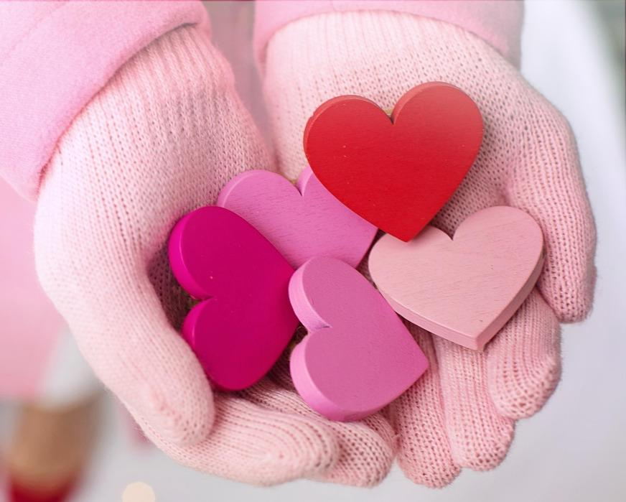
Leader: As we gather together today…
ALL: …we bring our thoughts and our hearts into this sacred space.
Notes:
Slide 2: Gathering
Let’s use our greeting to say to each other as we begin….
Leader: As we gather together today….
ALL: ….we bring our thoughts and our hearts into this sacred space.
Here are BSL actions for some of the words:
Leader’s words:
Gather: https://www.signbsl.com/sign/gather (1st video)
Today: https://www.signbsl.com/sign/today (1st video)
Pupils’ response:
Thoughts: https://www.signbsl.com/sign/thoughts (1st video)
Hearts: https://www.signbsl.com/sign/heart (1st video)

Slide 3
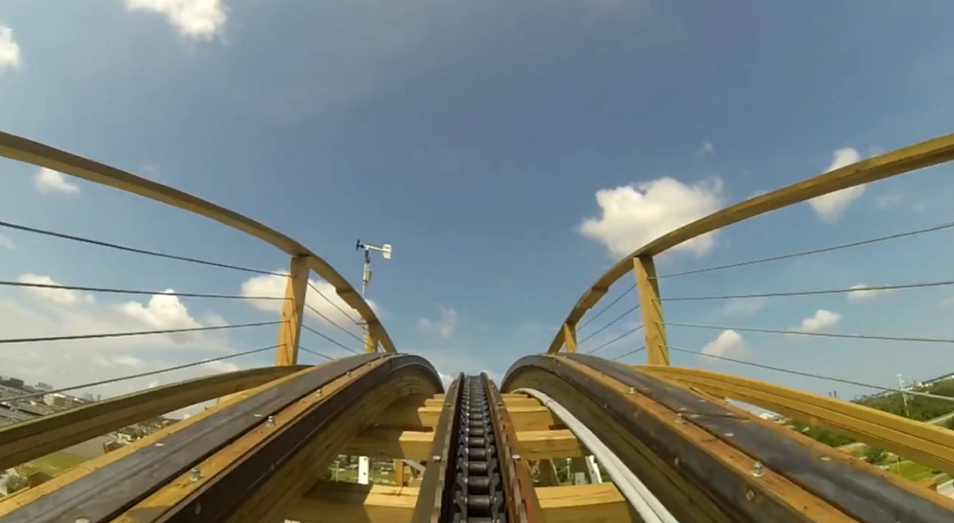
I wonder if life might be a bit like a roller coaster?
Notes:
Slide 3: We’re going to start our time together by looking at a short video clip. Can you guess what it might be of?!! [a roller-coaster ride! There is no sound, but you may find that you get some natural sound-scaping from children! Click on the picture and it will link you to the video – it was too large to save as part of the PowerPoint.]
Some people say that life is a bit like a roller-coaster – I wonder why this might be? I wonder what the ‘ups’ and ‘downs’ of life might look like for us?
[allow children to talk together, maybe in pairs; ask for some feedback from children]
We’re going to return to this idea at the end of our time today, but now let’s return to Daniel’s story.

Slide 4
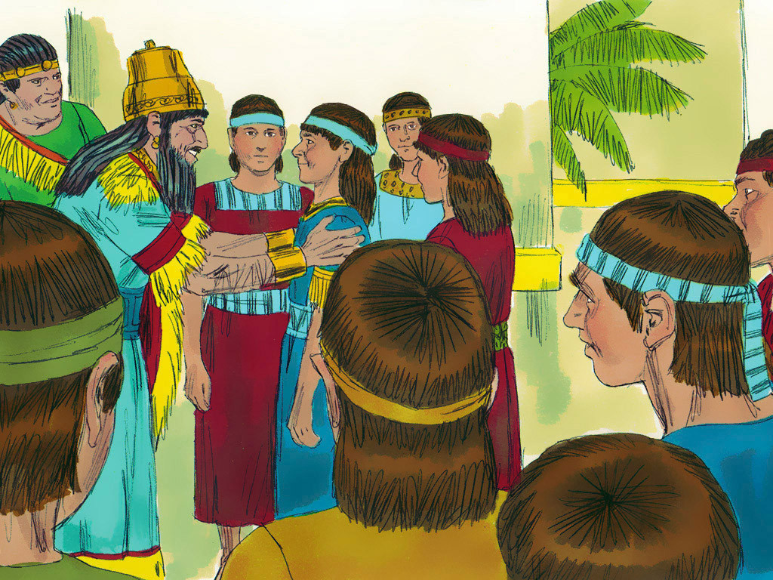
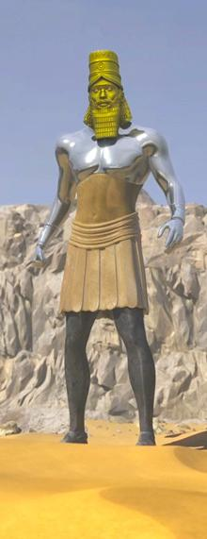
Notes:
Slide 4: When we left Daniel and his friends last week, they had found favour with the King because God had given them great wisdom….and we left on a cliffhanger, with God giving Daniel a very special talent. So, what was it?!....
God gave Daniel the ability to understand people’s dreams and to tell them what they meant, which is very useful, as the Kings Daniel serves have a lot of very strange dreams! Although today’s story is not about that, don’t forget this important detail, because it will come in handy in the weeks to come….!

Slide 5
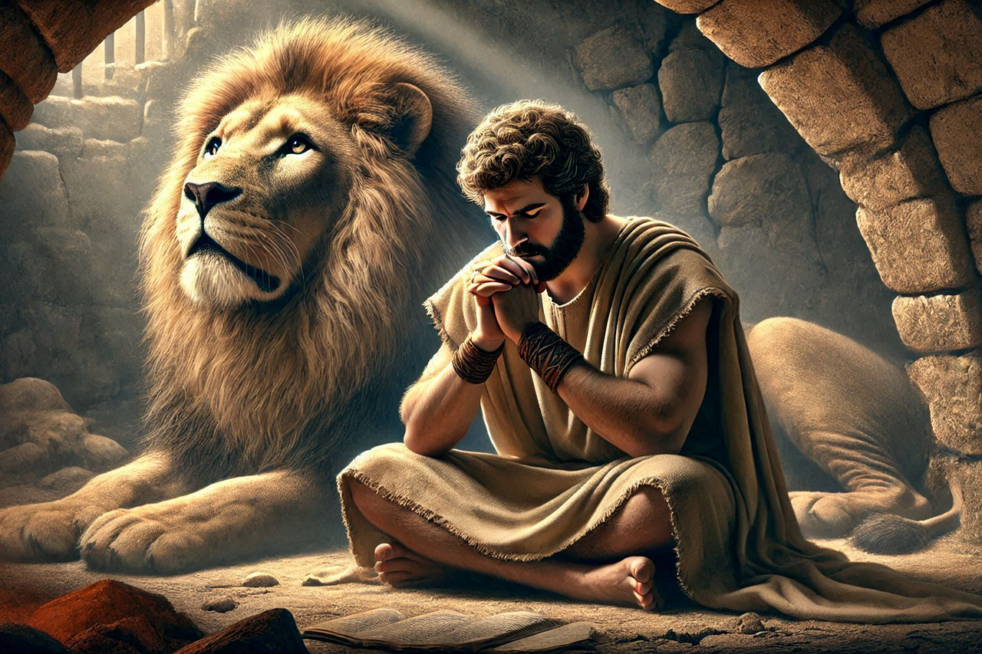


Shine like stars!
Notes:
Slide 5: As we go deeper into Daniel’s story, we will meet some ups, some downs and some twists and turns – and some really big challenges. Daniel isn’t in this part of the story, but today we see his friends Shadrach, Meshach and Abednego having to make some more really difficult decisions.
To help us to get really involved in the story today, we’re going to engage our best pantomime actions: we’ll cheer the goodies, ‘Hurray!!’ and ‘boo!’ the baddies – and you’ll see these signs pop up to help you to get them in the right place!!

Slide 6
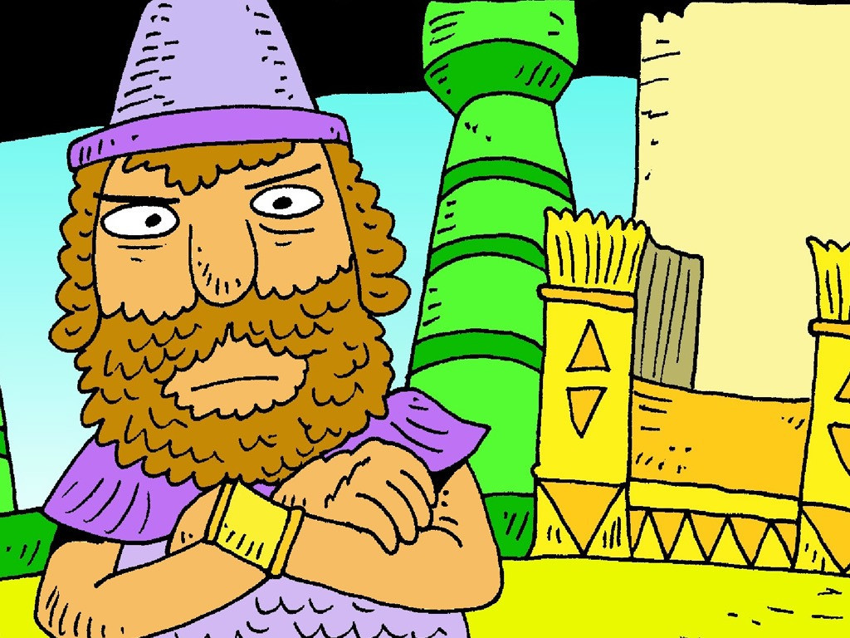

Notes:
Slide 6: King Nebuchadnezzar was a very powerful and bossy king. He was used to getting his own way – and he didn’t like it one little bit if people didn’t do what he said! ‘Booo!!’

Slide 7
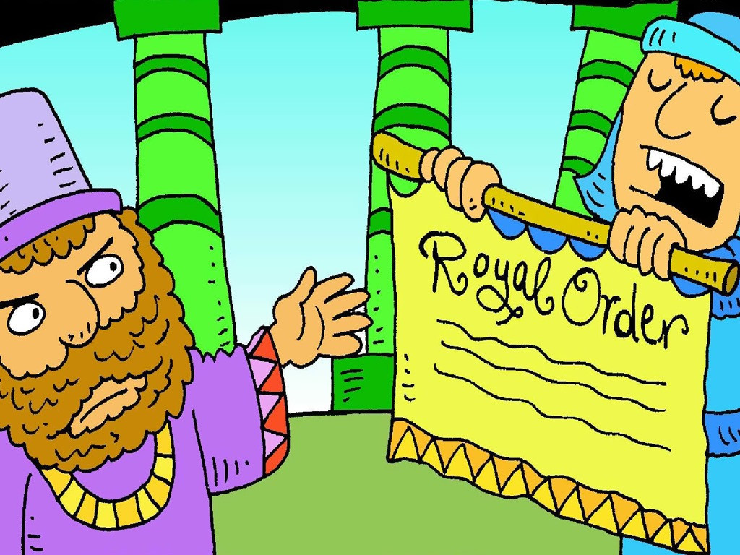
Notes:
Slide 7: King Nebuchadnezzar wanted to make himself the most important person in the Kingdom. ‘Boooo!’ ‘Everyone must bow down and pray to a big gold statue I have made. It will be your God,’ said the king.

Slide 8
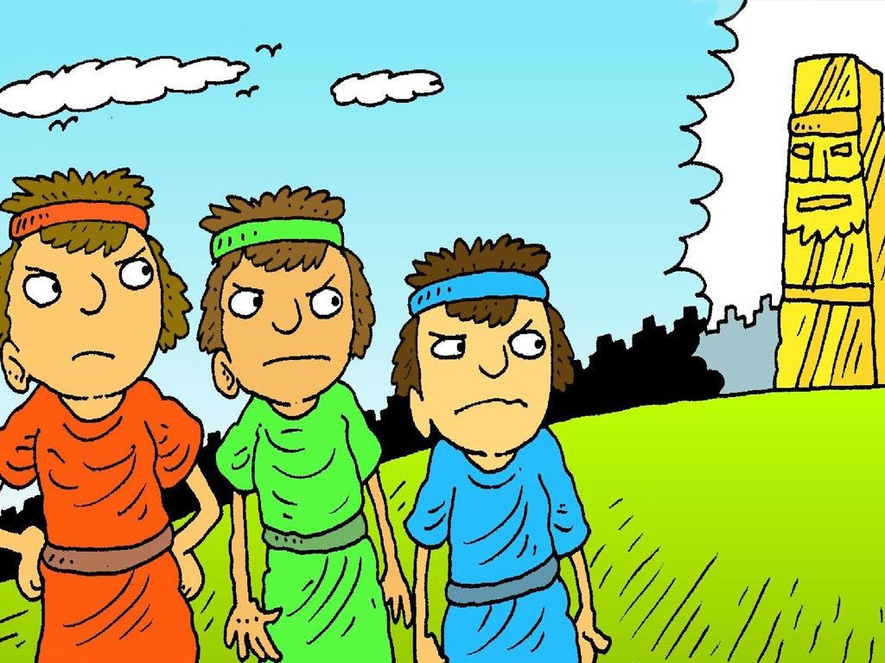

Notes:
Slide 8: Daniel’s good friends Shadrach, Meshach and Abednego heard what the King had decreed. Like Daniel, they wanted to follow God and would not worship the big gold statue. ‘Hurray!!’ ‘We only worship and pray to God,’ they said, ‘not to a statue a man has made.’

Slide 9
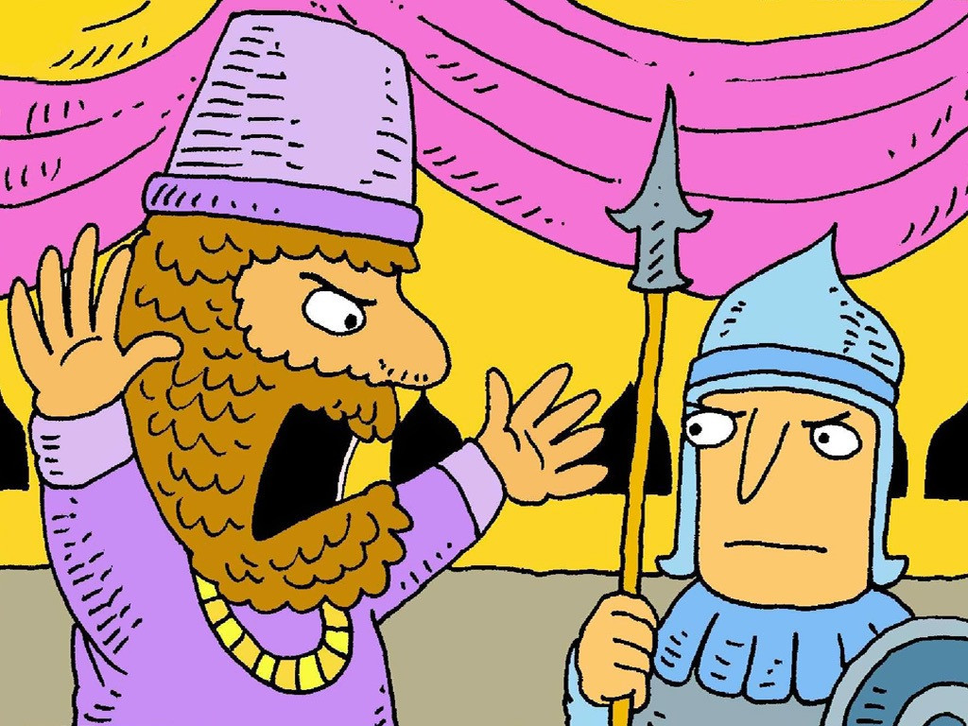
Notes:
Slide 9: The king was very angry, and he made another rule to punish Shadrach, Meshach and Abednego. ‘Booo!!’ ‘These men must be thrown into a fire,’ he said. ‘Make a very hot fire and they will change their mind.’

Slide 10
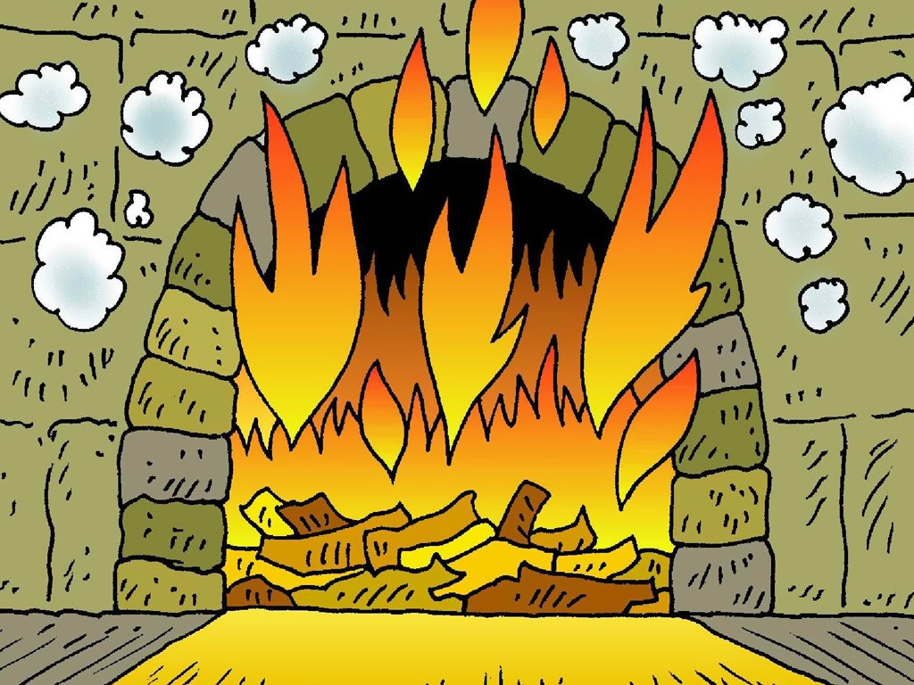
Notes:
Slide 10: The soldiers made a very hot fire. ‘Booo!’ The three friends prayed and asked God to help them. They would not bow down to King Nebuchadnezzar's statue. ‘Hurray!’

Slide 11
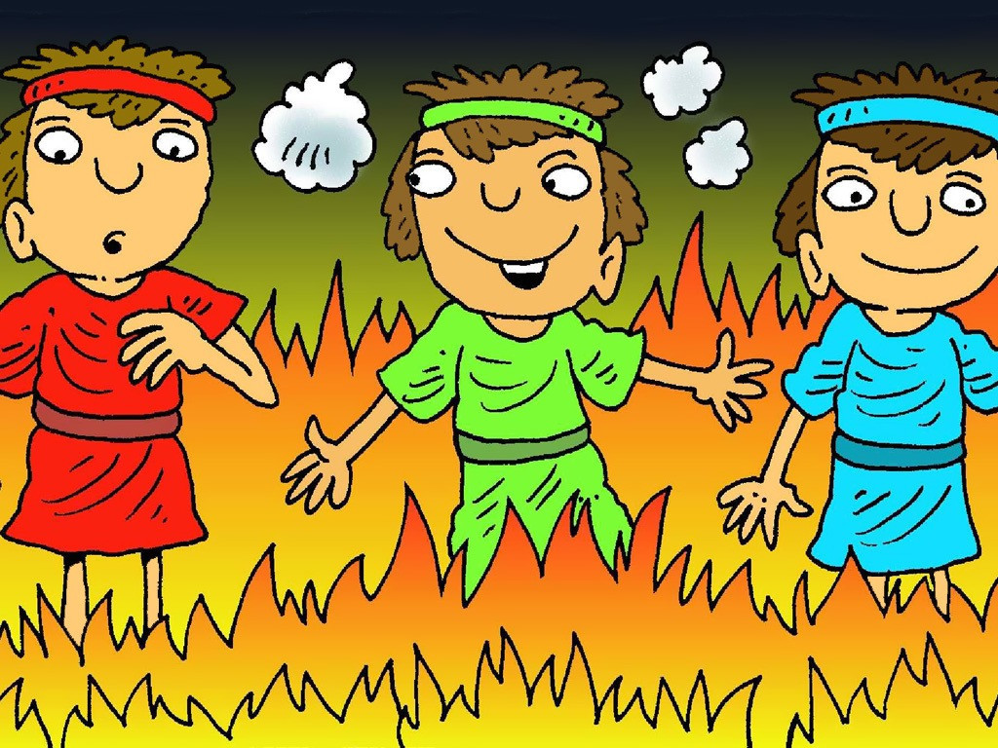
Notes:
Slide 11: The king’s solders threw the three friends into the fire. ‘Booo!’
It was very hot, but it didn’t burn them! ‘Hurray!’ God was looking after them! Not even their clothes got burnt…. ‘Hurray!’

Slide 12
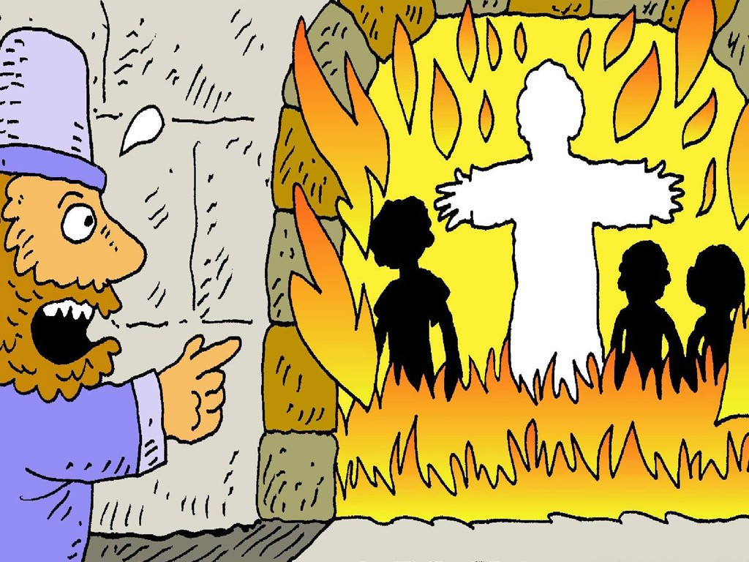
Notes:
Slide 12: The King looked into the fire and saw God’s angel looking after the men. ‘Hurray!’
He knew a statue could never do that. Then the King believed in God. ‘Hurray!’

Slide 13
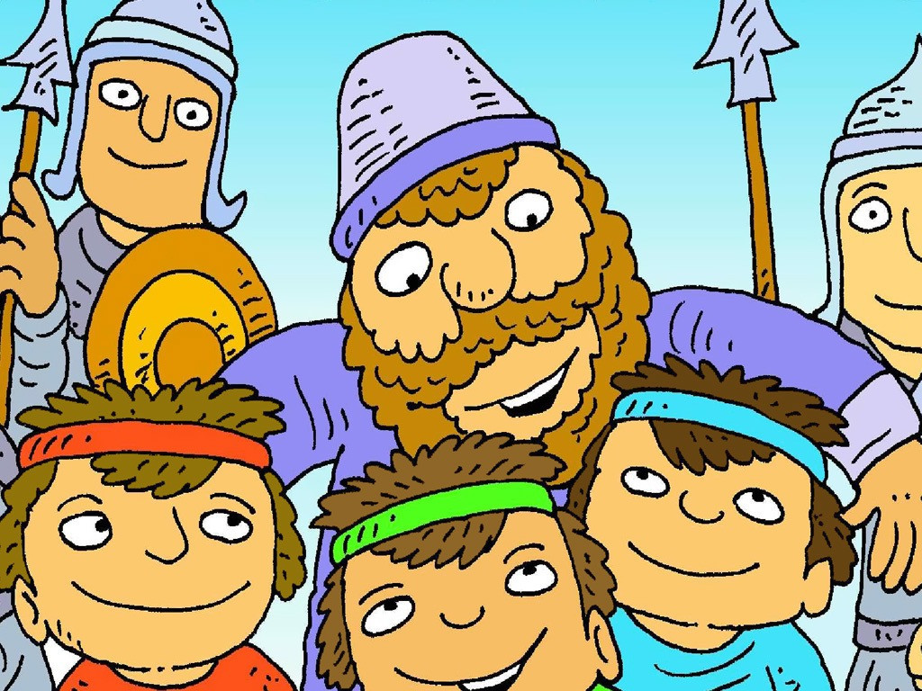
Notes:
Slide 13: Then the King made a new rule. ‘These three men were right and I was wrong.’ ‘Hurray!’
‘Everyone in my kingdom must pray to the one true God and not to statues,’ he said.

Slide 14

….I wonder if you’ve ever had to make a very difficult choice….
….or stand up for something that you believe is right?....
….I wonder what helps us to know what’s right and what’s wrong?....
Notes:
Slide 14: Responding and words for worship
As we think about this story of how Shadrach, Meshach and Abednego stood up for the things that they believed to be true, we are going to reflect on our own lives now.
As we said when we watched the rollercoaster clip, our lives are full of ups and downs, and twists and turns – and sometimes it means that life can be hard. Shadrach, Meshach and Abednego made a difficult choice to do what they believed was right, not knowing what might happen next. Let’s be still and wonder together…..
….I wonder if you’ve ever had to make a very difficult choice….
….or stand up for something that you believe is right?....
….I wonder what helps us to know what’s right and what’s wrong?....
[We recommend that you give some time this week to talking in class about these pondering questions – we have also created some reflection situation cards to help pupils to think. These are included with our resources.]

Slide 15
….I wonder how this idea might help someone who is going through a very difficult time? Or give us courage when we need to stand up for something we believe in?....
Notes:
Slide 15: We’re going to return to one very key moment in the story now, for a last bit of reflecting, as we come to the end of our time together. When the King looked into the fire, he saw that the three friends were not alone – God sent an angel to be with them. Some people think that it might even have been God himself who stood with them in the fire.
I wonder how this idea might help someone who is going through a very difficult time? Or give us courage when we need to stand up for something we believe in?
[Leave some time for personal thinking. Remind children that whether or not they believe in God, whatever they might be facing at the moment, they are not alone – emphasise who can help them and how.]
It’s not always easy to stand up for the things that we believe are right, especially when other people don’t seem to understand – or even make it difficult for us. I’m going to use some words as a prayer now, asking God to give us courage. You might want to make them your own and then join me by saying Amen at the end.

Slide 16
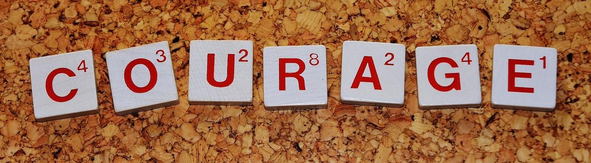
Give us courage, O God.
Notes:
Slide 16: So, I invite you to pray with me if you’d like to. There are some words for you to join in with, if you’d like to….
…..Give us courage, O God.

Slide 17

Give us courage, O God.
Notes:
Slide 17: When difficult decisions come our way…..Give us courage, O God.

Slide 18
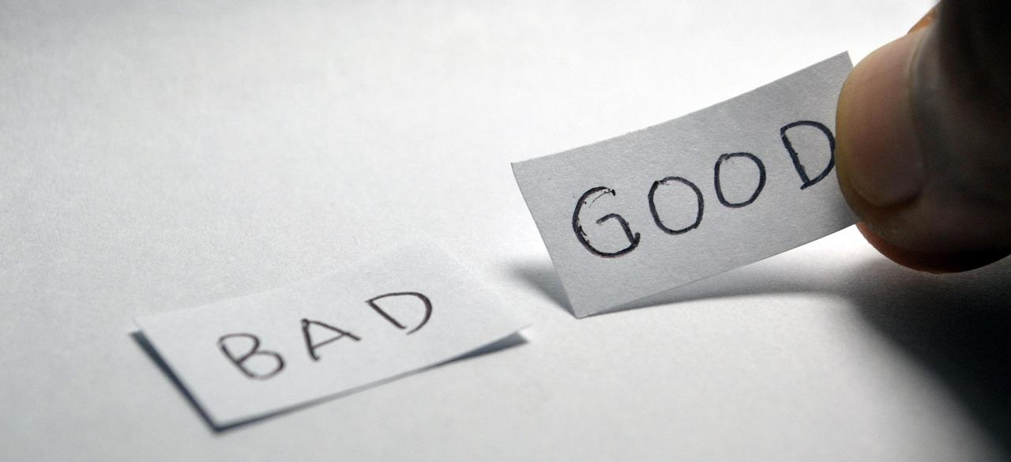
Give us courage, O God.
Notes:
Slide 18: When others make it difficult to make good choices…..Give us courage, O God.

Slide 19
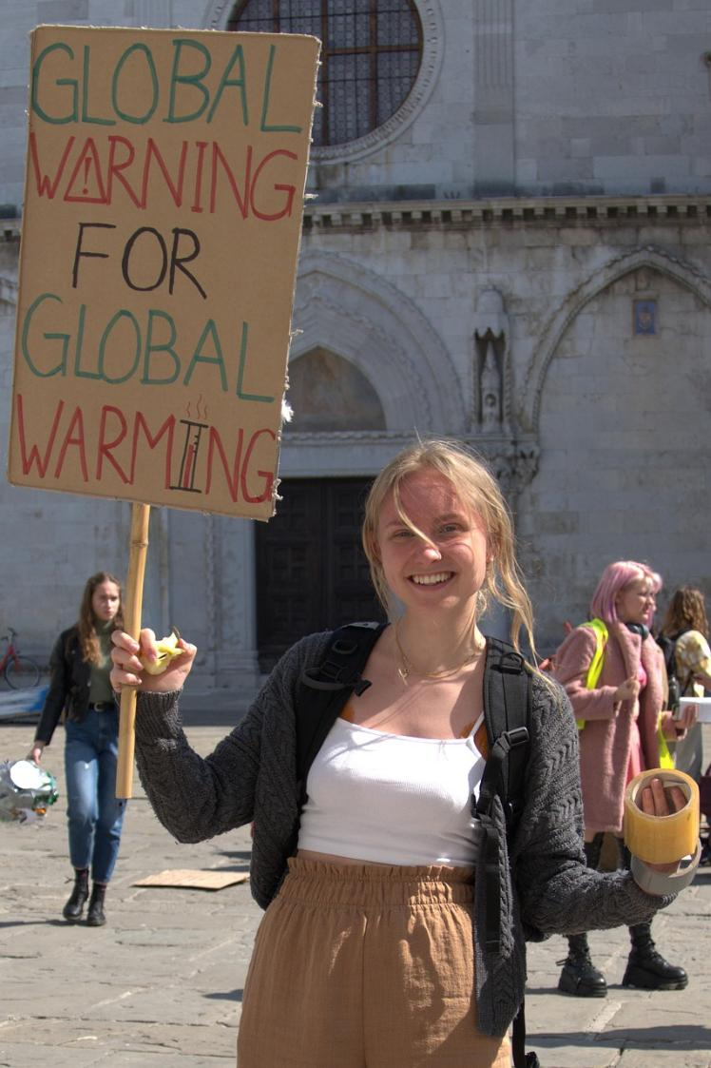
Give us courage, O God.
Notes:
Slide 19: When we have to stand up for something we believe is right…..Give us courage, O God.

Slide 20
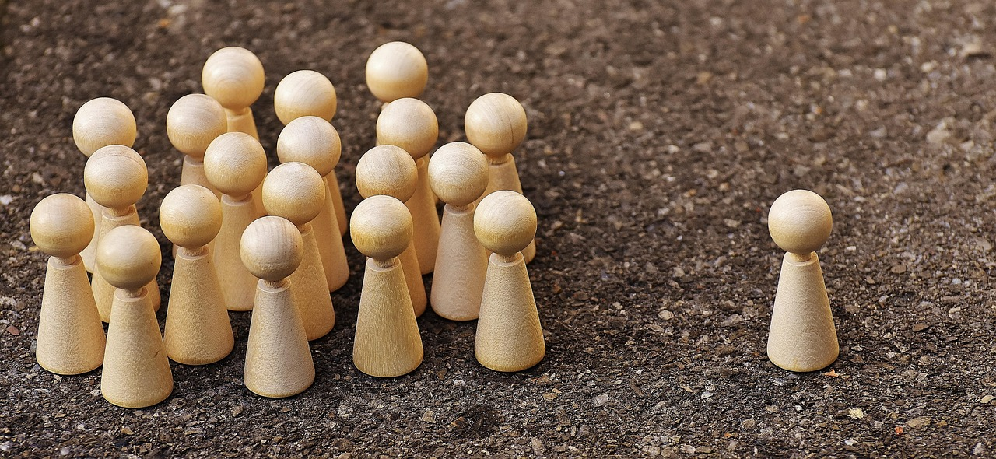
Give us courage, O God.
Notes:
Slide 20: When something is wrong and others need us to act …..Give us courage, O God.

Slide 21

Give us courage, O God.
Notes:
Slide 21: When we know what the right thing to do is, but it’s really hard…..Give us courage, O God.

Slide 22
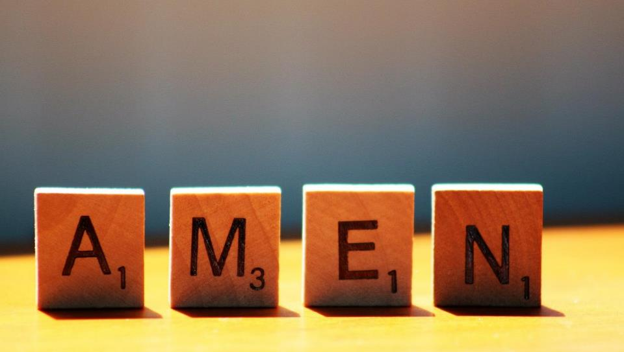

Slide 23



Leader: As we leave this place & time and go into the day ahead…
All: May we shine like stars!
Notes:
Sending: Slide 23
Leader: As we leave this place & time and go into the day ahead…
All: May we shine like stars!

Slide 24


Notes:
Slide 24: Reflective areas
Do: Pick a card and read the scenario on the back.
Think: What is the right thing to do?
Talk: What might help you to do the right thing? What might make this a hard thing to do? How might we help each other?

