Slide 1

Picture copyright-free from pixabay
Leader: We are on this journey together…
Children: We are friends along the road…
ALL: May God go with us.
Notes:
Slide 1 or 2 [choose whichever image you prefer, or use them in rotation]:
Use the greeting for this term
Leader: We are on this journey together…
Children: We are friends along the way…
ALL: May God go with us.
BSL interpretation:
Sign for ‘way’ (nearest to the idea of ‘journey’): British Sign Language BSL Video Dictionary - way
Sign for ‘friends’: British Sign Language: friends
Sign for ‘God: British Sign Language BSL Video Dictionary - God
Sign for ‘go with us’ – we have invented this! After you’ve signed ‘God’, bring your finger down alongside your other finger and make them ‘journey together’ in front of you.
Engaging:
As we heard last week, in the final term of this school year, we are beginning a new theme:

Slide 2
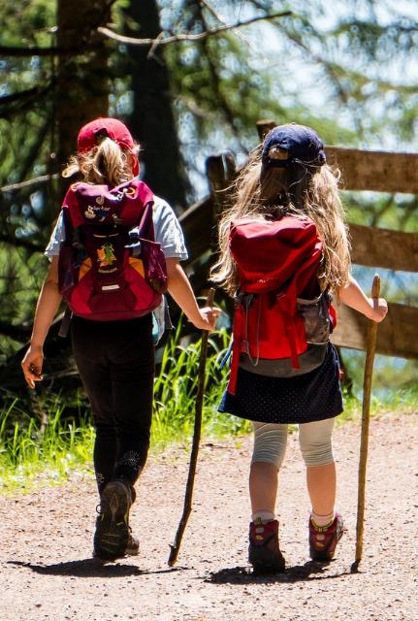
Picture copyright-free from pixabay
Leader: We are on this journey together…
Children: We are friends along the way…
ALL: May God go with us.
Notes:
Slide 1 or 2 [choose whichever image you prefer, or use them in rotation]:
Use the greeting for this term
Leader: We are on this journey together…
Children: We are friends along the way…
ALL: May God go with us.
BSL interpretation:
Sign for ‘way’ (nearest to the idea of ‘journey’): British Sign Language BSL Video Dictionary - way
Sign for ‘friends’: British Sign Language: friends
Sign for ‘God: British Sign Language BSL Video Dictionary - God
Sign for ‘go with us’ – we have invented this! After you’ve signed ‘God’, bring your finger down alongside your other finger and make them ‘journey together’ in front of you.
Engaging:
As we heard last week, in the final term of this school year, we are beginning a new theme:

Slide 3
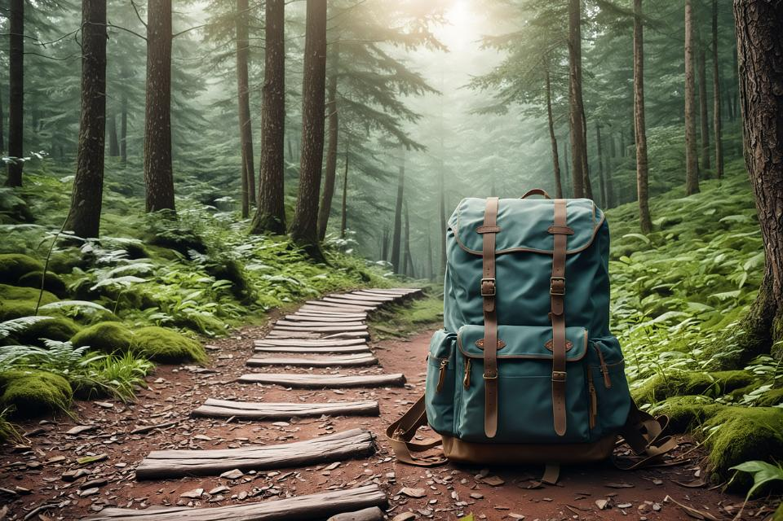
Picture copyright-free from pixabay
To boldly go….
Notes:
Slide 3: To boldly go….. Recap on last week’s adventure

Slide 4

Picture copyright-free from pixabay
What’s in the rucksack?
Notes:
Slide 4: What’s in the rucksack?
Let’s begin today with our trusty rucksack and find out what we have as our object for today….
This is a compass – I wonder if anyone has ever used one of these? Or knows what it’s for?
It’s a very useful object to help someone to navigate – find their way – and like last week’s macintosh, was very much an essential item for today’s adventurer. More of that in a few moments…..

Slide 5


Old
or
New?
Notes:
Slide 5: Old or new? Last week, we played a game called ‘Old or new?’
I have one more picture to show you….

Slide 6
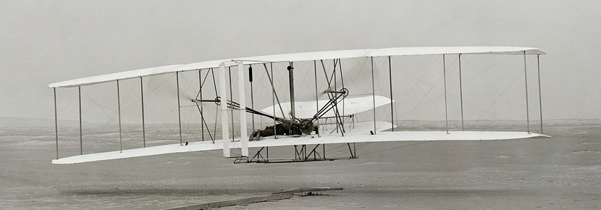
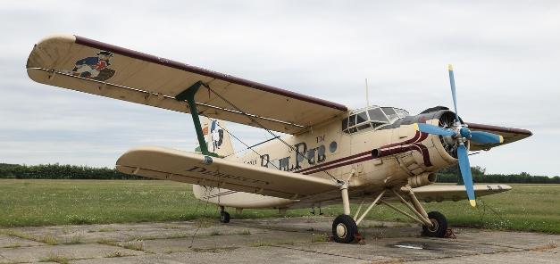
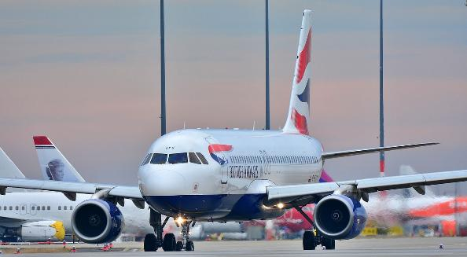
Picture copyright-free from pixabay
Old
New
Notes:
Slide 6: Spot the differences – as you look at the old and the new side by side, I wonder how may differences you can spot between them?
Allow children to talk about some of the major differences between the planes – depending on the age of your pupils, you may need to ask some leading questions!
The top picture is of a bi-plane – so-called because it has two wings. I wonder what might have been difficult about flying like this? Mind you, if you think this would be a bit tricky to fly in, the first planes were even more terrifying!
The very first plane to become airborne was designed and flown by Orville and Wilbur Wright, in 1903. It managed to fly all of 36.5 metres before hitting the ground!
Our adventurer for today was also famous for flying planes – but planes that were a little better at staying up in the air than the Wright Brothers’ plane!

Slide 7
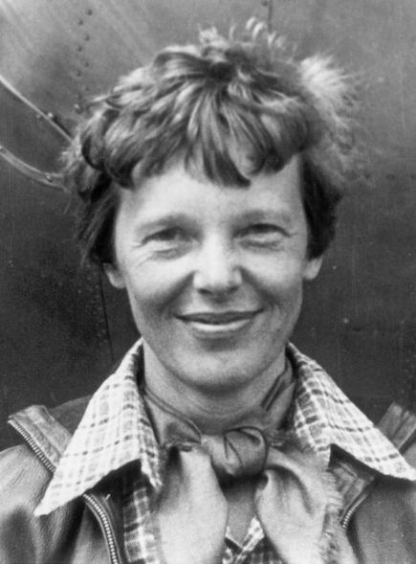
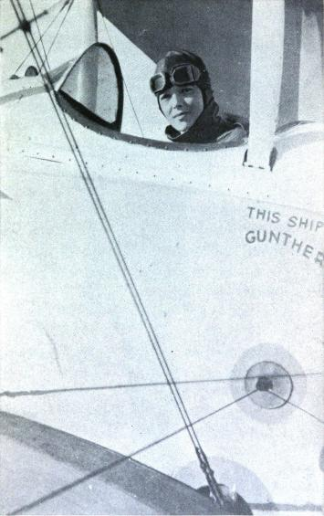
Images copyright-free from Wikipedia
Notes:
Slide 7: This is Amelia Mary Earhart who was born in in Kansas, USA in 1897, just 9 years after Thomas Stevens completed his Penny Farthing adventure.
In 1920, when she was 23 years old, she went on her first aeroplane flight and from that point on, she knew what she wanted to do in life – to fly planes.
It might seem a little strange to us, but Amelia’s world was very different to ours: it was a common thought that there were some things that women couldn’t or shouldn’t do, and throughout her life, Amelia was determined to challenge this idea, as we’ll hear.
And so, she took flying lessons: she was determined that nothing would stop her from achieving her dream! In 1928, she travelled with fellow pilots Wilmer Stultz and Louis Gordon….

Slide 8
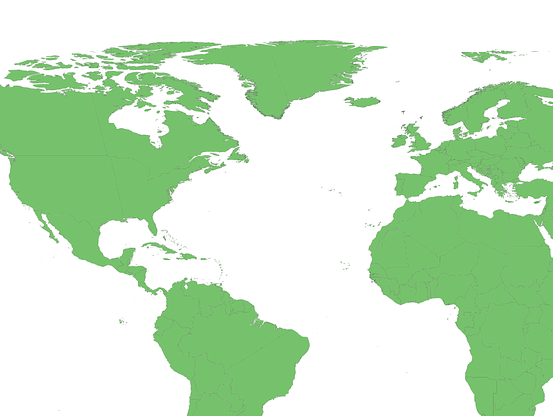

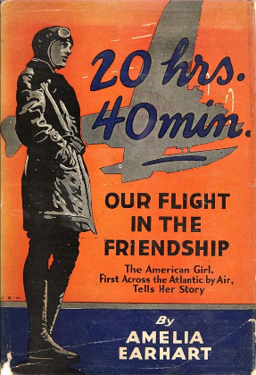


Image from Wikipedia
Notes:
Slide 8: ….from Newfoundland to Wales, in an aeroplane called ‘The Friendship’. It was the first time that any woman had ever flown that far. She took every chance she could to talk to people about it and even published a book about her adventure. By now she had become an international celebrity, and she was more determined than ever to champion the cause of women. In 1931, Amelia Earhart became the first president of an all-female flying club called the Ninety-Nines and then finally, in 1932, became the first woman to fly solo, on her own, across the Atlantic Ocean, following almost the same route that she had travelled 4 years earlier.
She was awarded the Distinguished Flying Cross medal in honour of her achievements, but what was even more important to her was the knowledge that never again would people assume that only men could fly!

Slide 9

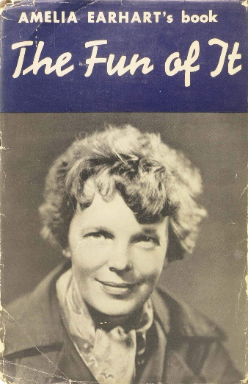
Notes:
Slide 9: Across the Pacific Ocean
In 1932, she published a second book, capturing one of her most famous sayings, ‘For the fun of it’, which told stories from her life and helped people to understand her attitude to life, her taste for adventure and her refusal to let people’s attitudes squash her dreams. Just 3 years after, in 1935, she became the first woman to fly across the Pacific Ocean from Hawaii to California. She was also the first person (man or woman!) ever to fly this route solo. But her biggest adventure yet – and one of the world’s still unsolved mysteries – was still to come…..

Slide 10
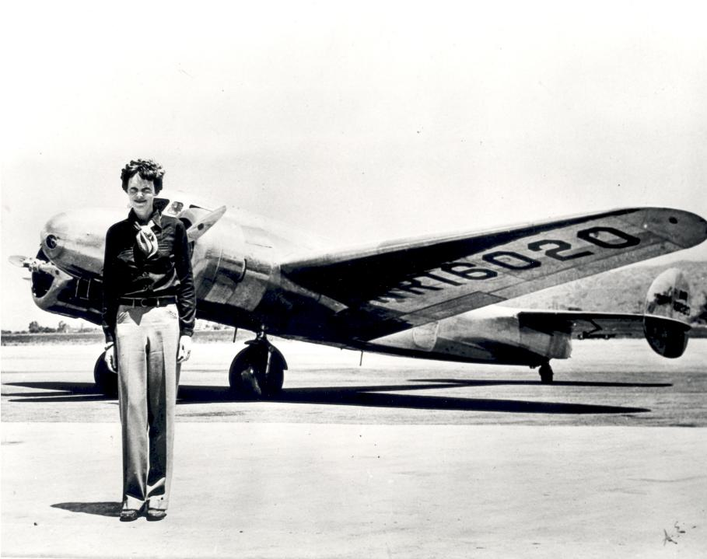
Image copyright-free from Wikipedia
Notes:
Slide 10: Around the world
In 1937, Amelia and her navigator Fred Noonan set out from Miami, Florida to fly East for a round-the-world trip by air that would see them travel along the coasts of North and South America, across Africa and India and out towards Papua New Guinea, refuelling as they went along. They left Lae, on Papua New Guinea on July 2nd, for almost the last leg of their journey to Honolulu before reaching America again, when their plane disappeared. It has never been found which remains one of the world’s greatest mysteries. [If you click on the link in the Resources section, you can see a Pathe newsreel featuring the news of her disappearance]
We’re going to leave Amelia’s adventure there for now, and think for ourselves about how the story of her life might be an encouragement to us…..

Slide 11
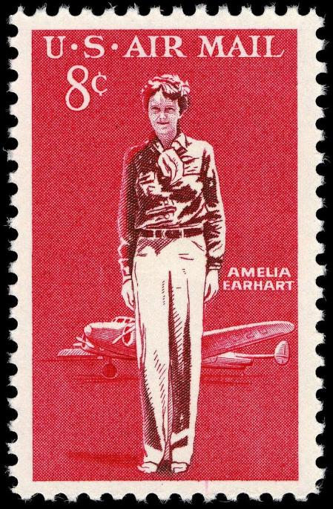
Everyone has oceans to fly, if they have the heart to do it. Is it reckless? Maybe. But what do dreams know of boundaries?
If enough of us keep trying, we should get someplace!
Women, like men, should try to do the impossible. And when they fail, their failure should be a challenge to others.
No kind action ever stops with itself….A single act of kindness throws out roots in all directions, and the roots spring up and make new trees.
Amelia was the first woman to feature on a US airmail stamp, 1963
Notes:
CHOOSE FROM SLIDE 11 OR SLIDE 12
Slide 11: Encouraging words You might want to select one or two of these to talk through with children.
Here are some words that Amelia Earhart spoke in her lifetime. I wonder which you think might have inspired or encouraged others? Or how they might encourage or inspire you? [talk through each / the quote you have selected, using the suggestions highlighted here]
Everyone has oceans to fly, if they have the heart to do it. Is it reckless? Maybe. But what do dreams know of boundaries?
In these words, Amelia is saying that everyone has a dream to do or be something, and that believing in your dream takes great courage. Making your dream happen can sometimes be challenging – you have to sometimes take risks, or do things (like she did) that no-one has tried before.
If enough of us keep trying, we should get someplace!
Some situations seem impossible (for Amelia, like women being treated the same as men). But the more people there are who try to change the situation, the more likely it is that change will come.
Women, like men, should try to do the impossible. And when they fail, their failure should be a challenge to others.
Being a women shouldn’t make a difference to trying to make your dream happen – if you fail, the fact that you tried should inspire and challenge others.
No kind action ever stops with itself….A single act of kindness throws out roots in all directions, and the roots spring up and make new trees.
Kindness grows kindness. [this may be the easiest quote for younger children]

Slide 12
courage
perseverance
encouragement
commitment
sense of adventure
?
Amelia was the first woman to feature on a US airmail stamp, 1963
Notes:
CHOOSE FROM SLIDE 11 OR SLIDE 12
Slide 12: What inspires us about Amelia Earhart? There are some ideas on the slide for you to talk about with pupils, including a blank one at the end for you to add your own ideas. Allow pupils to suggest examples from the story of her life that show these qualities
Courage
Perseverance
Encouragement
Commitment
Sense of adventure
?

Slide 13
….encourage one another and build each other up….
(1 Thessalonians 5:11)
Notes:
Slide 13: Responding (and words for worship):
About 1900 years before Amelia Earhart was born, another great adventurer, the Apostle Paul (whose story we will share in a few weeks!) wrote these words about the importance of encouragement:
….encourage one another and build each other up….
(1 Thessalonians 5:11)
Paul wrote these words to one of the very first churches, who were also living in challenging times. He wanted to remind them of the power of encouragement in helping their community to grow.
Encouragement is important to our community too. I wonder what encouraging words you could think of right now? [if time allows, you might ask pupils to share ideas: you may need to give a few examples to get them going!]

Slide 14
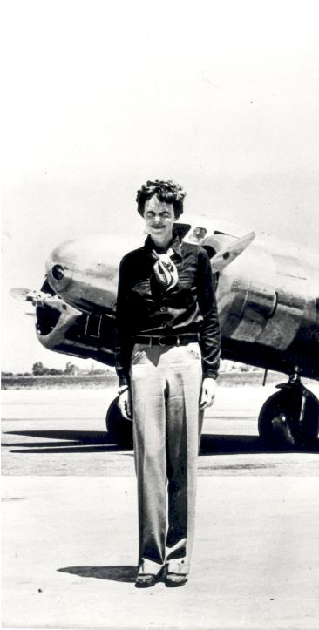
….encourage one another and build each other up…. (1 Thessalonians 5:11)
….I wonder how her story might have encouraged you today?....
….I wonder how we might encourage one another in our words and in our actions?.....
….I wonder how our encouragement might help others to achieve their dreams?.....
Notes:
Slide 14: Let’s be quiet and still now as we bring our time together to a close. We’ve been thinking today about the life and adventures of Amelia Earhart and how they inspired and encouraged others to reach for their dreams.
….I wonder how her story might have encouraged you today?....
…..I wonder how we might encourage one another in our words and in our actions?.....
….I wonder how our encouragement might help others to achieve their dreams?.....

Slide 15
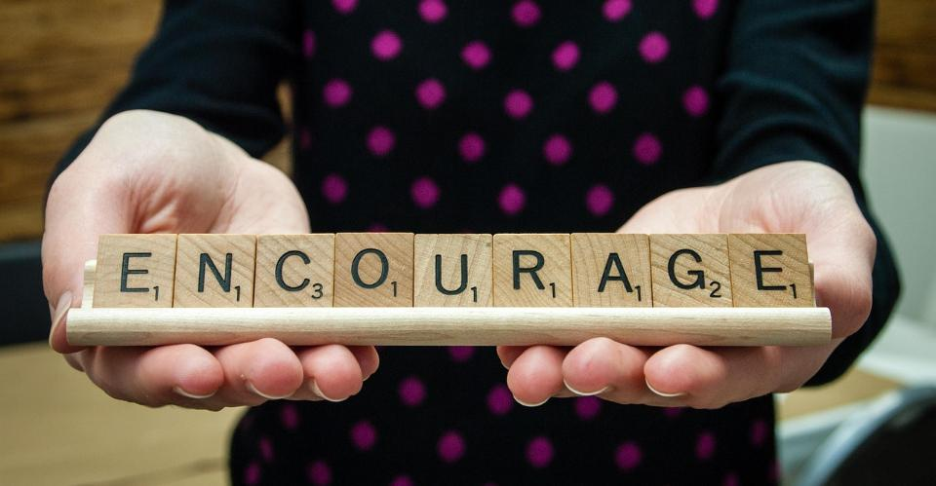
May we encourage and build each other up.
Notes:
Slide 15: Prayer [based on Paul’s words to the Thessalonians]
I am going to use the Apostle Paul’s words now in a prayer. There is a part that you can join in with if you would like to.
May we encourage and build each other up.

Slide 16
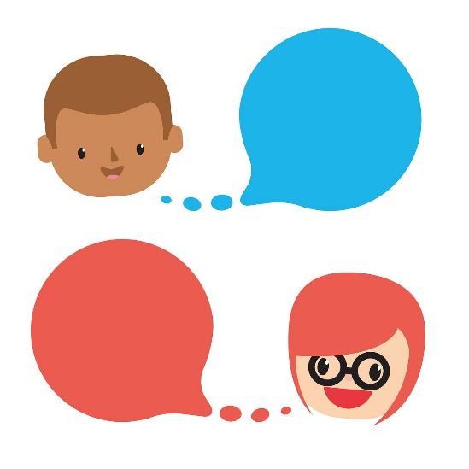
May we encourage and build each other up.
Notes:
Slide 16: In the words that we speak
May we encourage and build each other up.

Slide 17

May we encourage and build each other up.
Notes:
Slide 17: In the actions that we take
May we encourage and build each other up.

Slide 18
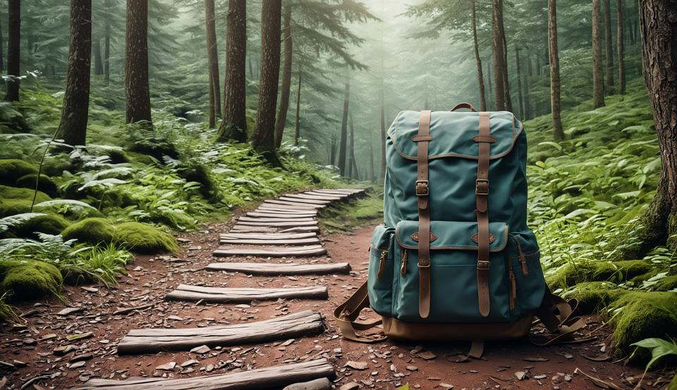
May we encourage and build each other up.
Notes:
Slide 18: On all of life’s journey,
May we encourage and build each other up.

Slide 19


Slide 20

Picture copyright-free from pixabay
Leader: We have journeyed together today. As we leave this place and time and go into the day ahead…
ALL: …May God go with us.
Notes:
Slide 20: Use this term’s leaving words
Leader: We have journeyed together today. As we leave this place and time and go into the day ahead….
ALL: ….May God go with us.
Sign for ‘God: British Sign Language BSL Video Dictionary - God
Sign for ‘go with us’ – we have invented this! After you’ve signed ‘God’, bring your finger down alongside your other finger and make them ‘journey together’ in front of you.

Slide 21
Picture copyright-free from pixabay
Notes:
Ideas for classroom reflection: Encouragement cards
Take a blank encouragement card
Talk together about the things you find encouraging about Amelia Earhart’s life and her example. How did she encourage others?
Think about someone who might need encouraging this week. This could be someone in school, or someone at home.
Write them a card with some helpful, encouraging words. Don’t forget to give it to them!

