Slide 1
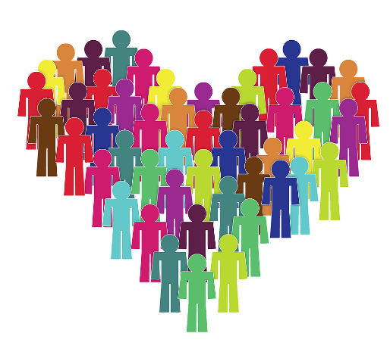
Pictures copyright-free from pixabay
Leader: We are a creative community. As we gather together today…
ALL: May our thinking, talking and wondering help us to grow.
Notes:
Slide 1: Gathering
Use the new greeting, with BSL actions if desired.
Leader: We are a creative community. As we gather together today….
ALL: May our thinking, talking and wondering help us to grow.
Here are BSL actions for some of the words:
Leader’s words:
Creative: https://www.signdictionary.co.uk/view/creative?q=creative#title
Community: (we use the word ‘gathering’ as it’s a simpler sign!) https://www.signbsl.com/sign/gathering
Gather together: https://www.signbsl.com/sign/gather (1st video)
Pupils’ response:
Think: https://www.brightbsl.co.uk/signs/think
Talk: https://www.signbsl.com/sign/talk (1st video)
Wonder: https://www.signbsl.com/sign/wonder (1st video)
Grow: https://www.signbsl.com/sign/grow (2nd video)

Slide 2
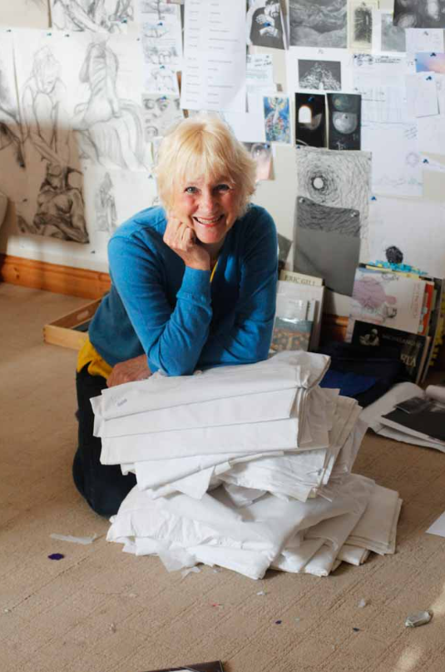
Threads Through the Cross
Notes:
Slide 2: Threads Through the Cross
Today, we begin looking at the panels that Jacqui will be bringing to Guildford Cathedral this week when her exhibition opens. There will be new panels to look at each week from now until the start of Advent.

Slide 3
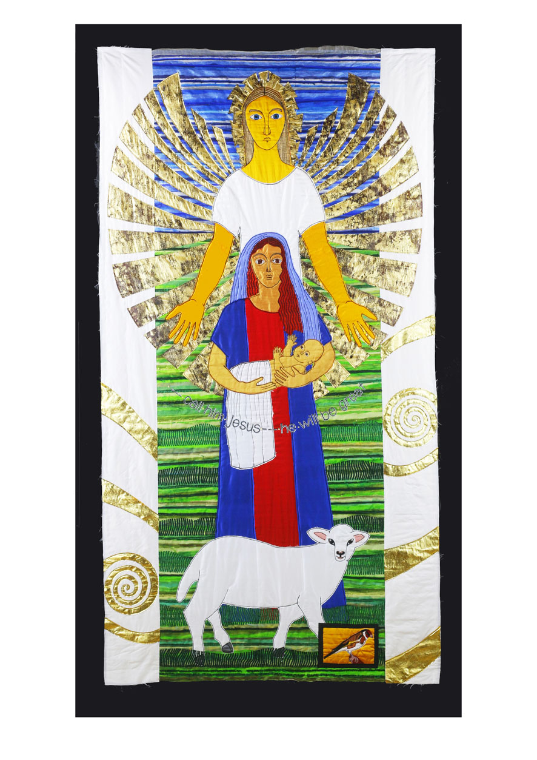
‘call him Jesus – he will be great’
Notes:
Slide 3: This week’s panel
Spend a while just gazing at the panel. Relax, and focus on calm breathing.
Let your eyes take in (look at) every detail……. [leave silence for a short while]
Now I’m going to use some questions to help us…for now, we’re not going to tell each other the answers.
….Which parts do you especially like?
….Which story do you think this is?
….Who are the people in this panel?
….How are the people feeling?
….Are there any words to read?
….Can you find a bird?
Now spend a few minutes talking about the things you were thinking about….and pick out the words ‘Call him Jesus – he will be great’ to confirm what children might already have said. Also pick out the golden spiral that Jacqui stitches as the reminder of God’s presence. There’s a reminder about this symbol on the next slide to use if it will help.

Slide 4
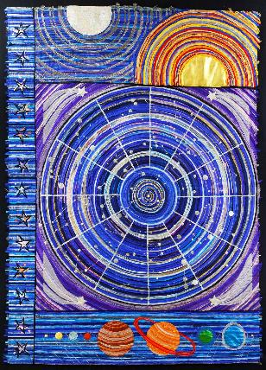
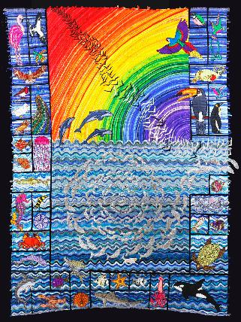
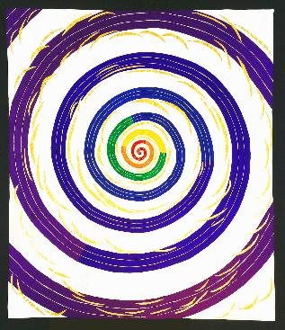
‘Let us make human beings in our image and likeness.’
…created to be creative…
Notes:
Slide 4: optional, as a reminder of the spiral element

Slide 5
He shall be called Jesus
Mary, you have found favour with God.
Let this happen to me as you say!
Notes:
Slide 5: He shall be called Jesus
This is part of the story that we usually think about at Christmas time! Jacqui gave this panel the name ‘He shall be called Jesus.’
[As you may have noticed] It shows two different moments in time – the moment when the angel appeared to Mary and told her that she would have a baby that was to be God’s Son….. and then the moment when Mary held Jesus in her arms for the first time.
[Connect this with what pupils may already have talked about]
We’ll talk some more about Mary in a moment, but first, let’s look at the bird that Jacqui has put into this panel, especially for children to spot!! This is a goldfinch, which often appeared in medieval paintings of Mary and Jesus, as a symbol of Jesus as both King (the gold stripe) and as human (the red bits, the colour of blood), so Jacqui chose to put this little bird in her panel as well. We will see other birds in other panels that we look at over the coming weeks, that will be there to show us something important.
Now let’s go back to thinking about Mary. Mary was chosen by God to do a very important job – to bring Baby Jesus into the world and to look after him whilst he was a child. It must have felt a great responsibility!! It was something that no one else except her very close family knew about – a bit like a secret mission. When the angel appeared to her, as well as telling her not to be afraid (!) he said ‘Mary, you have found favour with God.’ The angel told her that God had noticed her going about her everyday life and had chosen her for this very special role. I wonder what you think God had noticed her doing? [You might want to talk about this together before recommencing]
And so these are the words that Mary spoke to the angel: Let this happen to me as you say! She humbly accepted that she had been chosen and did the very best that she could. I don’t expect that she ever thought that so many thousands of years later, we would be talking about her story! I wonder how her story might help us to think about ourselves and our school community?…..Let’s pause and think for a few minutes….

Slide 6

How does it feel to be given a special job to do?
Is it important that we try to do it well? Why?
Notes:
Slide 6: Being chosen – talk together. You will need to root this discussion in the context of your own school
How does it feel to be given a special job to do?
Is it important that we try to do it well? Why?

Slide 7
Let this happen to me as you say!
….I wonder what we might learn from Mary’s example?....
….I wonder how our attitude might be like hers?....
....and what God might notice us doing this week?....
Notes:
Slide 7: Responding and words for worship
We’ve thought about the different ways in which we might sometimes be chosen to do special jobs at school. We’ve also heard how Mary was chosen by God because of how she was doing ordinary, everyday things, and then was given an important job to do in being the mother of Jesus. The Angel said that Mary had ‘found favour with God’ in just going about her ordinary, everyday life.
….I wonder what we might learn from Mary’s example?....
….I wonder how our attitude might be like hers?....
....and what God might notice us doing this week?....
[you might want to allow some time for discussion here as well]
And as we’ll be hearing over the next few weeks, Mary was not the only one who had been chosen for a very important job!
Opportunity for reflection / prayer
I’m going to pray now. If this is something that you feel comfortable doing, then there will be some words for us to share together. If you don’t want to pray, then use the quiet to be still with your own thoughts. Here are the words….

Slide 8
Help us to do our best.
Notes:
Slide 8: Help us to do our best.

Slide 9
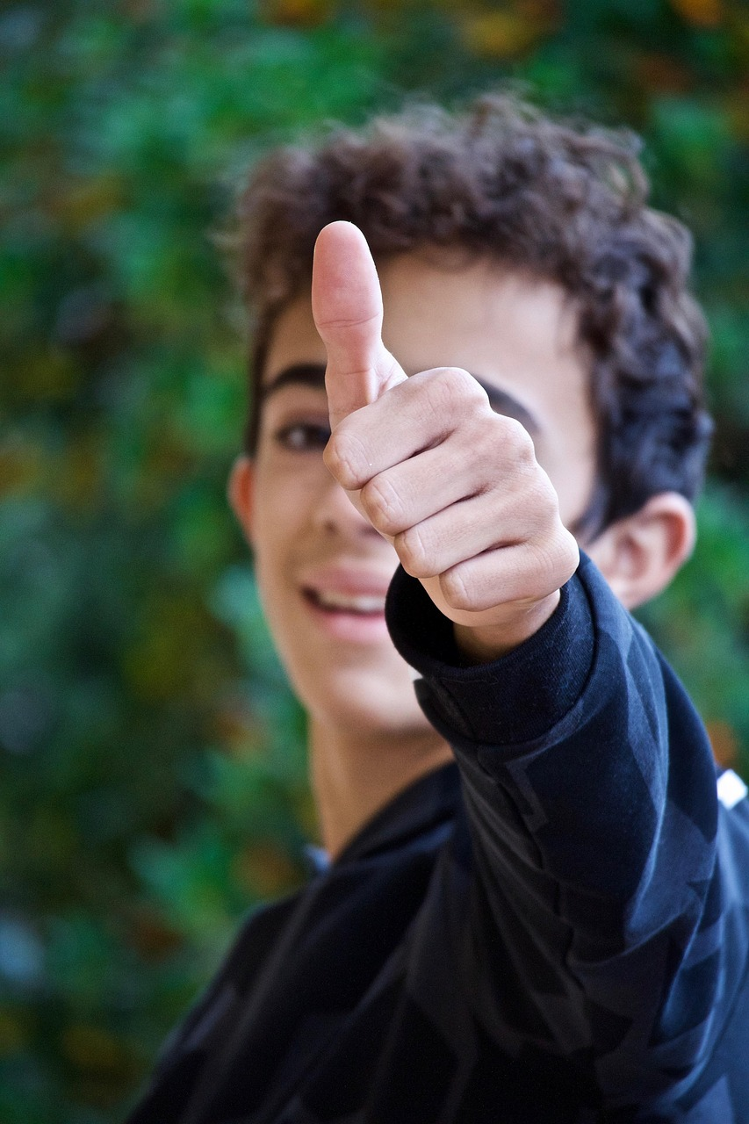
Notes:
Slide 9: If we’re given a job to do….

Slide 10
…help us to do our best.
Notes:
Slide 10: Help us to do our best.

Slide 11
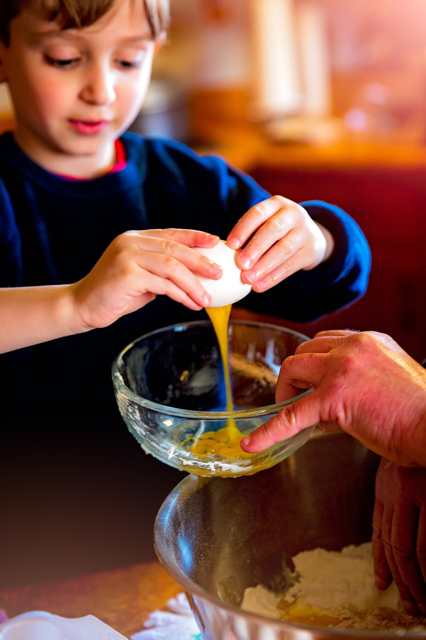
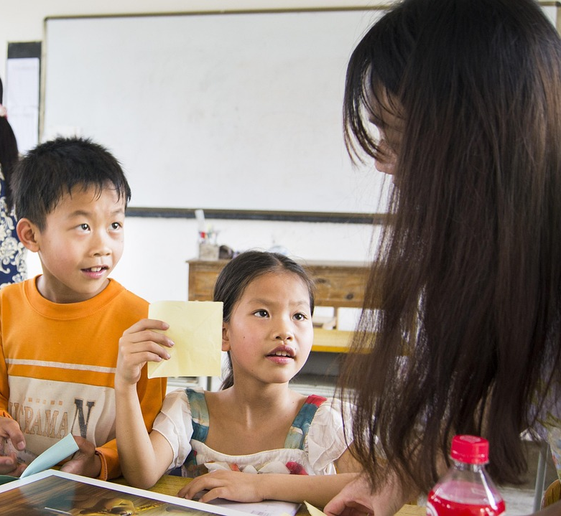
Notes:
Slide 11: If we’re helping at home…..Or helping at school

Slide 12
…help us to do our best.
Notes:
Slide 12: Help us to do our best.

Slide 13
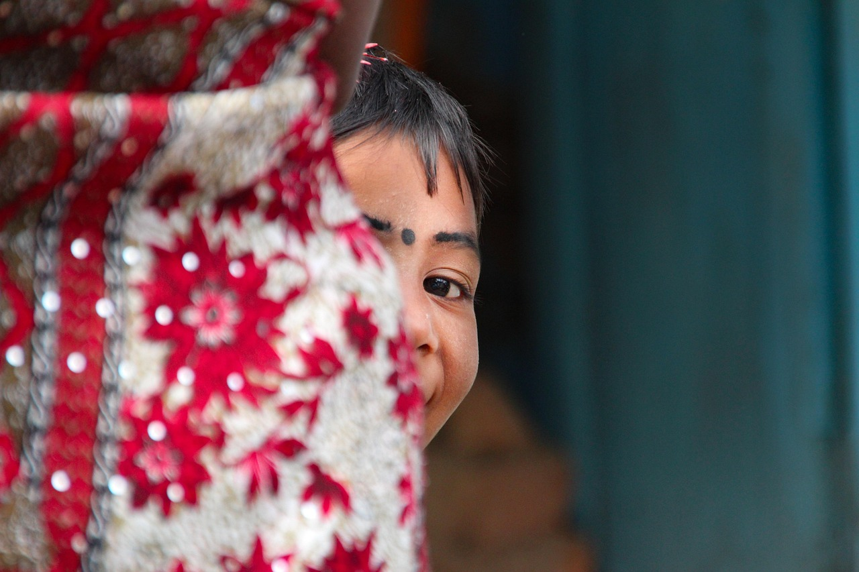
Notes:
Slide 13: Even when no-one notices….

Slide 14
…help us to do our best.
Notes:
Slide 14: Help us to do our best.

Slide 15
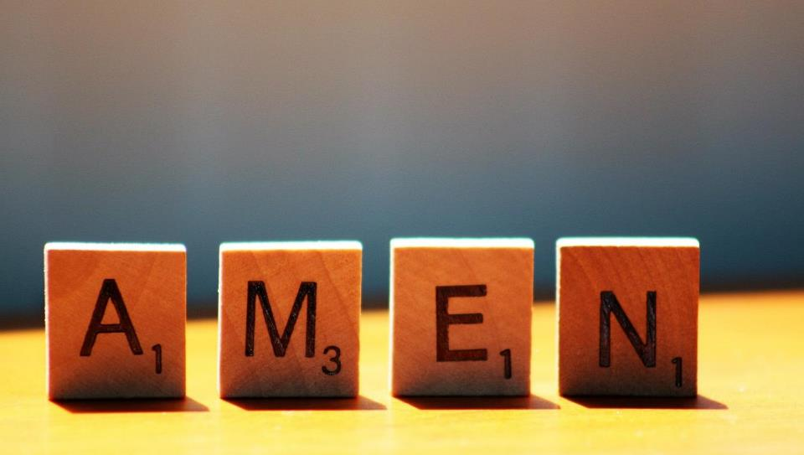

Slide 16
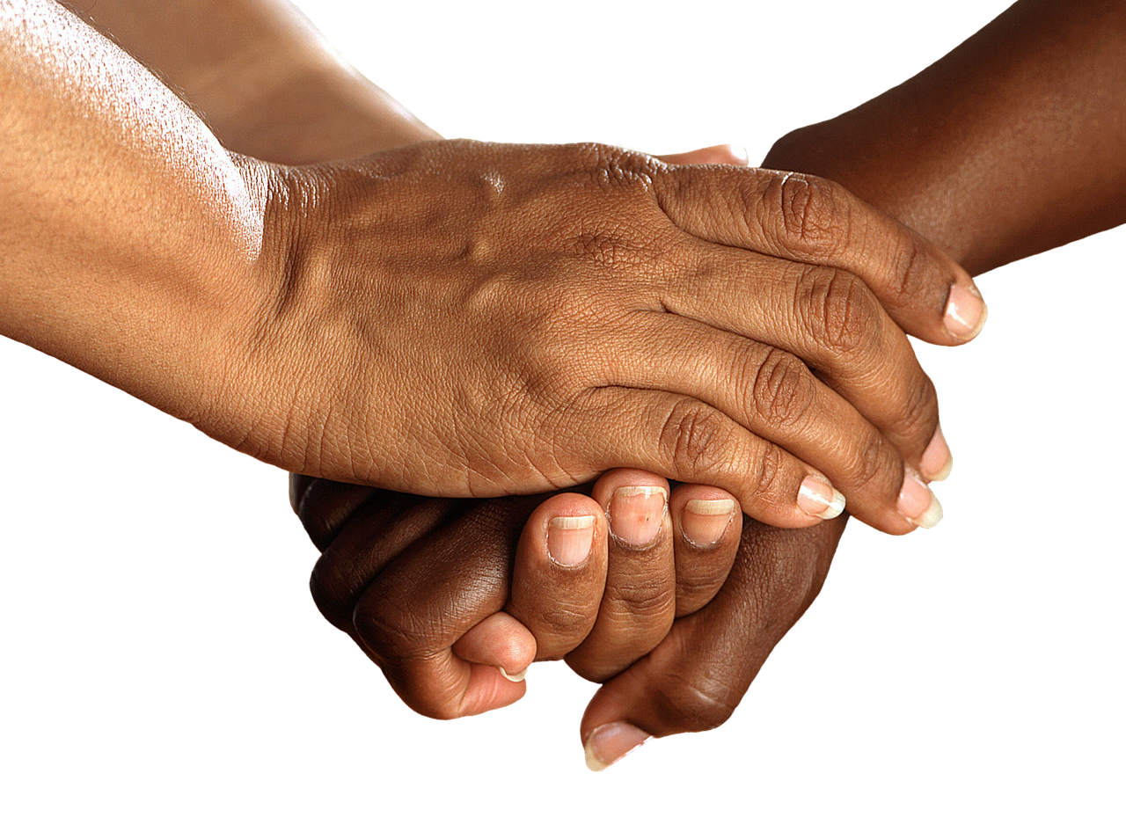


Leader: As we leave this place & time and go into the day ahead…
All: Together, we create a helpful community!
Notes:
Sending: Slide 16 (NB note different word from last week!)
Leader: As we leave this place & time and go into the day ahead…
All: Together, we create a helpful community!
BSL Together: https://www.signbsl.com/sign/together (1st video); Helpful: https://www.signbsl.com/sign/helpful
You already have signs for ‘community’

Slide 17

Notes:
Slide 16: Reflective areas
Think: How do you like to help others – at school or at home?
Talk: How does it feel when you help? Where can we help others?
Do: Take up the secret challenge this week – help someone in secret!!

Slide 18
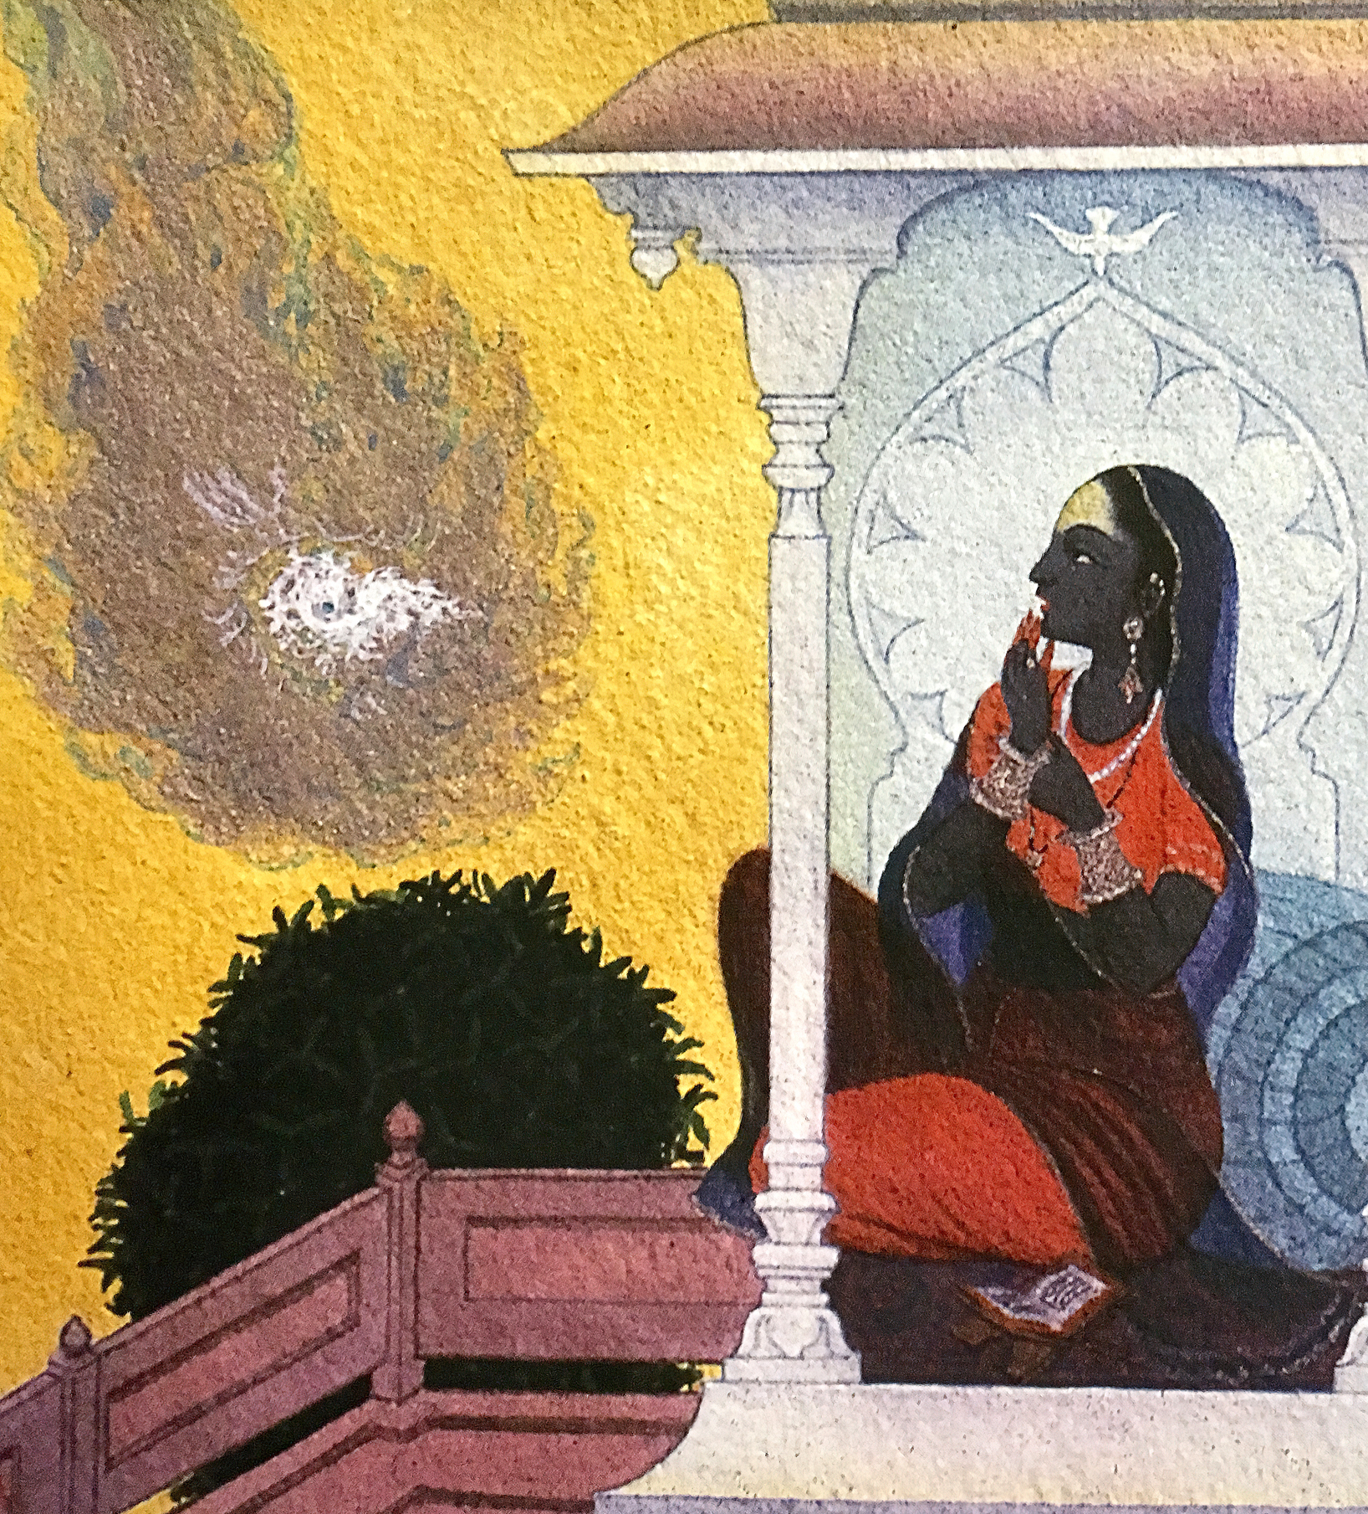
Wesley, Frank, 1923-2002. Annunciation in a Pavilion, from Art in the Christian Tradition,
Notes:
Slide 18: Showing the annunciation from different cultural perspectives
Link to original artwork: https://diglib.library.vanderbilt.edu/act-imagelink.pl?RC=59236, which includes some key information about the artist.
Looking at these two creative interpretations of this part of the story may be something that links with your RE curriculum, reflecting the fact that Christianity is a global religion, encouraging pupils to appreciate the diversity that exists across cultures, traditions and geographical areas. It’s important for pupils’ wider understanding that they are given opportunities to think about how Christians show Jesus as being ‘like them’, and that this important story for Christians is imagined in different ways across the world. It also creates an inclusive classroom environment, giving all pupils opportunity to see themselves in the art that they view.
You may wish to consider these questions:
What is the same? What is different?
Which culture / tradition does the 2nd piece come from?
Why do we think this?
What questions might we want to / need to ask?

