Slide 1
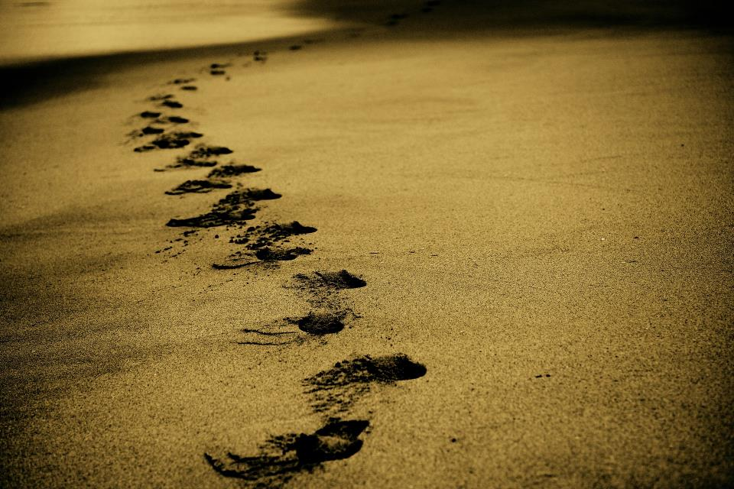
Picture copyright-free from pixabay
Leader: We are on this journey together…
Children: We are friends along the way…
ALL: May God go with us.
Notes:
Slide 1 or 2 [choose whichever image you prefer, or use them in rotation]:
Use the greeting for this term
Leader: We are on this journey together…
Children: We are friends along the way…
ALL: May God go with us.
BSL interpretation:
Sign for ‘way’ (nearest to the idea of ‘journey’): British Sign Language BSL Video Dictionary - way
Sign for ‘friends’: British Sign Language: friends
Sign for ‘God: British Sign Language BSL Video Dictionary - God
Sign for ‘go with us’ – we have invented this! After you’ve signed ‘God’, bring your finger down alongside your other finger and make them ‘journey together’ in front of you.
Engaging:
As we heard last week, in the final term of this school year, we are beginning a new theme:

Slide 2
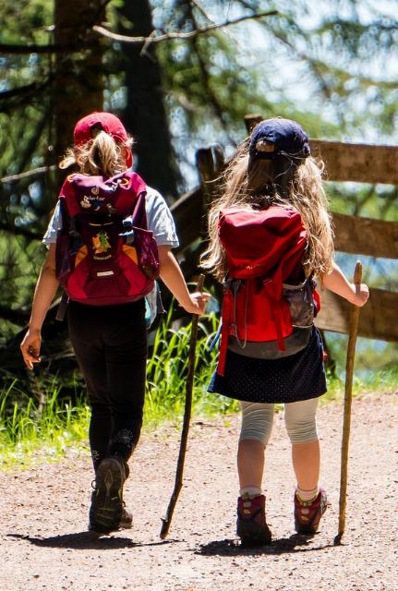
Picture copyright-free from pixabay
Leader: We are on this journey together…
Children: We are friends along the way…
ALL: May God go with us.
Notes:
Slide 1 or 2 [choose whichever image you prefer, or use them in rotation]:
Use the greeting for this term
Leader: We are on this journey together…
Children: We are friends along the way…
ALL: May God go with us.
BSL interpretation:
Sign for ‘way’ (nearest to the idea of ‘journey’): British Sign Language BSL Video Dictionary - way
Sign for ‘friends’: British Sign Language: friends
Sign for ‘God: British Sign Language BSL Video Dictionary - God
Sign for ‘go with us’ – we have invented this! After you’ve signed ‘God’, bring your finger down alongside your other finger and make them ‘journey together’ in front of you.
Engaging:
As we heard last week, in the final term of this school year, we are beginning a new theme:

Slide 3
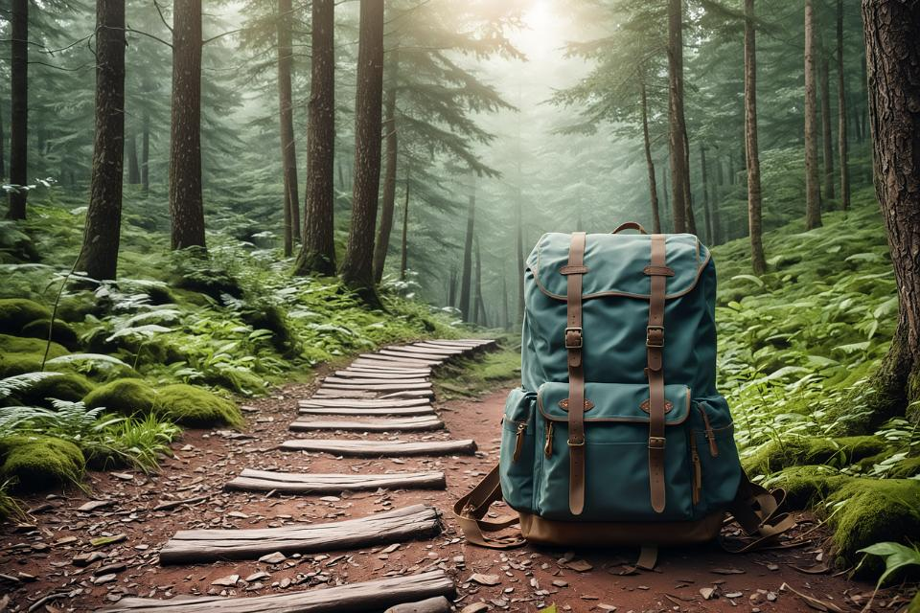
Picture copyright-free from pixabay
To boldly go….
Notes:
Slide 3: To boldly go….. We have another real-life adventure to share together in a moment, but first…..

Slide 4
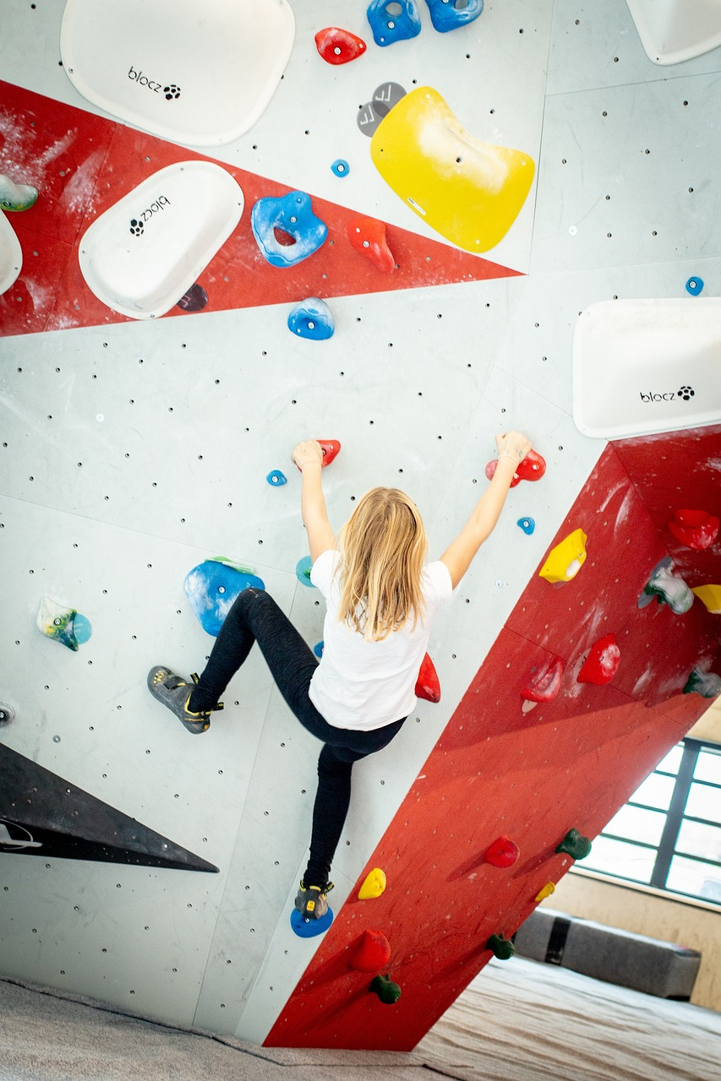
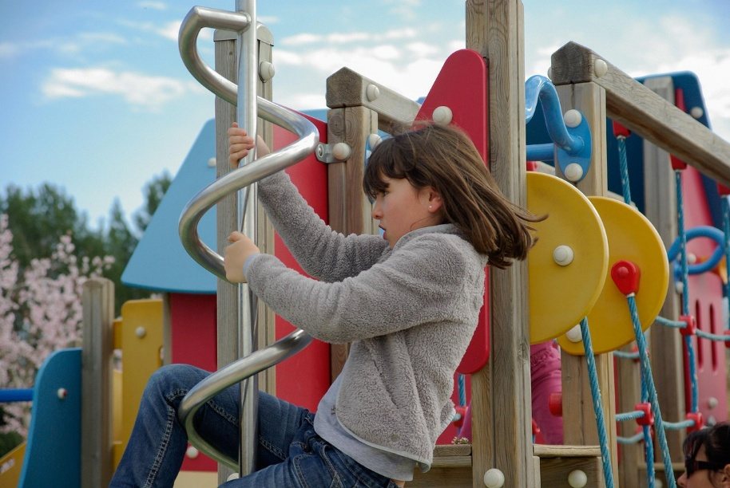
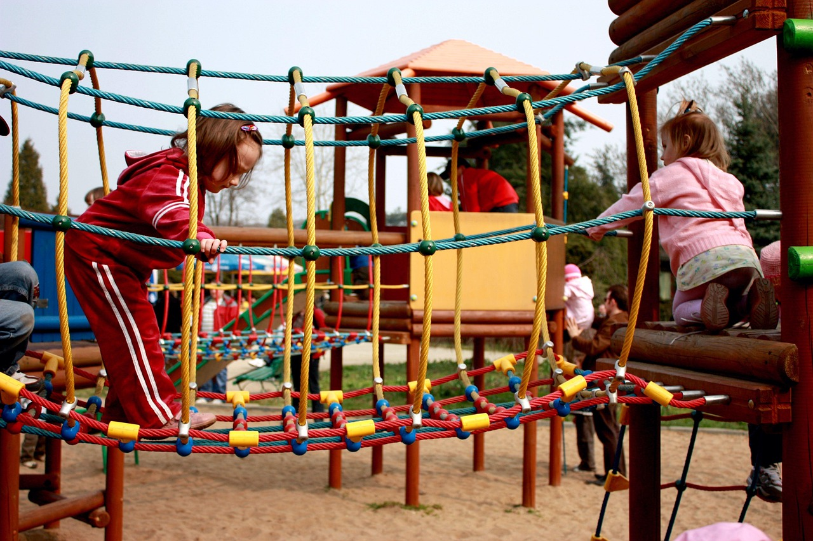
Notes:
Slide 4: Has anyone ever done anything like this? [ask pupils to share, especially if they had some experience of having to trust another person to help them]

Slide 5

Picture copyright-free from pixabay
What’s in the rucksack?
Notes:
Slide 5: What’s in the rucksack?
Take out the rope, and talk about how it might be used to help on a climbing adventure.

Slide 6
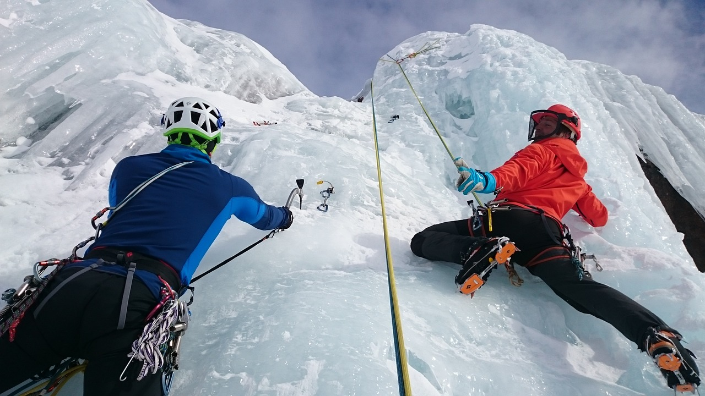
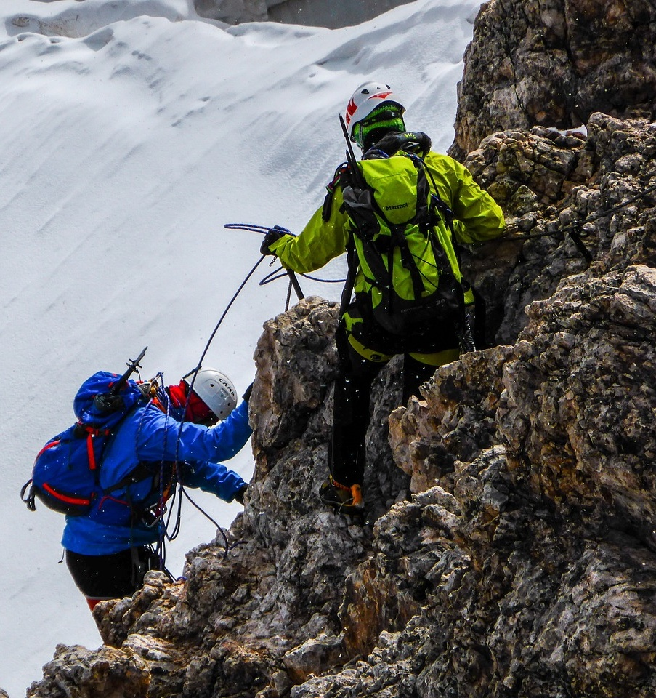
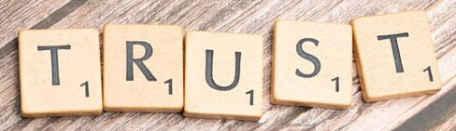
Notes:
Slide 6: More experienced climbers, like these ones in the photo, often work with a partner. Climbers are roped to their partner and will usually take it in turns to move up a rock-face, one of them climbing, the other having the rope securely fastened into the rock using bolts and carabiners like these [show them on the rope]. It’s not just a case of co-operation between them, they have to be able to completely trust that their climbing partner will support them (literally at times!) and watch out for them. At times, their life may literally depend on their partner.

Slide 7
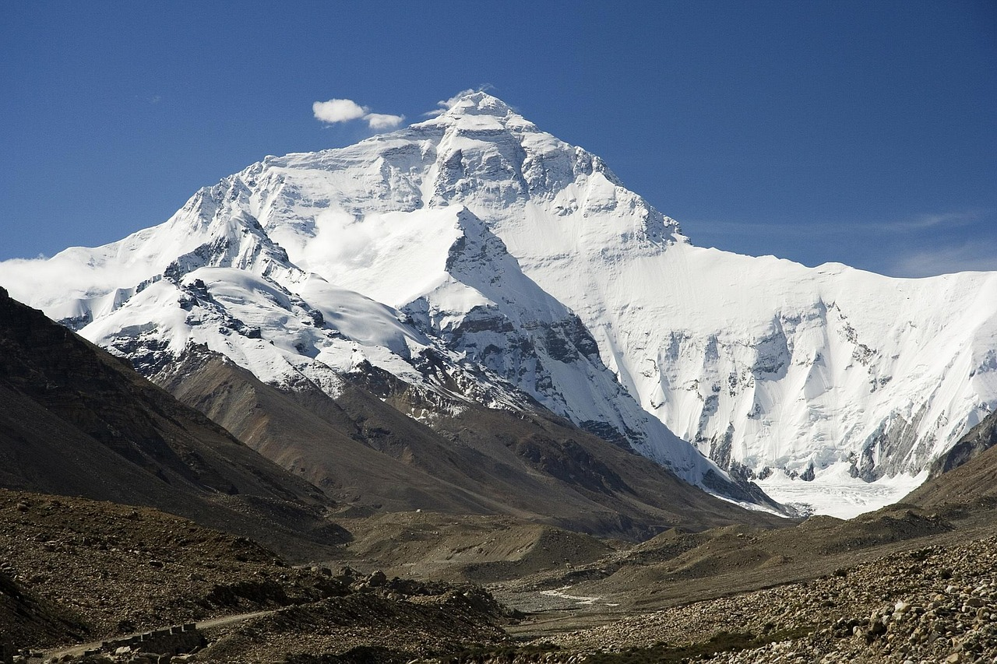
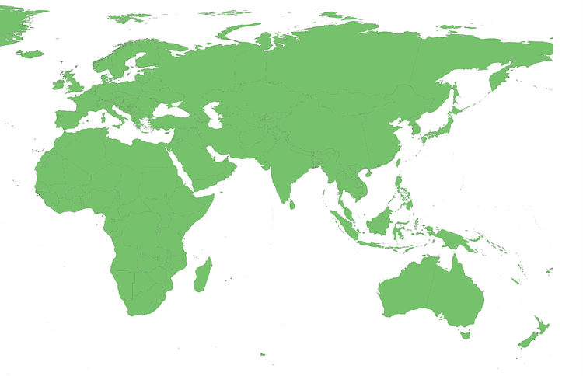

Mount Everest 27°59′17″N 86°55′30″E
Notes:
Slide 7: Some of you may recognise this as Mount Everest. Standing at 8,849 metres (29,032 ft), it’s the highest peak in the Himalaya mountain range and one of the most challenging mountains to climb. There have been many lives lost attempting to conquer Everest!

Slide 8
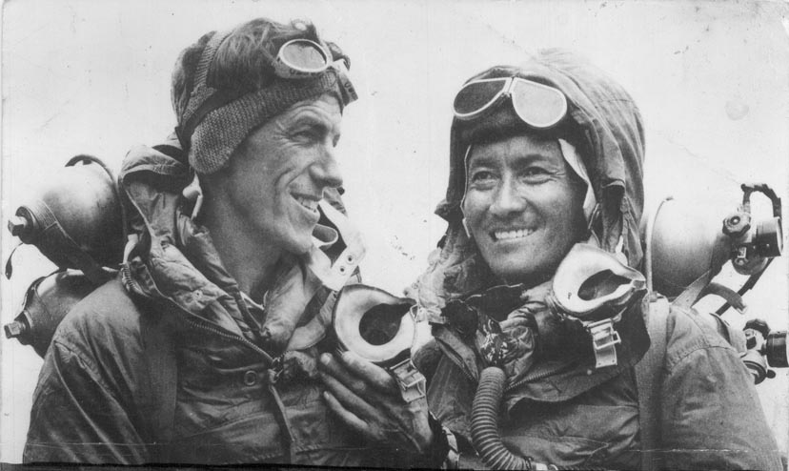
Images copyright-free from Wikipedia
Notes:
Slide 8: This is Sir Edmund Hillary with Tenzing Norgay, probably one of the most well-known climbing pairs in mountaineering history – and the first recorded pair to reach the top of Mount Everest, in 1953. They were part of the 9th British Expedition to Everest, though Tenzing had been a part of various Everest expeditions since 1935, when he was 20.
After the expedition, Hillary recalled the time that Tenzing saved his life, when, whilst descending an icefall, a chunk of the ice that Hillary was standing on broke away, and he plummeted into a deep crevasse (a deep crack in the ice).
Tenzing’s quick reactions – and brute strength, pulling on the rope that joined them – saved him from certain death. The trust that they developed on those mountain slopes was to develop into a life-long friendship between the two men.

Slide 9
Picture copyright-free from pixabay
What’s in the rucksack?
Notes:
Slide 9: What’s in the rucksack? So, what does this mean for us – and what else is in our rucksack today? [take out cards]
We’ve been thinking about how mountaineers ‘put their trust in’ their climbing partner. In our rucksack today, we have some different things that we might ‘put our trust’ in, to help us think more deeply now. As we add these things to our climbing rope here, think about each, and whether it’s something you put your trust in…..and then we’ll share our ideas together. [allow pupils to talk together in pairs, or share as they feel comfortable.]
We sometimes think that stories are just for children, but Jesus told his stories to help adults to understand important things. We’re going to hear one of his stories now – a story that he told to help people understand how to choose good things to put their trust in.
It’s one you might know, about two builders.

Slide 10
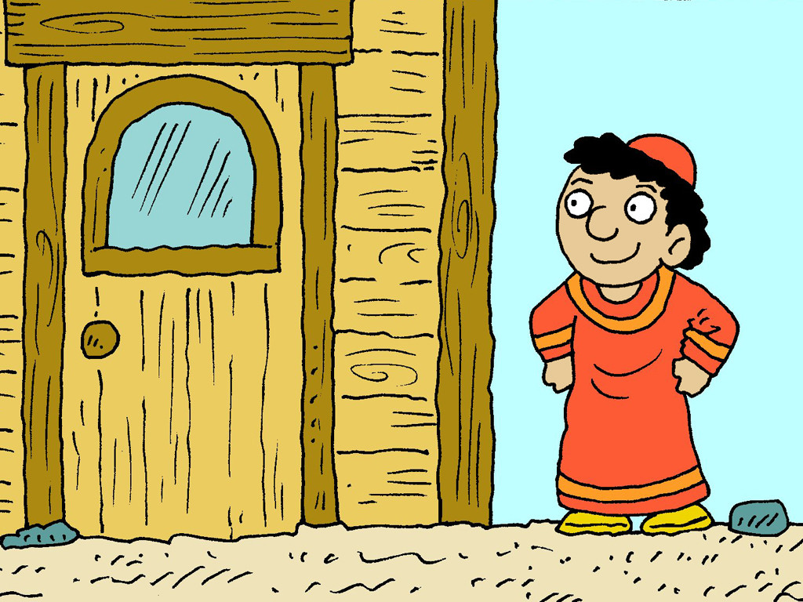

Notes:
Slide 10: One man built his house on the sand where there were fantastic views of the sea.

Slide 11
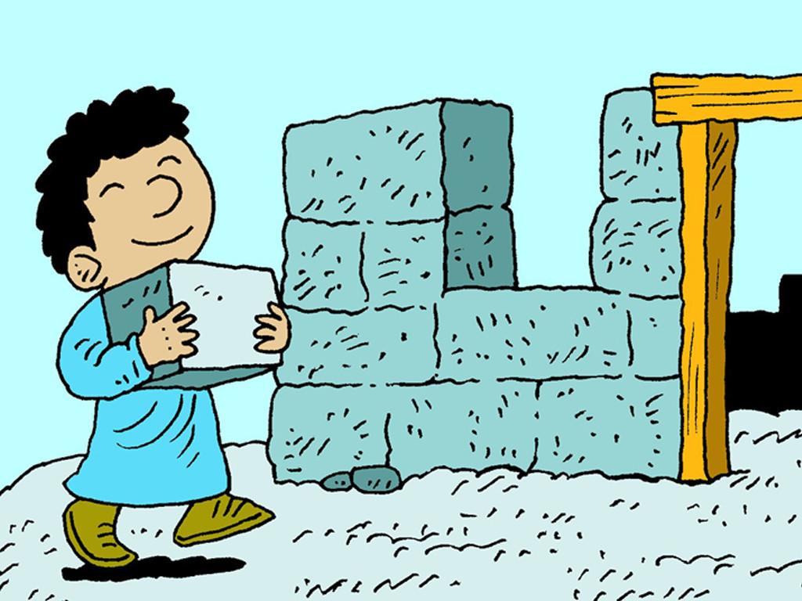
Notes:
Slide 11: The other builder chose to build his house high up on a rock, but it was much harder work to build!

Slide 12
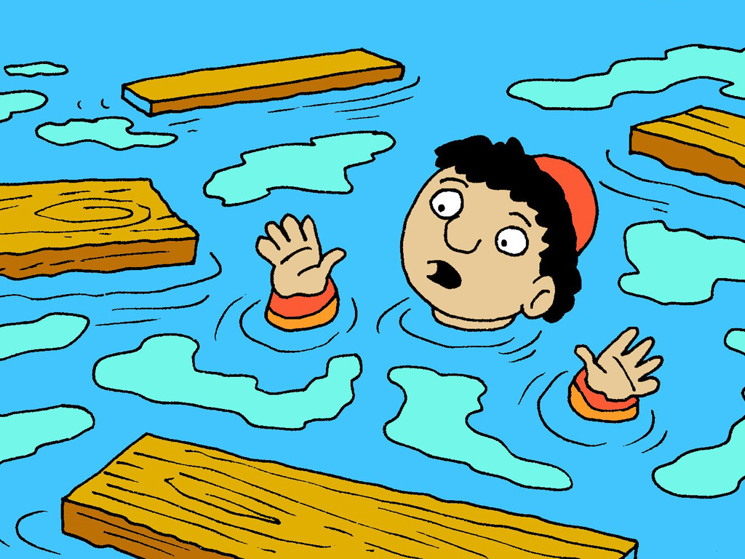
Notes:
Slide 12: When a storm came and the rain lashed down, the first builder’s house collapsed because sand doesn’t provide a firm foundation for a structure as big as a house.

Slide 13
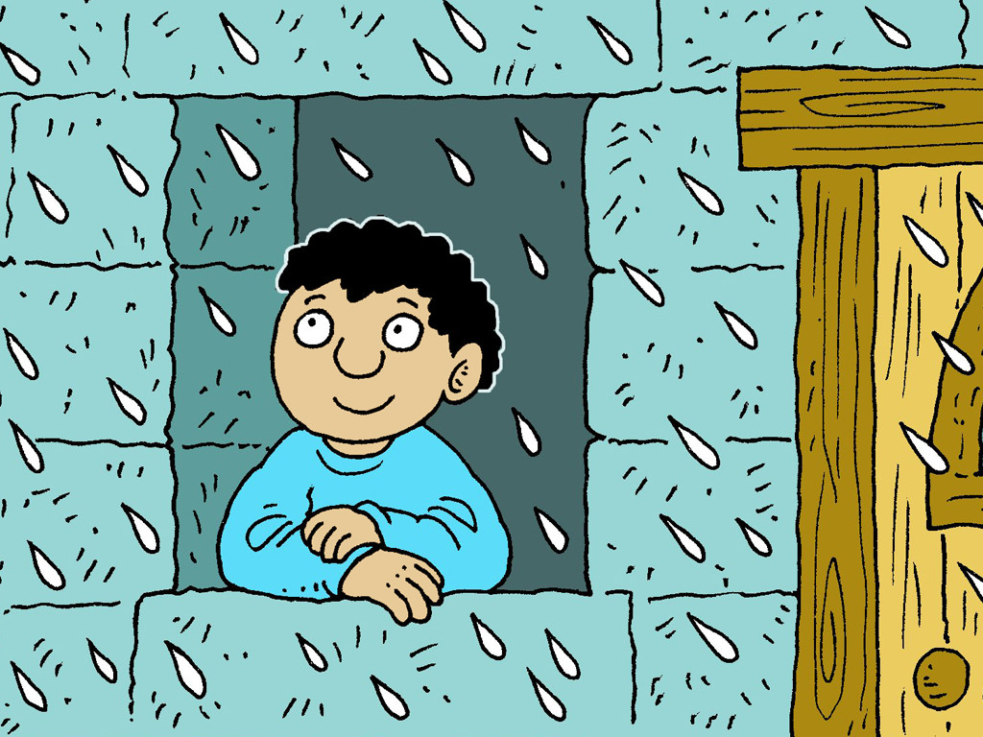
Notes:
Slide 13: The second builder’s house stood firm because he had chosen a good, firm foundation for his house, a rock that wouldn’t collapse when the storm came.
Jesus explained that people’s lives have to be built in the same way, on things that will stand firm and not fail, that we need to choose carefully the things that we ‘put our trust’ in.
So, let’s go back to our climbing rope: I wonder if some of these things are better than others for us to put our trust in?
[you might want to talk again, or just leave children to wonder for themselves]

Slide 14
….I wonder which are important things in your life – the things in which you put your trust?....
….I wonder which things make a strong foundation for our lives?.....
Notes:
Slide 14: Responding (and words for worship):
Let’s be quiet and still now as we bring our time together to a close.
In the quietness, look again at the words we’ve hung on our climbing rope….. [read them out]
…..I wonder which are important things in your life – the things in which
you put your trust?……
….I wonder which things make a strong foundation for our lives?….
…..maybe it’s something we’ve already hung on our climbing rope……
…..maybe it’s an idea of your own…..
In the story that Jesus told, he said that people could trust the things that he said and the things that he taught about God, who can also be trusted…..
I’m going to pray now. You might like to make the prayer your own by saying ‘Amen’ with me at the end, or prefer to think your own thoughts quietly in your head……

Slide 15
Dear God
Thank you for all the good things that we have in our lives. Help us to choose wisely the things in which we should put our trust.
Thank you that we can trust you.
Notes:
Slide 15: Prayer
Dear God
Thank you for all the good things that we have in our lives. Help us to choose wisely the things in which we should put our trust.
Thank you that we can trust you.

Slide 16
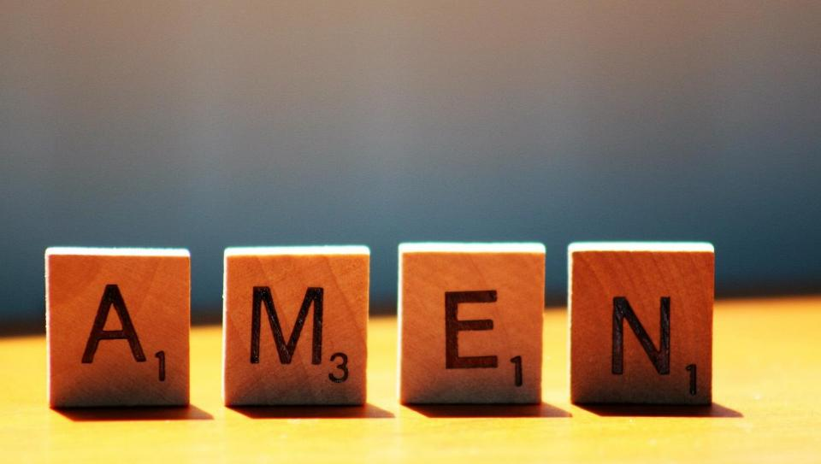

Slide 17
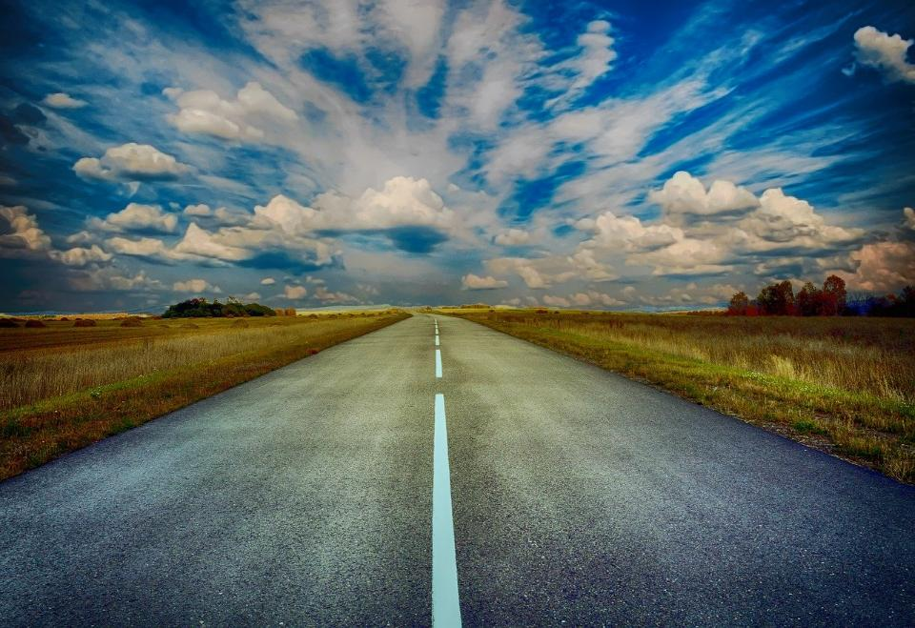
Picture copyright-free from pixabay
Leader: We have journeyed together today. As we leave this place and time and go into the day ahead…
ALL: …May God go with us.
Notes:
Slide 17: Use this term’s leaving words
Leader: We have journeyed together today. As we leave this place and time and go into the day ahead….
ALL: ….May God go with us.
Sign for ‘God: British Sign Language BSL Video Dictionary - God
Sign for ‘go with us’ – we have invented this! After you’ve signed ‘God’, bring your finger down alongside your other finger and make them ‘journey together’ in front of you.

Slide 18
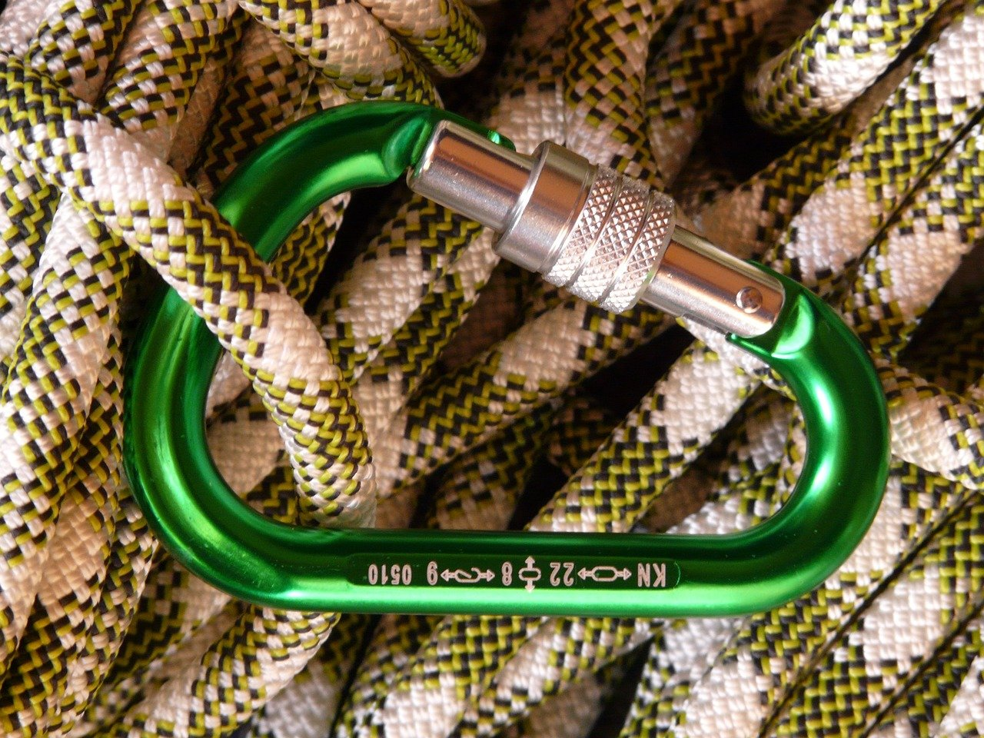
Picture copyright-free from pixabay
Notes:
Ideas for classroom reflection: What do we trust?
Take a blank card.
Think about the things that you trust in your life. Add your idea(s) to a card and hang it onto our ‘rope’
Turn your thoughts into a prayer if you want to.

