Slide 1

Pictures copyright-free from pixabay
Leader: We are a creative community. As we gather together today…
ALL: May our thinking, talking and wondering help us to grow.
Notes:
Slide 1: Gathering
Use the new greeting, with BSL actions if desired.
Leader: We are a creative community. As we gather together today….
ALL: May our thinking, talking and wondering help us to grow.
Here are BSL actions for some of the words:
Leader’s words:
Creative: https://www.signdictionary.co.uk/view/creative?q=creative#title
Community: (we use the word ‘gathering’ as it’s a simpler sign!) https://www.signbsl.com/sign/gathering
Gather together: https://www.signbsl.com/sign/gather (1st video)
Pupils’ response:
Think: https://www.brightbsl.co.uk/signs/think
Talk: https://www.signbsl.com/sign/talk (1st video)
Wonder: https://www.signbsl.com/sign/wonder (1st video)
Grow: https://www.signbsl.com/sign/grow (2nd video)

Slide 2
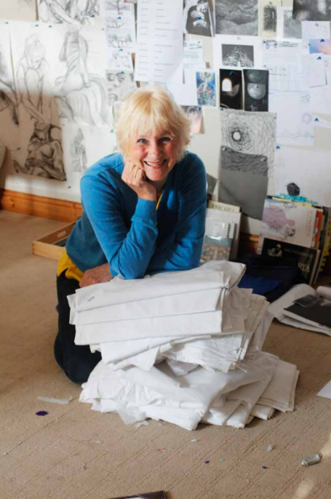
Threads Through the Cross
Notes:
Slide 2: Threads Through the Cross
Shortly, we will be looking at more of Jacqui’s panels. But first, something to think and talk about together.

Slide 3

Would you rather?...
Notes:
Slides 3-8: ‘Would you rather?’ game
We’re going to play a game about choices now, called ‘Would you rather?’ It’s very simple; I show you two options on the screen, and you decide which one you’d rather….I’ll give you a few moments to think and then you will show me by putting up your hand [It’s probably better not to allow children much time to discuss, otherwise you will run out of time! You could also change the actions to keep the pace up e.g. put your finger on your nose, hand on your head etc. Do involve the adults in the game as well!]
It’s a great game to play with your friends as well – you can very easily make up your own ideas!
[You could make this a more physical activity if you like at playtime, using two sides of the playground]

Slide 4
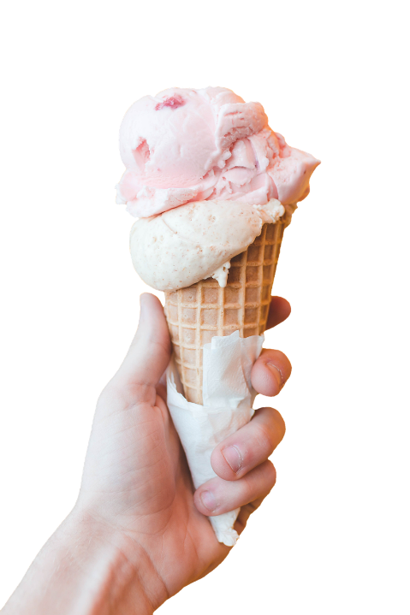
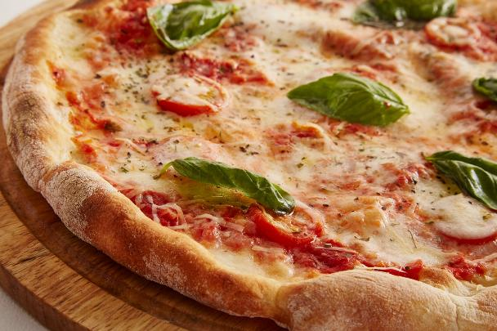
Notes:
Slide 4: Would you rather…….…..eat pizza or ice cream?

Slide 5
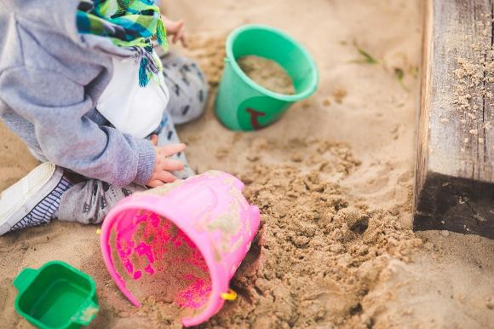
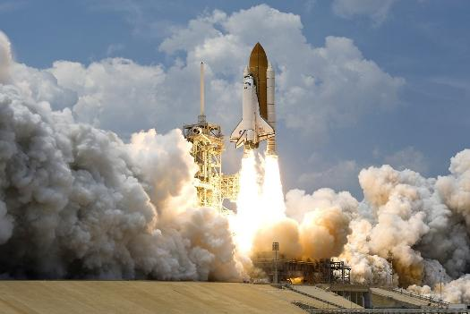
Notes:
Slide 5: Would you rather…….go to the beach or go to the moon?

Slide 6
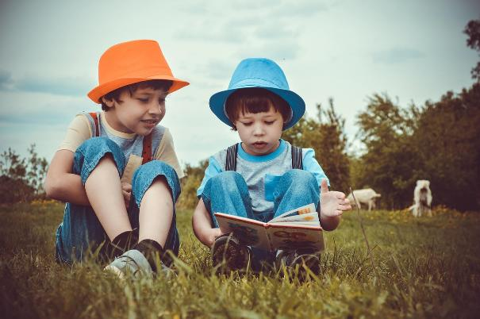
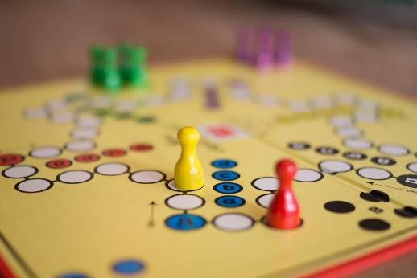
Notes:
Slide 6: Would you rather…….read a book or play a game?

Slide 7
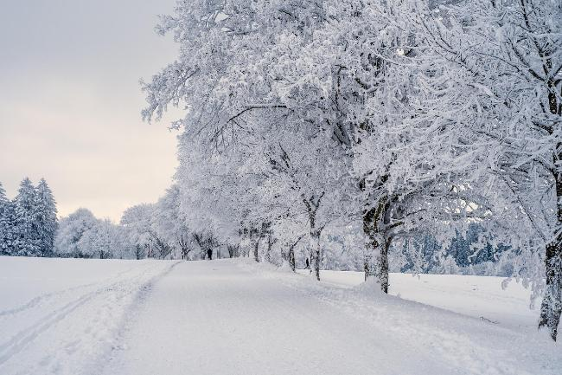
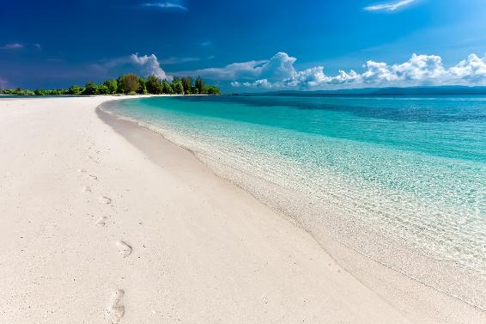
Notes:
Slide 7: Would you rather……. have winter snow or summer sun?

Slide 8
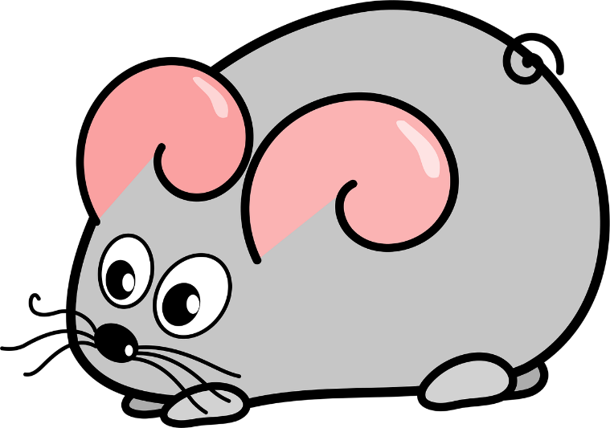
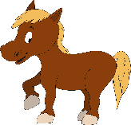
Notes:
Slide 8: Would you rather……meet a mouse the size of a horse, or a horse the size of a mouse?!

Slide 9
Choices
Notes:
Slide 9: Choices
Now some of these were a bit silly, and not at all possible, but in real life, we make choices every day – what to have for breakfast, who to play with at playtime, what to do to have fun at the weekend, and hundreds more! Some choices are ordinary, some are difficult – and we’ll continue talking about these during the week. I wonder if you might be facing some difficult choices at the moment?
Today’s panels feature 2 stories from the life of Jesus showing some choices that he had to make – and if you look really carefully, you might recognise some parts of the panel…..because there are ideas that we have seen before!

Slide 10
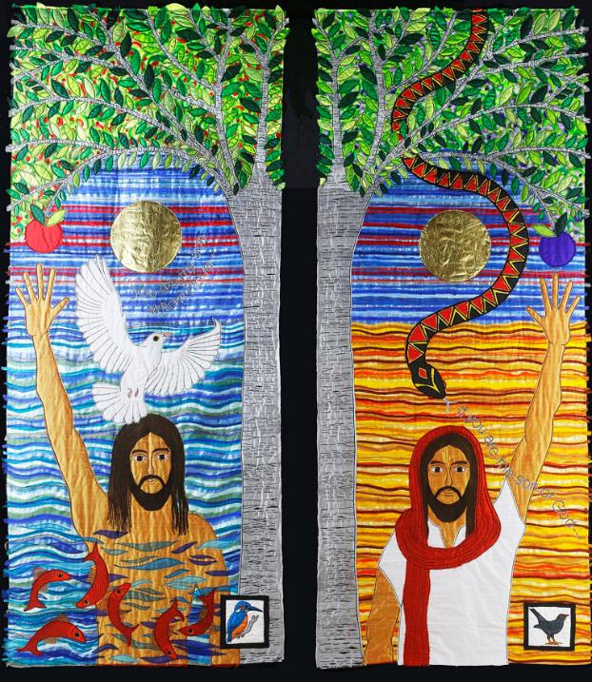
You are my Son, whom I love.
If you are the Son of God….
Notes:
Slide 10: This is my Son
Spend a while just gazing at the panels. Relax, and focus on calm breathing.
Let your eyes take in (look at) every detail……. [leave silence for a short while]
Now I’m going to use some questions to help us…for now, we’re not going to tell each other the answers. [select from the questions below, or use all, depending on the time / pupils you have]
….Where do you think Jesus is in each panel?
….I wonder what’s similar between the two panels? [pick out the two trees; the fruit – you’ve seen these before in the Garden of Eden; Jesus’ posture; the bright sun]
….and what’s different? [Jesus is in water / in the desert / wearing clothes in one; water / desert background; dove / snake]
….Which story/ies do you think these are from? [they are actually part of the same story – after Jesus was baptised, he went into the desert]
….Which parts have you seen before? [trees with fruit; dove=Holy Spirit; snake from Garden of Eden]
Now spend a few minutes talking about the things you were thinking about….and pick out the words ‘You are my Son, whom I love.’ and ‘If you are the Son of God…..’ to confirm what children might already have said.
….Whose words are these? [God the Father / Satan, the tempter – who also spoke to Adam and Eve in the Garden of Eden, where they made choices too]
….Can you find the birds? [for time purposes, we don’t talk about the birds in this script, but if children ask, this is what Jacqui said: ‘The kingfisher The blackbird is a traditional sign of temptation,

Slide 11
You are my Son, whom I love.
If you are the Son of God….
Notes:
Slide 11: Reflective story – using story on p.5 and props if desired.
We’re going to use the story of these panels to help us to think some more about choices….
[Place cloth] After Jesus was baptised, he went off alone into the desert. He spent a long time there praying and preparing for the work God had for him to do. He went without food for 40 days. At the end of this time God's enemy, Satan, the tempter, tempted Jesus with different ways that he could bring in God's Kingdom. He was offered three other ways to bring God's Kingdom into this world but each one of them avoided the cross.
Place the stone on the cloth:
'Why not change stones to bread and feed everyone who is hungry?' the tempter said. 'This will surely solve all the world's problems and bring in God's Kingdom!'
Place the tower on the cloth:
‘Why not jump down from a high tower in Jerusalem and defy gravity by landing safely?' he said. 'This will surely guarantee that people will believe you can do miraculous things and bring in God's Kingdom!'
Place the toy sword:
'Why not crush all the bad in the world with my help, so that everything is then ruled by you?' he said. 'This will surely bring in God's Kingdom!'
Allow the children time to think about the symbols of the story in front of them and wonder about these different ways of changing the world and making it more like heaven, with these questions:
I wonder if full stomachs are really the way to change people's hearts?
I wonder if a miracle jump would really persuade people?
I wonder if crushing the opposition in battle will really bring peace to the world?
But that’s not what Jesus chose. He knew that God’s way – the way that would take him to the Cross, [take the imitation sword and now turn it upside down (a sign of choosing not to fight); the shape that it makes is that of a cross] was the right way.

Slide 12
Let this happen to me as you say!
Notes:
Slide 12: Responding and words for worship
Today, we’ve thought about the choices that Jesus made, choices that were difficult and would take him to the Cross. He chose God’s way over the short-cuts that Satan the tempter offered him. We heard in an earlier story about how Mary also chose God’s way and said: Let this happen to me as you say!
We’ve also thought about what choices look like for us – some easier, some more difficult. We have many ways in school to help us to choose well…. [you may want to contextualise here, using values/tools that are familiar for your school community] and anyone who is a part of this community will always help you if you ask for it…..

Slide 13

Notes:
Slide 13: The choices we make are like a fork in the road – do we go this way, or that way? As we think about the choices that lie ahead of us today, let’s wonder together……You might want to bring a choice into your mind now….

Slide 14
….I wonder what choices we might face today?....
….I wonder what might help us to choose well?....
....I wonder what we might learn from the example set by Jesus?....
Notes:
Slide 14: Responding and words for worship
….I wonder what choices we might face today?....
….I wonder what might help us to choose well?....
….I wonder what we might learn from the example set by Jesus?....
Opportunity for reflection / prayer
I’m going to pray now. If this is something that you feel comfortable doing, then there will be some words for us to share together. If you don’t want to pray, then use the quiet to be still with your own thoughts. Here are the words….

Slide 15
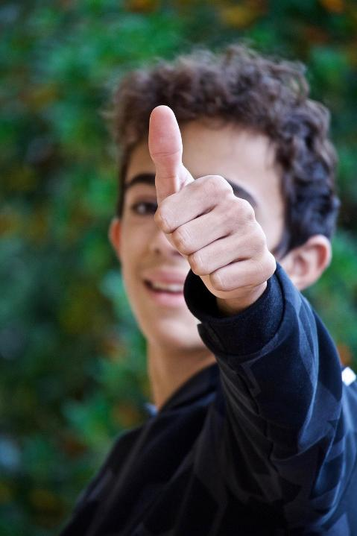
Help us to choose well.
Notes:
Slide 15: Help us to choose well.

Slide 16
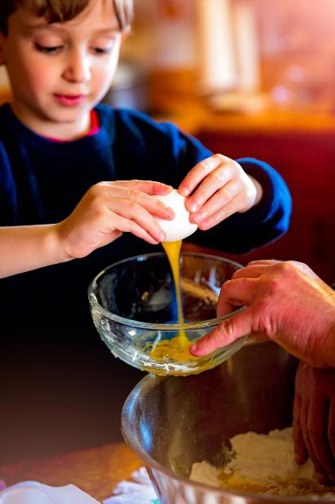
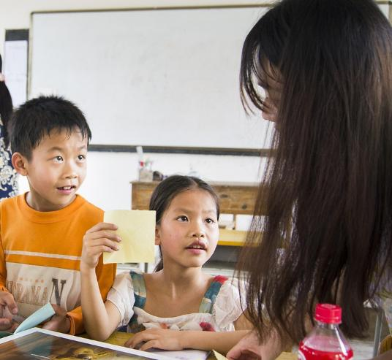
Notes:
Slide 16: In the choices we make at home and at school

Slide 17
Help us to choose well.
Notes:
Slide 17: Help us to choose well.

Slide 18
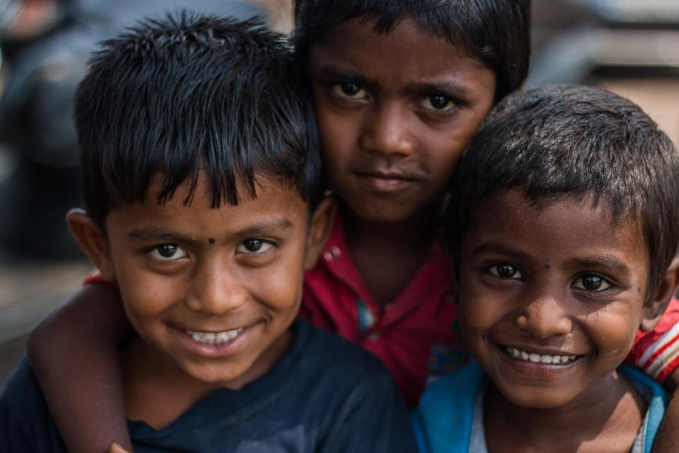
Notes:
Slide 18: In the friends that we make

Slide 19
Help us to choose well.
Notes:
Slide 19: Help us to choose well.

Slide 20
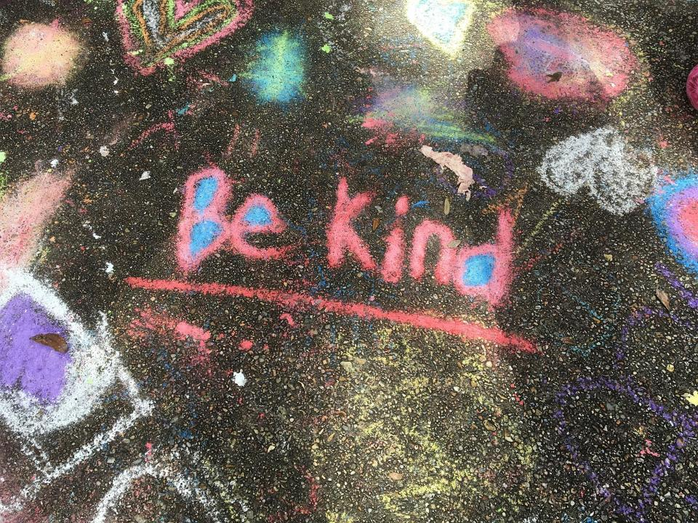
Notes:
Slide 20: In the way that we treat one another….

Slide 21
Help us to choose well.
Notes:
Slide 21: Help us to choose well.

Slide 22
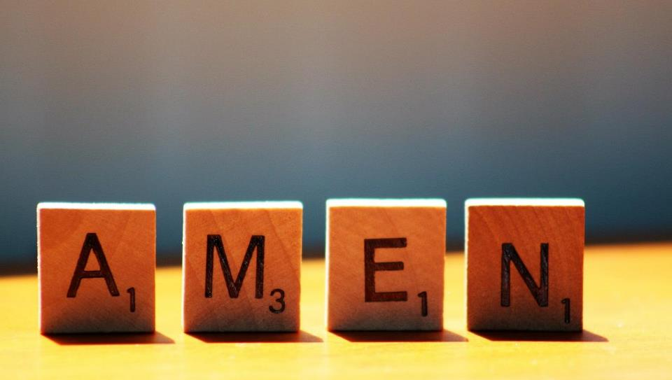

Slide 23



Leader: As we leave this place & time and go into the day ahead…
All: Together, we create a responsible community!
Notes:
Sending: Slide 22 (NB note different word from last week!)
Leader: As we leave this place & time and go into the day ahead…
All: Together, we create a responsible community!
BSL Together: https://www.signbsl.com/sign/together (1st video); Responsible: https://www.signbsl.com/sign/responsibility
You already have signs for ‘community’

Slide 24
Notes:
Slide 24: Reflective areas – ‘Fork in the road’ choices
Think: Think about some choices that you have made today or this week. Which ones were harder than others?
Talk: How can we help each other to make good choices in school?
Do: Take a ‘fork in the road’ card. Choose one of your more difficult choices and draw / write about it on the card. You might want to talk to another person or to God about what you have written.

Slide 25
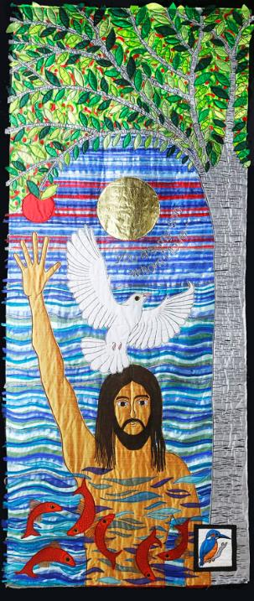
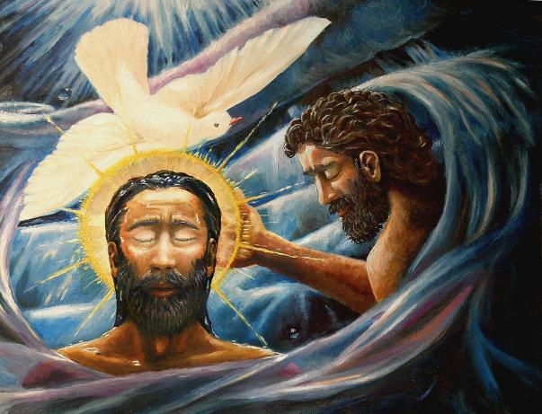
Baptism of Christ, by Dave Zelenka from Art in the Christian Tradition
Notes:
Slide 25: Showing Jesus’ baptism from different cultural perspectives
Link to original artwork: https://diglib.library.vanderbilt.edu/act-imagelink.pl?RC=56385, which includes some key information.
Looking at these two creative interpretations of this part of the story may be something that links with your RE curriculum, reflecting the fact that Christianity is a global religion, encouraging pupils to appreciate the diversity that exists across cultures, traditions and geographical areas. It’s important for pupils’ wider understanding that they are given opportunities to think about how Christians show Jesus as being ‘like them’, and that this important story for Christians is imagined in different ways across the world. It also creates an inclusive classroom environment, giving all pupils opportunity to see themselves in the art that they view.
You may wish to consider these questions:
What is the same? What is different?
Which culture / tradition does the 2nd piece come from?
Why do we think this?
What questions might we want to / need to ask?

