Slide 1
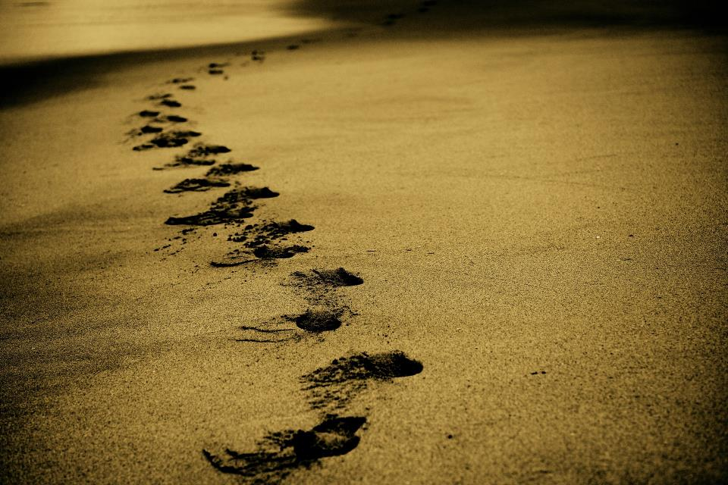
Picture copyright-free from pixabay
Leader: We are on this journey together…
Children: We are friends along the way…
ALL: May God go with us.
Notes:
Slide 1 or 2 [choose whichever image you prefer, or use them in rotation]:
Use the greeting for this term
Leader: We are on this journey together…
Children: We are friends along the way…
ALL: May God go with us.
BSL interpretation:
Sign for ‘way’ (nearest to the idea of ‘journey’): British Sign Language BSL Video Dictionary - way
Sign for ‘friends’: British Sign Language: friends
Sign for ‘God: British Sign Language BSL Video Dictionary - God
Sign for ‘go with us’ – we have invented this! After you’ve signed ‘God’, bring your finger down alongside your other finger and make them ‘journey together’ in front of you.
Engaging:
As we heard last week, in the final term of this school year, we are beginning a new theme:

Slide 2
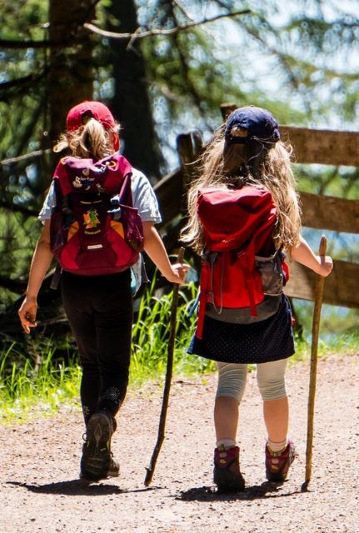
Picture copyright-free from pixabay
Leader: We are on this journey together…
Children: We are friends along the way…
ALL: May God go with us.
Notes:
Slide 1 or 2 [choose whichever image you prefer, or use them in rotation]:
Use the greeting for this term
Leader: We are on this journey together…
Children: We are friends along the way…
ALL: May God go with us.
BSL interpretation:
Sign for ‘way’ (nearest to the idea of ‘journey’): British Sign Language BSL Video Dictionary - way
Sign for ‘friends’: British Sign Language: friends
Sign for ‘God: British Sign Language BSL Video Dictionary - God
Sign for ‘go with us’ – we have invented this! After you’ve signed ‘God’, bring your finger down alongside your other finger and make them ‘journey together’ in front of you.
Engaging:
As we heard last week, in the final term of this school year, we are beginning a new theme:

Slide 3
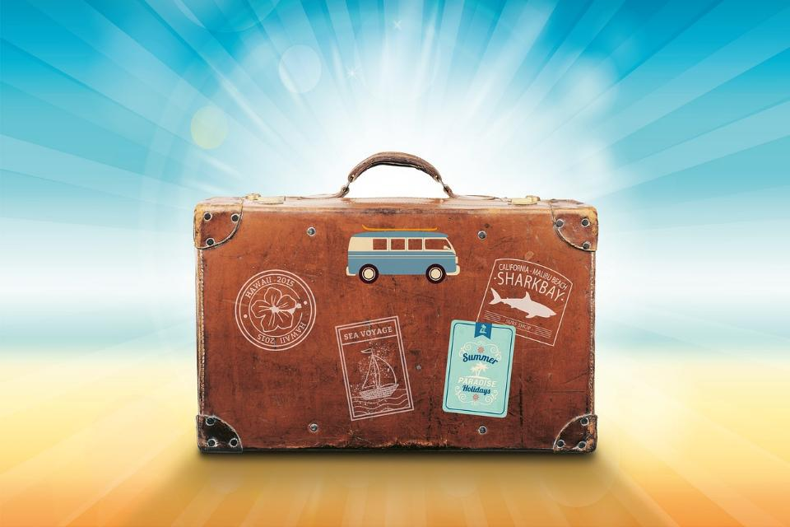
Picture copyright-free from pixabay
Notes:
Slide 3: Holiday mementoes
I wonder if you’ve ever been on a very memorable journey somewhere – and have kept something as a reminder of your time? Here is one/are some of mine [show your own mementoes, explaining why they are significant]….now let’s hear about a few of yours!

Slide 4
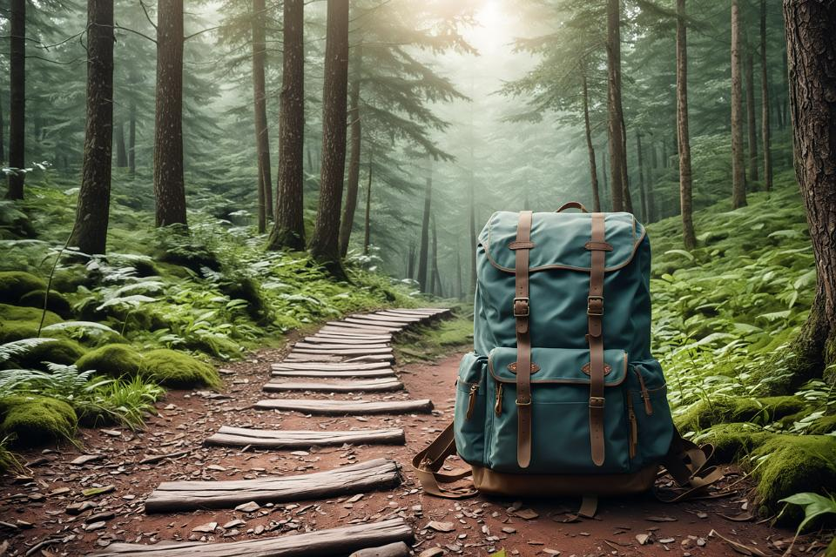
Picture copyright-free from pixabay
To boldly go….
Notes:
Slide 4: To boldly go….. Today we are going to share a story about a very special kind of journey called a pilgrimage. Many millions of people across the world might take a pilgrimage, which is a physical journey to a place with a spiritual significance. The action of going on a pilgrimage might help some people to get closer to God, or to grow as a person. We’ll pick this idea up in a short while, but first….

Slide 5

Picture copyright-free from pixabay
What’s in the rucksack?
Notes:
Slide 5: What’s in the rucksack today? In our rucksack today we have something that’s a very special reminder of a once-in-a-lifetime pilgrimage for many millions of people across the world. I wonder what it might be? [You could ask some children to share their ideas, then take out the water – feign some surprise, and then wonder together about what it might mean]

Slide 6
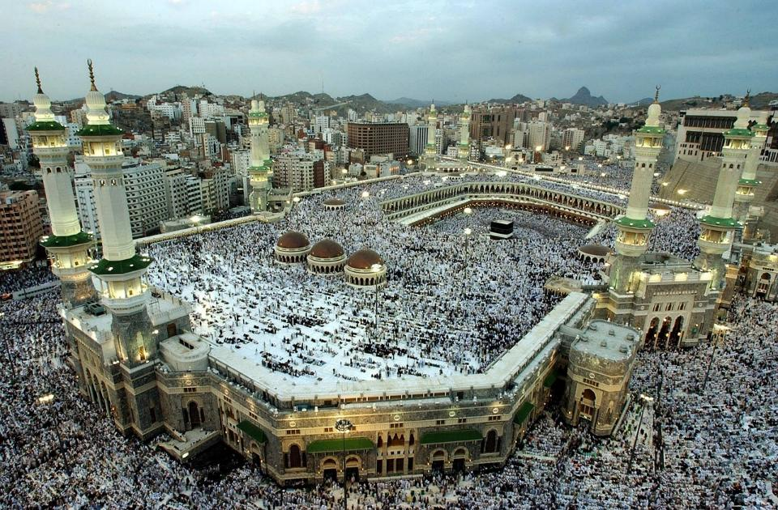
Picture copyright-free from pixabay
Hajj حَجّ
Notes:
Slide 6: A bottle of very special water (so, not this one, because we can see that this is one we could buy in a shop!) can be a reminder of a pilgrimage that Muslims try to take once in their lifetime, to Mecca, the birthplace of the Prophet Muhammad* (may peace and blessings be upon him.) These words ‘may peace and blessings be upon him’ – As-Salamu-Alaikum (in Arabic) – are spoken by Muslims as a mark of respect after the name of the Prophet. [*it’s not expected that non-Muslims do this, but we choose to use it here to model how Muslims would do it] The pilgrimage is called Hajj [written in Arabic as well]. Our story today explains why something as ordinary as a bottle of water might be something a bit more special for Muslims on Hajj….. [use script on p3-4]

Slide 7
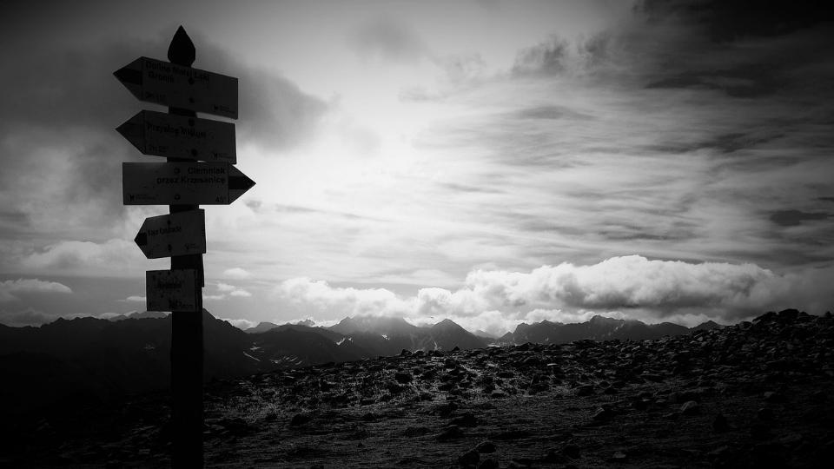
Picture copyright-free from pixabay
Notes:
Slide 8: Hajar was thirsty – thirstier than she had ever been. She was on a journey, if it could be called that, because she wasn’t sure now where she was, or even where she was going. She had been travelling for what felt like days, wandering in the desert wilderness, with her young son, Isma’il, strapped onto her back along with some water for the journey. She understood the reason for her journey – a test of faith. Ibrahim (may peace be upon him) was Isma’il’s father, and Allah had promised that Ibrahim would be the father of a great nation through his son. But it was hard, now, to imagine how this part of the story would end.

Slide 8
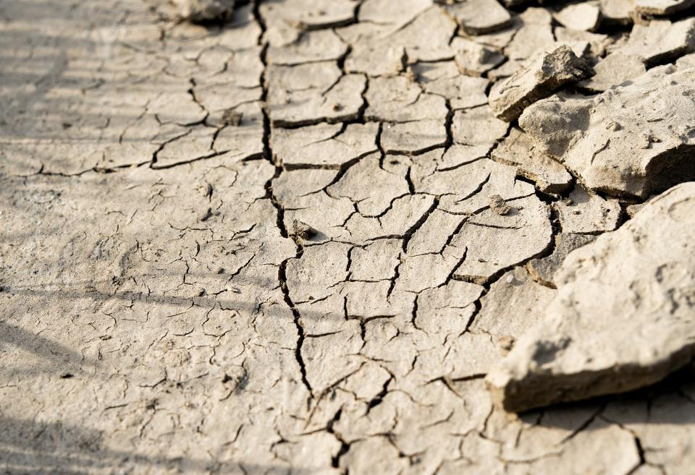
Picture copyright-free from pixabay
Notes:
Slide 8: All around her was desert – dry, waterless, dusty ground, with nothing but red earth as far as the eye could see. Except, that was for a few scrubby bushes, and the hills in the distance…What was worse was that Isma’il was thirsty too. Hajar squeezed the water skin to push the last few drops of precious water into his dry little mouth, knowing that once it had gone, they would have to find water somewhere. But from where? There was certainly none to be seen here – or anywhere near here.

Slide 9
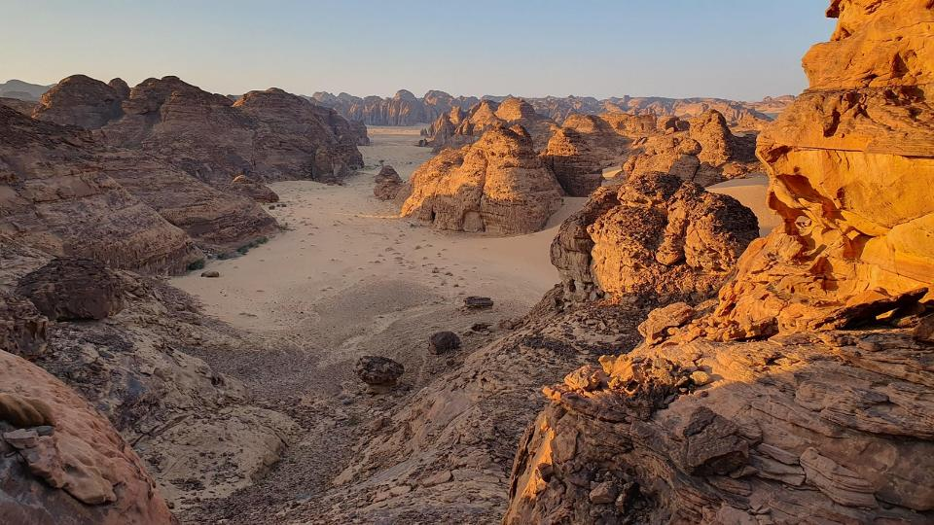
Picture copyright-free from pixabay
Notes:
Slide 9: The sun beat down on her as she struggled on, heading towards the small patch of scrubby desert bushes that she could see in the distance, in the hope of a little shade from the noonday sun. The dusty ground was burning hot under her feet, scorching her soles even through her shoes. Isma’il was getting heavier on her back and she wondered if she’d ever make it to the bushes…..

Slide 10
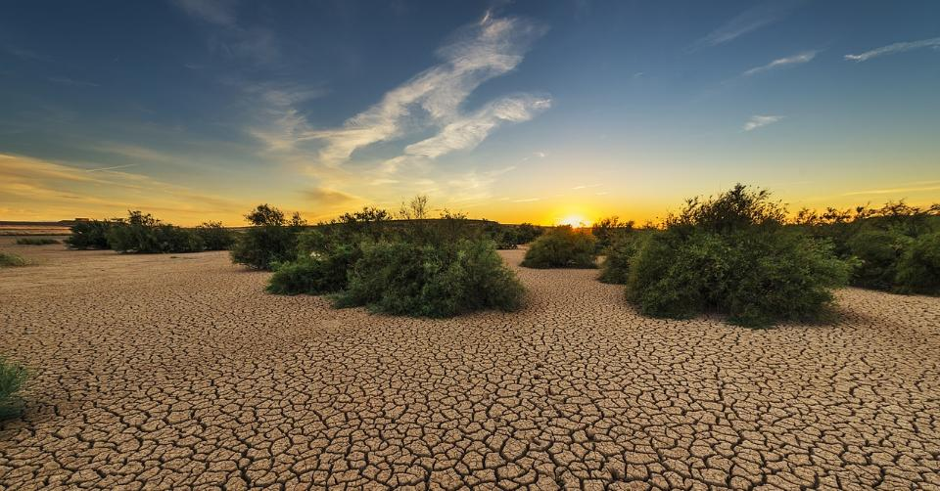
Picture copyright-free from pixabay
Notes:
Slide 10: Somehow, Hajar did, and she collapsed, exhausted, pushing the precious bundle she bore, and herself, under the edge of the largest bush, so that they were both covered by a little shade. She closed her eyes…..

Slide 11
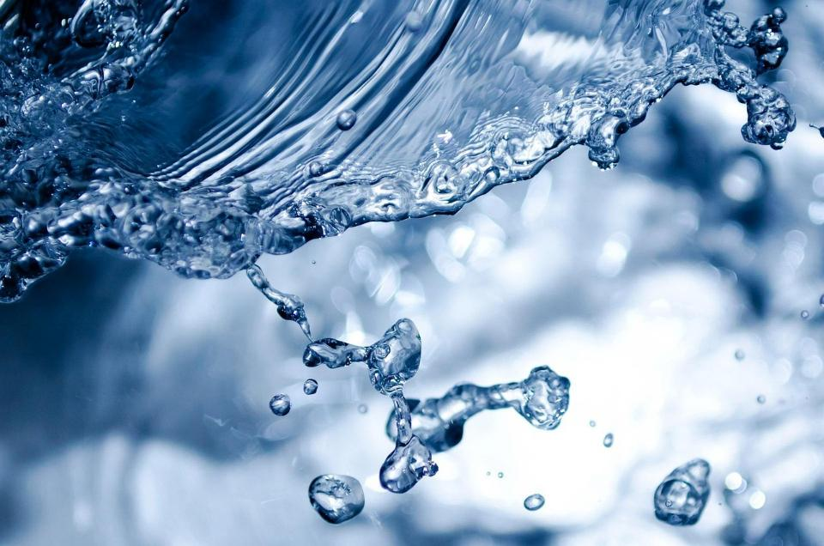
Picture copyright-free from pixabay
Notes:
Slide 11: …She tried to imagine what it would be like to drink cool, clear water – hoping that the dream of it might satisfy her thirst somehow. How wonderful it would be to wash the desert sand out of her mouth and feel the cool refreshment that the water would bring…..!!! What was she to do? Isma’il needed water – and he needed it now! She looked out, desperately, from their shady haven and saw the hills. Miraculously, they were closer than she had imagined they would be. Perhaps there would be water there? Well, she had no choice – there was nowhere else that she could look.

Slide 12
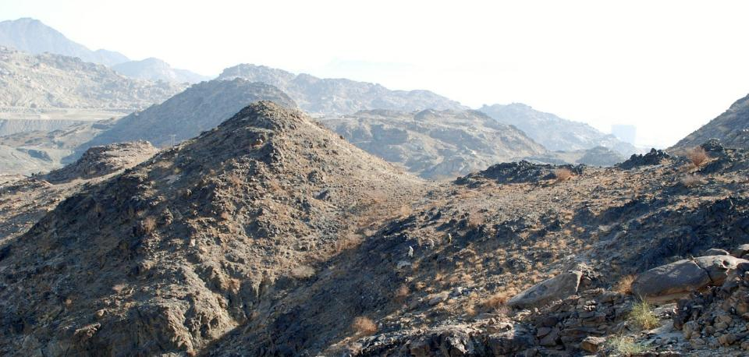
Picture copyright-free from pixabay
Notes:
Slide 12: So desperate was she that she ran, in panic, to the hills – first up one, then the other, over and over, seven times, in search of water. But there was no water to be found and so Hagar sank to the ground, weeping, for she feared that her son would surely die. She couldn’t bear it – what then would become of Allah’s promise?! She covered her face with her hands and sobbed until she could cry no more…….

Slide 13
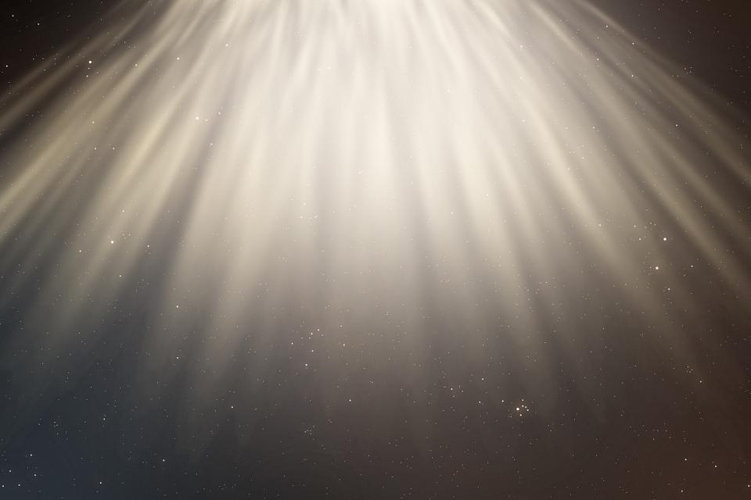
Picture copyright-free from pixabay
Notes:
Slide 13: It was when she had given up all hope that it happened. Out of nowhere, she heard a voice! An angel – it was an angel!! Allah’s messenger told her not to be afraid – that He had heard the sound of her son, Isma’il, crying, and that Isma’il would yet be the father of a great nation.

Slide 14
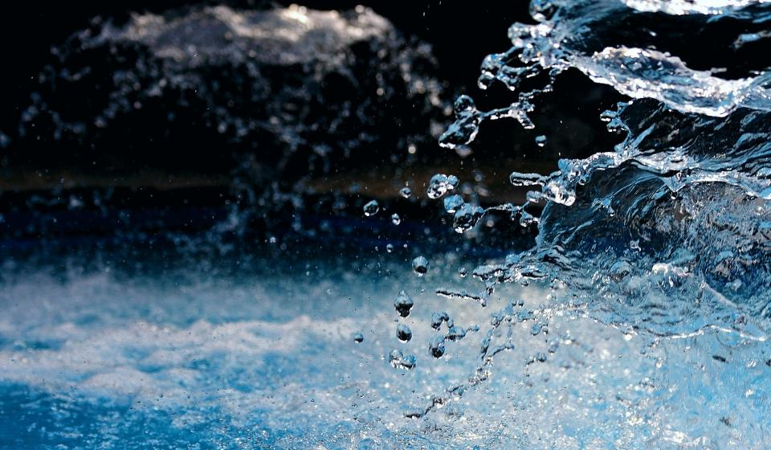
Picture copyright-free from pixabay
Notes:
Slide 14: There was a deep rumble, and there, where the angel had scraped the ground with his staff, was a spring of the most beautiful water that she had ever seen, running cool and clear. It was a miracle!

Slide 15
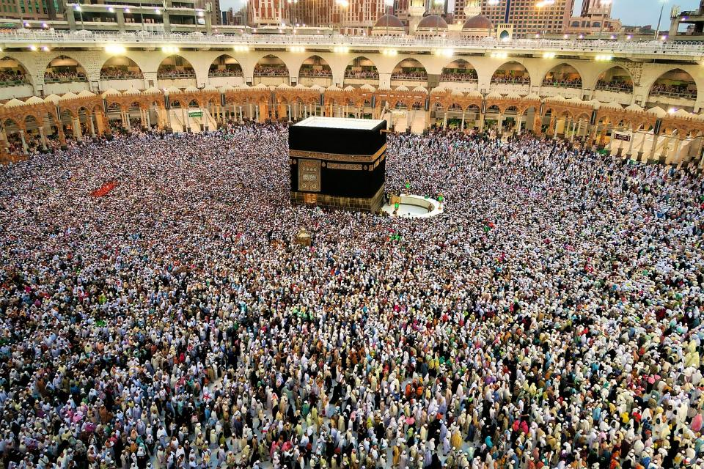
Picture copyright-free from pixabay
Notes:
Slide 15: It’s a miracle that is remembered each time a pilgrim of Islam goes on Hajj, for the well that was built to contain the spring still brings forth water, even 4000 years later. A mighty city grew up close by – the city that is called Mecca, the birthplace of the Prophet Muhammad (may peace and blessings be upon him), a city that is visited by millions of pilgrims on Hajj every year. And the pilgrims who come run up and down the hills, just as Hajar did…

Slide 16
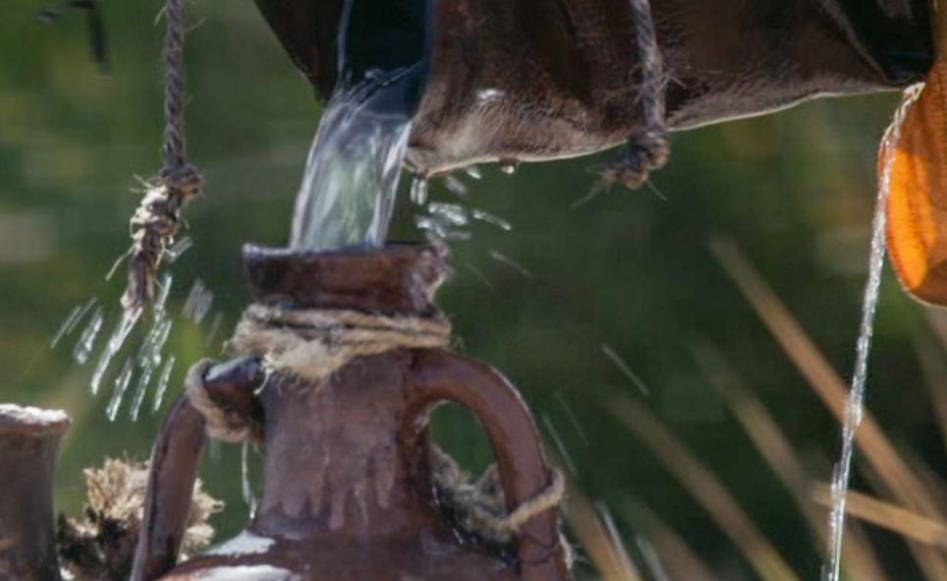
Notes:
Slide 16: …and drink from that well, now called Zamzam, the well that saved Hajar and her son Isma’il, the father of the Arabic nations.

Slide 17
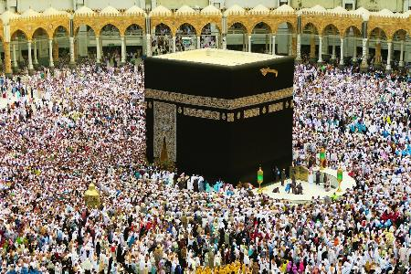
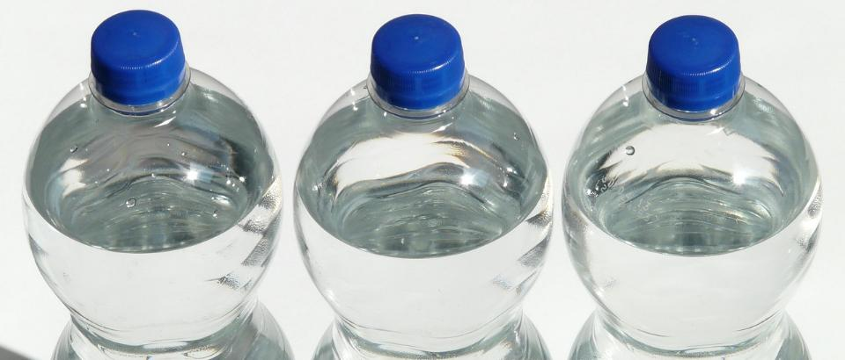
Picture copyright-free from pixabay
Zamzam water
Notes:
Slide 17: The Well of Zamzam is just 20 metres east of the site of the Kaaba – the holiest place for Muslims, which is circled 7 times by Hajj pilgrims.
Pilgrims might bring back some water from the well as a reminder of their special journey, but also to be shared as a blessing with those back home. There are stories of the miraculous properties of this special water, but they are for another day and another time!

Slide 18
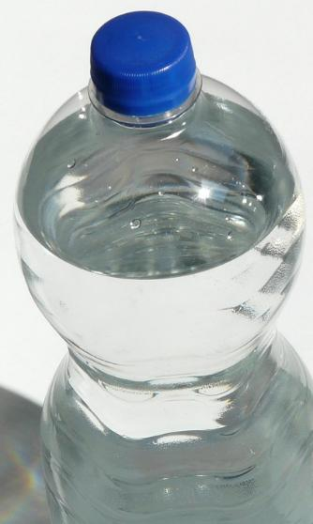
….I wonder what stood out for you in the story?....
….I wonder what Muslims might feel as they share in Hajar’s journey?....
….I wonder why Zamzam water is such a special reminder for Muslims of their Hajj experience?....or how it might help Muslims to feel closer to God?....
….I wonder what special journeys we might have been on – and what objects might help us to remember?...
Notes:
Slide 18: Responding (and words for worship):
Let’s be quiet and still now as we bring our time together to a close.
We’ve heard today about Muslims’ special pilgrimage to Mecca – and the story of Hagar’s journey in the desert.
….I wonder what stood out for you in the story?....
….I wonder what Muslims might feel as they share in Hajar’s journey?....
….I wonder why Zamzam water is such a special reminder for Muslims of their Hajj experience?....or how it might help Muslims to feel closer to God?....
….I wonder what special journeys we might have been on – and what objects might help us to remember?...
At the very end of our time together, I am going to use an ancient prayer of blessing, which you can make your own if you would like to.

Slide 19
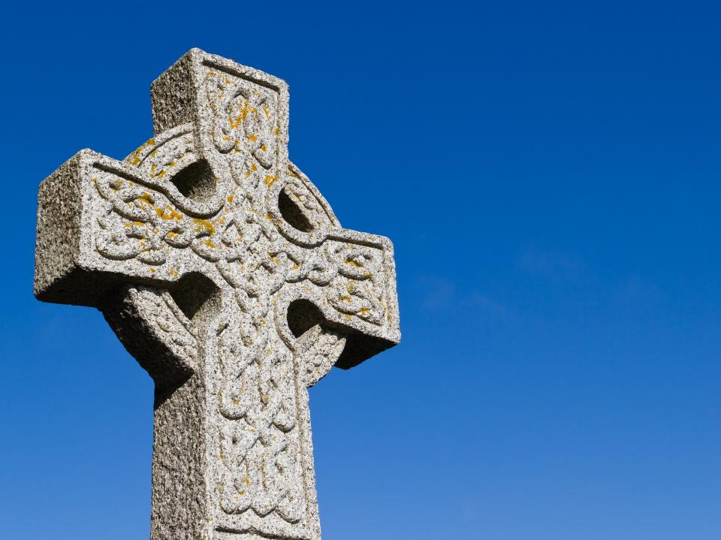
Picture copyright-free from pixabay
A Celtic Blessing
Notes:
Slide 19: It’s a Christian blessing that is very old, probably from Ireland (which is one part of the British Isles) This blessing talks about wishing someone well as they go on their journey….that their journey will be an easy one. This may be an actual journey, but it could also mean the journey of people’s lives. As you listen, you might not understand every word, because the language is like a poem, so I’m going to use some pictures to help us. [Try to leave a pause between each slide, and resist the urge to explain the words: let them sink in and let the words and pictures ‘speak’ to children at whatever level they will absorb them, even if it’s only to enjoy how they sound. Read it more than once if you think it will help.]

Slide 20
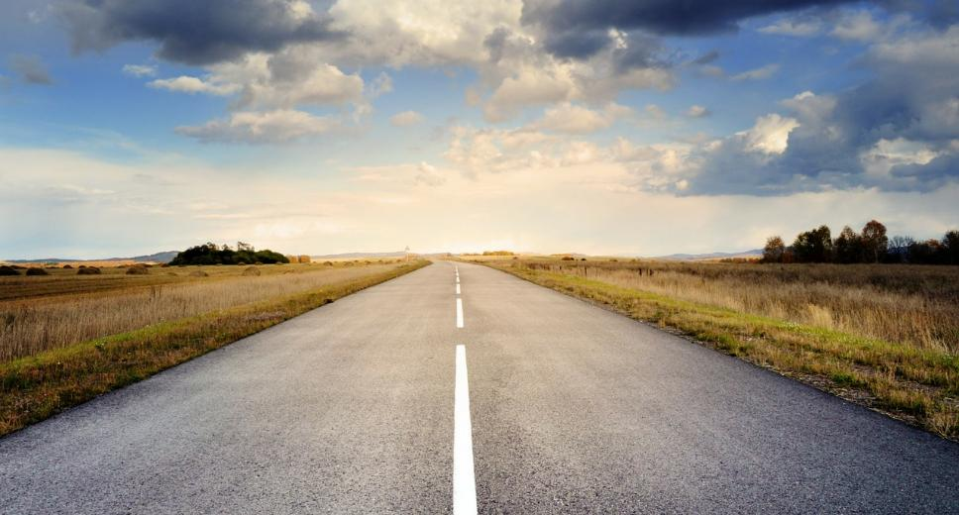
Picture copyright-free from pixabay
May the road rise up to meet you.

Slide 21
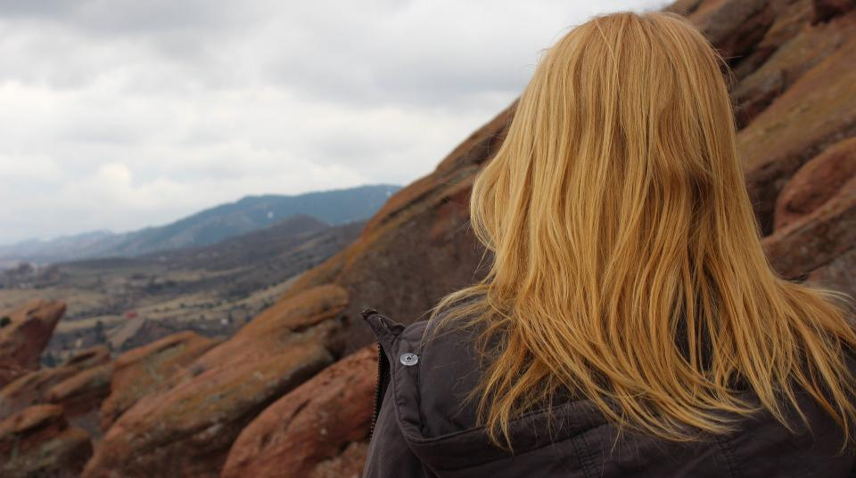
Picture copyright-free from pixabay
May the wind be always at your back.

Slide 22
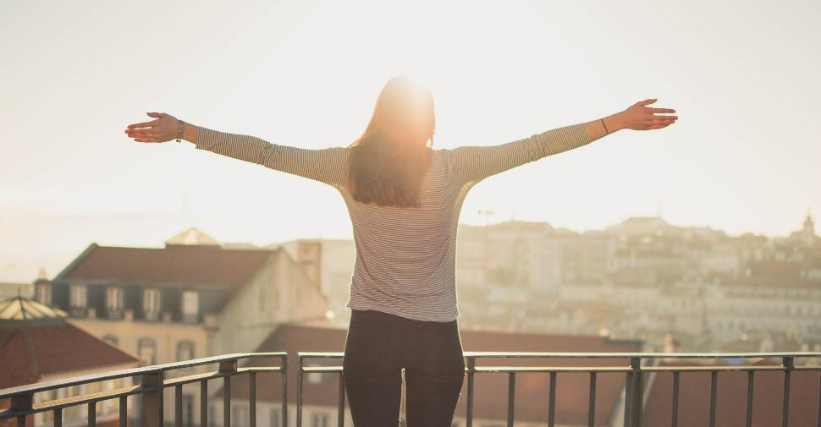
Picture copyright-free from pixabay
May the sun shine warm on your face,

Slide 23
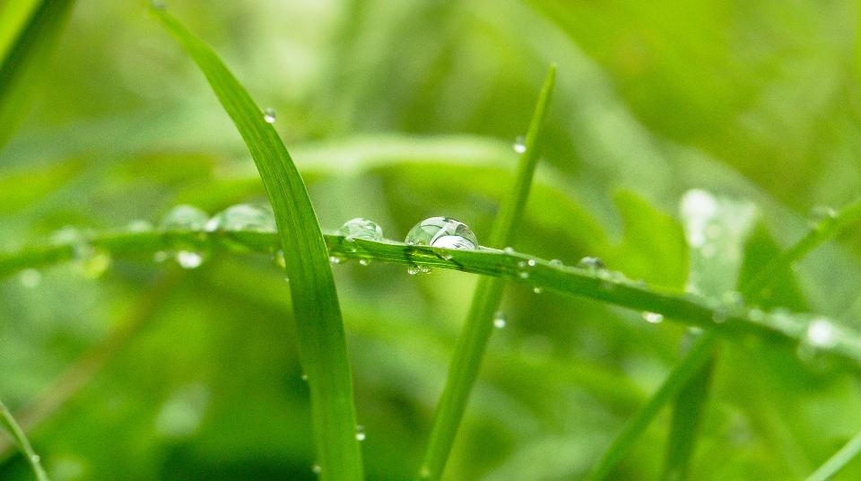
Picture copyright-free from pixabay
…the rains fall soft on your fields…

Slide 24
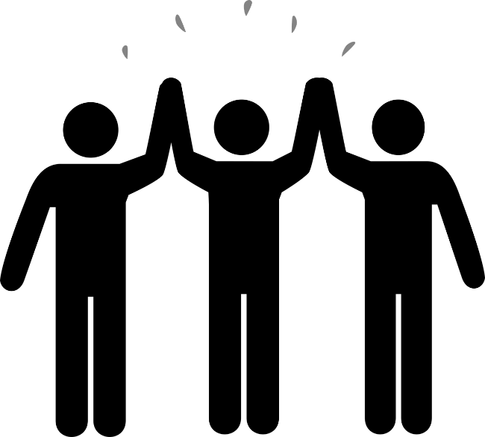
…and until we meet again,

Slide 25
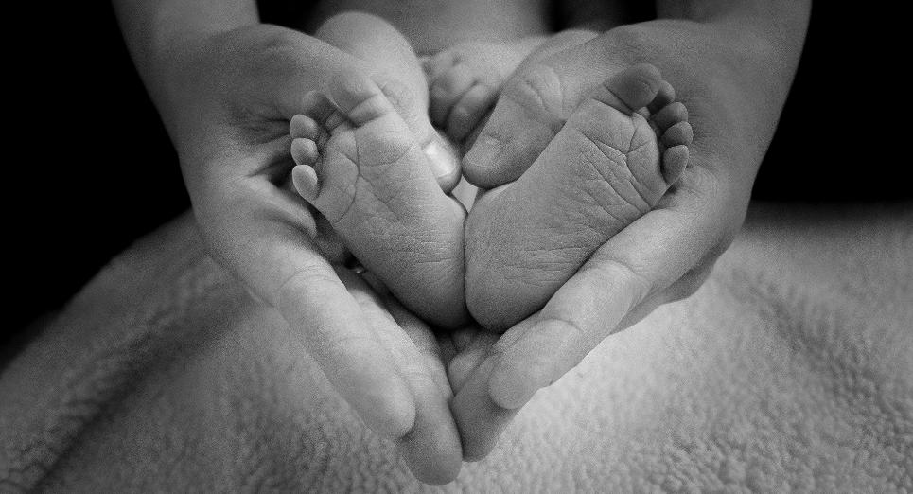
Picture copyright-free from pixabay
…may God hold you in the palm of his hand.

Slide 26
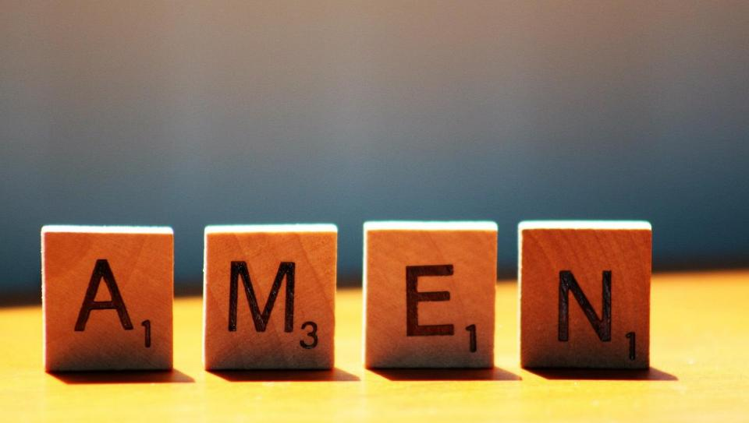

Slide 27
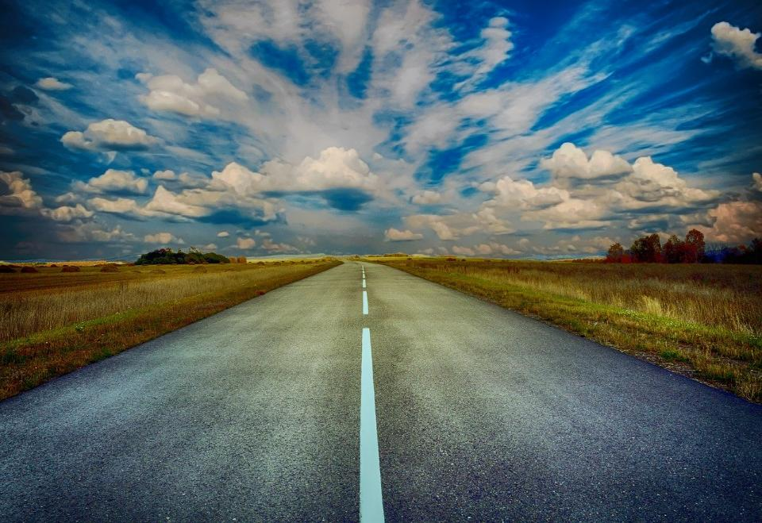
Picture copyright-free from pixabay
Leader: We have journeyed together today. As we leave this place and time and go into the day ahead…
ALL: …May God go with us.
Notes:
Slide 17: Use this term’s leaving words
Leader: We have journeyed together today. As we leave this place and time and go into the day ahead….
ALL: ….May God go with us.
Sign for ‘God: British Sign Language BSL Video Dictionary - God
Sign for ‘go with us’ – we have invented this! After you’ve signed ‘God’, bring your finger down alongside your other finger and make them ‘journey together’ in front of you.

Slide 28
Picture copyright-free from pixabay
Notes:
Ideas for classroom reflection: Memorable journeys
Water from the Well of Zamzam is a special reminder for Muslims of their pilgrimage to Mecca.
This water isn’t special in any way, but we are going to use it today to help us to think….
Hold the bottle in your hands and think of a very special journey that you have been on
How was that journey a blessing for you – and maybe for others too?
Maybe turn your thoughts into a prayer….
Talk together about your journeys, or bring in some mementoes of your time to show to each other during this week.

