Slide 1
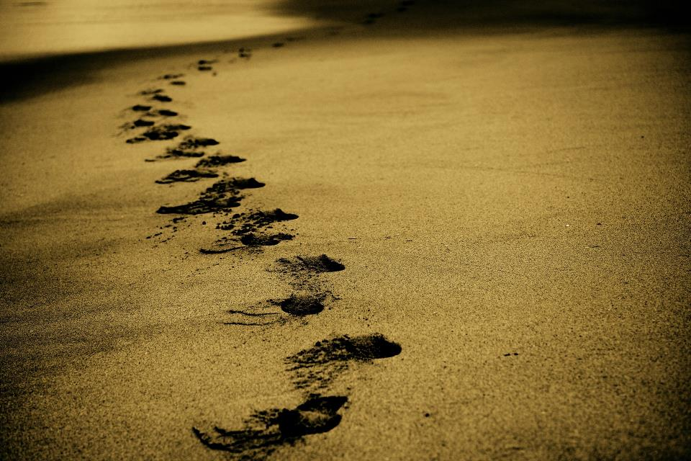
Picture copyright-free from pixabay
Leader: We are on this journey together…
Children: We are friends along the way…
ALL: May God go with us.
Notes:
Slide 1 or 2 [choose whichever image you prefer, or use them in rotation]:
Use the greeting for this term
Leader: We are on this journey together…
Children: We are friends along the way…
ALL: May God go with us.
BSL interpretation:
Sign for ‘way’ (nearest to the idea of ‘journey’): British Sign Language BSL Video Dictionary - way
Sign for ‘friends’: British Sign Language: friends
Sign for ‘God: British Sign Language BSL Video Dictionary - God
Sign for ‘go with us’ – we have invented this! After you’ve signed ‘God’, bring your finger down alongside your other finger and make them ‘journey together’ in front of you.
Engaging:
As we heard last week, in the final term of this school year, we are beginning a new theme:

Slide 2
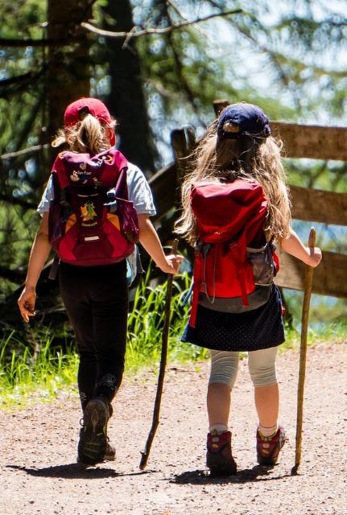
Picture copyright-free from pixabay
Leader: We are on this journey together…
Children: We are friends along the way…
ALL: May God go with us.
Notes:
Slide 1 or 2 [choose whichever image you prefer, or use them in rotation]:
Use the greeting for this term
Leader: We are on this journey together…
Children: We are friends along the way…
ALL: May God go with us.
BSL interpretation:
Sign for ‘way’ (nearest to the idea of ‘journey’): British Sign Language BSL Video Dictionary - way
Sign for ‘friends’: British Sign Language: friends
Sign for ‘God: British Sign Language BSL Video Dictionary - God
Sign for ‘go with us’ – we have invented this! After you’ve signed ‘God’, bring your finger down alongside your other finger and make them ‘journey together’ in front of you.
Engaging:
As we heard last week, in the final term of this school year, we are beginning a new theme:

Slide 3
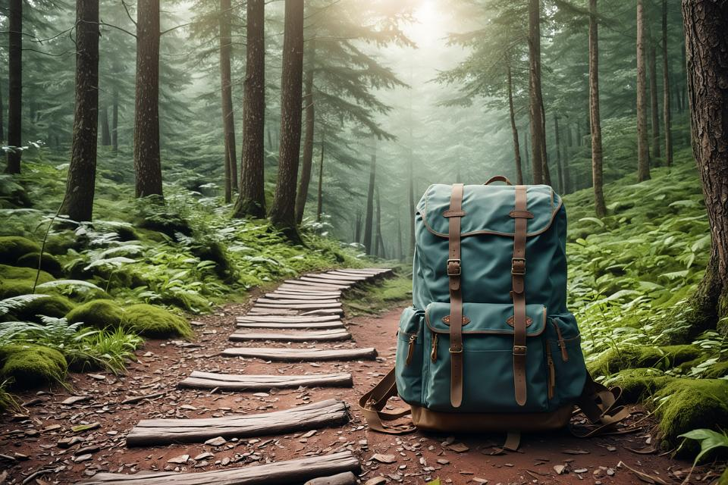
Picture copyright-free from pixabay
To boldly go….
Notes:
Slide 3: To boldly go….. Today we are going on another journey, a journey that began in the time of Jesus, but before we go there…..

Slide 4
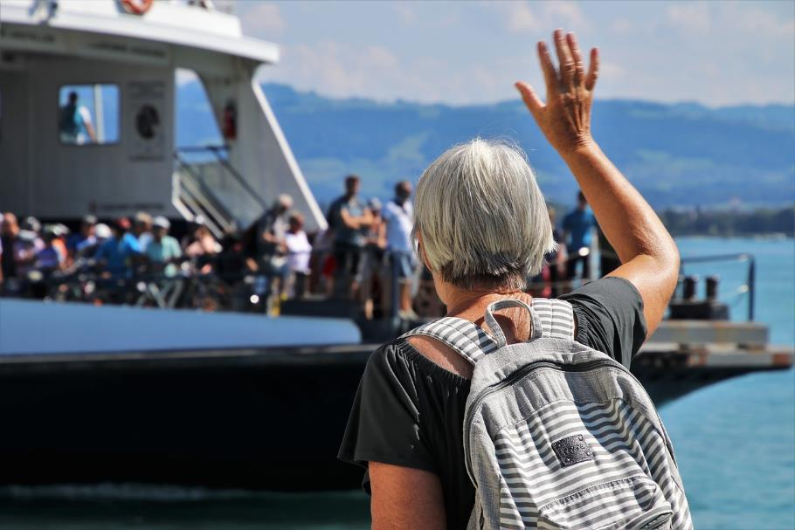
Picture copyright-free from pixabay
Adios!
Au revoir!
Αντίο!
Arriverderci!
Auf Wiedersehen!
Mā te wā
Notes:
Slide 4: ‘Goodbye’
We say goodbye for all sorts of different reasons….[think of some together] Going on a journey sometimes means saying ‘goodbye’ – as well as ‘hello’! – and every language across with world will have a word that means ‘goodbye’. Let’s look at some now….

Slide 5

UK
Goodbye!
Notes:
Slides 5-11: Look at the different words that all mean ‘goodbye’ – how many do children recognise? Practise saying some together - invite children who speak the language to advise on pronunciation.
Slide 5: UK

Slide 6

France
Au revoir!
Notes:
Slide 6: French

Slide 7

Germany
Auf Wiedersehen!
Notes:
Slide 7: German [the ‘w’ is pronounced as a ‘v’]

Slide 8

Arriverderci!
Italy
Notes:
Slide 8: Italian

Slide 9

Spain
Adios!
Notes:
Slide 9: Spanish

Slide 10

Greece
Αντίο!
Notes:
Slide 10: Greek Αντίο - pronounced ‘antio’

Slide 11

New Zealand
Mā te wā
Notes:
Slide 11: Mā te wā
Maori is the native language in New Zealand, and this phrase literally means – ‘until we meet again’. What a lovely way to end!!

Slide 12

Picture copyright-free from pixabay
What’s in the rucksack today?
Notes:
Slide 12: In our rucksack today we have ….a gift – maybe a present for someone as you leave, to say ‘goodbye’ and ‘remember me’. I wonder what might be inside? [allow children time to guess, but don’t open the gift yet!]

Slide 13
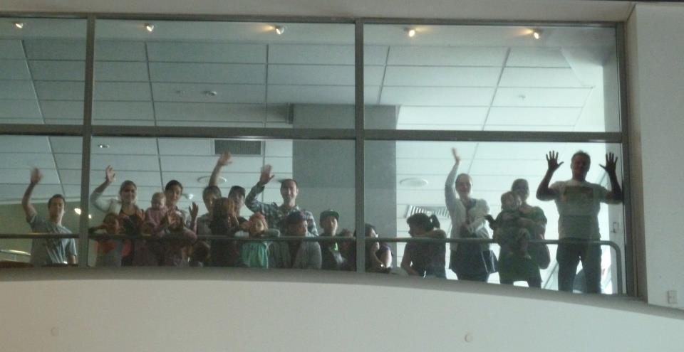
Notes:
Slide 13: I wonder if you’ve ever had to say ‘goodbye’ to someone who you wouldn’t be seeing again for a long time? I remember when.....[Share a personal story here if you have one, rather than ask children to tell theirs – it could end in tears!]

Slide 14
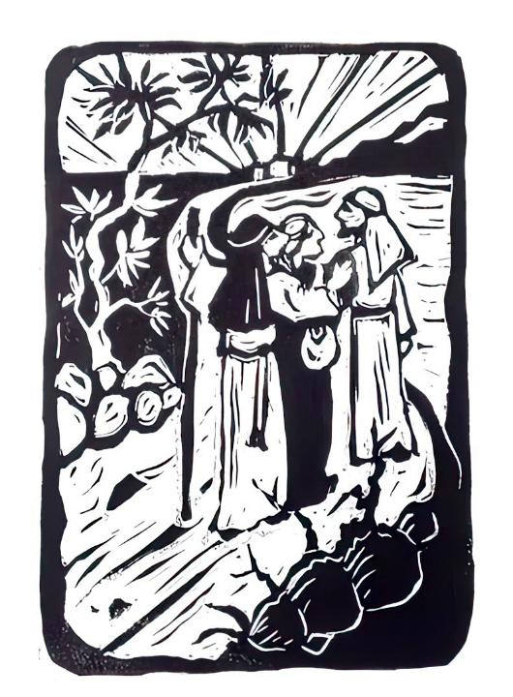
The Walk
Notes:
Slide 14: Our very first story this term told us how Jesus’ friends, the disciples, were very glad to have Jesus back with them again after his resurrection. Well, today’s story is a farewell story: but it’s a sort of happy-sad goodbye.... Listen, and you’ll find out why..... [use script on p4-5]

Slide 15
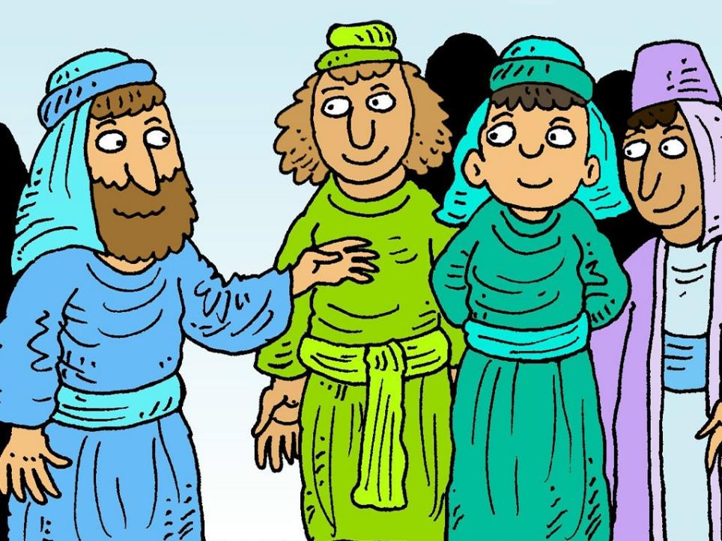
Notes:
Slide 15: After Jesus’ resurrection, the disciples were all gathered together in Jerusalem. Suddenly Jesus appeared among them, as if out of nowhere. Well, you can imagine what they all thought: ‘It’s a ghost!!!’ But Jesus asked them for some supper – and ate a piece of fish right in front of them. It wasn’t a ghost – it was really Jesus! But God had given him a brand new body – a forever body that would be the same, well….forever! God’s promise to rescue the world through Jesus had come true – and Jesus’ brand new body was proof that things would never be the same again. Jesus appeared to them in the same way, many times over many days.

Slide 16
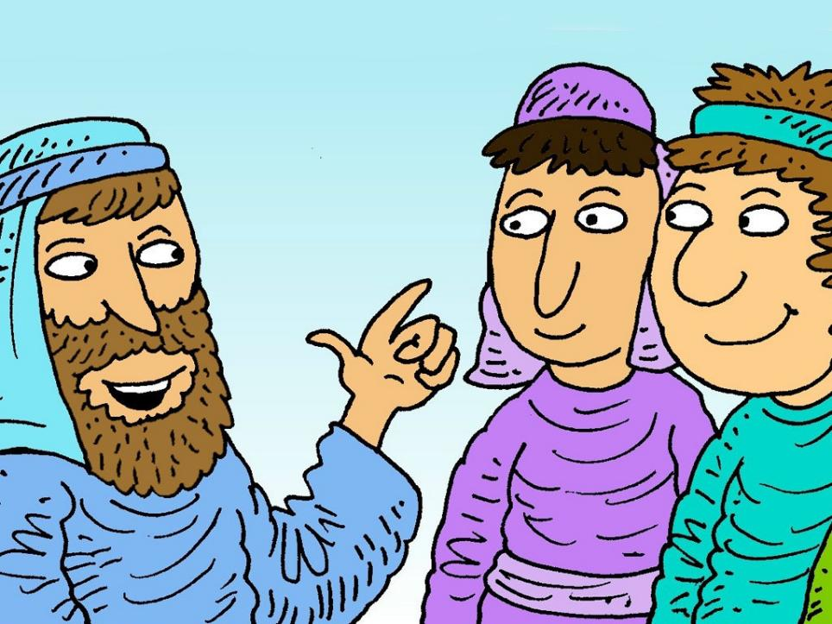
Notes:
Slide 16: ‘Stay here in Jerusalem’, Jesus told them. ‘I am going home to my Father. But don’t worry! I will send you what he has promised: the Holy Spirit. It’s a special gift for you…a powerful gift….a little piece of heaven that will live in your hearts, and help you to tell the whole world what God has done.’
‘And don’t forget!’ he added ‘I will never leave you: never! I will be with you….always and forever!’

Slide 17
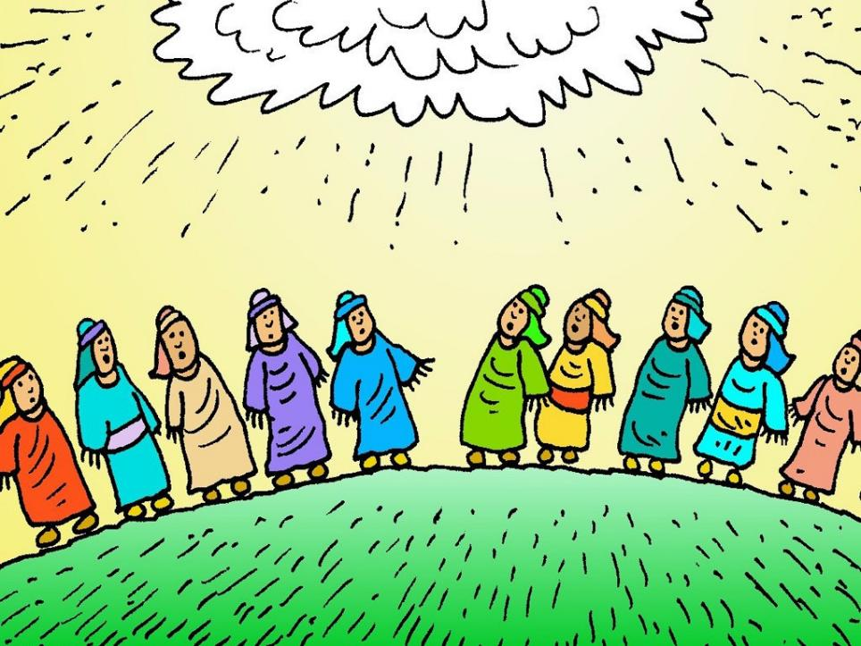
Notes:
Slide 17: And then, in a blaze of bright light, the friends watched as Jesus left them for the last time and was taken up into heaven. They watched until he was hidden by the clouds….and then stood, staring at the sky, hardly knowing what to do next.

Slide 18
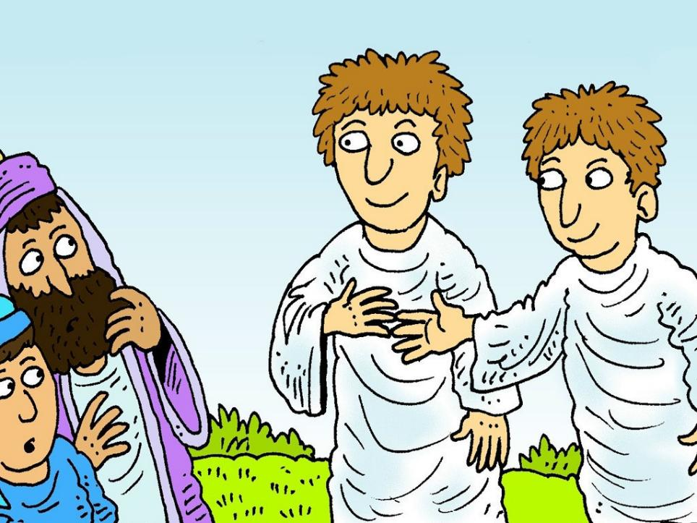
Notes:
Slide 18: Two shining men were standing there beside them. ‘What are you doing?’ they asked. ‘Jesus has gone home, but one day he will come back, in just the same way as you have seen him leave.’

Slide 19
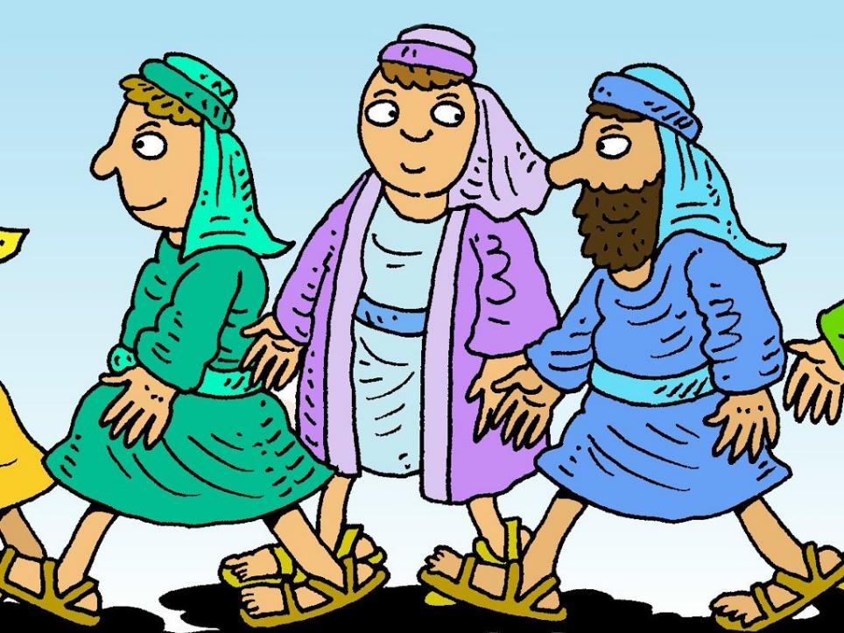
Notes:
Slide 19: And so the friends returned to Jerusalem with a strange sort of happiness in their hearts, as they remembered what Jesus had said about the gift from heaven – and that he would be with them always.

Slide 20
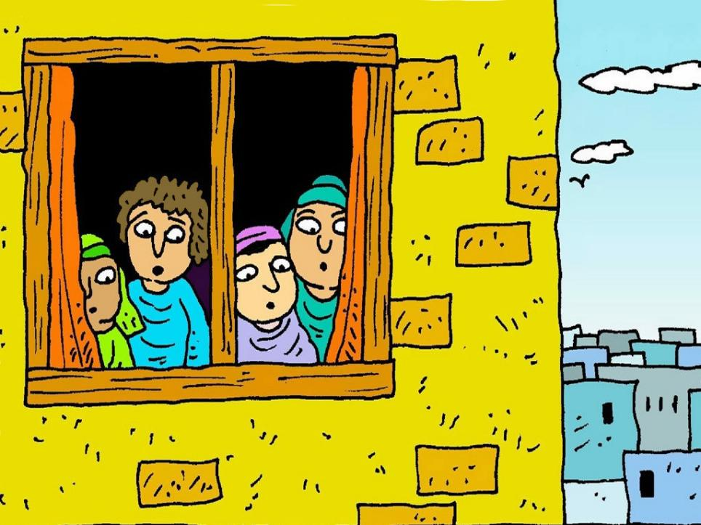
Notes:
Slide 20: They had to wait 10 days before the gift that Jesus promised them arrived! The friends were all gathered together in the upper room, waiting, just as Jesus had asked them to be. Suddenly there was a noise like rushing wind and as the friends looked at each other…

Slide 21
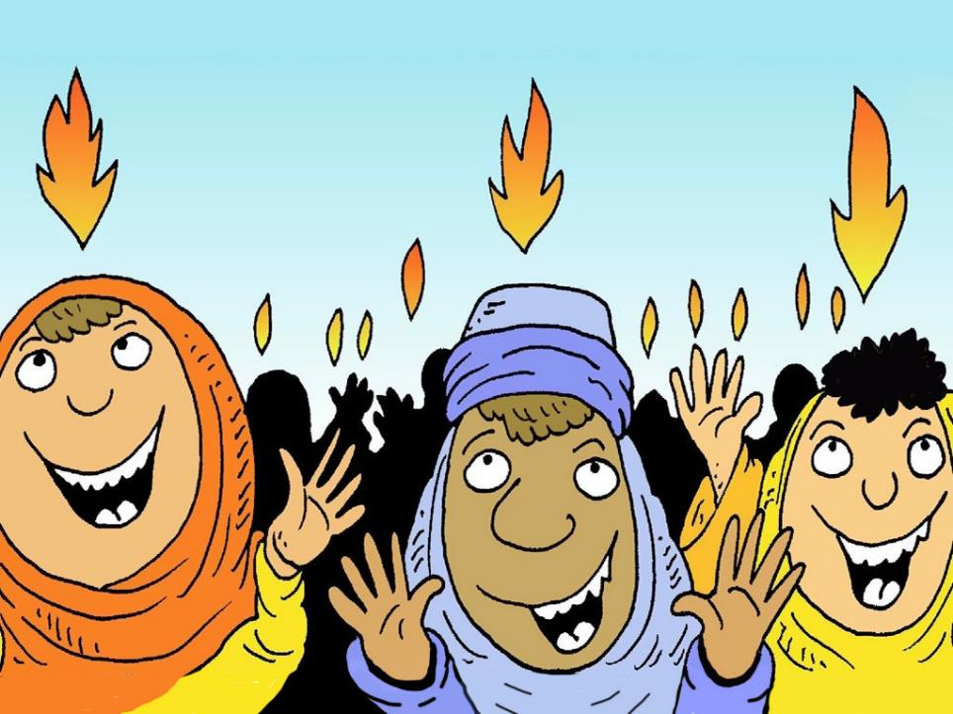
Notes:
Slide 21: …they saw tongues of flame hovering over each one’s head. The flames were bright but they did not burn. Instead, the friends’ hearts were full of God’s love and they praised God, in every language under the sun! The present of God’s presence had arrived!! God’s Holy Spirit was given to each one of the friends that day and they went out into the city, telling others about what God had done for them.

Slide 22
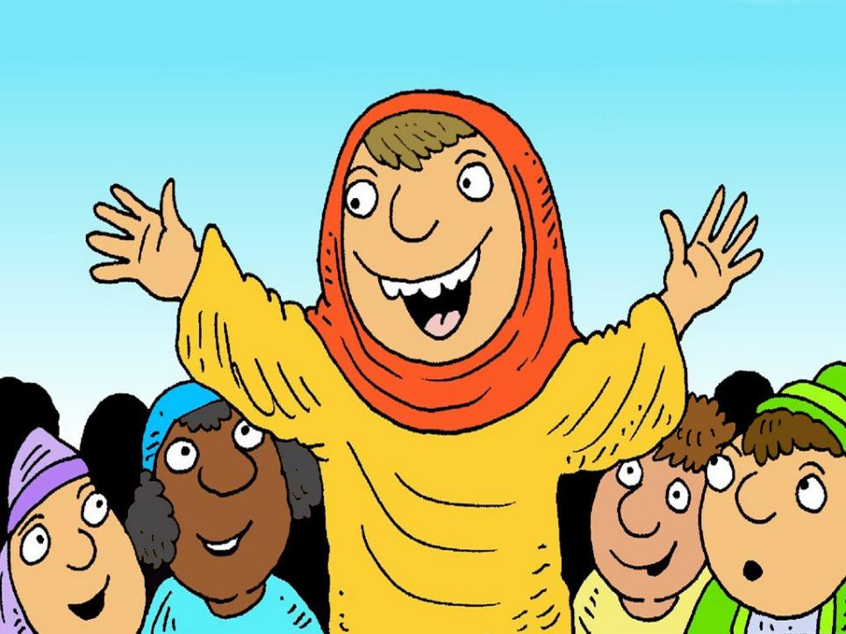
Notes:
Slide 22: All the people who’d travelled to Jerusalem to celebrate the Jewish festival of Shavuot were astonished. ‘We can hear these people praising God in our own language!’ they remarked.

Slide 23
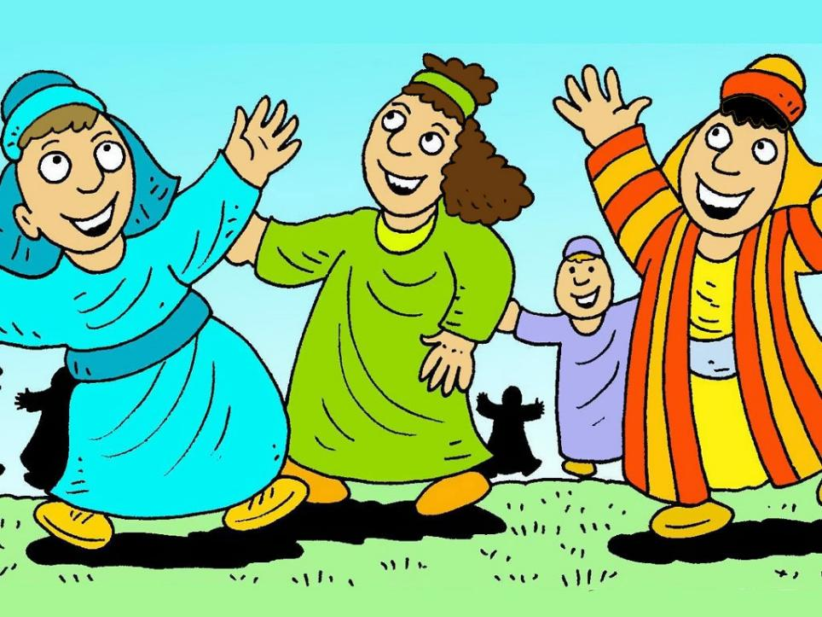
Notes:
Slide 23: The present of God’s Holy Spirit, his presence, was the beginning of something new – over 3000 people came to believe in God that day, the birthday of the Church. And every year since, the Church has celebrated that very special birthday as the festival of Pentecost.

Slide 24
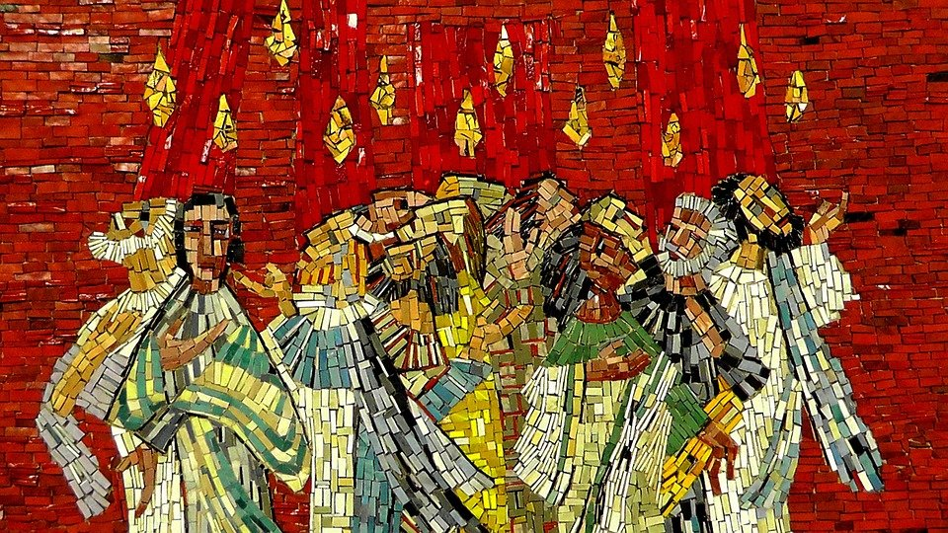
Pentecost
Notes:
Slide 24: As we’ve heard, Pentecost, the coming of God’s Holy Spirit to ordinary people, is celebrated by Christians all over the world. The story we’ve just shared used some symbols of the Holy Spirit – many of which can be found in churches, and of course in our very own Guildford Cathedral…..

Slide 25
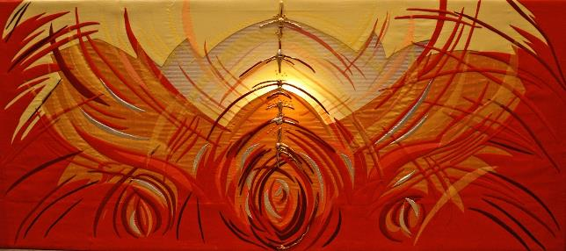
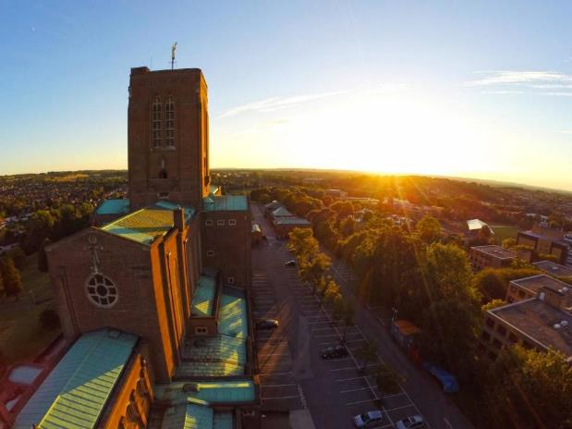
Cathedral of the Holy Spirit
Notes:
Slide 25: …whose proper name is the Cathedral of the Holy Spirit. The symbol of fire, or flames, is one of the most common of these symbols, because of this Pentecost story.

Slide 26
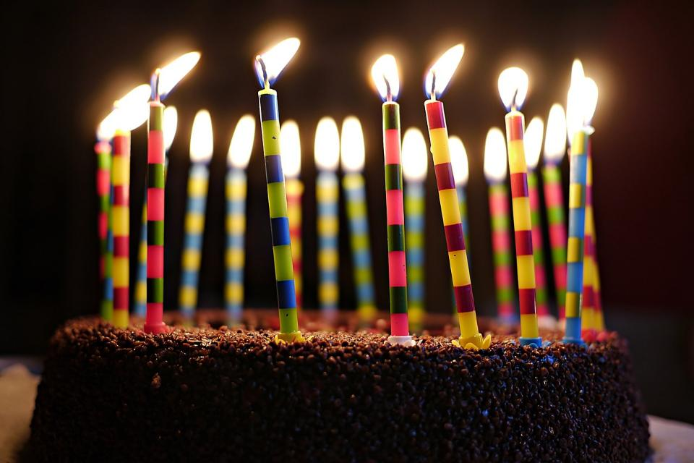
Notes:
Slide 26: Let’s be quiet and still now as we bring our time together to a close……
…the story of the birthday of the Church reminds us of how ordinary people changed the world with the present of God’s presence…..

Slide 27
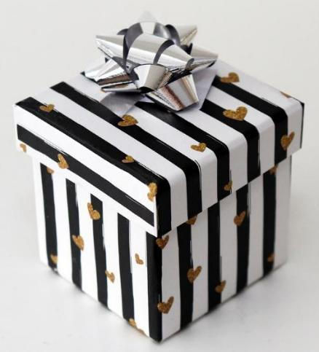
Picture copyright-free from pixabay
It will help you.
I will be with you, always and forever
It’s a little piece of heaven.
It will give you power.
The gift
Notes:
Slide 27: The gift
Earlier on in our time together, we took a gift box out of our rucksack – I hope you can see how it fits in with our story for today! Jesus’ gift to his followers – and every Christian since – was the present of his presence, his Holy Spirit. Inside our gift box, I have a few things to help us as we think together about this gift, the present of God’s presence. [take out speech bubbles and read them, talking briefly about each if you need to]
It will help you: It helped the disciples to be brave and tell others about Jesus. Christians sometimes call the Holy Spirit ‘The Helper’. It also helps followers of Jesus to follow him, which sometimes means making difficult decisions in life.
‘I will be with you, always and forever’: This was a promise for Jesus’ disciples then, and for all who follow him afterwards, bringing strength, peace and comfort whatever happens. For many of Jesus’ disciples, this sustained them through times of great difficulty [NB most of them encountered persecution, and like Jesus, an untimely death]
It’s a little piece of heaven: It’s like heavenly DNA! It gives followers of Jesus the same family characteristics as Jesus himself as the Holy Spirit helps them to become more like him.
It will give you power: This doesn’t mean physical strength, but the power to love and serve others as Jesus did, or to act bravely when needed.

Slide 28
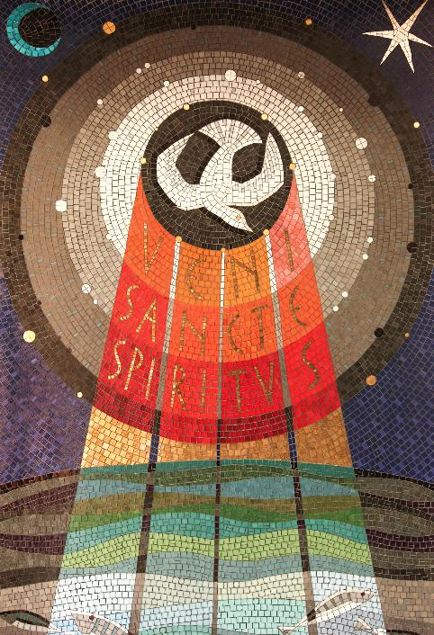
….I wonder how this promise made the disciples feel?....
….I wonder how this promise helps Christians now?....
….I wonder what you think about the promise that Jesus made?....
….I wonder if you know anyone who might find these words helpful today?....
‘I will be with you, always and forever.’
Notes:
Slide 28: At the end of our time together today, let’s be quiet and still. Jesus promised his friends, the disciples, that through the gift of his Holy Spirit, ‘I will be with you, always and forever.’
….I wonder how this promise made the disciples feel?....
….I wonder how this promise helps Christians now?....
….I wonder what you think about the promise that Jesus made?....
….I wonder if you know anyone who might find these words helpful today?....
Jesus said that the present of the presence of God’s Holy Spirit is a gift for all those who follow Jesus on their life’s journey….it’s his way of being with them, always and forever.
Spend some time in quiet reflection now…..
Prayer:
I’m going to use a prayer that’s based on the promise that Jesus made. Join in the words on the screen (‘We are not alone!’) if you’d like to, or if you’d prefer, just be still and quiet with your own thoughts:

Slide 29
Picture copyright-free from pixabay
We are not alone!
Notes:
Slide 29: Dear God
We remember how you sent the gift of your Spirit.
We are not alone

Slide 30
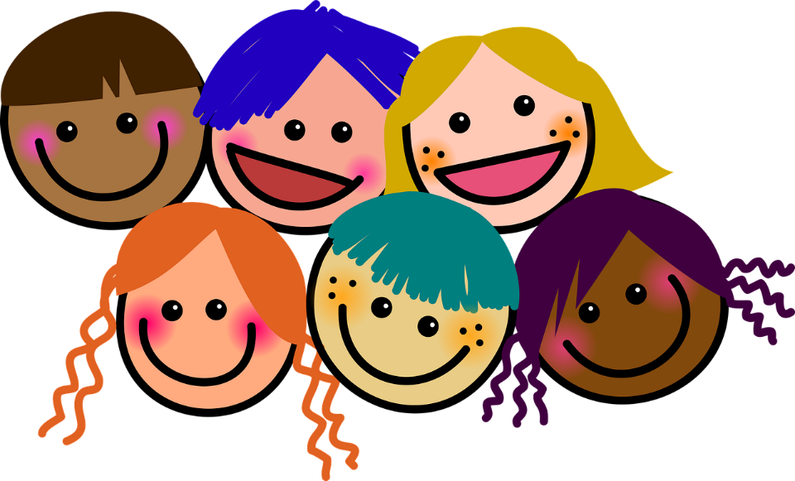
Picture copyright-free from pixabay
We are not alone!
Notes:
Slide 30: As part of this school community
We are not alone!

Slide 31


We are not alone!
Notes:
Slide 31: In our homes and with our families
We are not alone

Slide 32
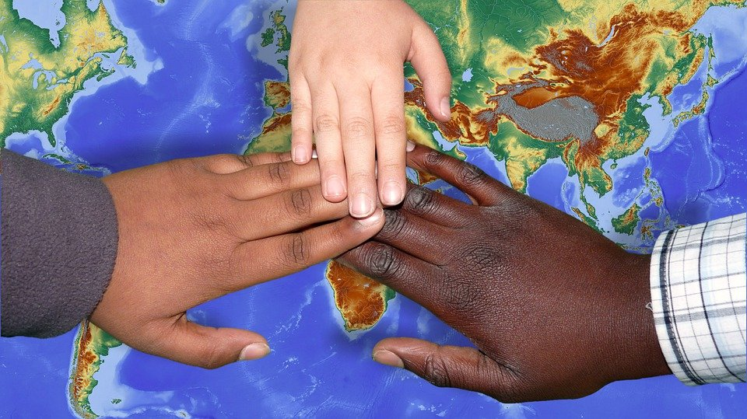
Picture copyright-free from pixabay
We are not alone
Notes:
Slide 32: Wherever we are and whatever we do,
We are not alone!

Slide 33
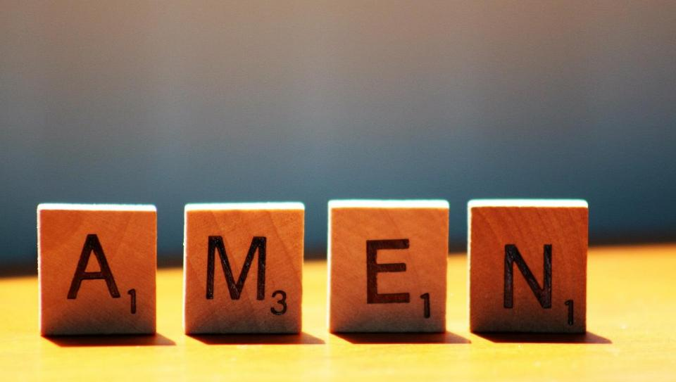

Slide 34
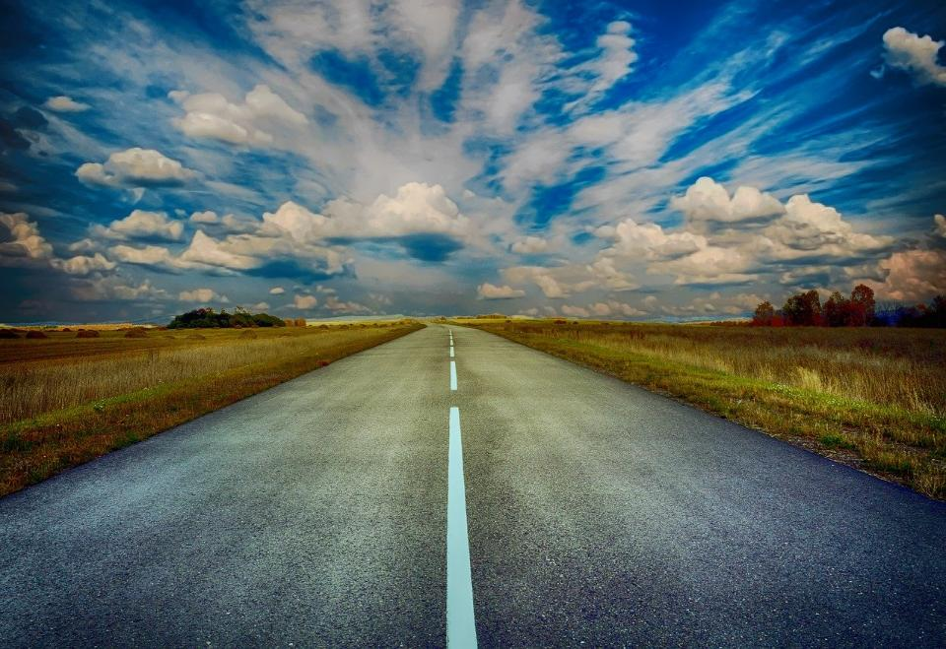
Picture copyright-free from pixabay
Leader: We have journeyed together today. As we leave this place and time and go into the day ahead…
ALL: …May God go with us.
Notes:
Slide 34: Use this term’s leaving words
Leader: We have journeyed together today. As we leave this place and time and go into the day ahead….
ALL: ….May God go with us.
Sign for ‘God: British Sign Language BSL Video Dictionary - God
Sign for ‘go with us’ – we have invented this! After you’ve signed ‘God’, bring your finger down alongside your other finger and make them ‘journey together’ in front of you.

Slide 35


Picture copyright-free from pixabay
Notes:
Ideas for classroom reflection: battery tealights
‘Be who God made you to be, and you’ll set the world on fire’.
When the gift of the Holy Spirit came, Jesus’ disciples changed the world by being who God had made them to be.
St. Catherine of Siena wanted to encourage other Christians to follow the disciples’ example.
Take time to explore the words of St. Catherine of Siena with your own class, especially with younger children, or they may interpret the words literally! Ensure in your discussion that you include sharing thoughts about being the very best ‘me’ that they can be, the things that children are passionate about, or the things that they are good at.
I wonder who you think you are? Or who God made you to be?
What character, talents and abilities do you have?
How can you use these to make the world a better place – to ‘set the world on fire’?
Take a tealight and turn it on and hold it in your hands as you think or pray.
‘Be who God made you to be, and you’ll set the world on fire’.
Leave the tealight on the tray as a sign that you will try to do this.

