Slide 1
We are here together….
May our attitudes make our school community a happy place today.
Notes:
Slide 1: Use the gathering words for this term
Leader: We are here together
ALL: May our attitudes make our school community a happy place today.

Slide 2
Beatitudes
Beati
‘How-to-be-attitudes’
Notes:
Slide 2: Today we are going to be hearing about some more words from the Beatitudes, about forgiveness. (Some of you might see also some connections with last week’s theme of treating others fairly, showing justice…)

Slide 3
Notes:
Slide 3: We’re going to start straight away with a story from the life of Jesus, a story that some of you may remember from last year!.....
When people do things that are wrong, it is very easy for us to point the finger at them and want them to be punished. The Bible tells a story of how Jesus behaved when a woman who had done wrong was brought to him.

Slide 4
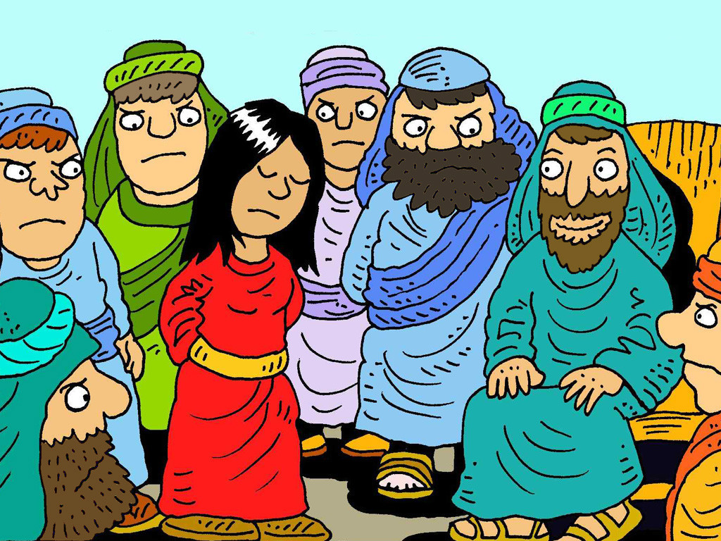
Notes:
Slide 4: One day, Jesus was teaching in the temple courts – and as usual, many people had gathered to listen to him.
Some Jewish leaders brought a woman to him, and pushed her in front of him. ‘Teacher,’ they said. ‘This woman has committed the worst sin ever. Our law says that she should be severely punished. What do you say about it all?’ But they were really trying to get Jesus into trouble.

Slide 5
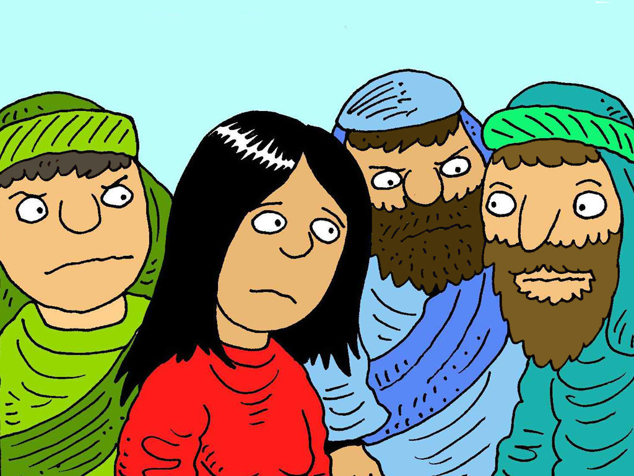
Notes:
Slide 5: But Jesus didn’t say anything. He didn’t wag his finger at her, or speak angrily to her, or tell her off…. Not a word…. Nothing!

Slide 6
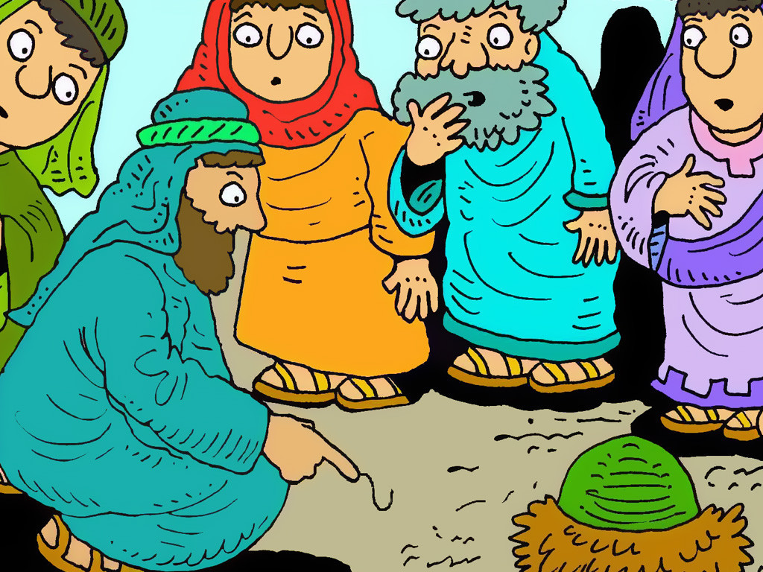
Notes:
Slide 6: Instead, he bent down and doodled in the dust with his finger. Now Jesus could see what the leaders couldn’t, which was the woman’s heart – a heart that was desperate to be forgiven, not blamed.
You could almost touch the anger building in the leaders who were waiting for Jesus’ response. Why didn’t he reply? How dare he ignore them? They demanded an answer, again… and again….and again.

Slide 7
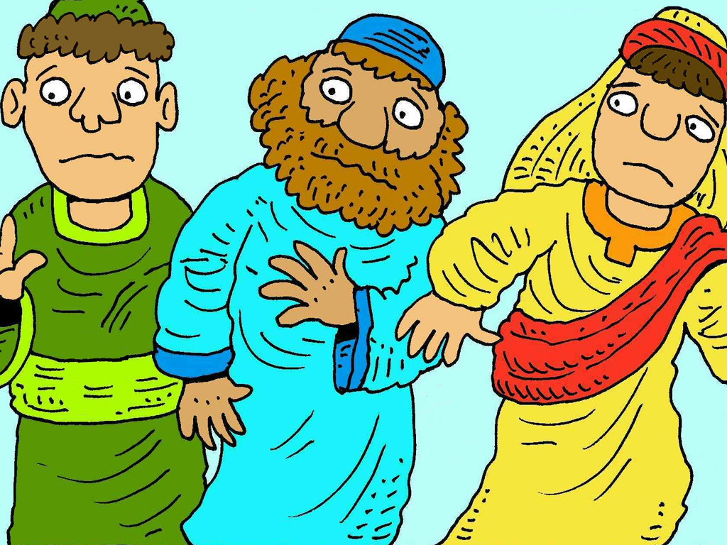
Notes:
Slide 7: Eventually, Jesus stood up and faced the leaders. He spoke to them, and not to her: ‘If any one of you can honestly say that you have never done anything wrong, then you can be first in the queue with your stone.’ And then he went back to drawing in the dust. One by one, the leaders drifted away, until just Jesus was left, with the woman standing beside him.

Slide 8
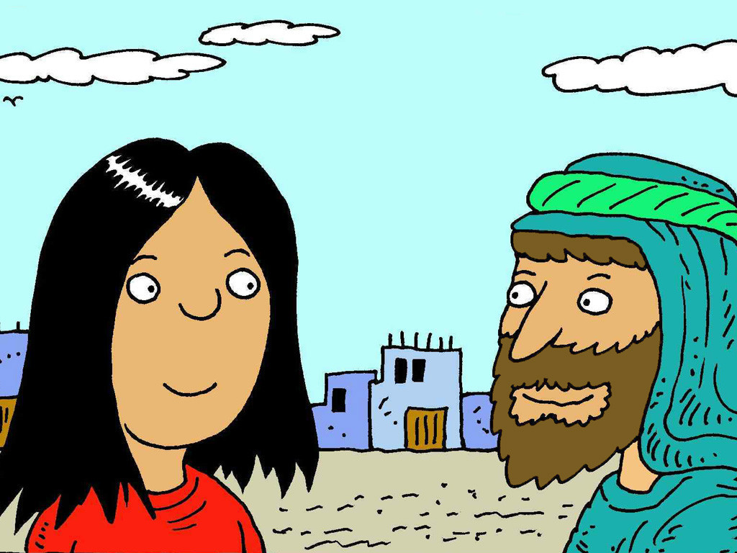
Notes:
Slide 8: Now Jesus spoke. His face was kind and his voice was soft. ‘Woman, where are the men who accused you? Is there no-one left to blame you?’
‘No sir,’ she replied.
‘Then neither do I,’ Jesus said to her. ‘Go now, and live in a better way, a way that pleases God.’

Slide 9
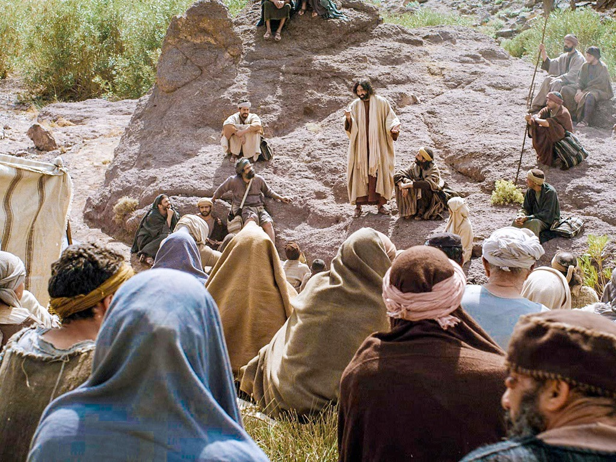
Those who show forgiveness to others are truly happy. Forgiveness will be given to them.
Notes:
Slide 9: When Jesus spoke to the people on the mountain, he said ‘Those who show forgiveness to others are truly happy. Forgiveness will be given to them.’
I wonder how these words link with our story? [ask a few children to explain their ideas, if time allows]

Slide 10
….I wonder what was unfair in this story?….
….I wonder who showed forgiveness?....
…..I wonder how the woman’s life was changed by Jesus’ words?....
….I wonder what the leaders said to each other as they went away?....
….I wonder what these things might show us about forgiveness this week?.....
Notes:
Slide 10: Responding and words for worship
Let’s think together now about Jesus’ words – and his actions in the story about the woman.
….I wonder what was unfair in this story….
….I wonder who showed forgiveness?....
…I wonder how the woman’s life was changed by Jesus’ words?...
…I wonder what the leaders said to each other as they went away?...
….I wonder what these things might show us about forgiveness this week?.....
Forgiving isn’t always easy, and although we don’t know what happened after the leaders left Jesus and the woman, I hope that they learned something for themselves about what’s important in God’s Kingdom.
Jesus taught the crowds that forgiving others is important – because it helps to rebuild broken relationships, but also because some day, we might need others to forgive us.
….I wonder if you’ve found this to be true here in school, or in your homes?....
Take some time now to think, reflect or pray about the things we’ve shared today…..

Slide 11
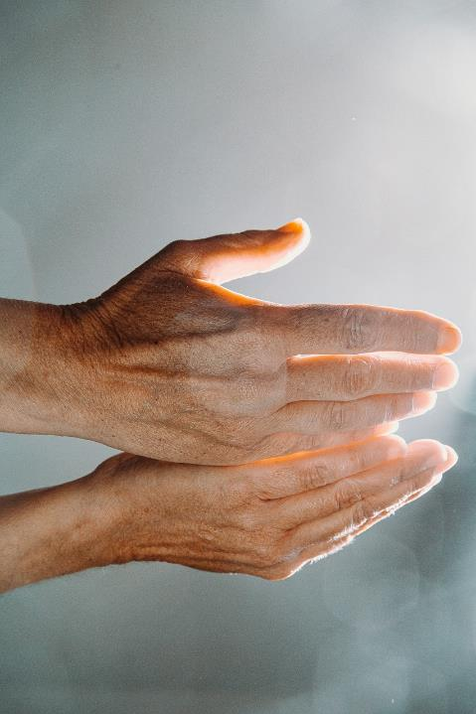
‘May we forgive and be forgiven.’
Notes:
Slide 11: ‘May we forgive and be forgiven…’

Slide 12
Notes:
Slide 12: When others hurt our feelings….

Slide 13
‘May we forgive and be forgiven.’
Notes:
Slide 13: ‘May we forgive and be forgiven…’

Slide 14
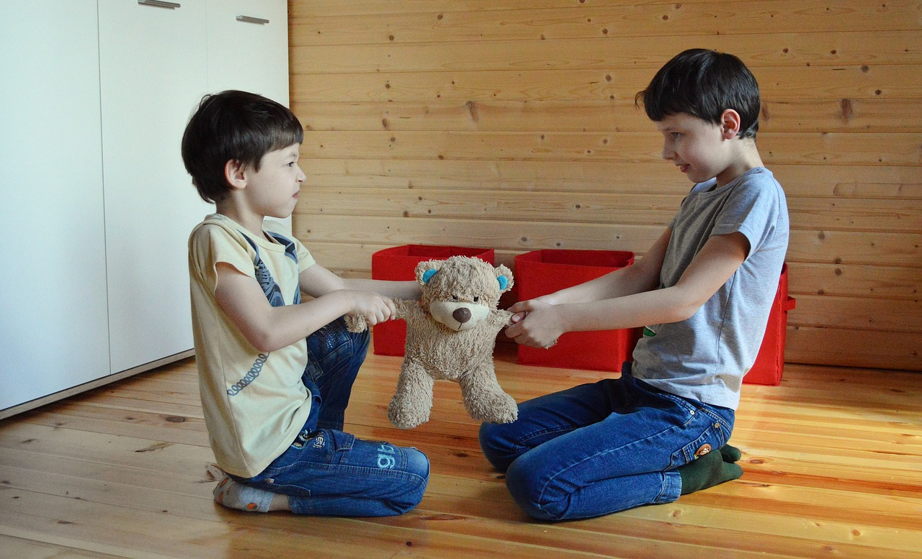
Notes:
Slide 14: When friendships get messed up

Slide 15
‘May we forgive and be forgiven.’
Notes:
Slide 15: ‘May we forgive and be forgiven…’

Slide 16
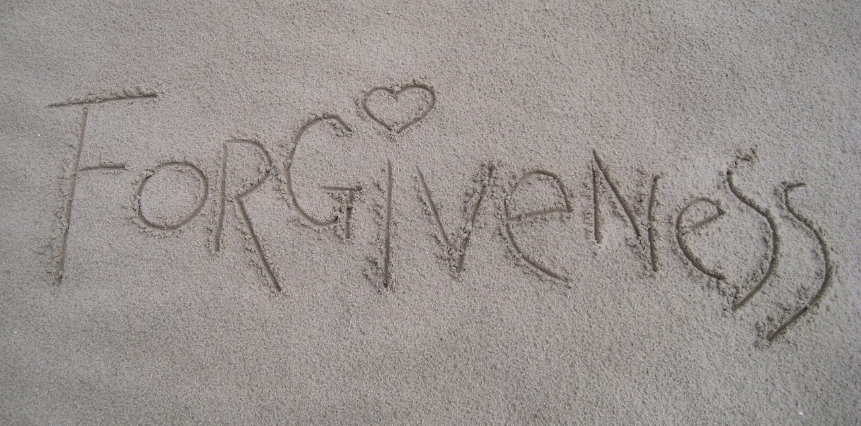
Notes:
Slide 16: However hard it is…..

Slide 17
‘May we forgive and be forgiven.’
Notes:
Slide 17: ‘May we forgive and be forgiven…’

Slide 18
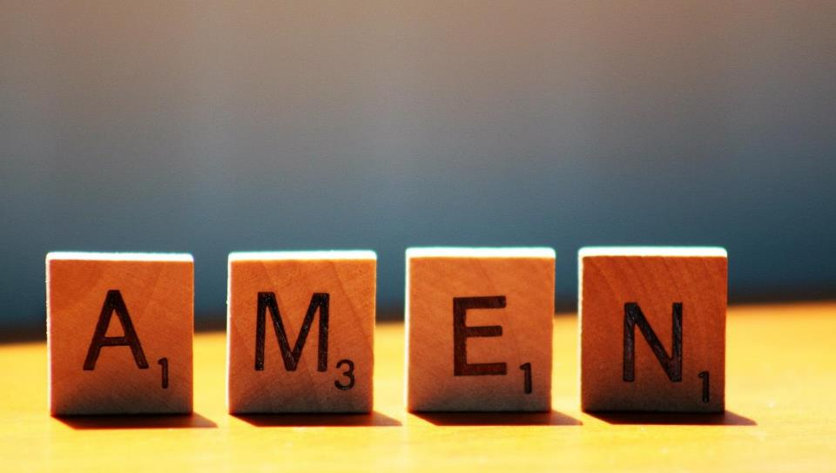

Slide 19
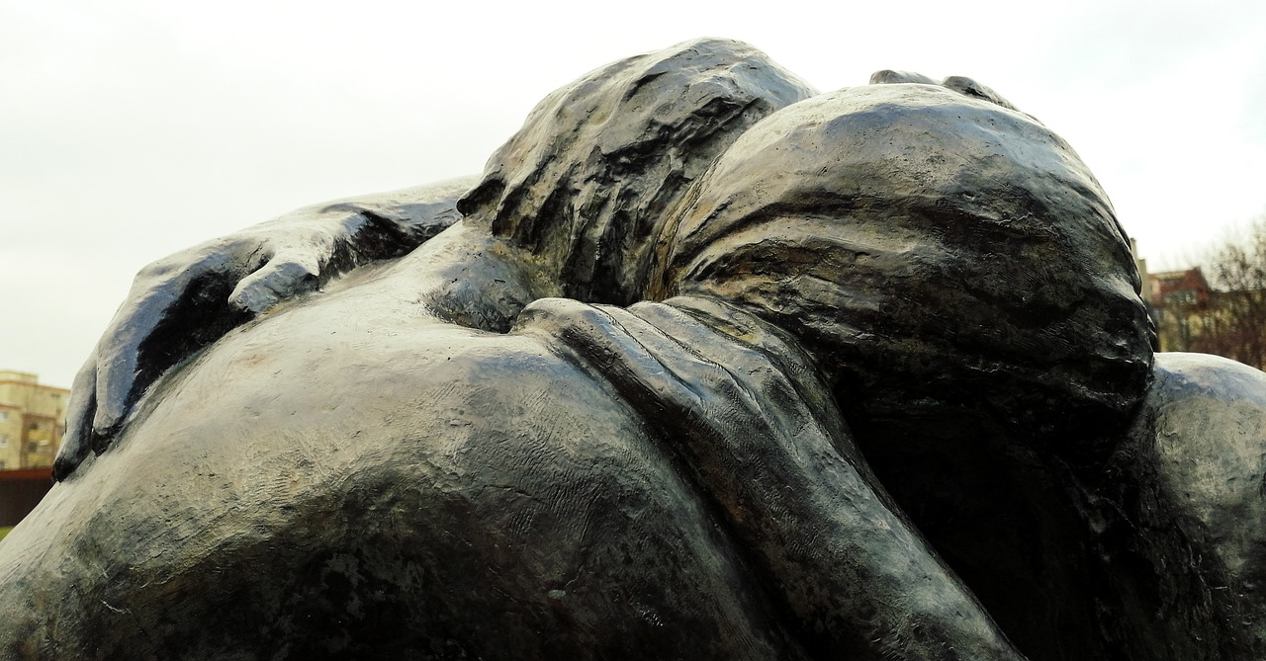
Leader: As we leave this place & time and go into the day ahead…
All: May we forgive and be forgiven.

Slide 20
Notes:
Slide 14: Reflective areas
Put a set of balance scales in your reflective area. The bucket balance scales that can be found in infant classes are ideal. You will also need some blocks or weights with injustices written or stuck on them. There are some examples provided on p.6. Also provide some small pieces of paper and pens, for children to write / draw on.

