Slide 1
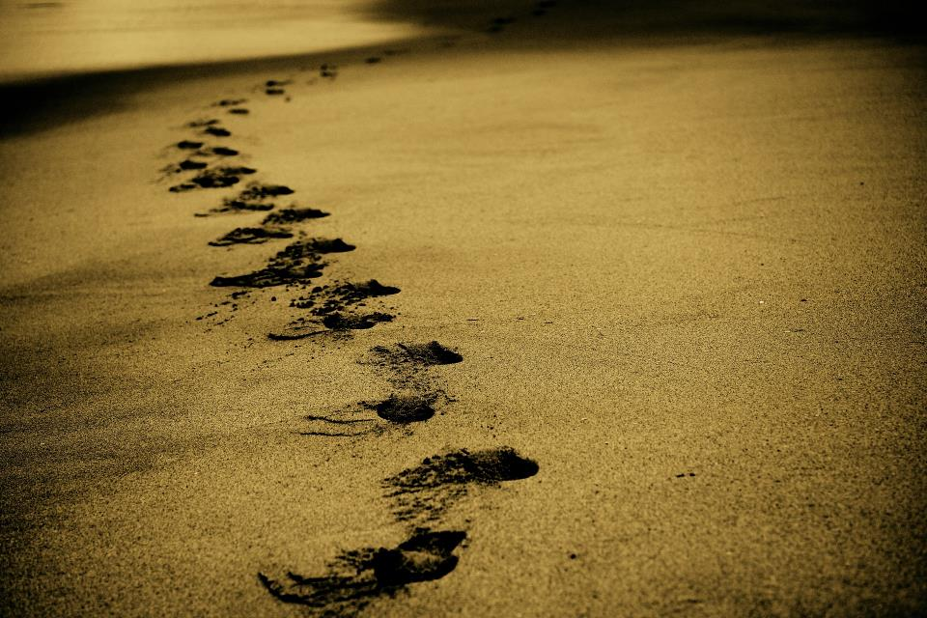
Picture copyright-free from pixabay
Leader: We are on this journey together…
Children: We are friends along the way…
ALL: May God go with us.
Notes:
Slide 1 or 2 [choose whichever image you prefer, or use them in rotation]:
Use the greeting for this term
Leader: We are on this journey together…
Children: We are friends along the way…
ALL: May God go with us.
BSL interpretation:
Sign for ‘way’ (nearest to the idea of ‘journey’): British Sign Language BSL Video Dictionary - way
Sign for ‘friends’: British Sign Language: friends
Sign for ‘God: British Sign Language BSL Video Dictionary - God
Sign for ‘go with us’ – we have invented this! After you’ve signed ‘God’, bring your finger down alongside your other finger and make them ‘journey together’ in front of you.
Engaging:
As we heard last week, in the final term of this school year, we are beginning a new theme:

Slide 2
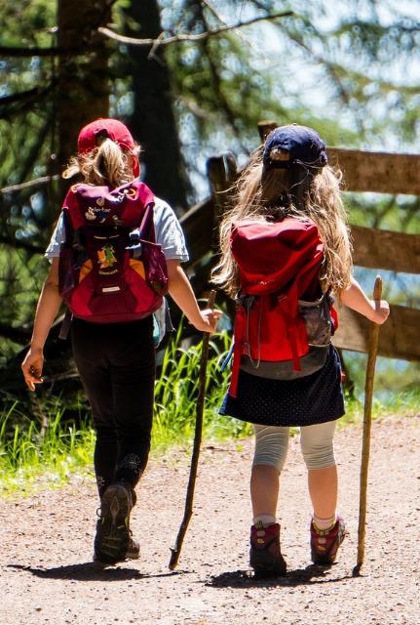
Picture copyright-free from pixabay
Leader: We are on this journey together…
Children: We are friends along the way…
ALL: May God go with us.
Notes:
Slide 1 or 2 [choose whichever image you prefer, or use them in rotation]:
Use the greeting for this term
Leader: We are on this journey together…
Children: We are friends along the way…
ALL: May God go with us.
BSL interpretation:
Sign for ‘way’ (nearest to the idea of ‘journey’): British Sign Language BSL Video Dictionary - way
Sign for ‘friends’: British Sign Language: friends
Sign for ‘God: British Sign Language BSL Video Dictionary - God
Sign for ‘go with us’ – we have invented this! After you’ve signed ‘God’, bring your finger down alongside your other finger and make them ‘journey together’ in front of you.
Engaging:
As we heard last week, in the final term of this school year, we are beginning a new theme:

Slide 3
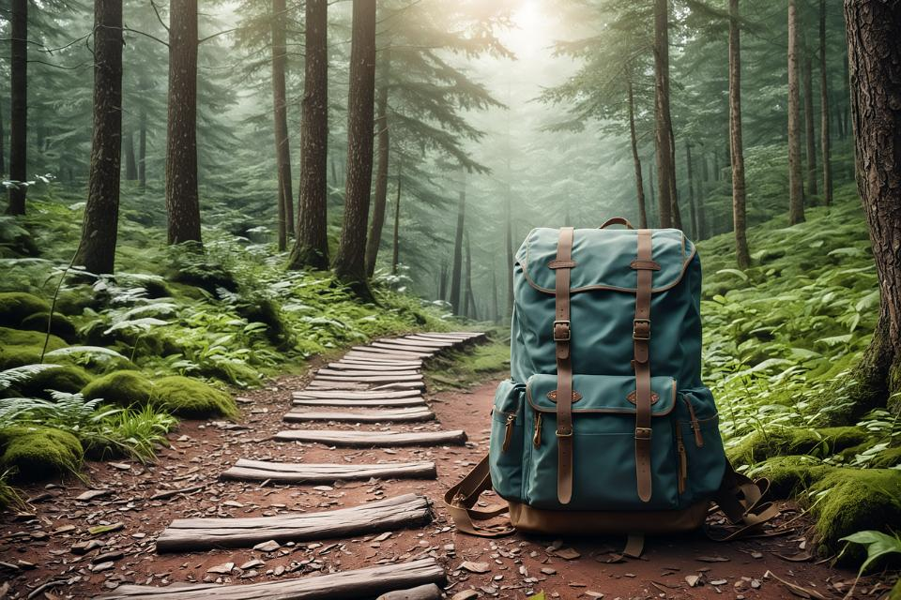

Picture copyright-free from pixabay
To boldly go….
Notes:
Slide 3: To boldly go….. Today we are going on another journey, with someone who had witnessed the start of the Church as we heard last week, in the Pentecost story. [recap this briefly if you need to]

Slide 4

Picture copyright-free from pixabay
What’s in the rucksack today?
Notes:
Slide 4: What’s in the rucksack today? Open your rucksack and show the sunglasses, talking about what they are for and how they might help on a journey. Talk about how they help to change what we see – so that our eyes can cope better with bright sunshine! Then introduce each of your other optical objects, and ask them to spot the connection, which should be that ‘they help you to see things’ (or similar).

Slide 5
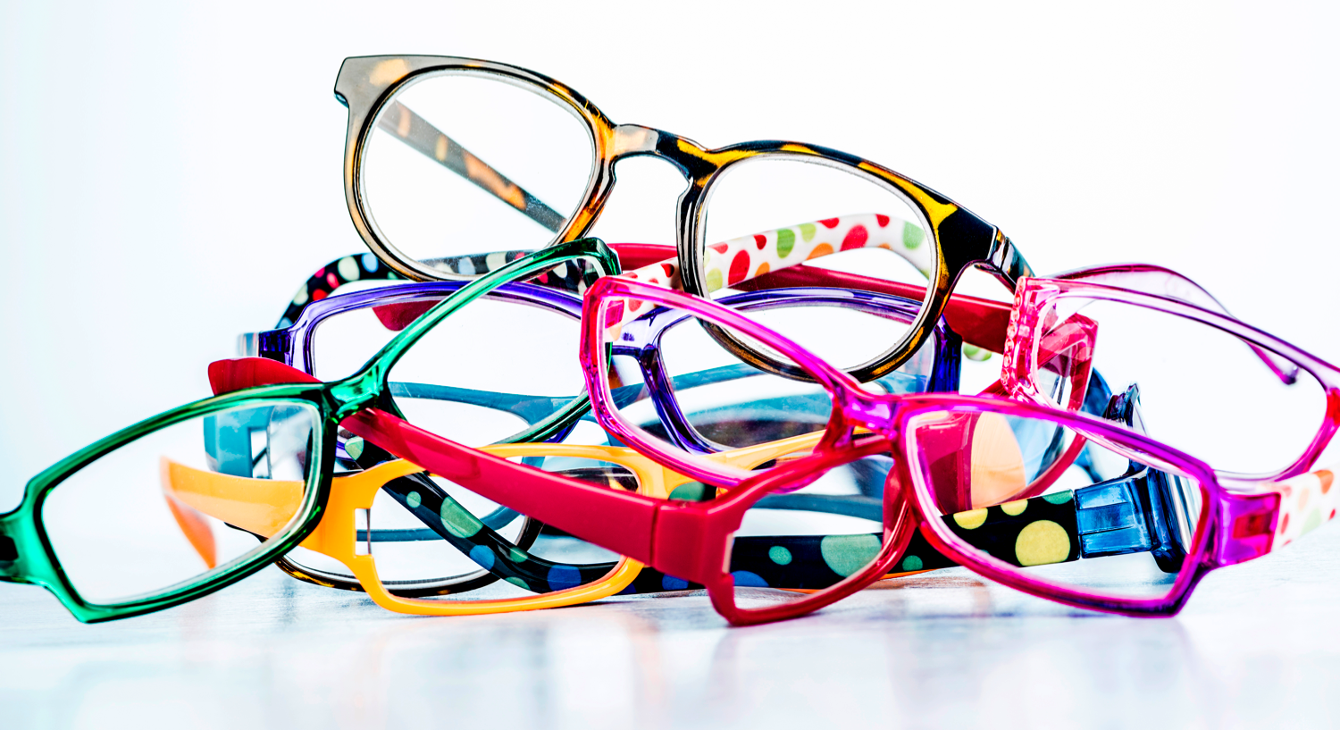
Checking our eyesight!
Notes:
Slides 5&6: Ask a child (who doesn’t wear glasses) to put on the dress-up glasses, cover one eye and do a mock ‘eye test’ using slide 6 – don’t make too big a deal of what they can or can’t read, as this is not the point. Repeat with the other eye, then try it again with both working together: the child should find that it’s easier to read the chart with both eyes open.

Slide 6
E
F P
T O Z
L P E D
P E C F D
E D F C Z P
Notes:
Slides 5&6: Ask a child (who doesn’t wear glasses) to put on the dress-up glasses, cover one eye and do a mock ‘eye test’ – don’t make too big a deal of what they can or can’t read as this is not the point. Repeat with the other eye, then try it again with both working together: the child should find that it’s easier to read the chart with both eyes open.

Slide 7
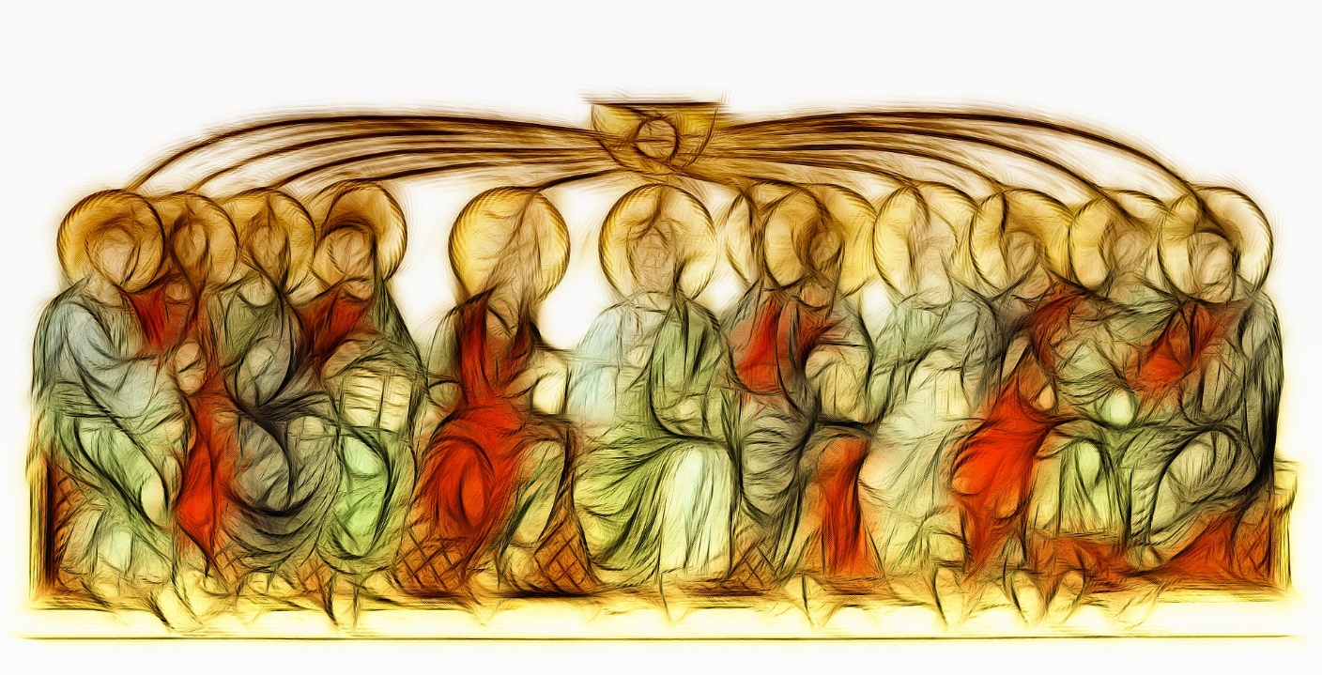
Picture copyright-free from pixabay
…to be continued...
Notes:
Slide 7: Being able to see properly is really important – and wearing glasses can help! In today’s story, we hear a lot about seeing…..so watch out, and see if you can spot a connection between the story and our rucksack object….
The story carries on from the one we heard last time, when God sent his Holy Spirit upon the disciples and the first Church began. It is about a man named Saul, and what happened when he met Jesus… As we tell the story together, there will be some things for you to wonder…. Keep thinking about these and we’ll talk later on. [use story & props listed on p3-4]

Slide 8
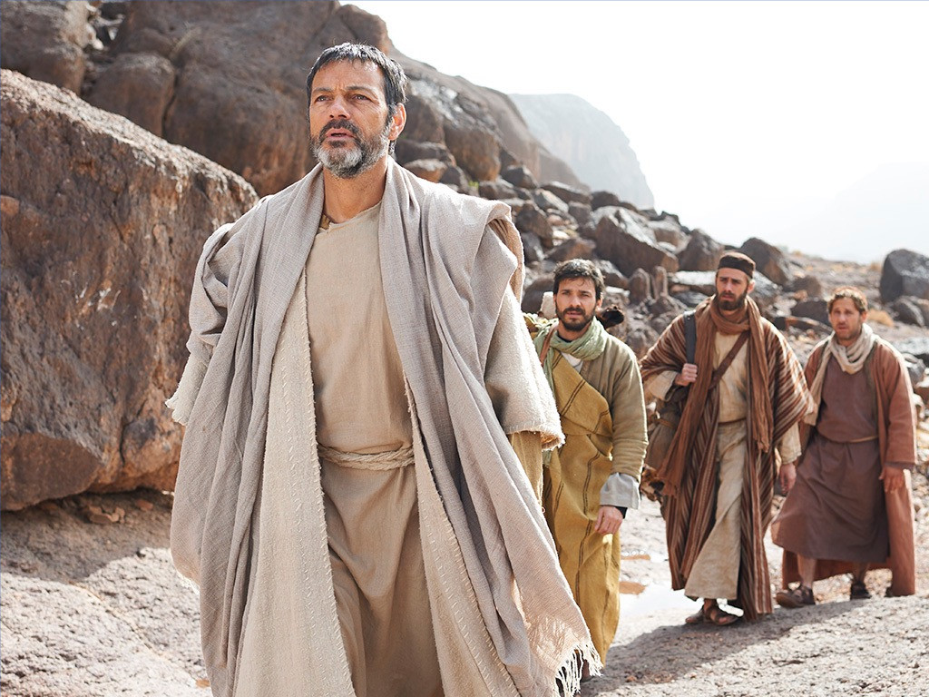
Paul’s journey
Notes:
Slide 8: Paul’s Journey

Slide 9

….I wonder what made Saul such an unkind person at the start?....
….I wonder how Saul felt when he couldn’t see?.....
….I wonder how Ananias felt, knowing who he was to visit?....
….I wonder why Saul changed his name?....
Notes:
Slide 9: At the end of our story, let’s have a time to talk together. In our story, we asked quite a lot of questions! [go back to some of the wondering questions posed in the story. Children could talk in pairs, or you could have an open discussion, or find another way that fits your context. You may wish to focus on just one question, or leave this for children to ponder in their classrooms later]
….I wonder what made Saul such an unkind person at the start?....
….I wonder how Saul felt when he couldn’t see?.....
….I wonder how Ananias felt, knowing who he was to visit?....
….I wonder why Saul changed his name?....

Slide 10
….I wonder how being blind made Saul see things in a new way?....
….I wonder how this experience changed things for Saul, and for others?....
….I wonder what others saw when they looked at Paul?....
….I wonder what this story might teach us?....
Notes:
Responding (and words for worship): *we use both names here, you may want to use either Saul or Paul, reflecting what’s easiest for your children.
Slide 10: Let’s be still and quiet together now….
…We’ve been thinking today about how Paul met Jesus on the road to Damascus….
….we’ve heard how this event changed his life, and helped him to see everything in a different kind of way….
….I wonder how being blind made Saul* see things in a new way?....
…I wonder how this experience changed things for Saul*, and for others?.....
….I wonder what others saw when they looked at Paul*?....
....I wonder what this story might teach us?.....
…think quietly to yourself about these things….. and bring them before God now if you’d like to…

Slide 11
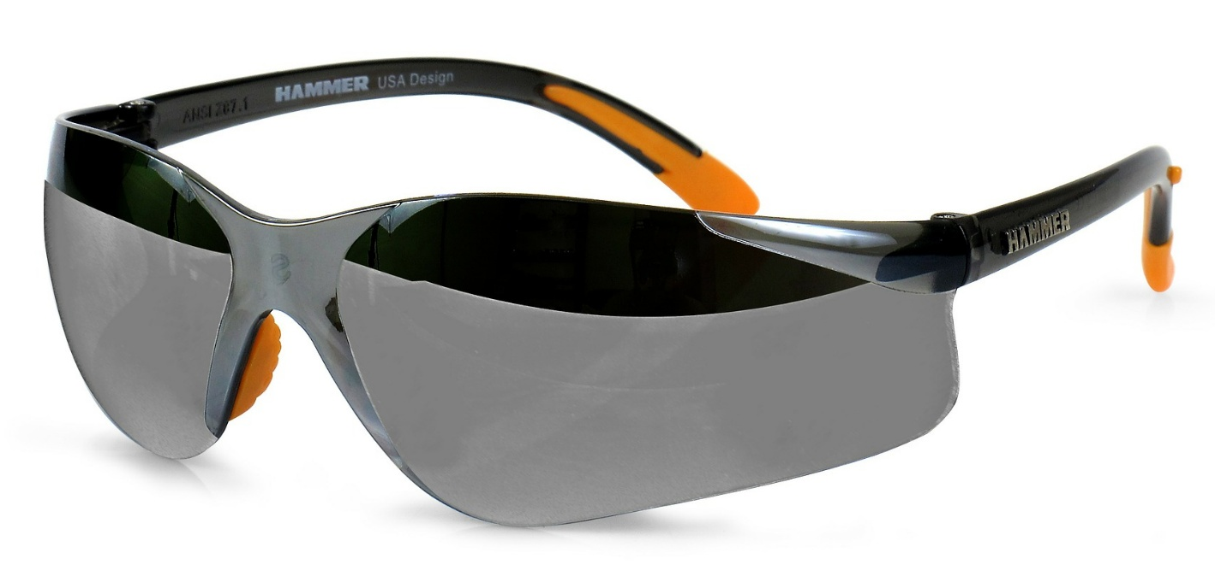
Dear God
Thank you for this story of how Saul became Paul and learned to see the world differently. Thank you for Ananias who heard your voice and chose to do what you asked him to. Help us to ‘see’ other people or situations that we face as you do. Amen
Notes:
Slide 11, Option 1:
Dear God
Thank you for this story of how Saul became Paul and learned to see the world differently. Thank you for Ananias who heard your voice and chose to do what you asked him to. Help us to ‘see’ other people or situations that we face as you do. Amen

Slide 12
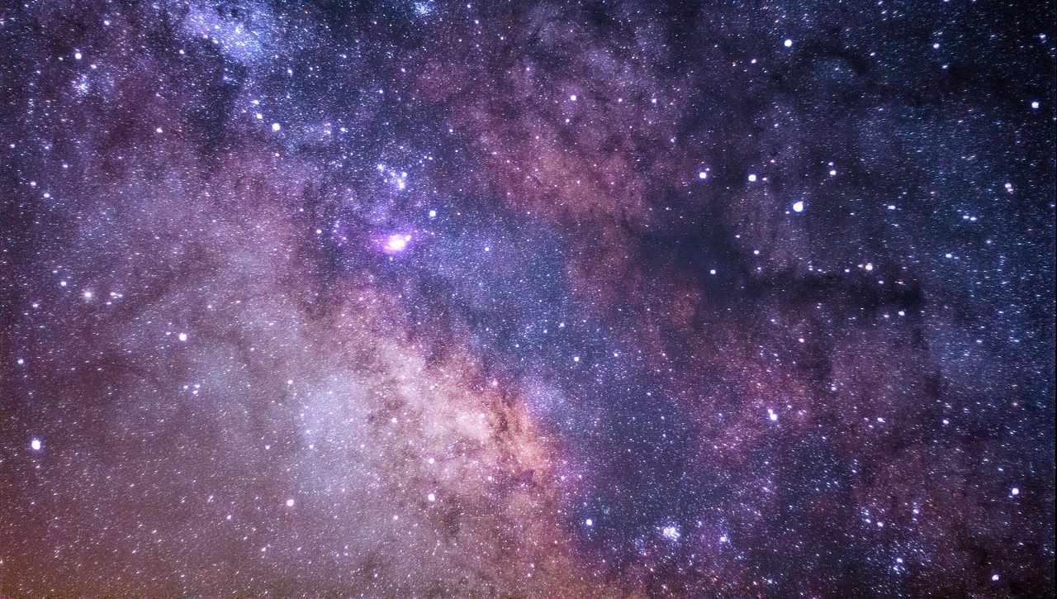
Help us to see as you see, God
Notes:
Slide 12, Option 2: I’m going to turn my thoughts into a prayer now. There’s a part for you to join in with if you’d like to make the prayer your own – or you can just continue to be still and quiet with your own thoughts. Here are the words for us to join together with:
Help us to see as you see, God….

Slide 13
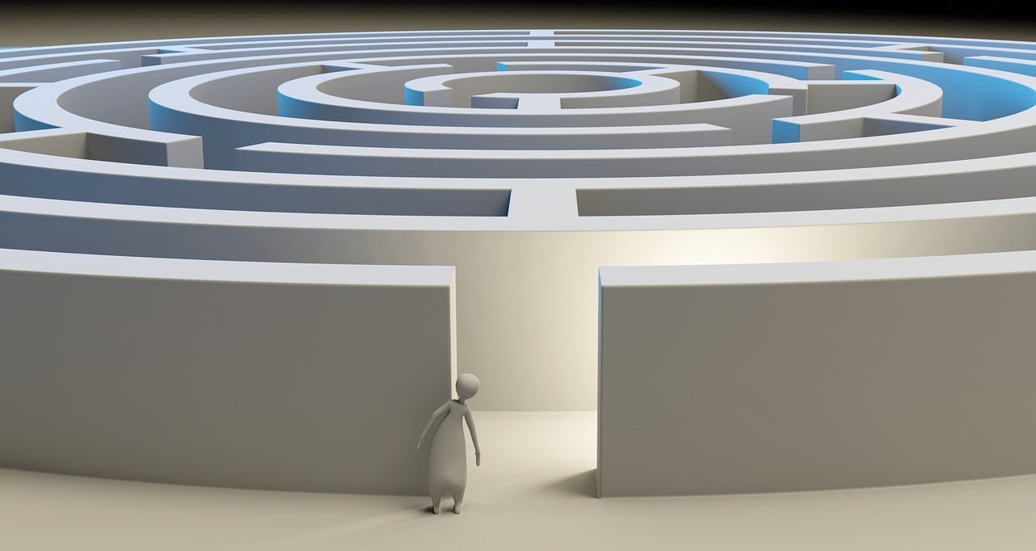
Help us to see as you see, God
Notes:
Slide 13: When we are faced with difficult challenges
Help us to see as you see, God….and see the solution, not the problem

Slide 14
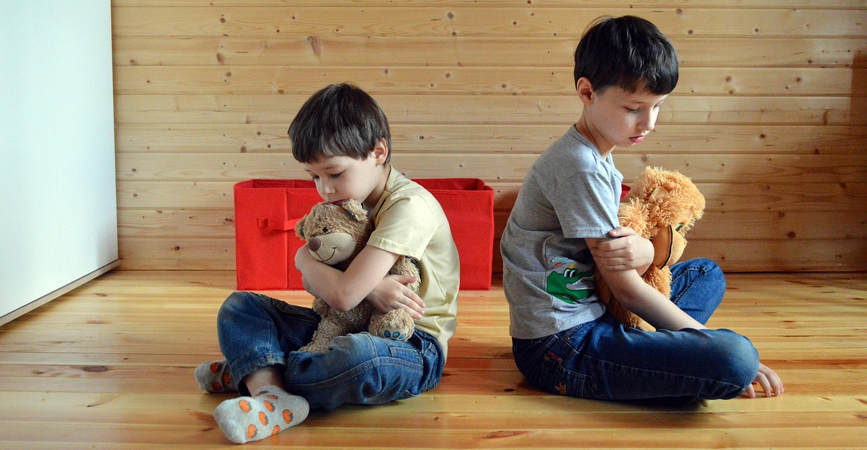
Help us to see as you see, God
Notes:
Slide 14: When we are faced with difficult people
Help us to see as you see, God….and treat them with love and compassion.

Slide 15
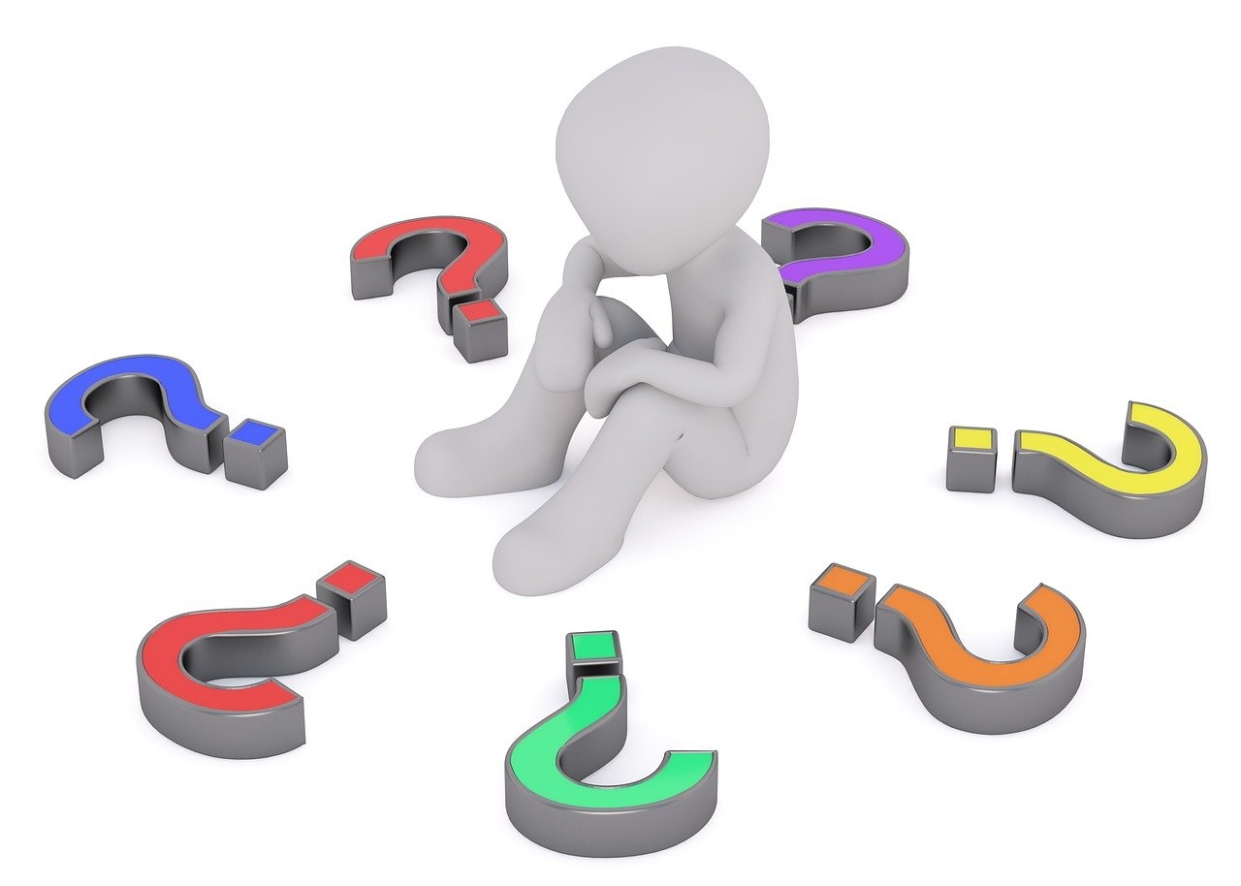
Help us to see as you see, God
Notes:
Slide 15: When life causes us to question,
Help us to see as you see, God….and turn to you.

Slide 16
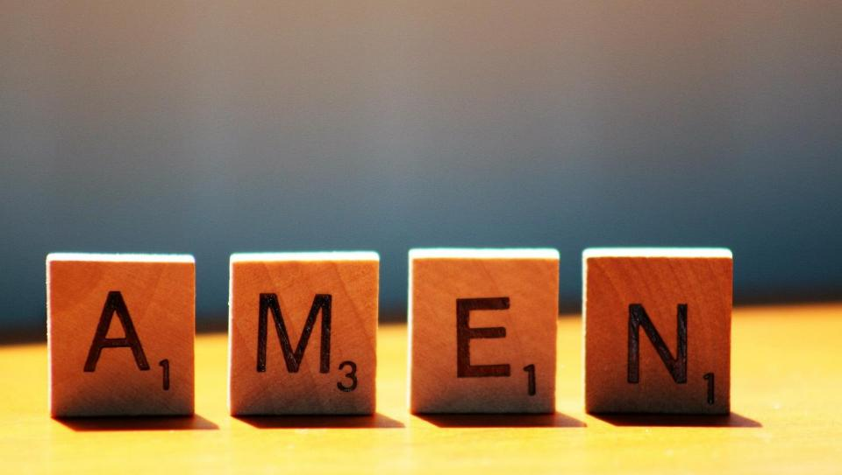

Slide 17
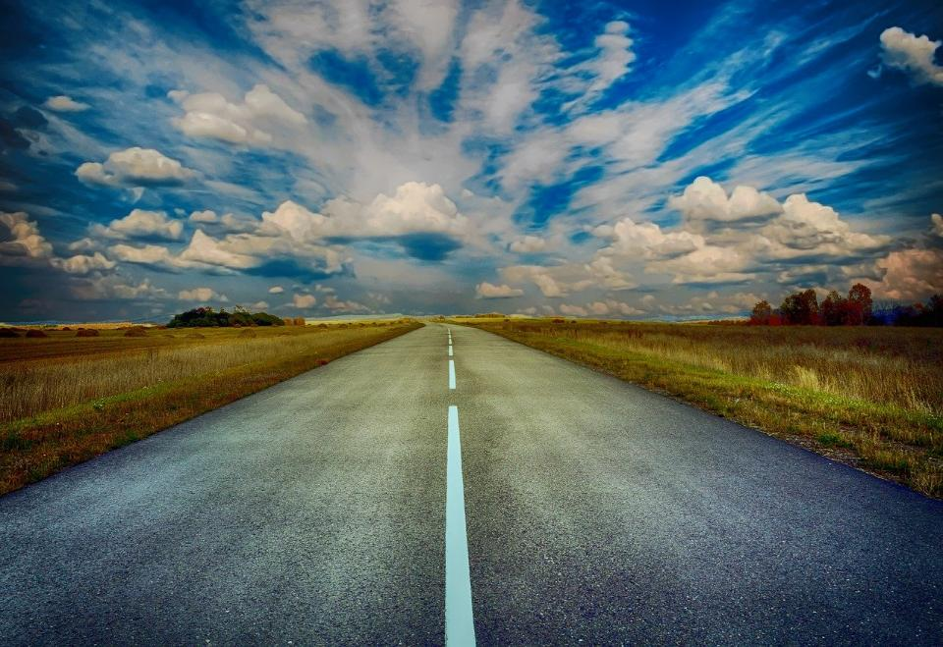
Picture copyright-free from pixabay
Leader: We have journeyed together today. As we leave this place and time and go into the day ahead…
ALL: …May God go with us.
Notes:
Slide 17: Use this term’s leaving words
Leader: We have journeyed together today. As we leave this place and time and go into the day ahead….
ALL: ….May God go with us.
Sign for ‘God: British Sign Language BSL Video Dictionary - God
Sign for ‘go with us’ – we have invented this! After you’ve signed ‘God’, bring your finger down alongside your other finger and make them ‘journey together’ in front of you.

Slide 18
Picture copyright-free from pixabay
Notes:
Ideas for classroom reflection: a variety of glasses
Put on the different glasses and think about how they change how you see things.
Are there people or situations you might need to ‘see’ differently?
Talk about how this might change our school for the better.
If you’d like to, bring these before God and ask Him to help you to see things as He does.

