Slide 1
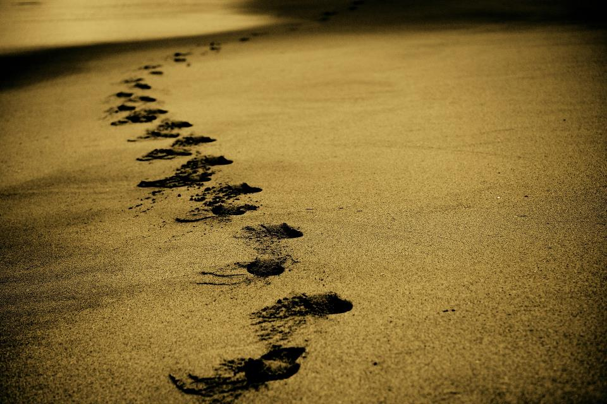
Picture copyright-free from pixabay
Leader: We are on this journey together…
Children: We are friends along the way…
ALL: May God go with us.
Notes:
Slide 1 or 2 [choose whichever image you prefer, or use them in rotation]:
Use the greeting for this term
Leader: We are on this journey together…
Children: We are friends along the way…
ALL: May God go with us.
BSL interpretation:
Sign for ‘way’ (nearest to the idea of ‘journey’): British Sign Language BSL Video Dictionary - way
Sign for ‘friends’: British Sign Language: friends
Sign for ‘God: British Sign Language BSL Video Dictionary - God
Sign for ‘go with us’ – we have invented this! After you’ve signed ‘God’, bring your finger down alongside your other finger and make them ‘journey together’ in front of you.
Engaging:
As we heard last week, in the final term of this school year, we are beginning a new theme:

Slide 2
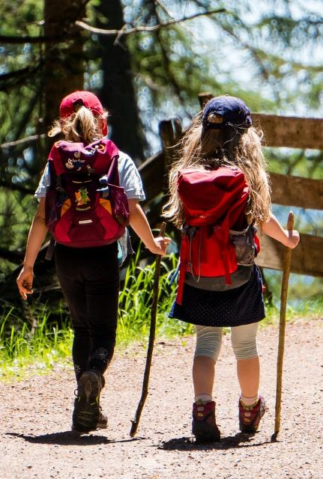
Picture copyright-free from pixabay
Leader: We are on this journey together…
Children: We are friends along the way…
ALL: May God go with us.
Notes:
Slide 1 or 2 [choose whichever image you prefer, or use them in rotation]:
Use the greeting for this term
Leader: We are on this journey together…
Children: We are friends along the way…
ALL: May God go with us.
BSL interpretation:
Sign for ‘way’ (nearest to the idea of ‘journey’): British Sign Language BSL Video Dictionary - way
Sign for ‘friends’: British Sign Language: friends
Sign for ‘God: British Sign Language BSL Video Dictionary - God
Sign for ‘go with us’ – we have invented this! After you’ve signed ‘God’, bring your finger down alongside your other finger and make them ‘journey together’ in front of you.
Engaging:
As we heard last week, in the final term of this school year, we are beginning a new theme:

Slide 3
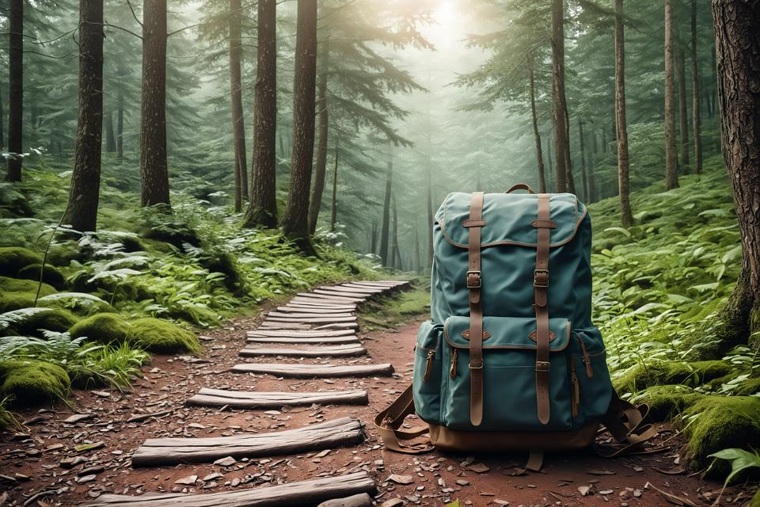
Picture copyright-free from pixabay
To boldly go….
Notes:
Slide 3: To boldly go….. Today we are going on several journeys, continuing with the story of Paul’s life.

Slide 4
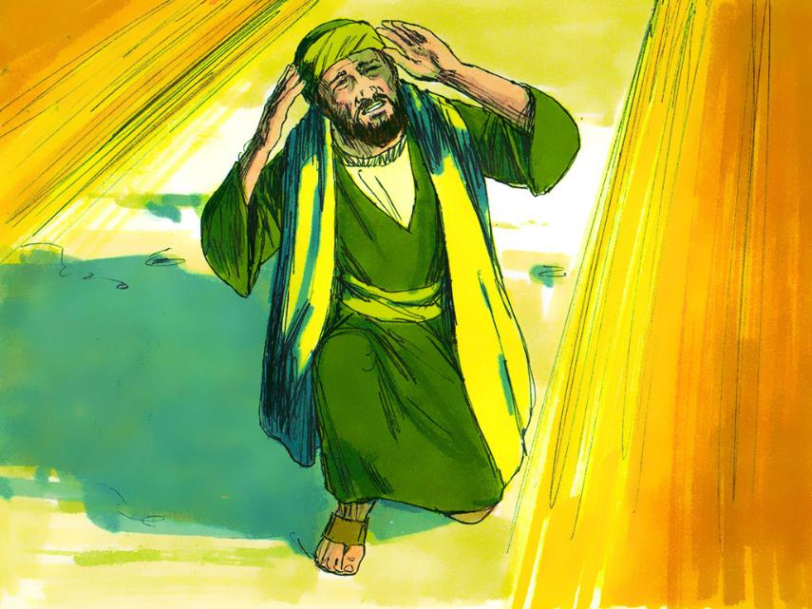
St. Paul
(AD5-67)
Notes:
Slide 4: If you recall, he became a Christian when he had a vision of Jesus as he was travelling on a journey to Damascus, in Syria. He was so changed that he spent the rest of his life travelling around (about 10,000 miles!) to tell as many people as he could about what Jesus had done.

Slide 5
Picture copyright-free from pixabay
What’s in the rucksack today?
Notes:
Slide 5: What’s in the rucksack today? Open your rucksack and get the map out. Talk about why they’re useful – share stories of being lost / finding your way

Slide 6
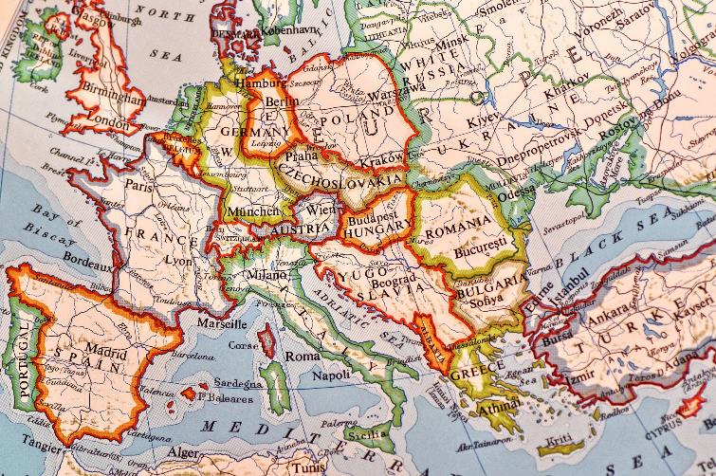
Picture copyright-free from pixabay
Through many dangers…
Notes:
Slide 6: Many of the journeys that Paul took were dangerous, and we’re going to hear about some of them using these [show water bottle] – but with messages in, just like you’d use if you were sending an ‘SOS’ to be rescued from a desert island. [Use the bottles in order, with the script on p3 for some clarification. If you want to read the original stories, the Bible references are given]

Slide 7
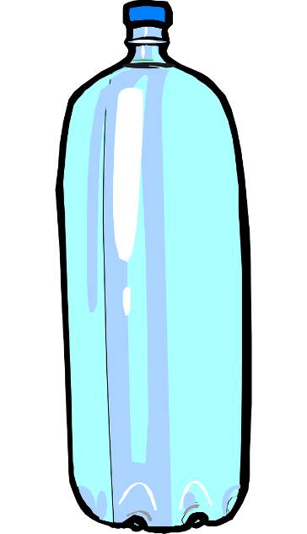
1
Picture copyright-free from pixabay
Notes:
Slide 7: Bottle 1. DANGER!! [Acts 14:8-28] (LYSTRA)
Crowds tried to hurt Paul because of the things he was saying about God, and they threw him out of the city.

Slide 8
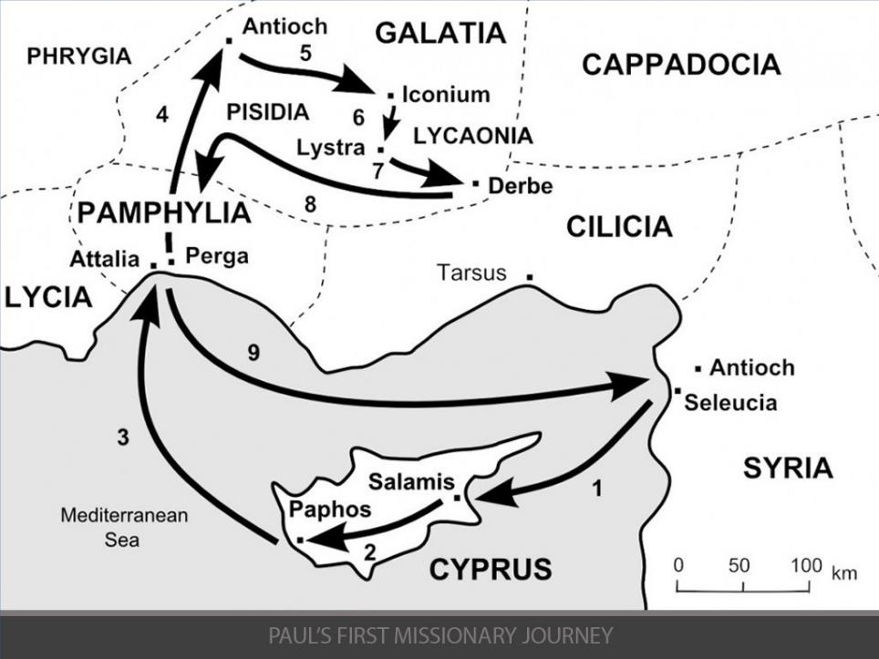
DANGER!!
44-46 AD
Notes:
Slide 8: And so Paul began one of several journeys around the Mediterranean, telling everyone about Jesus, who had changed his life. [follow the arrows from 1-9 to see where he went]

Slide 9
2
Picture copyright-free from pixabay
Notes:
Slide 9: Bottle 2. PRISON! [Acts 16:11-40] (PHILIPPI)

Slide 10
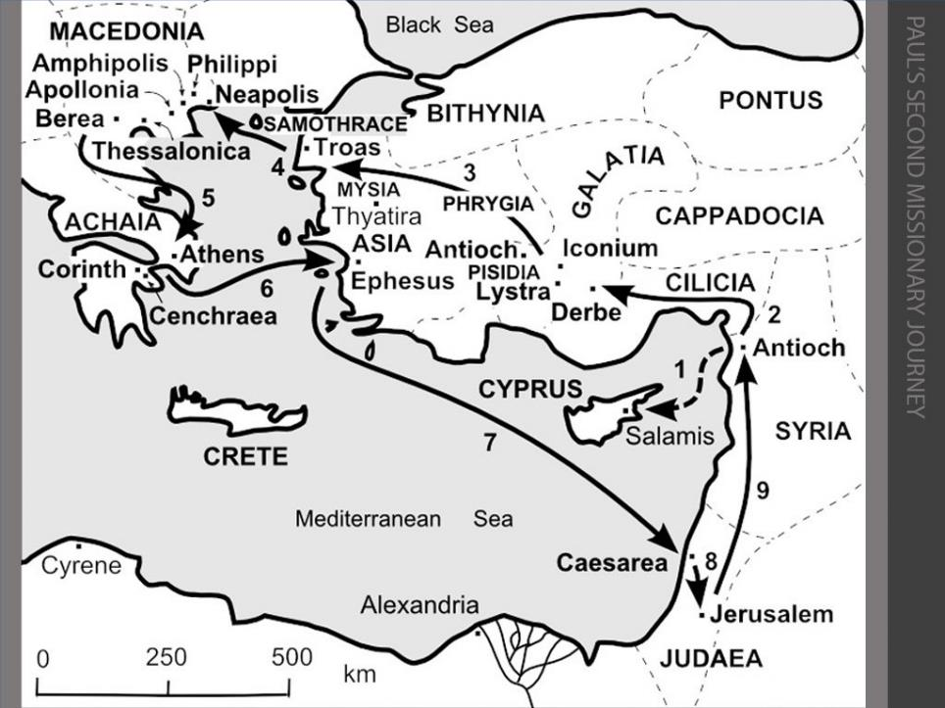
PRISON!!
49-52 AD
Notes:
Slide 10: In Philippi, Paul was put in prison. That night, as he and his friend Silas were praying and singing, God shook the earth with an earthquake that opened all the doors of the prison and shook the chains off the prisoners. Although they were free,

Slide 11
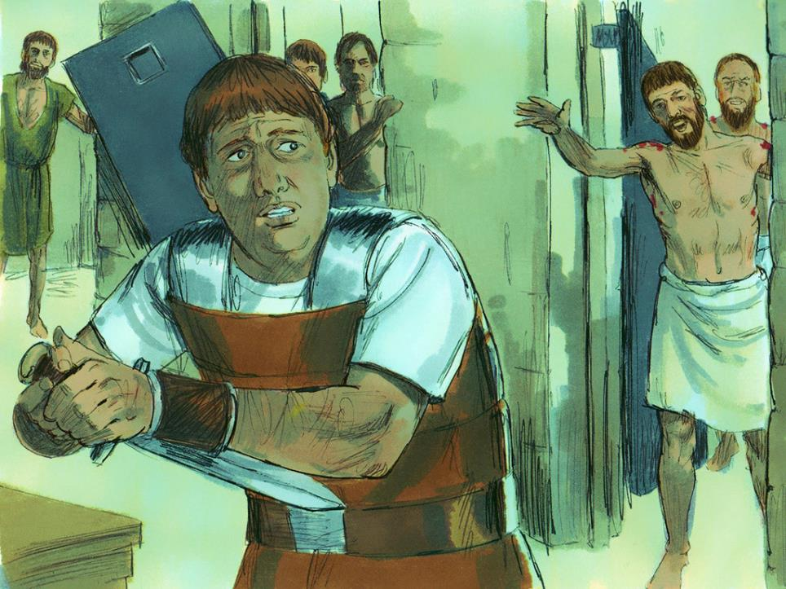
Notes:
Slide 11: Paul and Silas didn’t want the jailer to get into trouble because they’d escaped, so they stayed behind and waited. The jailer was so impressed, he became a follower of Jesus and the leaders in Philippi let Paul and Silas go.

Slide 12
49-52 AD
Notes:
Slide 12: [Acts 18:1-18] Paul then travelled through parts of Greece. In a Greek city, named Corinth,

Slide 13
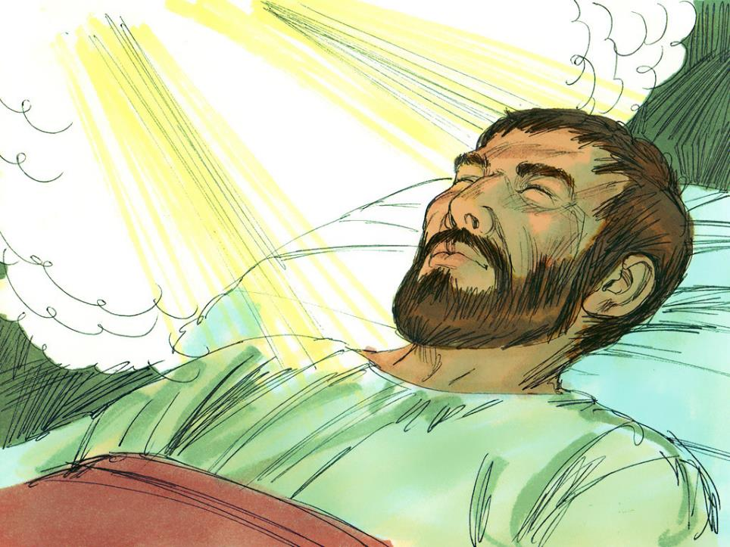
…Don’t be afraid to speak. I am with you and will keep you safe….
Notes:
Slide 13: ….Paul had a dream in which God spoke to him and told him that he would keep them safe, no matter what.

Slide 14
3
Picture copyright-free from pixabay
Notes:
Slide 14: Bottle 3. TRIAL BY ROMANS!! [Acts 21:27-23:35; also Acts 24&25] (JERUSALEM)

Slide 15
TRIAL BY ROMANS!!
Notes:
Slide 15: Paul then travelled back to the church in Jerusalem.

Slide 16
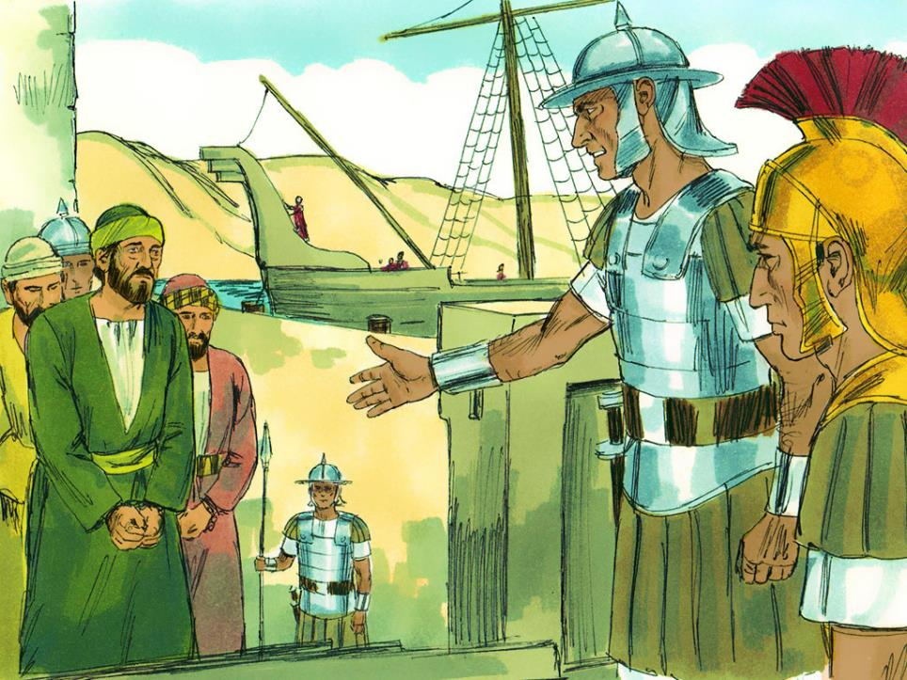
Notes:
Slide 16: There, he was arrested and sent before the Romans to be tried – and punished. The Roman governor sent Paul to Rome.

Slide 17
4
Picture copyright-free from pixabay
Notes:
Slide 17: Bottle 4. SHIPWRECKED!! [Acts 27:1-44] (MALTA)

Slide 18
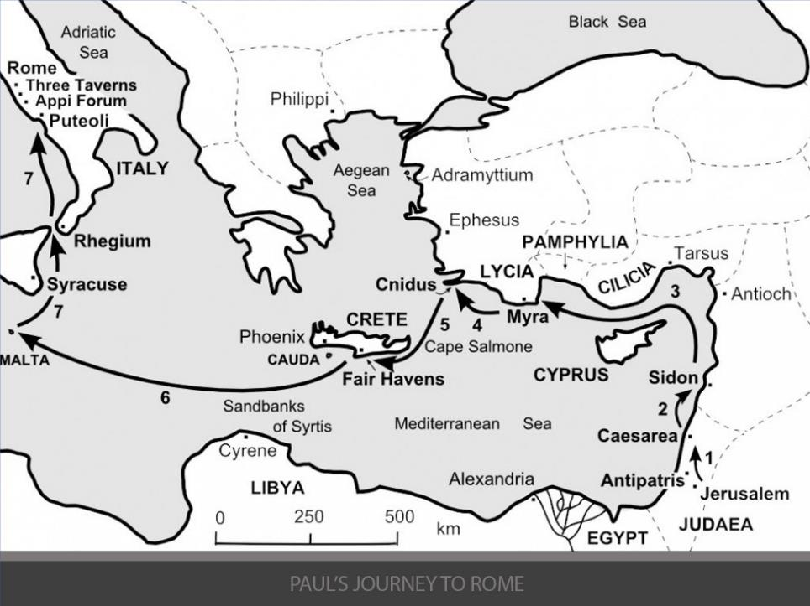
SHIPWRECKED!!
58-61 AD
Notes:
Slide 18: On his way to Rome, a storm blew in,

Slide 19
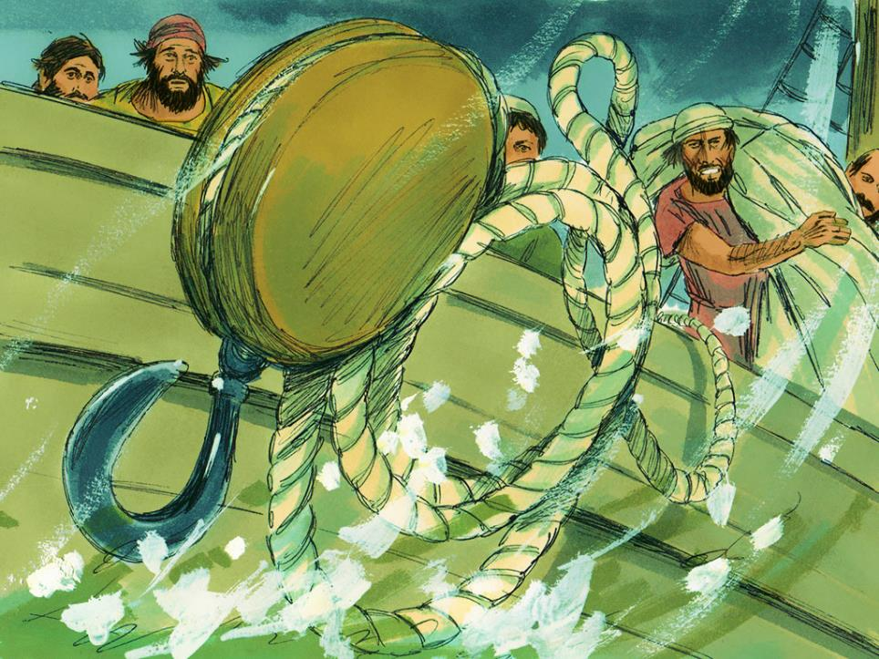
Notes:
Slide 19: and the boat began to sink.

Slide 20
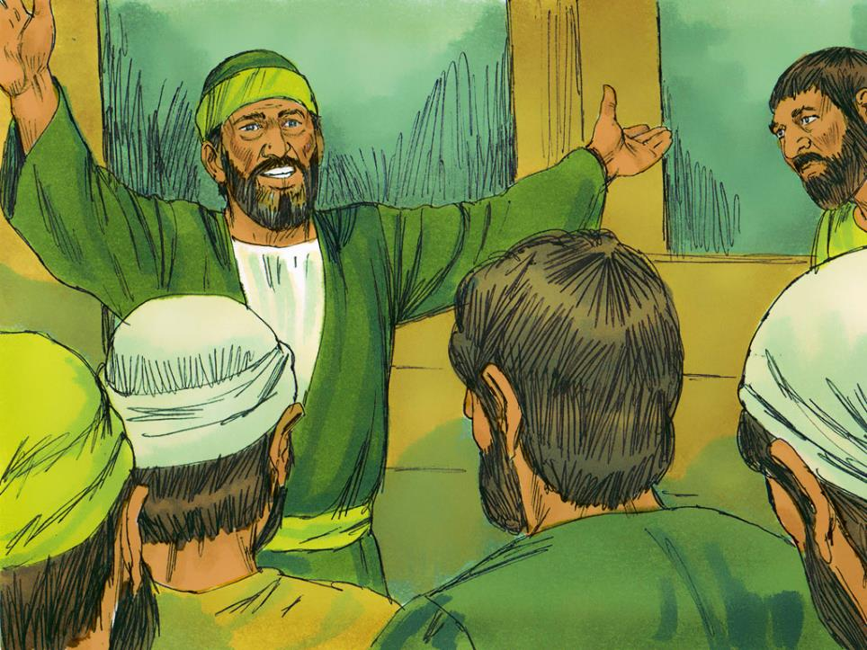
….everyone will be safe! We will be shipwrecked on an island….
Notes:
Slide 20: Paul told everyone on the boat what God had told him, that no-one would be harmed, & that the storm would shipwreck them on an island.

Slide 21
5
Picture copyright-free from pixabay
Notes:
Slide 21: Bottle 5. SNAKEBITE!! [Acts 28:1-6] (MALTA)

Slide 22
58-61 AD
Notes:
Slide 22: On the island of Malta, where they were shipwrecked,

Slide 23
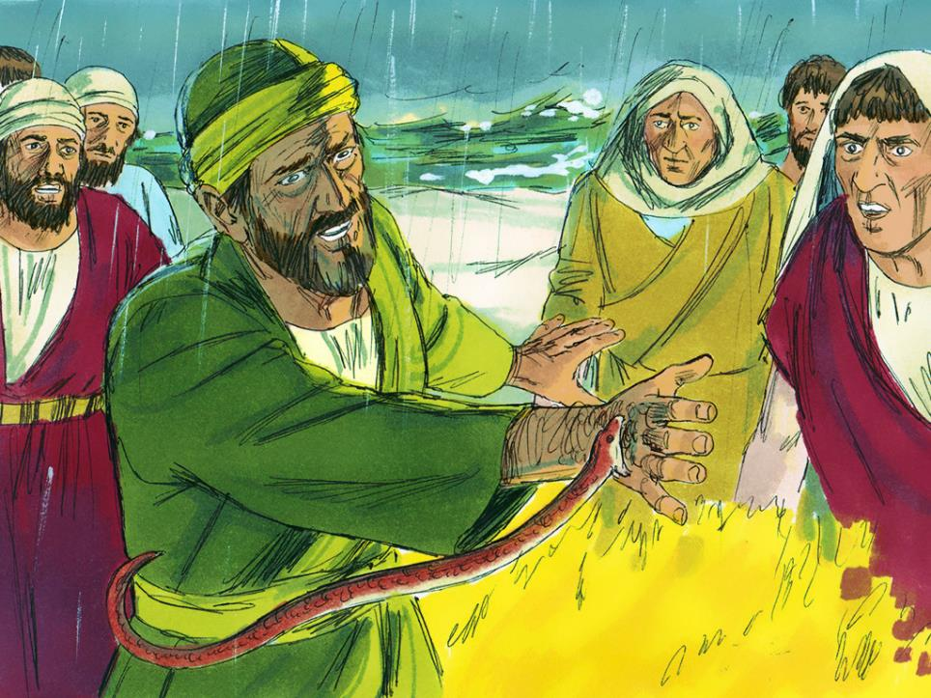
SNAKEBITE!!
Notes:
Slide 23: Paul was bitten by a snake, but the poison didn’t harm him! He then continued on his way to Rome.

Slide 24
6
Picture copyright-free from pixabay

Slide 25
HOUSE ARREST!!
58-61 AD
Notes:
Slide 25: In Rome, Paul was put under house arrest, which meant he wasn’t allowed to leave the place where he was staying.
People think that Paul lived like this for about 2 years, waiting for his trial as a Roman citizen.

Slide 26
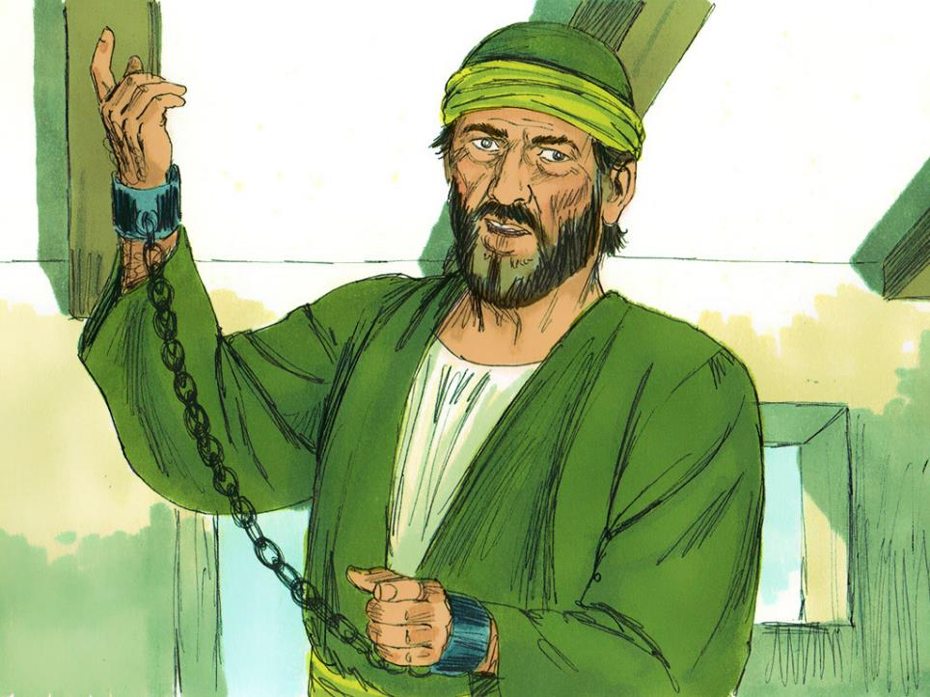
Notes:
Slide 26: People think that Paul lived like this for about 2 years, waiting for his trial as a Roman citizen.

Slide 27
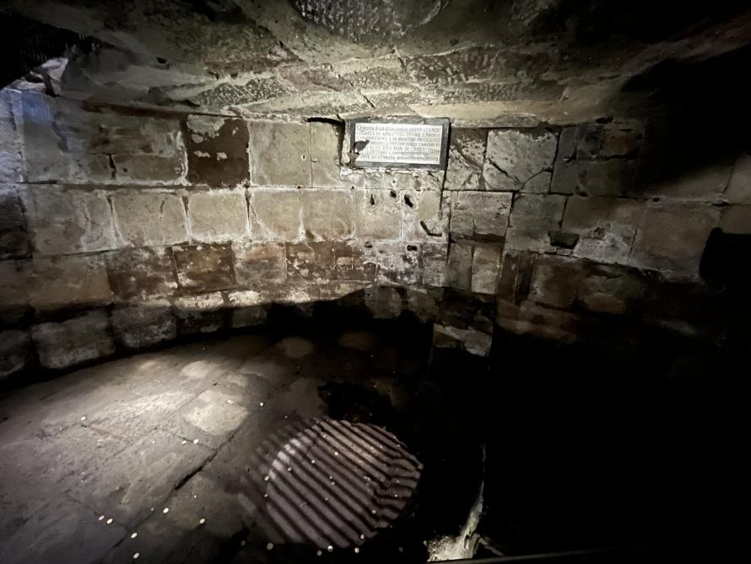
Notes:
Slide 27: Excavations in Rome uncovered the place where Paul may have been kept prisoner during this time – as you can see, it’s a bit less like a ‘house’, and more like a dungeon! [This is called the Mamertine Prison, and can be seen just outside the remains of the Roman Forum]

Slide 28
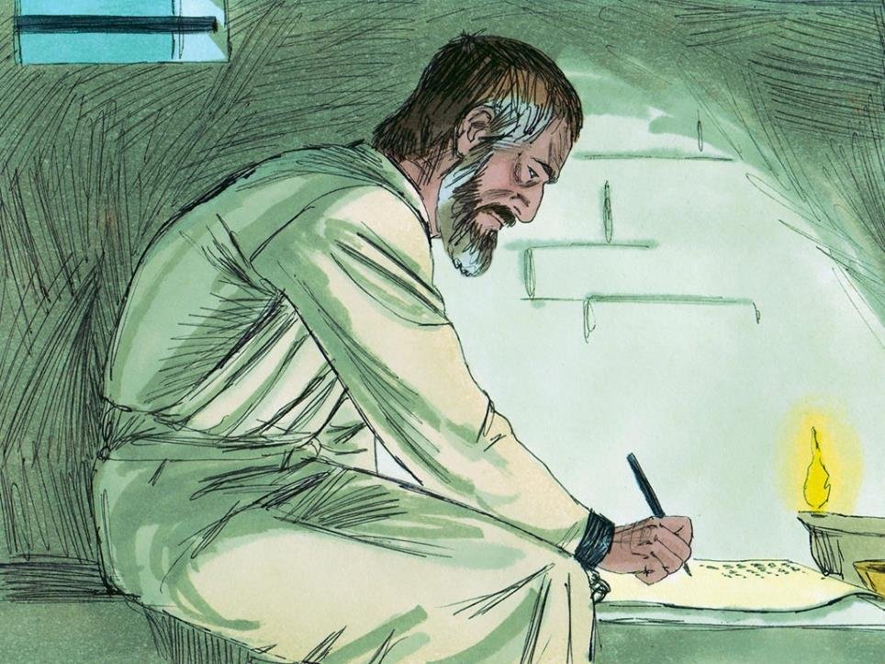
….Run the race with perseverance. Keep on going, and don’t give up!….
Notes:
Slide 28: What happened after this, no-one is quite sure, and Paul may have been allowed to visit some of the churches that he had set up, but we do know that he wrote lots of letters to the very first church leaders, encouraging them and giving them good advice. In one of them, to the church in Jerusalem, he wrote these words, words we’ve already used this term: “Run the race with perseverance! Keep on going and don’t give up!”
He wasn’t talking about an actual race, but the feeling that life is sometimes hard, like running in a race and getting tired. I wonder if you’ve ever felt like that? I wonder how often Paul felt like that himself?

Slide 29
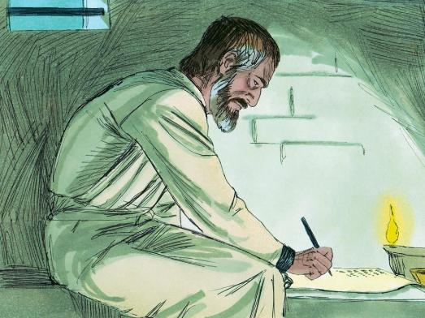
….I wonder why it was so important to Paul that he told others about Jesus?....
….I wonder what this might mean for us, today?....
….I wonder what difficulties we might be facing or things we might need help with?....
Notes:
Slide 29: Responding (and words for worship):
Let’s be still and quiet together now….
…in the stillness, let’s think about the things that we’ve heard today, about Paul and the dangers he faced to tell others about Jesus….
….about how he kept on going and didn’t give up…..
….I wonder why it was so important to Paul that he told others about Jesus?....
….many times in his life, Paul asked that God would be with him on his journey…..
….I wonder what this might mean for us, today?....
……I wonder what difficulties we might be facing or things we might need help with?….
….use these few moments of stillness to bring them to God, or to think….
I’m going to turn my thoughts into a prayer now, as I ask God to help us to put some of these ideas into practice. Make the prayer your own if you’d like to…or if you’d prefer not to pray, then just sit quietly with your own thoughts.

Slide 30
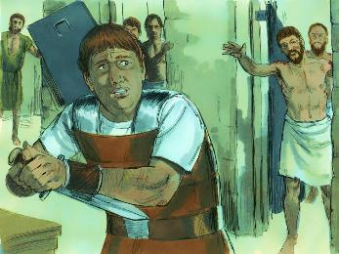
Dear God
Thank you for the inspiration of Paul – how he trusted you and didn’t give up.
When hard times come, please help us to keep on going and not give up. Be with us we pray.
Notes:
Slide 30: Prayer
Dear God
Thank you for the inspiration of Paul – how he trusted you and didn’t give up.
When hard times come, please help us to keep on going and not give up. Be with us we pray.

Slide 31
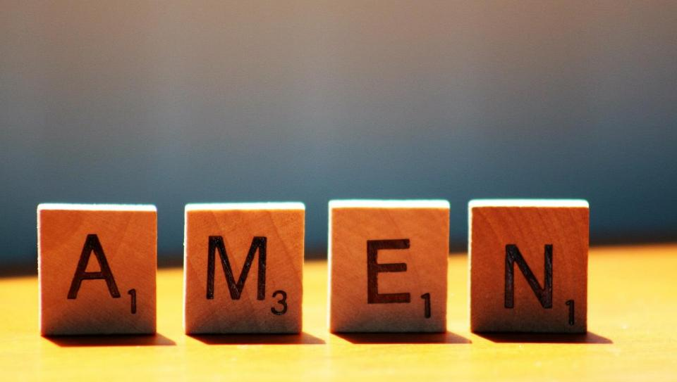

Slide 32
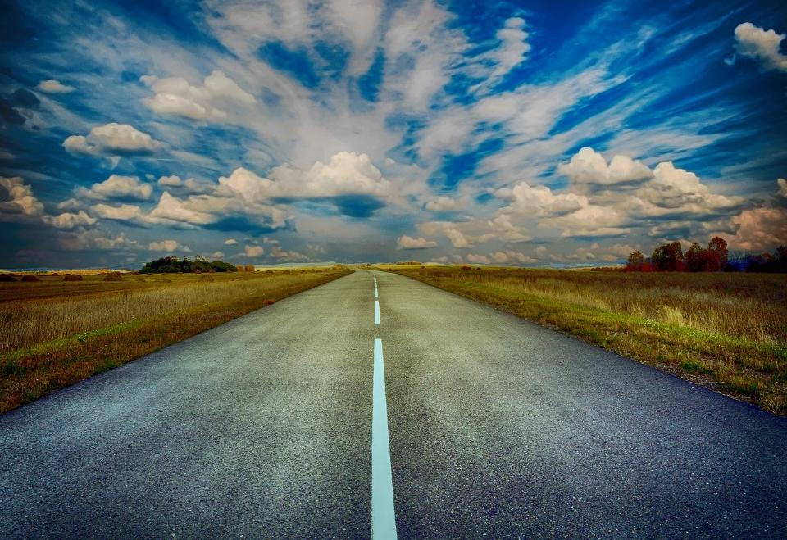
Picture copyright-free from pixabay
Leader: We have journeyed together today. As we leave this place and time and go into the day ahead…
ALL: …May God go with us.
Notes:
Slide 17: Use this term’s leaving words
Leader: We have journeyed together today. As we leave this place and time and go into the day ahead….
ALL: ….May God go with us.
Sign for ‘God: British Sign Language BSL Video Dictionary - God
Sign for ‘go with us’ – we have invented this! After you’ve signed ‘God’, bring your finger down alongside your other finger and make them ‘journey together’ in front of you.

Slide 33
Notes:
Ideas for classroom reflection: map strips
Cut up strips of old maps (or print the version that’s on p.4) Leave these in your reflective area with the empty bottle.
Paul’s life was full of adventure and danger, but he trusted God.
Talk together about where you saw this in the story.
Do you sometimes feel like giving up? Are there things you feel are really hard to do?
Write a message or a prayer on a strip of map, then post it into the bottle. As you do, ask God to help you, if you’d like to.

