Slide 1
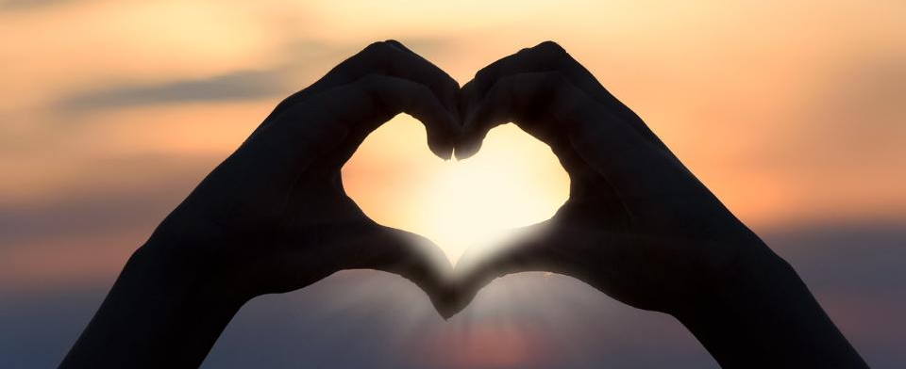
Leader: As we gather together
ALL: …we bring our hearts.
Notes:
Slide 1: Use the gathering words for this term, or your usual greeting if you prefer. The greeting comes with BSL signing; you can view the demos using links under the slide.
Leader: As we gather together,
ALL: …we bring our hearts
Signs for greeting: click on links
Hearts: British Sign Language BSL Video Dictionary - heart

Slide 2
Leader: As we gather together
ALL: …we share our thoughts.
Notes:
Slide 2: Use the gathering words for this term, or your usual greeting if you prefer. The greeting comes with BSL signing; you can view the demos using links under the slide.
Leader: As we gather together,
ALL: …we share our thoughts.
Signs for greeting: click on links
Thoughts: British Sign Language BSL Video Dictionary - thought

Slide 3
Leader: As community together
ALL: …we serve one another.
Notes:
Slide 3: Use the gathering words for this term, or your usual greeting if you prefer. The greeting comes with BSL signing; you can view the demos using links under the slide.
Leader: As community together,
ALL: …we serve one another.

Slide 4
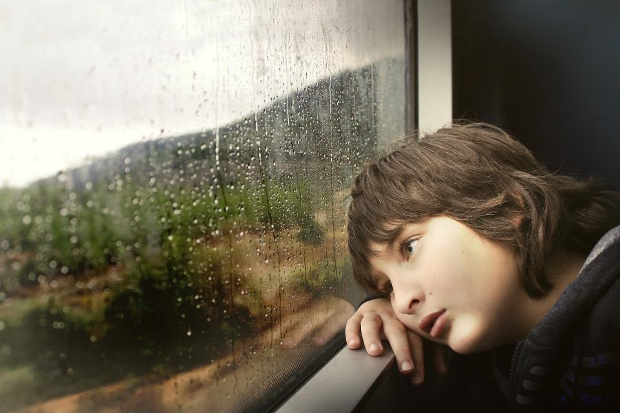
What makes someone sad?
Notes:
Discussion Option 1, Slide 4: What makes someone sad?
Talk together about your answers to the question, being aware that children (like the adults in the room) will feel able to share at a range of levels, from the deeply personal, to what makes ‘people’ sad generally, and maybe give particular examples such as a moment in a film. This may have nothing to do with the age of the children.

Slide 5
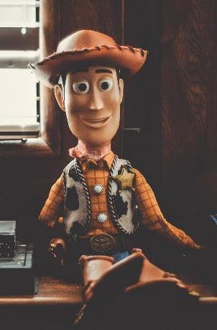
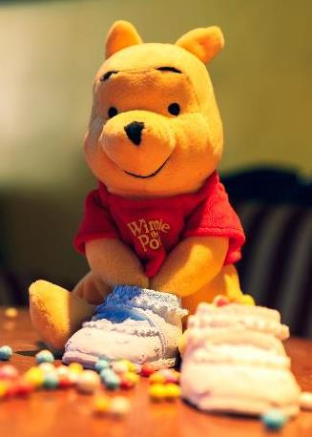
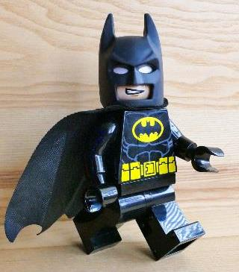
Best Friends
Notes:
Discussion Option 2, Slide 5: I wonder how many pairs of ‘best friends’ you can name? – there are a few ideas to get us talking here in this picture.
I wonder who your best friend is / your friends are – and what made you choose each other? [if time allows, you could share some stories here]

Slide 6
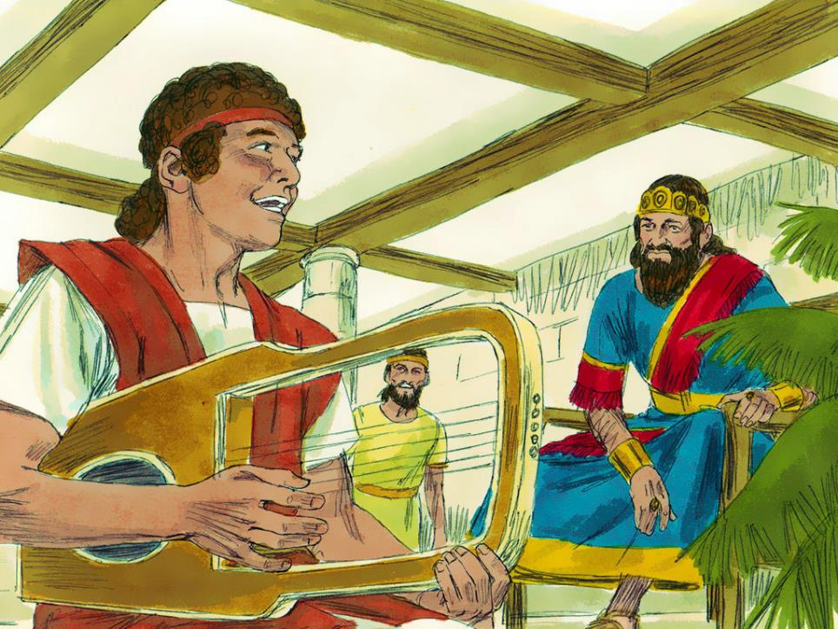
…the very best of friends.
Notes:
Slide 6: We’re going to hear a short story now about two best friends, a sad time that they experienced – and some words written by one of them in the middle of great sadness in which there’s another promise….. In the story you’ll hear the words ‘David and Jonathan’ (so no guesses as to the best friends’ names!) When you do, you might want to join in with the refrain ‘the very best of friends’. [Use the script on p.4]
In the Bible, there’s a story about two friends. David wrote songs for the King. Jonathan was a prince, the son of King Saul, and David was his best friend.
David and Jonathan – the very best of friends

Slide 7
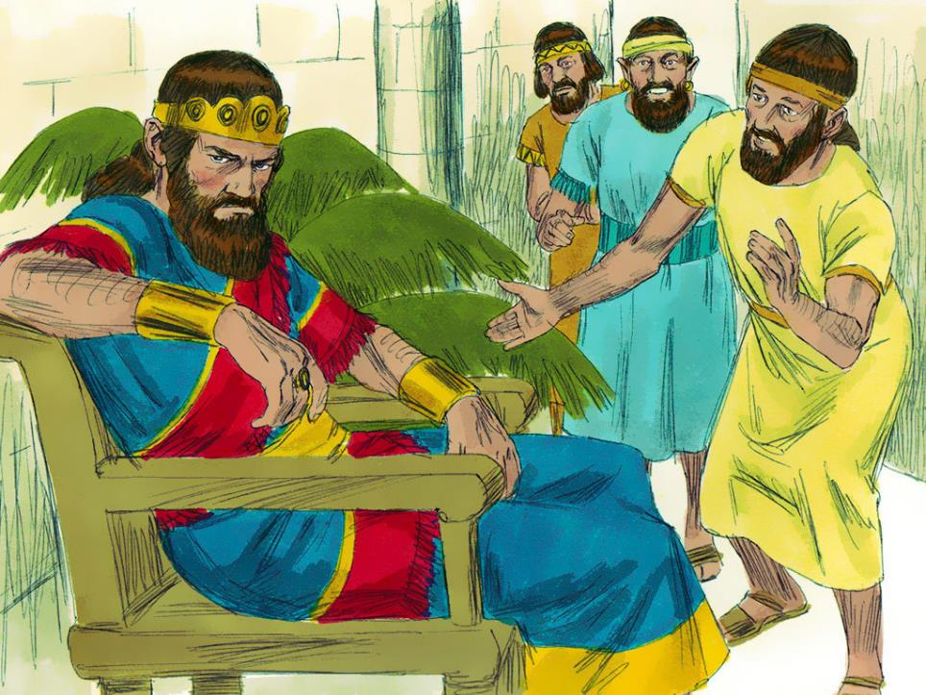
…the very best of friends.
Notes:
Slide 7: They’d been friends since David was not much more than a boy. I expect you can imagine some of the things they got up to!! However, being the friend of a prince wasn’t as easy as you might think, especially when Jonathan’s father, King Saul, was as jealous of David as he was.
David and Jonathan – the very best of friends

Slide 8
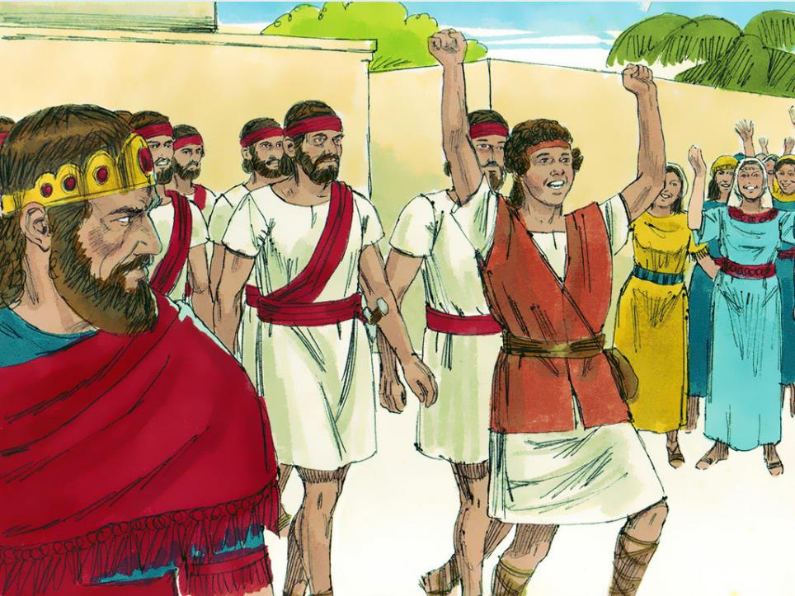
…the very best of friends.
Notes:
Slide 8: People liked and admired David for how great he was on the battle field, but King Saul hated hearing this, and wanted David out of the way for good, even though David and Jonathan were – the very best of friends.

Slide 9
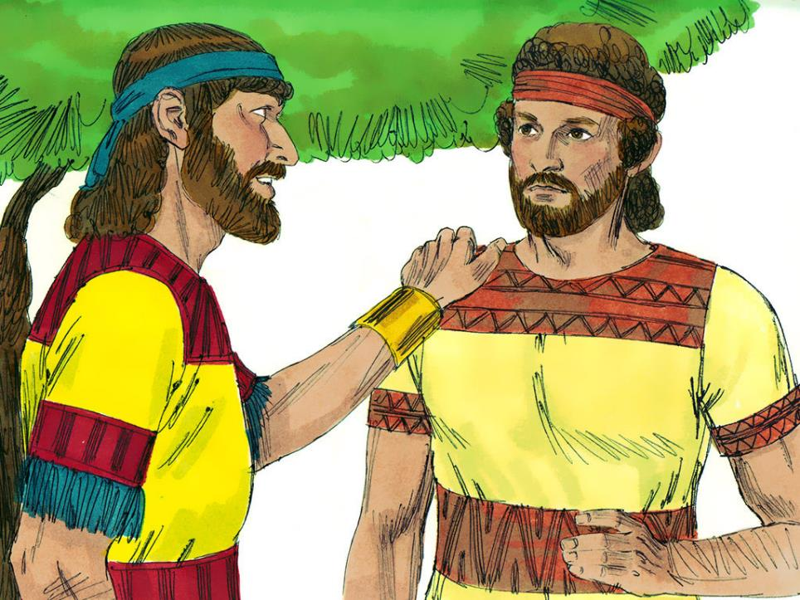
…the very best of friends.
Notes:
Slide 9: Jonathan found out about the plan and decided that he cared about David too much to let his father hurt him in any way.
David and Jonathan – the very best of friends

Slide 10
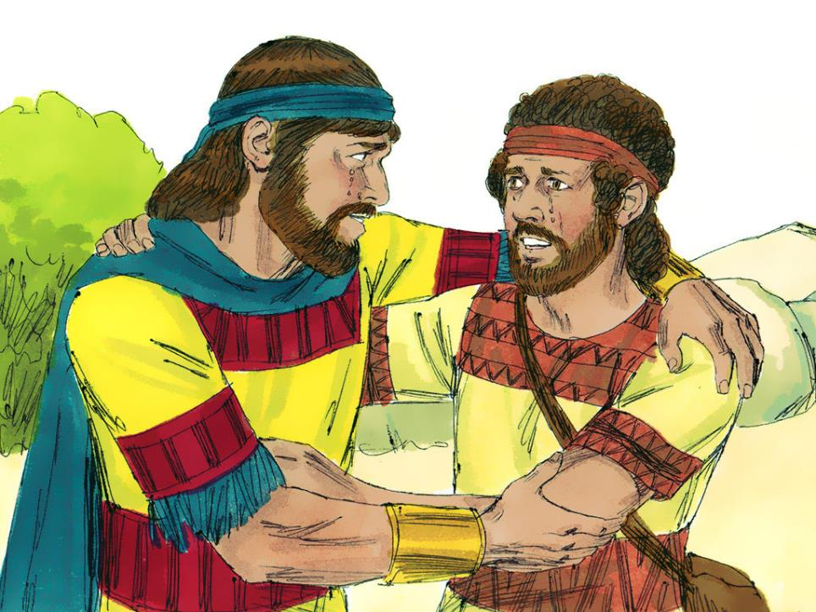
…the very best of friends.
Notes:
Slide 10: So, Jonathan sent David away, knowing what that meant; knowing that they might never meet again; knowing how much he would miss his friendship, but wanting more than anything else to protect David and keep him safe.
David and Jonathan – the very best of friends

Slide 11
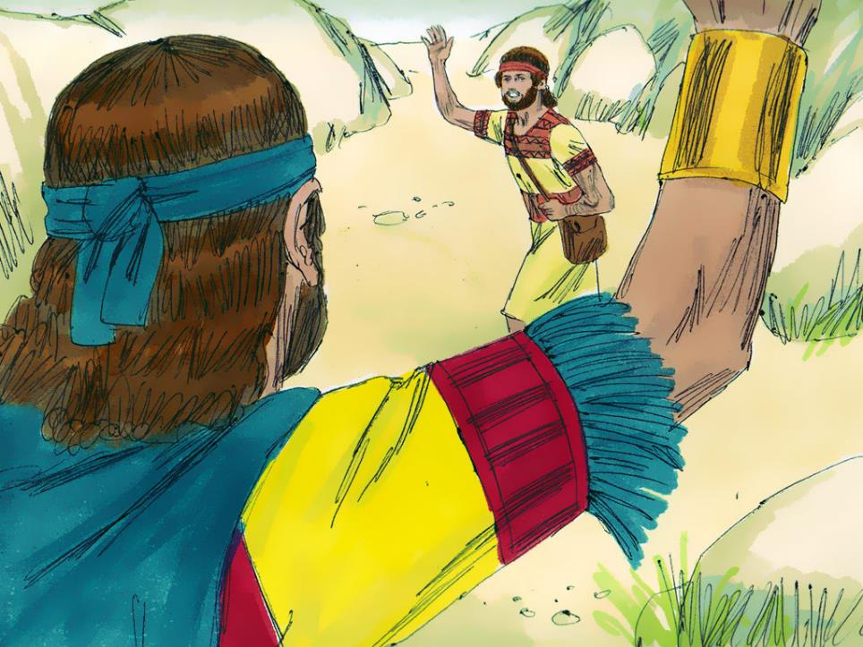
…the very best of friends.
Notes:
Slide 11: David left the palace and went to live in Gath, a long way away, with sadness heavy in his heart. Maybe you can understand what he was feeling…..
David and Jonathan – the very best of friends

Slide 12
…the very best of friends.
Notes:
Slide 12: Sadly, David never saw Jonathan again [optional: for Jonathan died in battle beside his father.], but he never forgot their friendship. He wrote: ‘I miss you most of all: you were like my brother, truly loyal to me.’
David and Jonathan – the very best of friends
I wonder what this story teaches us?

Slide 13
Songs from
the heart
Notes:
Slide 13: Songs from the heart As we’ve heard so far this term, there are many examples in the Psalms that David wrote where he shares feelings of sadness and anger – as well as words of great happiness and praise. It was not long after the separation from his best friend, Jonathan, that David wrote these words, expressing his sadness to God:

Slide 14
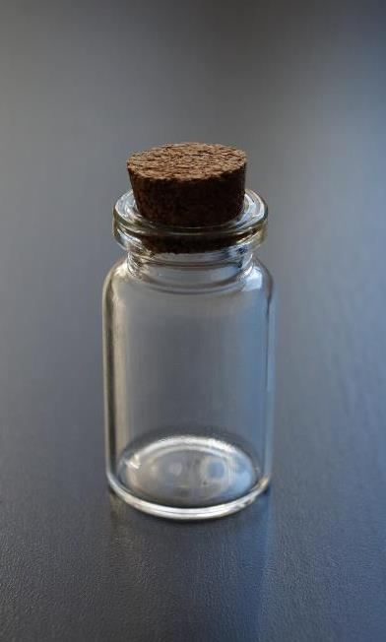
You have stored my tears
in your bottle
and counted each of them….
Psalm 56:8
God is close to the brokenhearted.
Psalm 34:18
Notes:
Slide 14:
You have stored my tears in your bottle and counted each of them….
He also wrote in Psalm 34:
…God is close to the brokenhearted….
David believed that God had not left him during the difficult times in his life, but instead was taking notice of every tear that David cried and keeping them, treasuring them almost, in his bottle. David’s tears mattered deeply to God.

Slide 15
You have stored my tears in your bottle
and counted each of them.
Psalm 56:8
…. I wonder what you think about these words?
….I wonder if it helps to know that God sees – and counts – every tear?
….I wonder how these words might bring comfort when someone is sad?
Notes:
Slide 15:
…. I wonder what you think about these words?
….I wonder if it helps to know that God sees – and counts – every tear?
….I wonder how these words might bring comfort when someone is sad?

Slide 16
God is close to the brokenhearted.
‘God comforts us when we are in need, so that we can be a comforter to others in need.’
2 Corinthians 1: 4 [adapted CEV translation]
Notes:
Slide 16: We’ve already heard that David believed that ‘God is close to the brokenhearted’, which is what he himself had experienced. But to help us as we draw near to the end of our time together, we ‘re going to hear some more words from the Bible, written by St Paul in the New Testament part of the Bible: ‘God comforts us when we are in need, so that we can be a comforter to others in need.’ 2 Corinthians 1: 4 [adapted CEV translation] This means that we can help to comfort others when they are sad.
[It’s good to think about how you might do this, so pause now and talk about your ideas together e.g. giving others space; sitting quietly beside them; [appropriately] putting an arm around their shoulders; talking with them etc. – children might also be able to think of their own ways to be a ‘comforter’.]

Slide 17
You have stored my tears
in your bottle
and counted each of them….
Psalm 56:8
Notes:
Slide 17: Reflection time
Now we’re going to use David’s picture of tears in a bottle to give each other some space today (& this week in our classrooms) to think about any sadnesses we carry, and if you want to, to bring them before God as David did, or maybe instead to think about how you might bring comfort to someone else in their sadness. [Pause now, and use the reflective resources to help you….]
Words for worship…..So now, let’s spend a few moments being still and quiet together…..
…. let’s bring all that we have experienced in this space and time….
….and choose to leave it here….
….maybe you might want to put it into God’s hands, trusting that he has noticed you, and the sadnesses you carry, just as he noticed David….

Slide 18
You have stored my tears in your bottle
and counted each of them.
Psalm 56:8
“Thank you that you notice us.”
Notes:
Slide 18: Prayer:
Now I am going to use some words of a simple prayer; you can join in with the words ‘Thank you that you notice us’ at the end of each of my lines if you would like to.
When our lives are good and we are happy
Thank you that you notice us.
When our lives are troubled and we are confused,
Thank you that you notice us.
When sadness creeps in and causes us to cry,
Thank you that you notice us.
Whatever happens in our lives,
Thank you that you notice us.
Amen.

Slide 19
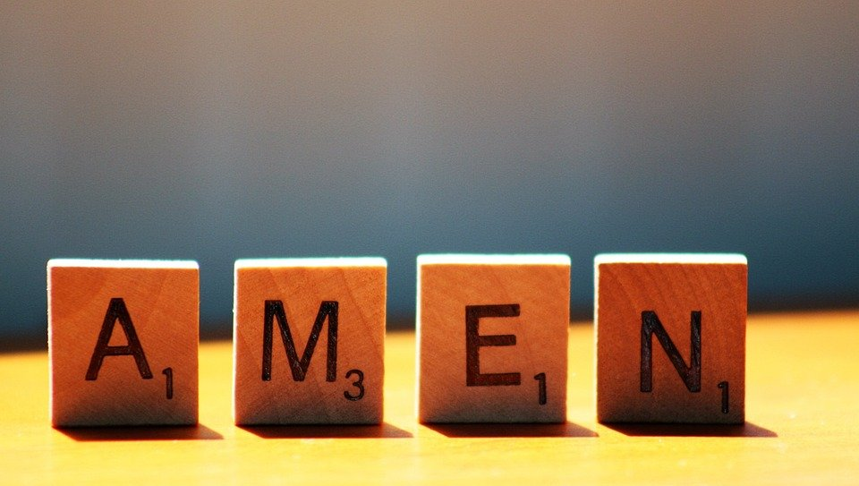
Notes:
Slide 19: Amen

Slide 20
Leader: As we leave this place & time and go into the day ahead…
All: …may we serve one another in our thoughts and words and actions.
Notes:
Sending: Slide 20
Leader: As we leave this place and time and go into the day ahead,
All: ….may we serve one another in our thoughts and words and actions.
Signs for response: click on links
Thoughts: British Sign Language BSL Video Dictionary - thought (signbsl.com)
Words (use 3rd definition): British Sign Language BSL Video Dictionary - word (signbsl.com)
Actions: British Sign Language BSL Video Dictionary - action (signbsl.com)

Slide 21
Notes:
Reflective / prayer idea for this week, which you have just modelled.
There are further ideas in the script.

