Slide 1
Picture copyright-free from pixabay
Leader: We are on this journey together…
Children: We are friends along the way…
ALL: May God go with us.
Notes:
Slide 1 or 2 [choose whichever image you prefer, or use them in rotation]:
Teach the new greeting for this term
Leader: We are on this journey together…
Children: We are friends along the way…
ALL: May God go with us.
BSL interpretation:
Sign for ‘way’ (nearest to the idea of ‘journey’): British Sign Language BSL Video Dictionary - way
Sign for ‘friends’: British Sign Language: friends
Sign for ‘God: British Sign Language BSL Video Dictionary - God
Sign for ‘go with us’ – we have invented this! After you’ve signed ‘God’, bring your finger down alongside your other finger and make them ‘journey together’ in front of you.
Engaging:
As we heard last week, in the final term of this school year, we are beginning a new theme:

Slide 2
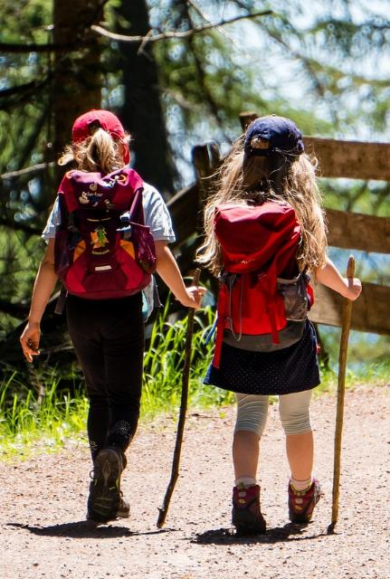
Picture copyright-free from pixabay
Leader: We are on this journey together…
Children: We are friends along the way…
ALL: May God go with us.
Notes:
Slide 1 or 2 [choose whichever image you prefer, or use them in rotation]:
Teach the new greeting for this term
Leader: We are on this journey together…
Children: We are friends along the way…
ALL: May God go with us.
BSL interpretation:
Sign for ‘way’ (nearest to the idea of ‘journey’): British Sign Language BSL Video Dictionary - way
Sign for ‘friends’: British Sign Language: friends
Sign for ‘God: British Sign Language BSL Video Dictionary - God
Sign for ‘go with us’ – we have invented this! After you’ve signed ‘God’, bring your finger down alongside your other finger and make them ‘journey together’ in front of you.
Engaging:
As we heard last week, in the final term of this school year, we are beginning a new theme:

Slide 3
Picture from CAFOD
Notes:
Slide 3: You may already have heard on the news about the death of Pope Francis, the leader of the Catholic Church and a very special figure for more than 1.4 billion Catholic Christians across the world. Today we are going to mark this sad news as a community together. Pope Francis had been ill for many weeks, but spoke his last words to the Church, from his home in the Vatican, the day before he died, in his Easter message. We’ll hear some of his words in a moment.

Slide 4
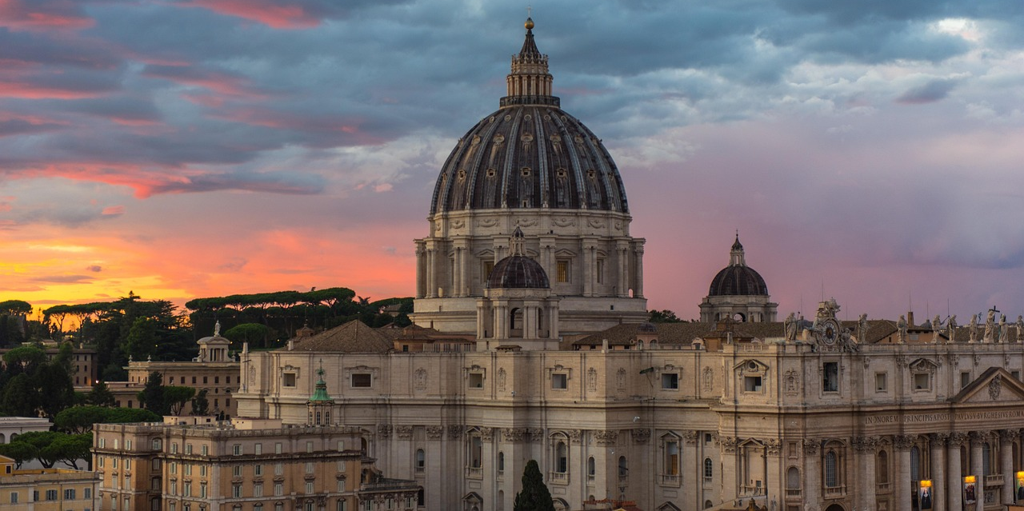
Notes:
Slide 4: The Vatican is the official home of the Pope, who leads the Roman Catholic Church worldwide. The Vatican and St. Peter’s Square in Rome will be the focus of much attention over the next few days as the Catholic Church prepares for Pope Francis’ funeral on Saturday and celebrates his life. But although he lived in these most beautiful of surroundings, and as Pope, could’ve made the grand Apostolic Palace his home, he chose instead the guest house next door, making a clear statement about his priorities as leader of the Catholic Church.

Slide 5
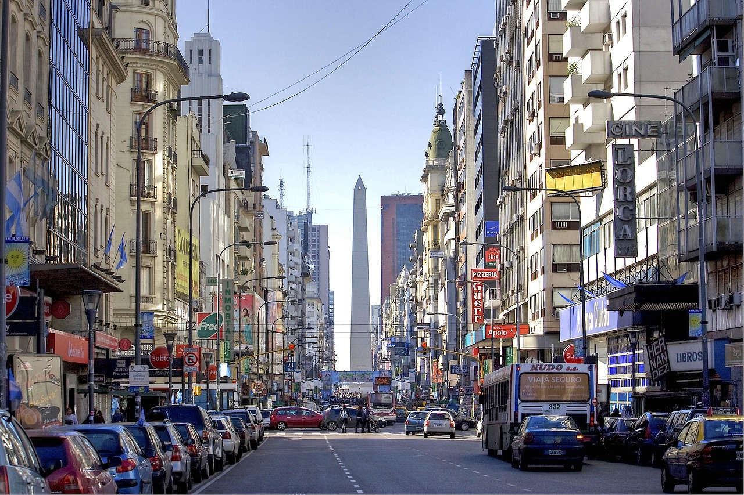
Notes:
Slide 5: Pope Francis was born in Buenos Aires, Argentina, on 17th December 1936. He was the oldest of 5 children. His birth name was Jorge Bergoglio* [see pronunciation guide, in Resources section] – he only became known as Francis once he became Pope – and he chose the name himself, showing his desire to be a humble leader, who cared for the poor and for the world. He was the first ever Pope from South America, and already in his 70s when he was made Pope in 2013. He had lived a life of faith, and was passionate about serving others, especially the poorest of the world, and children and young people, whom he called ‘the joy and hope of the Church and the world.’

Slide 6
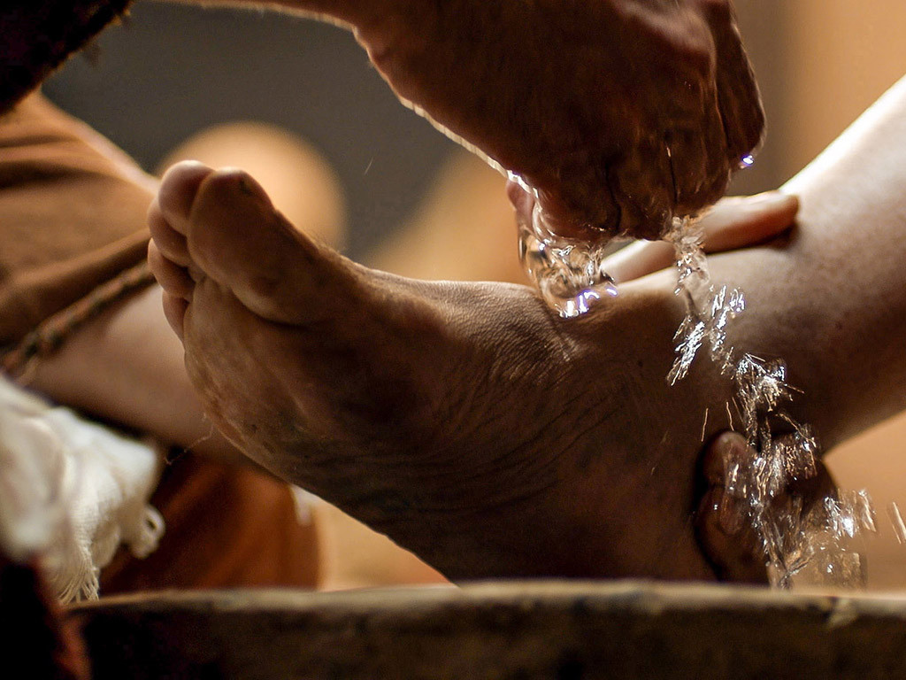
Notes:
Slide 6: Pope Francis’s hope for 2025 was that schools and communities all over the world would join together to make the world a better place, a place of justice, peace and love. He often showed this himself, choosing to wash the feet of people in prison, to hear the cries of the poor and campaign for climate justice, to be a sign of hope in how he lived.

Slide 7
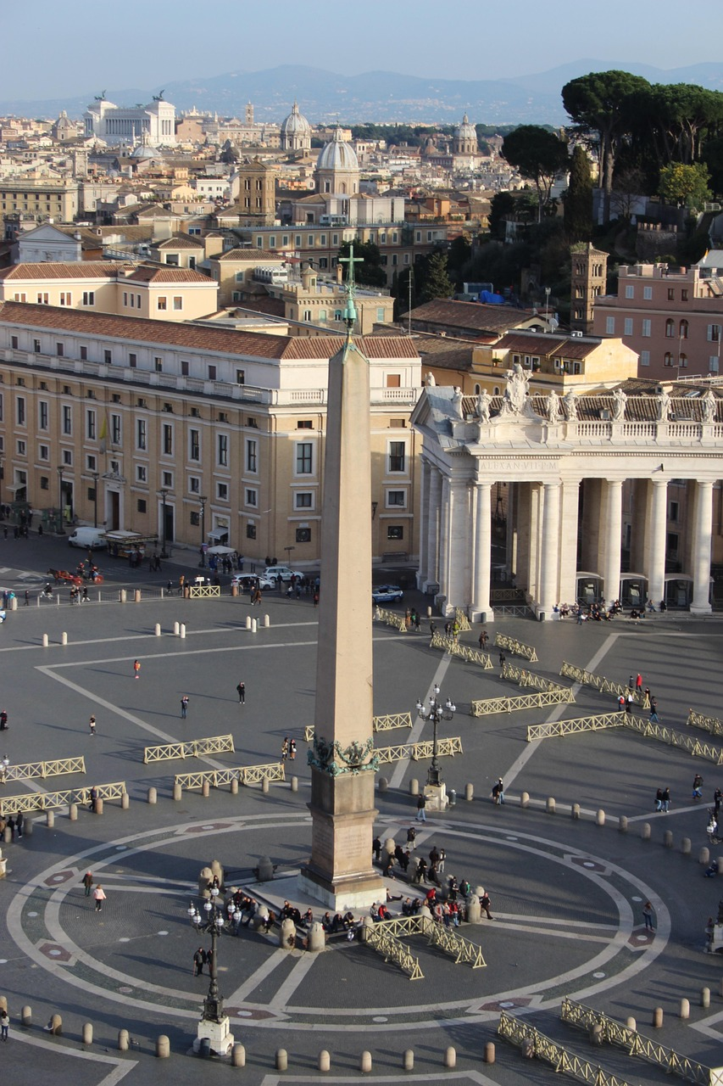
Love has triumphed over hatred, light over darkness and truth over falsehood [lies]. Forgiveness has triumphed over revenge…
Sisters and brothers, especially those of you experiencing pain and sorrow, your silent cry has been heard, and your tears have been counted; not one of them has been lost!
On this day, I would like all of us to hope anew and to revive our trust in others, including those who are different than ourselves….... For all of us are children of God! I would like us to renew our hope that peace is possible!.... May the principle of humanity never fail to be the hallmark of our daily actions.
Notes:
Slide 7: His Easter message was spoken less than a day before his death, such wise words for us all, as we try to live well in this world. Here are just a few of them for us to think about:
Love has triumphed over hatred, light over darkness and truth over falsehood [lies]. Forgiveness has triumphed over revenge…
Sisters and brothers, especially those of you experiencing pain and sorrow, your silent cry has been heard, and your tears have been counted; not one of them has been lost! [I wonder where we’ve heard that before?! – they were David’s words in Psalm 56]
On this day, I would like all of us to hope anew and to revive our trust in others, including those who are different than ourselves….. For all of us are children of God! I would like us to renew our hope that peace is possible!.... May the principle of humanity never fail to be the hallmark of our daily actions.
[You may want to talk about these together – or follow them up during the days that follow]

Slide 8
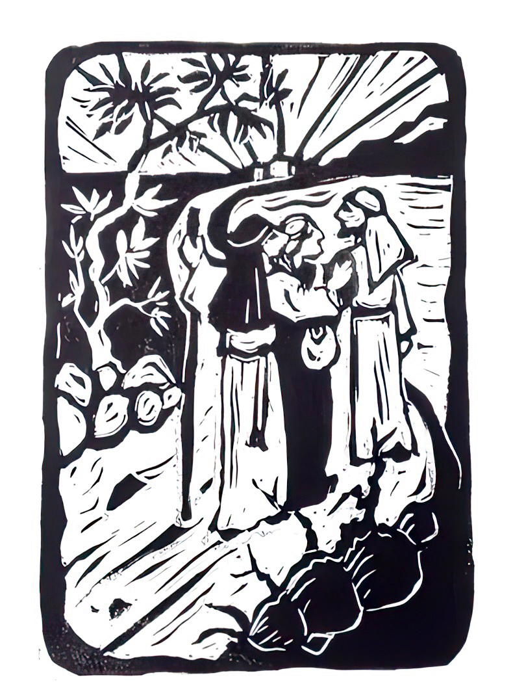
‘We had hoped…’
‘…he alone can make all things new.’
Notes:
Slide 8: Emmaus Road
Earlier this week, we heard the story of how Jesus met some of his friends along the road to Emmaus on the first Easter Day, and heard the friends say these words: ‘We had hoped…’
Their disappointments were turned into joy as they met the risen Jesus. As we’ve heard in Pope Francis’ message, his hopes were pinned firmly on the reality of the death and resurrection of Jesus. His final words in his speech were these, which come from the very last book in the Bible: ‘…he alone can make all things new.’
Pope Francis believed this with all of his heart and was certain that he would be sharing in the life with no end that Jesus promised.
Let’s be quiet and still for a few moments now….
….I wonder what you hope for in this world?
….I wonder how the memory of Pope Francis might be a comfort to Catholic Christians across the world – and an example for others?
Think quietly to yourself now…..

Slide 9
…You make all things new!
Notes:
Slide 9: Prayer:
We are going to use Pope Francis’ last words our theme words …You make all things new! to help us as we pray now. Join in with me if you would like to make the prayer your own.

Slide 10
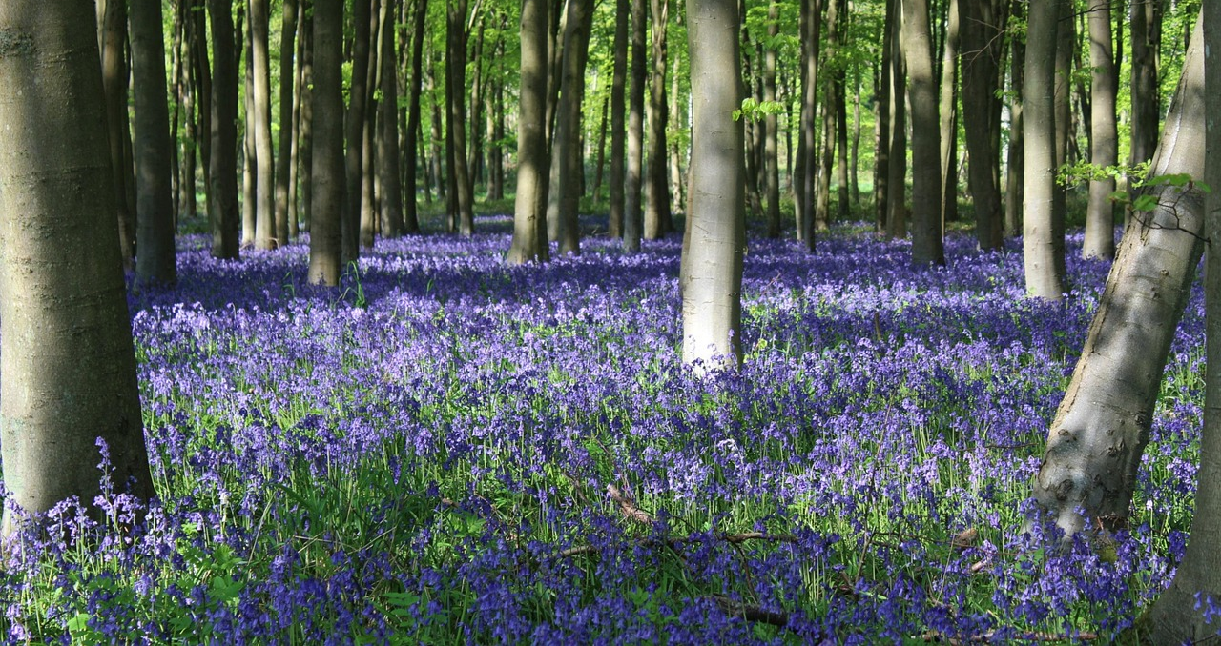
Picture copyright-free from pixabay
…You make all things new!
Notes:
Slide 10: As we look at the natural world around us, we can see that
…You make all things new!

Slide 11
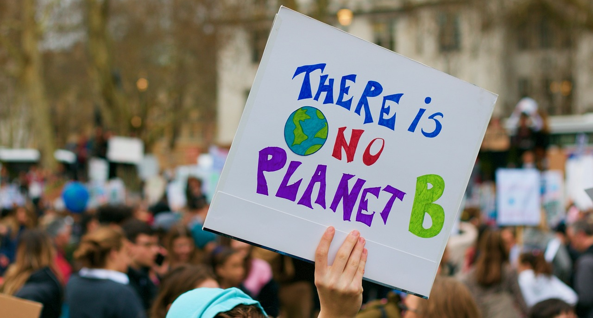
Picture copyright-free from pixabay
…You make all things new!
Notes:
Slide 11: As we work together for the good of our world
…You make all things new!

Slide 12
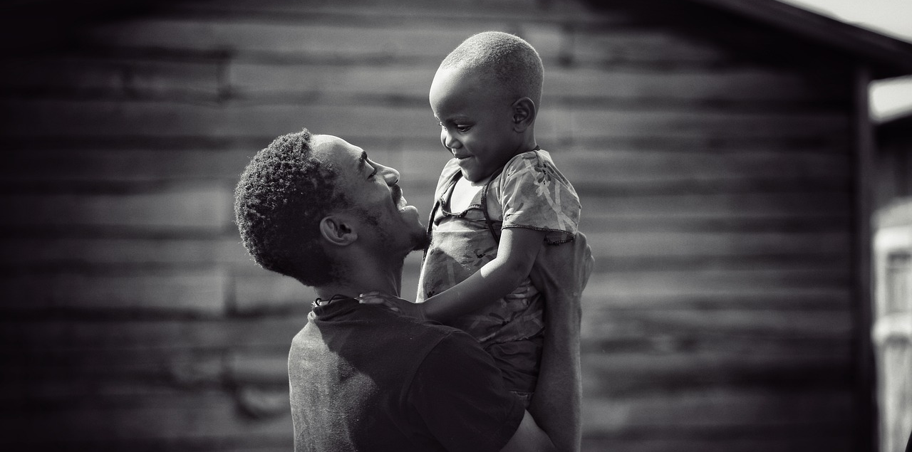
Picture copyright-free from pixabay
…You make all things new!
Notes:
Slide 12: As we care for the needs of others
…You make all things new!

Slide 13
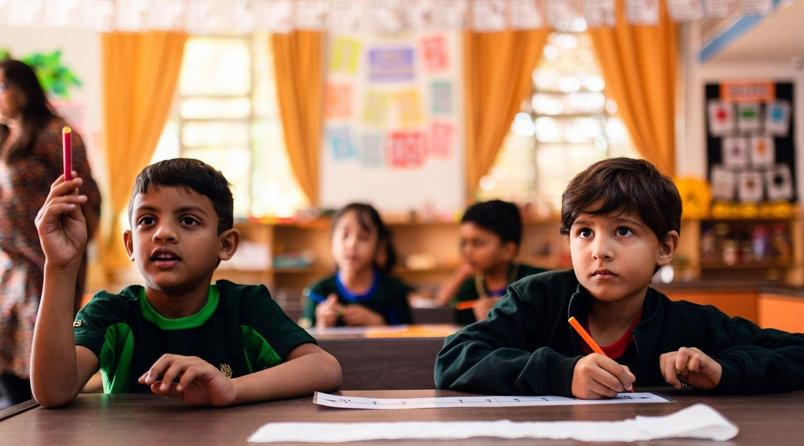
Picture copyright-free from pixabay
…You make all things new?
Notes:
Slide 13: In the life and work of our school, will
…You make all things new?

Slide 15
Picture copyright-free from pixabay
Leader: We have journeyed together today. As we leave this place and time and go into the day ahead…
ALL: …May God go with us.
Notes:
Slide 15: Use the new leaving words for this term (which are very similar to the opening words you will use next week!):
Leader: We have journeyed together today. As we leave this place and time and go into the day ahead….
ALL: ….May God go with us.
Sign for ‘God: British Sign Language BSL Video Dictionary - God
Sign for ‘go with us’ – we have invented this! After you’ve signed ‘God’, bring your finger down alongside your other finger and make them ‘journey together’ in front of you.

